Slide 1

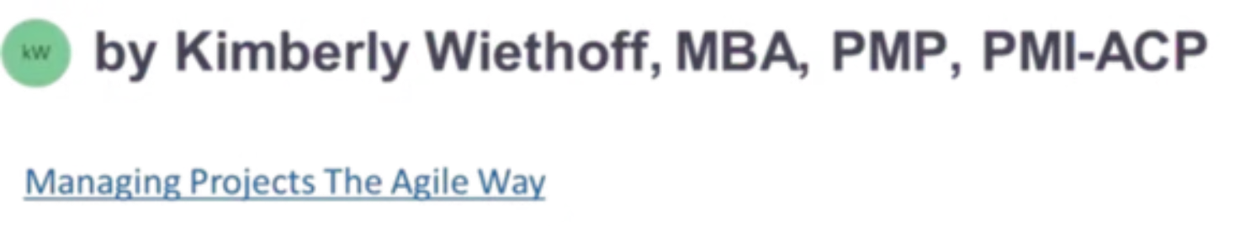
Beyond Scrum Ceremonies: How Agile Coaches Create High-Performing Teams
True Agile coaching goes far beyond facilitating stand-ups and retrospectives. It's about building teams that consistently deliver value, adapt to change, and take ownership of outcomes — long after the ceremonies end.
#AgileCoaching #AgileTransformation #Scrum #ScrumMaster #AgileLeadership #LeadershipDevelopment #ContinuousImprovement #TeamPerformance #HighPerformingTeams #EnterpriseAgility #LeanAgile #OrganizationalChange #ServantLeadership #ProjectManagement #ProductManagement #BusinessTransformation #DigitalTransformation #AgileMindset #TeamCollaboration #FutureOfWork

Slide 2
The Core Challenge
Ceremonies Are a Tool — Not the Destination
What Most Organizations See
What High-Performing Teams Actually Need
Stand-ups. Sprint planning. Retrospectives. Reviews. These rituals become the definition of "being Agile" — a checklist of meetings that signals compliance with the framework.
An environment where teams deliver value continuously, solve problems proactively, and take ownership of outcomes. Agile Coaches create the conditions for this — ceremonies are simply one tool among many.
Organizations that invest in coaching, leadership development, team dynamics, and continuous improvement build teams capable of sustaining long-term success.

Slide 3


Doing Agile vs. Being Agile
Many teams execute Scrum ceremonies correctly and still fail to achieve meaningful business results. The gap between process compliance and genuine agility is where coaches make the greatest impact.
Going Through the Motions
Attending stand-ups without meaningful collaboration
Completing retrospectives without implementing improvements
Delivering sprint commitments while missing customer needs
Following practices while remaining dependent on management for decisions
The Agile Mindset
Transparency and shared accountability as daily habits
Continuous learning embedded in team culture
Proactive problem-surfacing before issues escalate
Genuine collaboration across functions and disciplines
An Agile Coach helps teams make the critical transition from process compliance to mindset transformation — the shift that separates good teams from great ones.

Slide 4
Creating Psychological Safety
One of the most defining characteristics of high-performing teams is psychological safety — the shared belief that team members can speak openly without fear of criticism or blame. Without it, risks stay hidden and issues fester.
Raise Risks Early
Share Ideas Openly
Teams that feel safe surface problems before they become crises, enabling proactive response rather than reactive firefighting.
Innovation flows freely when people aren't afraid of judgment. Safe environments produce more creative, higher-quality solutions.
Admit Mistakes
Challenge Assumptions
Failure becomes a learning opportunity rather than a career risk. Teams improve faster when they can be honest about what went wrong.
Critical thinking thrives when dissent is welcomed. The strongest teams question the status quo respectfully and constructively.
The strongest Agile teams are not those that avoid problems — they are those that surface and address problems quickly.

Slide 5

Shifting From Individual Success to Team Ownership
Many organizations unintentionally reward individual performance while expecting collaborative outcomes. Agile Coaches help dismantle this contradiction by building a culture where success is genuinely shared.
Collective Goals
Cross-Functional Collaboration
Align the team around shared outcomes rather than individual task completion. Success is measured at the team level.
Break down silos and encourage teammates to contribute across disciplines, reducing dependency on any single individual.
Shared Accountability
Team Recognition
Every team member feels responsible for the outcome — not just their own tasks — creating greater resilience over time.
Celebrate team achievements rather than individual heroics. This reinforces collaborative behavior and sustainable performance.

Slide 6

Coaching Leaders, Not Just Teams
One of the most overlooked aspects of Agile coaching is leadership development. Agile transformations frequently stall because teams are asked to change while leadership continues operating with traditional command-and-control practices. Leadership behavior has a direct, measurable impact on team performance.
What Leaders Must Let Go Of
What Agile Leaders Embrace
Micromanaging delivery decisions
Hoarding information or authority
Penalizing failure rather than learning from it
Measuring activity instead of outcomes
Empowering teams to make decisions at the right level
Actively removing organizational impediments
Supporting safe experimentation and innovation
Encouraging radical transparency across the organization
Even the most capable Agile teams will struggle if organizational structures discourage collaboration and innovation. Coaching leaders is non-negotiable.

Slide 7

Building a Culture of Continuous Improvement
Retrospectives are valuable — but continuous improvement extends far beyond a single meeting every sprint. For high-performing teams, the improvement mindset becomes woven into everyday work, not reserved for a dedicated ceremony.
Experiment
Reflect
Measure
Adapt
Agile Coaches foster this mindset by helping teams analyze performance metrics, learn from failures, and maintain an unwavering focus on customer value — making improvement a cultural constant rather than an occasional activity.

Slide 8

Developing Strong Scrum Masters
Scrum Masters are force multipliers for Agile success. A skilled Scrum Master removes obstacles, sharpens collaboration, and strengthens practices at the team level — freeing the Agile Coach to tackle broader organizational challenges.
01
02
Facilitation Mastery
Coaching Techniques
Coach Scrum Masters to run ceremonies that generate real insights and decisions — not just meetings that consume time.
Develop the ability to ask powerful questions, listen actively, and guide teams toward self-discovery rather than prescribing answers.
03
04
Organizational Navigation
Driving Improvement Initiatives
Equip Scrum Masters to engage stakeholders confidently, manage competing priorities, and escalate systemic impediments effectively.
Empower Scrum Masters to lead meaningful change within their teams — building momentum for the broader Agile transformation.

Slide 9

Leveraging Metrics to Drive Improvement
Metrics should create insight, not assign blame. High-performing Agile teams use data to guide decisions and identify opportunities for growth — always in service of better outcomes, never as a performance surveillance tool.
The Coach's Role With Data
Sprint Predictability
Velocity Trends
Agile Coaches help teams interpret what the data is actually telling them — and more importantly, how to translate that understanding into meaningful, targeted action.
The goal is never better numbers on a dashboard. The goal is better outcomes for the team, the customer, and the organization. Metrics are a compass, not a scoreboard.
Are commitments reliable and realistic?
Is throughput stable, growing, or erratic?
Cycle & Lead Time
Defect Rates
How fast does work flow from start to done?
Is quality improving over time?
Coaches watch for "gaming" behavior — when teams optimize for the metric itself rather than the outcome it was designed to reflect.
Team Engagement
Customer Satisfaction
Are people energized and invested in the work?
Is the team delivering real value to end users?

Slide 10
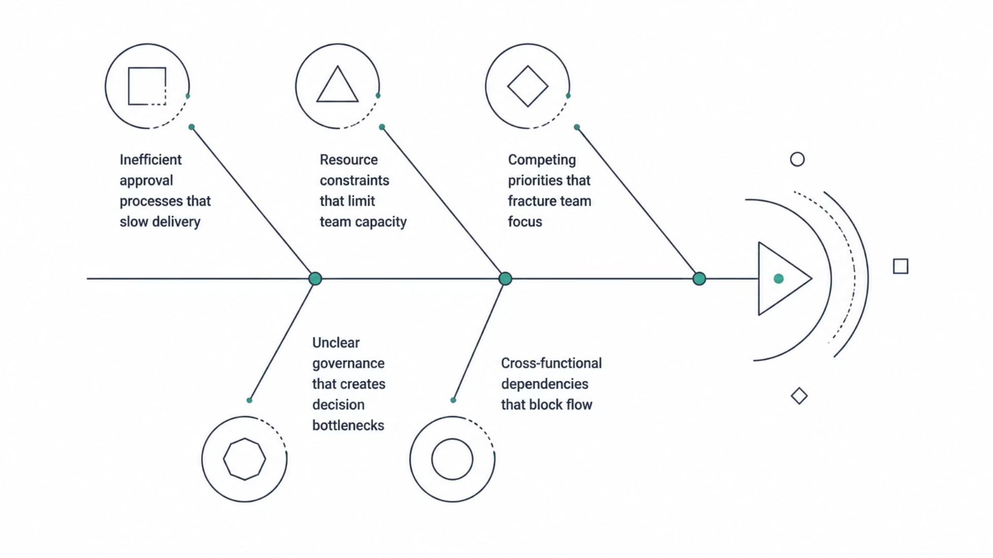

Removing Organizational Impediments
Many delivery challenges are not team problems at all. They are systemic — embedded in the structures, processes, and governance models that surround the team. Agile Coaches serve as organizational change agents, identifying these barriers and partnering with leadership to dismantle them.
Sometimes the greatest value a coach provides comes from changing the environment around the team — not changing the team itself. Structural change enables team change.

Slide 11
The Role of AI in Modern Agile Coaching
As Agile coaching evolves, AI is becoming a powerful ally — not a replacement for human judgment, but a force multiplier for coaches who want to spend less time collecting data and more time developing people.
Analyze Delivery Trends
Identify Emerging Risks
Monitor Team Health
AI tools surface patterns across sprints and teams that would take hours to identify manually, enabling faster, more informed coaching conversations.
Early warning signals — like declining velocity or rising defect rates — can be detected automatically, giving coaches time to intervene before problems escalate.
Sentiment analysis and engagement signals help coaches understand how teams are feeling — not just how they are performing on paper.
The future Agile Coach combines human-centered leadership with data-driven intelligence — empathy and analytics working in concert.

Slide 12

High-Performing Teams Are Built, Not Scheduled
Planning sessions, stand-ups, reviews, and retrospectives provide structure — but lasting success comes from something deeper: trust, accountability, collaboration, continuous improvement, and strong leadership at every level.
Mentors
Change Agents
Developing Scrum Masters and team members into confident, self-sufficient Agile practitioners.
Removing systemic barriers and reshaping the organizational environment to enable team success.
Leadership Advisors
Catalysts
Guiding leaders toward servant leadership behaviors that amplify — rather than constrain — team performance.
Accelerating organizational transformation by fostering a culture of continuous learning and shared ownership.
Organizations that invest in true Agile coaching build teams that are more productive, more resilient, more innovative — and capable of delivering sustained business value for the long term. Agile is not about the ceremonies. It is about helping people and teams achieve their highest potential.

