Slide 1

From Firefighting to Flow: How Lean Thinking Transforms Project Delivery
Transform your project management approach from constant crisis mode to sustainable success with Lean principles.
#ManagingProjectsTheAgileWay #LeanProjectManagement #ContinuousImprovement #AgileDelivery #LeanThinking #ProjectLeadership
kW
by Kimberly Wiethoff
Managing Projects The Agile Way

Slide 2

The Cost of Firefighting
Is Your Team Stuck in Reactive Mode?
Many project teams spend more time reacting than delivering, rushing from one crisis to the next with barely time to breathe before the next deadline looms.
This reactive firefighting approach leads to:
Constant last-minute reprioritization
Wasted time waiting on decisions
Preventable defects requiring fixes
Unproductive meetings
Team burnout and frustration

Slide 3








Understanding Lean Thinking
Originally developed in manufacturing, Lean is a powerful philosophy for project management that focuses on delivering value by eliminating waste and improving flow.
Waste Reduction
Value Focus
Systematically identify and eliminate the eight forms of waste: defects, overproduction, waiting, non-utilized talent, transportation, inventory, motion, and extra-processing.
Identify what truly matters to customers and stakeholders, eliminating activities that don't contribute to value.
Continuous Improvement
Continuous Flow
Create systems where work moves smoothly from start to finish with minimal delays, handoffs, and bottlenecks.
Foster a culture where teams constantly seek to refine processes and eliminate emerging inefficiencies.

Slide 4

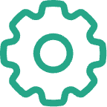




Identifying Process Waste
Waiting
Overprocessing
Teams idle while waiting for decisions, approvals, or information from stakeholders or other departments.
Adding more features than needed, excessive documentation, or redundant review cycles that don't add value.
Defects
Task Switching
Time spent fixing errors, bugs, or misunderstandings that could have been prevented with better planning.
Productivity losses when team members juggle multiple priorities and constantly shift their focus between different projects.
Underutilized Talent
Inventory
Not leveraging team members' full skills or having people work on tasks that don't match their expertise.
Backlogs of partially completed work, excessive documentation, or features built too far in advance of need.

Slide 5
From Firefighting to Flow
Flow in project management means tasks move smoothly from initiation to completion with minimal friction. Here's how Lean transforms common challenges:
Firefighting Symptom
Lean Solution
Missed deadlines due to task pileups
Use Work In Progress (WIP) limits to prevent overload
Long waits for approvals
Implement visual management tools like Kanban boards
Poor handoffs between teams
Apply value stream mapping to improve timing and communication
Repetitive issues resurfacing
Use root cause analysis and Kaizen for incremental fixes
Context switching and multitasking
Create dedicated focus time and clear prioritization

Slide 6




Core Lean Project Tools
Kanban Boards
Value Stream Mapping
Visual workflow management that limits work in progress and highlights bottlenecks by moving tasks through columns representing process stages.
Diagram the journey of deliverables from request to completion, identifying wait times, handoffs, and opportunities for process improvement.
Flow Metrics
Root Cause Analysis
Measure cycle time, lead time, and throughput instead of just utilization to focus on value delivery speed and predictability.
Techniques like "5 Whys" that help teams identify and address the underlying causes of problems rather than symptoms.

Slide 7
Real-World Example: Lean in Action
Healthcare Tech Company Challenge
Results After Lean Implementation
1
Increase in delivery predictability
A healthcare technology company struggled with:
Delivery delays due to last-minute scope changes
2
Reduction in rework
Inconsistent sprint commitments
Rising team burnout
3
Decrease in team overtime hours
Lean Approach Revealed
Redundant review cycles causing rework
4
Plus, significantly higher team morale and reduced burnout
Stories being pulled before requirements were clear
Teams overcommitted and context-switching too frequently

Slide 8
5 Easy Lean Wins to Try This Week
Visualize Your Work
Track Flow Metrics
Hold a Quick Kaizen
Start with a basic Kanban board to make work visible. Use physical cards on a wall or digital tools like Trello, Asana, or Jira. Make blockers and dependencies immediately visible.
Begin measuring cycle time (how long tasks take from start to finish) or lead time (time from request to delivery), not just velocity. Use simple spreadsheets or built-in analytics.
Ask the team: "What's one small change we can make this sprint to improve?" Implement it immediately and measure the impact. Celebrate small wins to build momentum.
Limit Work in Progress
Map Your Value Stream
Set a maximum number of tasks that can be in progress simultaneously. Start with 1-2 items per person. This reduces context switching and helps teams focus on finishing.
Sketch the journey of a user story from request to delivery. Identify where the delays happen. Look for handoffs, waiting periods, and approval bottlenecks to address.

Slide 9

Implementing WIP Limits
The Power of Focus
Work In Progress (WIP) limits are one of the most transformative Lean practices for project teams. They force prioritization and completion over starting new work.
How to Implement WIP Limits
Start with 1-2 items per person per stage
Make the limits visible on your Kanban board
When a column is at its limit, team members must help finish existing work before starting new tasks
Track violations and discuss in retrospectives
Adjust limits based on data and team feedback
WIP limits make bottlenecks visible and encourage collaboration to resolve them, rather than simply starting more work and creating further congestion.

Slide 10
Leading the Lean Transformation
1
Model the Mindset
2
Start Small, Learn Fast
3
Involve the Team
Demonstrate calm, thoughtful delivery over frantic heroics. Celebrate steady progress and learning over dramatic last-minute saves. Make your own work visible and limit your own WIP.
Lean transformations fail when imposed from above. Involve team members in identifying waste and designing solutions. Their frontline perspective is invaluable, and their buy-in is essential.
Begin with one team or one project. Don't try to transform everything at once. Create quick wins that build momentum and demonstrate the value of Lean approaches to skeptics.
4
Measure What Matters
5
Be Patient and Persistent
Shift from utilization metrics to flow metrics. Track cycle time, throughput, and quality. Celebrate improvements in predictability and customer satisfaction, not just efficiency.
Changing habits takes time. Expect resistance and backsliding. Keep reinforcing Lean principles through daily stand-ups, retrospectives, and one-on-one coaching.

Slide 11
Common Challenges and Solutions
Challenge
Solution
Resistance from team members comfortable with current methods
Start with small, non-threatening changes. Use data to demonstrate benefits. Involve resistors in designing solutions.
Management pressure to take on more work
Use flow metrics to show how limiting WIP actually increases throughput and quality. Calculate the cost of context switching.
Difficulty sustaining improvements
Build Lean practices into daily routines. Create visual reminders. Celebrate and share successes regularly.
Stakeholders requesting frequent priority changes
Implement a clear change management process. Show the impact of changes on delivery using data.
Team feels Lean is too rigid or bureaucratic
Focus on principles over specific practices. Adapt tools to fit team needs. Empower team to experiment.

Slide 12

From Chaos to Calm: Your Lean Journey
Sustainable project delivery is built on flow, not fire drills. As you begin your Lean journey, remember:
You don't need a full transformation to make progress
Start by eliminating one source of waste
Celebrate each small win
Build a culture of continuous improvement
Focus on creating value, not just activity
Transform your projects from firefighting to flow—one improvement at a time.

Slide 13
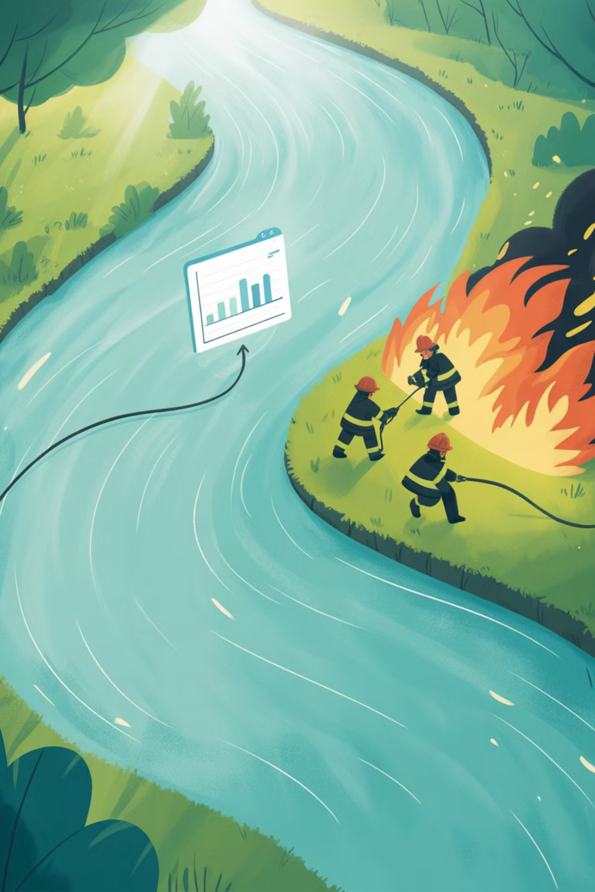
Final Thoughts
As project leaders, embracing Lean means modeling calm, thoughtful delivery over frantic heroics. It means creating systems where work flows, teams grow, and customers get what they need—on time and without drama.
You don't need a full Lean transformation to make progress. Start small. Eliminate one source of waste. Celebrate one win.And remember: sustainable delivery is built on flow, not fire drills.

