Slide 1

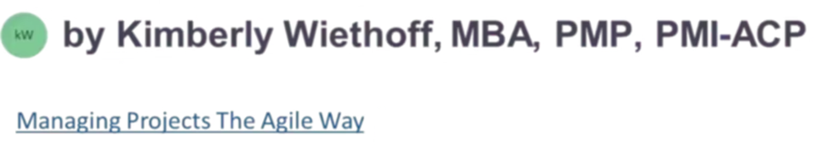
The Agile Manifesto: Four Core Values That Transformed Software Development
In 2001, seventeen visionary developers gathered in Snowbird, Utah, to revolutionize how we build software. Their breakthrough: the Agile Manifesto, a set of values and principles that prioritizes people, collaboration, and adaptability over rigid processes and documentation.
#AgileManifesto #AgileValues #IndividualsOverProcesses #WorkingSoftware #CustomerCollaboration #RespondToChange #AgilePrinciples #AgileDevelopment #AgileMindset #AgileTransformation #ManagingProjectsTheAgileWay

Slide 2

The Birth of a Movement
The Problem
The Solution
Traditional software development was failing teams and customers alike. Rigid methodologies, excessive documentation, and inflexible plans created frustration and delayed delivery of value.
In February 2001, seventeen developers came together seeking common ground. What emerged was not another methodology, but a set of values that would reshape the entire industry.
Developers across various methodologies recognized a common thread: the need for a more human-centered, responsive approach to building software.
The Agile Manifesto represented a fundamental shift in thinking—from process-heavy bureaucracy to people-focused collaboration.

Slide 3
The Four Core Values
At its heart, the Agile Manifesto presents four powerful statements that challenge conventional wisdom. These values don't reject traditional practices—they simply prioritize what matters most.
Individuals and Interactions
Working Software
over processes and tools
over comprehensive documentation
Customer Collaboration
Responding to Change
over contract negotiation
over following a plan

Slide 4

Value #1: Individuals and Interactions Over Processes and Tools
People are at the absolute heart of software development. While processes and tools certainly have their place, they cannot replace the power of human communication, creativity, and collaboration.
Agile recognizes that software engineers create solutions for real people—users who want to improve their lives and achieve their goals. Without genuine communication and collaboration between developers and users, even the most sophisticated tools and processes would fail to deliver what's truly needed.
This value emphasizes fostering a collaborative and empowered team environment where individuals are valued for their unique contributions. When team members interact freely and openly, innovation flourishes and problem-solving becomes more effective.

Slide 5
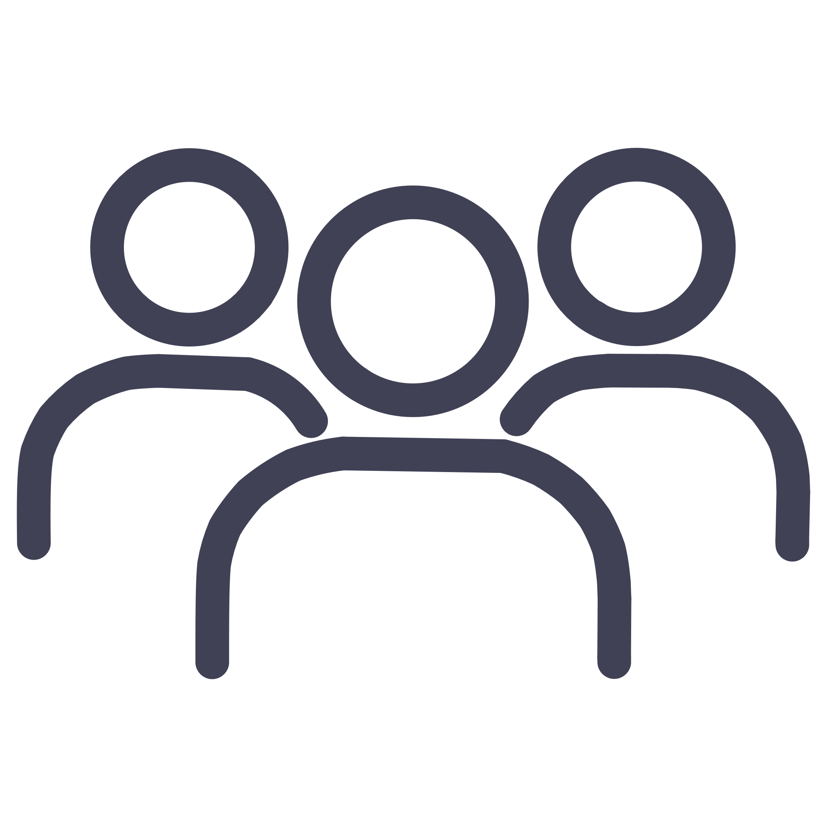



Why People Matter More Than Process
Empowered Teams
Innovation Through Interaction
When individuals feel valued and heard, they take ownership and drive results.
Breakthrough solutions emerge from conversations, not from following rigid procedures.
Continuous Learning
Direct Communication
Teams that interact openly share knowledge and grow together organically.
Face-to-face conversations solve problems faster than any documentation or tool.

Slide 6
Value #2: Working Software Over Comprehensive Documentation
While documentation certainly has its place and provides value, Agile prioritizes delivering functional, working software that customers can actually use. This doesn't mean abandoning documentation entirely—it means being smart about what we document and when.
The Agile approach provides just enough documentation to begin developing the final product. As the software evolves through development, each delivered increment is evaluated, and additional documentation is created only as needed. This streamlined approach avoids the lengthy delays that plagued traditional Waterfall methodology.
Instead of months spent creating technical specifications, requirements documents, design documents, and extensive test plans before writing a single line of code, Agile teams focus on delivering working software that demonstrates real value to customers early and often.

Slide 7
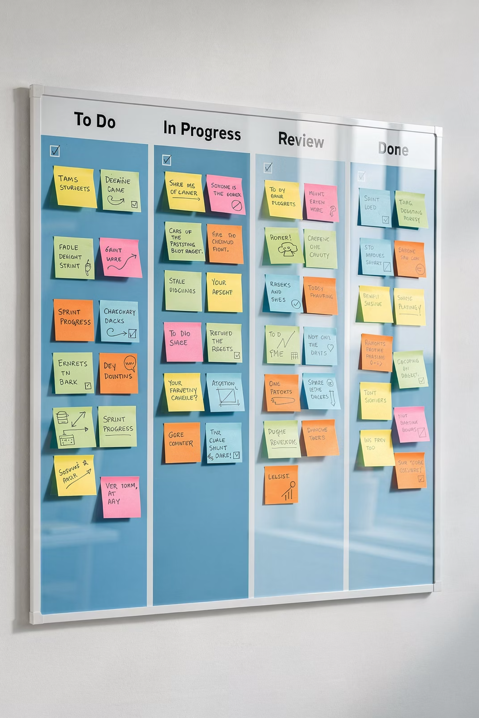


The Documentation Dilemma
Traditional Approach
Extensive upfront documentation
Months of planning before coding
Documents often outdated by delivery
Delayed feedback from users
Agile Approach
Just-enough documentation
Working software in weeks
Living documentation that evolves
Immediate user feedback

Slide 8

Value #3: Customer Collaboration Over Contract Negotiation
In the early days of software development, contracts were king. Detailed product specifications would be negotiated and locked into contracts, creating a rigid framework that often led to conflict.
The problem? Most of the time, the end result created a disconnect between what the contract stated, what the product actually did, and what the customer truly needed. Requirements evolved, priorities shifted, but contracts remained static.
Agile transformed this dynamic by emphasizing continuous development with direct customer feedback loops. The product roadmap begins with a high-level concept and progresses through an iterative process, incorporating customer input at every stage.

Slide 9








The Power of Continuous Collaboration
Plan
Build
Start with high-level concept and customer goals
Create working increment of software
Refine
Review
Incorporate feedback and adjust priorities
Demonstrate to customer and gather feedback
This iterative cycle ensures the product evolves to meet customer expectations, not just contractual obligations. Collaboration becomes the foundation of success, replacing adversarial contract negotiations with partnership.

Slide 10
Value #4: Responding to Change Over Following a Plan
Traditional software development relied on static plans and roadmaps designed and documented upfront. Development efforts were expected to adhere rigidly to these plans, regardless of changing circumstances. This inflexible approach proved inefficient in a world where software needs, requirements, and priorities constantly evolve.
The Agile Manifesto recognizes that change is not a disruption—it's an opportunity. Software development teams should have the ability to change direction and pivot when requirements shift or new information emerges.
With dynamic roadmaps that can be updated monthly or quarterly, Agile teams adapt fluidly to changing conditions. This flexibility allows organizations to respond to market shifts, customer feedback, and technological advances without being constrained by outdated plans.

Slide 11

Embracing Change as Opportunity
Q1: Initial Vision
Q3: Market Shift
Launch with core features based on market research
Adapt roadmap to address emerging competitor
Q2: User Feedback
Q4: Innovation
Pivot based on actual usage patterns and requests
Integrate new technology that enhances value
Key Insight: In Agile, change is viewed as an opportunity for learning and improvement, not as a setback or failure. Teams that embrace this mindset can navigate uncertainty with confidence.

Slide 12
The Twelve Principles: Practical Guidance
Beyond the four core values, the Agile Manifesto includes twelve principles that provide actionable guidance for implementation. These principles translate philosophy into practice.
Deliver Value Early and Often
Welcome Changing Requirements
Satisfy customers through continuous delivery of valuable software
Even late in development, harness change for competitive advantage
Deliver Frequently
Work Together Daily
From weeks to months, with preference for shorter timescales
Business people and developers must collaborate throughout the project
Support Motivated Individuals
Face-to-Face Conversation
Build projects around motivated people in trusted environments
The most efficient method of conveying information to and within teams

Slide 13
The Twelve Principles: Continued
Working software is the primary measure of progress
Agile processes promote sustainable development. The sponsors, developers, and users should be able to maintain a constant pace indefinitely
Rather than focusing on documentation or process compliance, Agile teams are measured by their ability to deliver functional, valuable software.
Sustainable pace prevents burnout and enhances long-term productivity. Teams should deliver value consistently without excessive overtime or stress.
Continuous attention to technical excellence and good design enhances agility
Simplicity—the art of maximizing the amount of work not done—is essential
Clean code, refactoring, and well-architected systems allow teams to adapt quickly to change. Technical debt slows progress—Agile keeps it in check.
Agile values simplicity and focus. Eliminating non-essential work allows teams to concentrate on what truly delivers value to the customer.
The best architectures, requirements, and designs emerge from self-organizing teams
At regular intervals, the team reflects on how to become more effective, then tunes and adjusts its behavior accordingly
Agile trusts teams to make the right decisions. When team members are empowered to collaborate and innovate, the result is often better than top-down directives.
Retrospectives and continuous improvement are central to Agile. Teams pause regularly to evaluate what’s working and what isn’t—and make changes to improve performance.

Slide 14

The Lasting Impact of Agility
Since its inception in 2001, the Agile Manifesto has catalyzed a paradigm shift in how software is developed worldwide. It has empowered teams to embrace uncertainty, welcome change, and deliver value with unprecedented speed and efficiency.
Agile methodologies like Scrum, Kanban, and Extreme Programming have become ubiquitous in the tech industry, fundamentally reshaping organizational structures, processes, and cultures. What started with seventeen developers has influenced millions.
20+
71%
3x
Years of Impact
Organizations Using Agile
Faster Delivery
Transforming software development since 2001
Majority of companies have adopted Agile practices
Agile teams typically deliver value three times faster

Slide 15
Embrace the Agile Mindset
"We are uncovering better ways of developing software by doing it and helping others do it."
As we reflect on the Agile Manifesto and its enduring legacy, we're reminded of the transformative power of agility in driving innovation, collaboration, and customer satisfaction. By embracing these values and principles, organizations can navigate the complexities of the digital age with confidence and resilience.
The Agile Manifesto isn't just about software development—it's about creating better ways of working together, delivering value, and adapting to change. Whether you're a developer, product manager, or business leader, these principles offer a path toward more effective, human-centered work.
Start with people—invest in communication and collaboration
Focus on delivering working solutions, not perfect documentation
Build partnerships with customers through continuous feedback
Welcome change as an opportunity for improvement and learning

