Slide 1

Inside an Enterprise RAG Architecture
How LLMs, Embeddings, and Vector Databases Work Together
Enterprise AI requires more than the capabilities of general-purpose Large Language Models (LLMs). Retrieval-Augmented Generation (RAG) bridges this gap by grounding AI responses in an organization’s trusted data through a pipeline of chunking, embeddings, vector databases, and context-aware retrieval.
This overview examines the key challenges organizations must address—including hallucinations, security and access control, data quality, and knowledge freshness—while highlighting the program manager’s critical role in governing, scaling, and evolving RAG from an initial pilot into a secure, reliable, enterprise-grade platform.
Kimberly Wiethoff, MBA, PMP, PMI-ACP — AI Transformation Program Leader
#ArtificialIntelligence #GenerativeAI #RAG #RetrievalAugmentedGeneration #LLM #VectorDatabase #Embeddings #EnterpriseAI #AITransformation #AIGovernance #ProgramManagement #TechnicalProgramManagement #PMO #EnterpriseArchitecture

Slide 2


The Enterprise AI Gap
What General AI Knows
What Enterprises Actually Need
A general-purpose LLM understands industries, domains, and concepts — finance, healthcare, project management, operations. But it does not automatically know what lives inside your organization's systems, documents, or institutional memory.
Every organization generates enormous volumes of knowledge daily: policies, contracts, project plans, technical documentation, regulatory requirements, incident records, and years of lessons learned. The real value of enterprise AI begins when a model can securely access and use that knowledge.
The fundamental challenge: How do we let AI use trusted organizational knowledge without retraining the model every time that knowledge changes?

Slide 3

The Answer: Retrieval-Augmented Generation
RAG allows an organization to connect an LLM to trusted enterprise information so that responses are generated using relevant organizational knowledge — rather than relying solely on what the model learned during training.
More Than a Document Connection
A Full Architecture
RAG is often described as "connecting company documents to an LLM." That captures only part of the idea.
Enterprise RAG involves data pipelines, embeddings, vector databases, retrieval mechanisms, security controls, governance, and operational processes.
A Leadership Concern
Program managers and business leaders must understand how components interact, where failures occur, and what must be governed as AI moves to production.

Slide 4
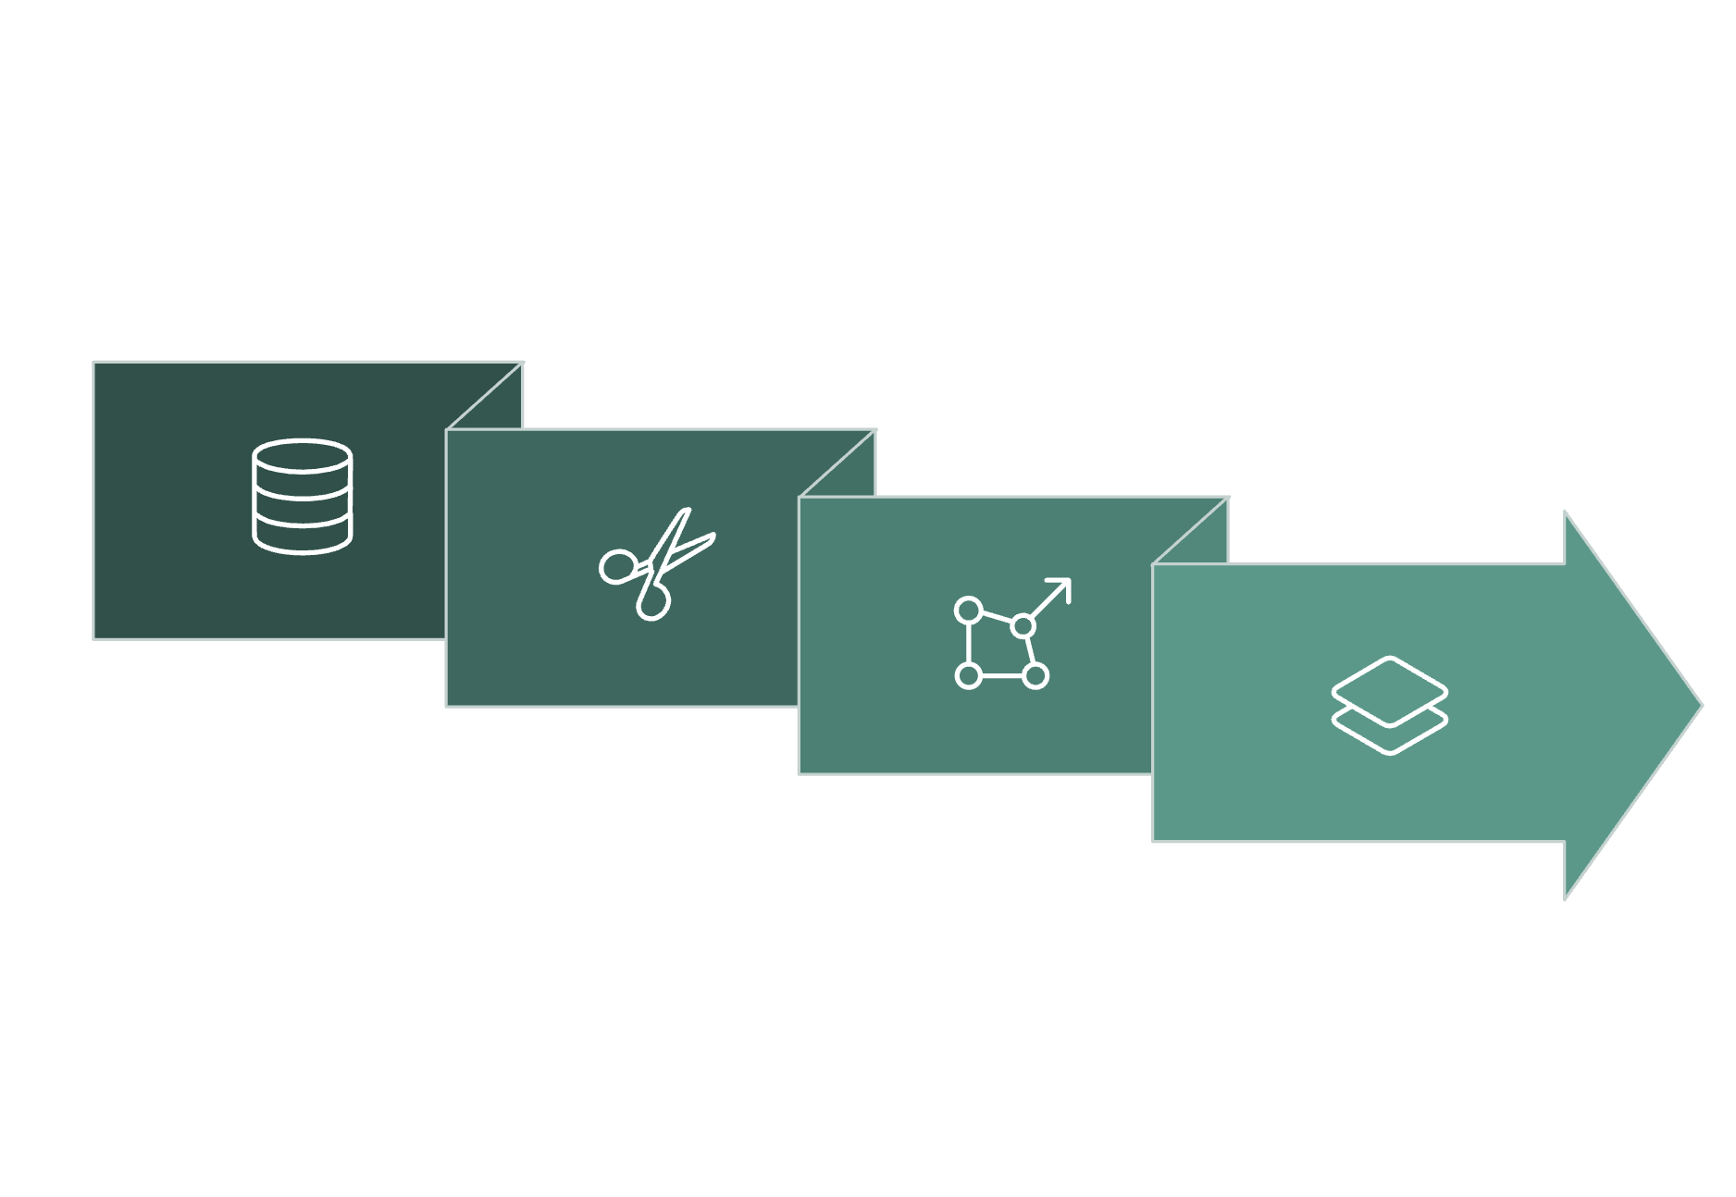
The RAG Architecture at a Glance
Each stage in the pipeline plays a distinct role in determining the quality, accuracy, and trustworthiness of the final answer. A weakness at any point — from source data governance to retrieval ranking — can degrade the response the user receives. Understanding this end-to-end flow is essential for program leaders responsible for RAG delivery.
Chunking
Vector DB
Enterprise Data
Embeddings

Slide 5

STEP 1
Enterprise Data: The Knowledge Foundation
Every RAG system begins with a critical question: what knowledge should the AI be allowed to access? Before debating platforms or models, organizations must determine and govern their sources.
Operational Knowledge
Policies, procedures, SOPs, training materials, project documentation, architecture records, incident and problem management records
Regulated Content
Contracts, regulatory documentation, compliance requirements, customer-support information, financial records
Institutional Knowledge
Lessons learned, product specifications, knowledge-base articles, SharePoint content, technical documentation

Slide 6
The First Real Challenge Is Information Governance
Before the first line of AI code is written, organizations must answer governance questions that are entirely non-technical in nature.
Authority & Ownership
Classification & Access
Retention & Currency
Which version of a policy is authoritative? Who owns the document, and who is responsible for keeping it current?
Does the document contain confidential, regulated, proprietary, or personally identifiable information? Should every employee receive the same answer?
When was this document last updated? How long should it remain in the knowledge base? How quickly must changes be reflected in the AI's responses?
RAG cannot create trustworthy organizational knowledge from untrustworthy source information. The quality of the AI experience begins with the quality of the enterprise data behind it.

Slide 7

STEP 2
Chunking: Breaking Documents Into Usable Pieces
Why Chunking Is Necessary
Why Chunking Is a Design Decision
An enterprise may contain millions of pages of information. Sending every relevant document to an LLM for each query would be inefficient, expensive, and often technically impossible — models have hard limits on how much text they can process in a single interaction.
Instead, documents are divided into smaller sections called chunks. A 60-page governance manual might be split into passages covering risk management, change control, financial governance, escalation procedures, and project closure.
Too large: Chunks may contain significant amounts of irrelevant information that confuse the retrieval system.
Too small: Critical context may be separated from the information needed to interpret it correctly.
For example, a paragraph describing an approval threshold is meaningless if the heading identifying which business unit it applies to was placed in a different chunk. Chunking directly determines retrieval quality — and ultimately the quality of the AI's answers.

Slide 8

STEP 3
Embeddings: Turning Meaning Into Numbers
Once documents are chunked, the system needs a way to determine which chunks are conceptually related to a user's question — even when the exact words differ. That is where embeddings become essential.
What an Embedding Is
Why It Matters
Semantic Search Power
A numerical representation of meaning. Rather than encoding only literal words, embeddings capture relationships between concepts in a multidimensional mathematical space.
"Project risk management" and "Identifying and mitigating delivery threats" use different words but share the same meaning. Traditional keyword search misses this. Embeddings recognize it.
The user's question is also converted into an embedding. The system then compares it to stored chunk embeddings to find which pieces of organizational knowledge are closest in meaning.

Slide 9
STEP 4
Vector Databases: Where Meaning Is Stored and Searched
Traditional Databases
Vector Databases
Exceptionally good at answering exact, structured queries:
Designed for a fundamentally different question:
"Which pieces of information are most similar in meaning to this question?"
When the user's question is converted into an embedding vector, the system compares it to all stored vectors and surfaces the chunks that are semantically closest — even when the user's terminology doesn't match the source document's exact wording.
Find customer ID 10452
Show all projects with status = Red
Return invoices created after August 1
These systems match precise values. They are not designed to understand conceptual similarity.

Slide 10
STEP 5
Retrieval: Finding the Most Relevant Information
When a program manager asks "What is our escalation process for a critical production issue?" — a RAG system doesn't send that question directly to the LLM. Something important happens first.
The system searches the approved enterprise knowledge base and retrieves the most relevant passages: severity classifications, escalation procedures, required stakeholders, response-time expectations, communication requirements, and executive-notification thresholds.
Retrieval quality is one of the most important factors determining whether a RAG application succeeds. A sophisticated LLM cannot compensate for consistently retrieving the wrong information.
Wrong document retrieved
Wrong section of the right document retrieved
Important section not retrieved at all
Outdated version retrieved

Slide 11
STEPS 6 & 7
From Context to Grounded Response
Step 6: Retrieved Information Becomes Context
Step 7: The LLM Generates the Answer
The retrieved passages are added to the prompt supplied to the LLM. The model is not asked "What do you know about this subject?" — it is asked "Based on this trusted information, what is the answer?"
This distinction is at the heart of enterprise RAG. Organization-specific knowledge retrieved at the time of the request is combined with the model's general reasoning capabilities.
It also means organizations can update the knowledge available to the AI without retraining the underlying LLM every time a policy or procedure changes.
The model receives the user's question and the enterprise context, then generates a grounded response — for example:
"Critical production incidents must be escalated to the Incident Manager and application owner within 15 minutes. Executive notification begins for Severity 1 incidents following the initial assessment."
A mature RAG application also provides citations linking back to the source material — creating the traceability that regulated industries, legal workflows, and audit environments require.

Slide 12

RAG Reduces Hallucinations — But Doesn't Eliminate Them
One of the most common misconceptions about RAG is that it eliminates hallucinations. It does not. RAG substantially improves grounding, but multiple failure points remain across the entire pipeline.
Wrong document retrieved
Outdated source information
Chunking context loss
Critical context was separated during document splitting
The retrieval system surfaces the wrong source entirely
The knowledge base reflects a policy that has since changed
Model misinterpretation
The LLM incorrectly summarizes or misreads the retrieved material
Organizations must evaluate the entire RAG pipeline — not just the LLM. Quality is determined by: Source Quality × Chunking × Embedding × Retrieval × Prompt × Model × Governance.

Slide 13

Security and Access Control Cannot Be an Afterthought
A technically successful retrieval system may be capable of finding HR policies, financial records, legal documents, customer contracts, and executive strategy documents. That does not mean every employee should receive all of them.
Are permissions applied at retrieval time?
Security must be enforced where information is surfaced — not just at the application layer.
What happens when an employee changes roles?
Access changes must propagate quickly to prevent unauthorized retrieval.
Are prompts and responses logged and auditable?
Administrators must be able to audit which sources generated any given response.
Enterprise AI governance must extend beyond the model itself to the data and retrieval layers surrounding it.

Slide 14

Knowledge Freshness: The Hidden Operational Challenge
Enterprise Knowledge Is Always Changing
Questions Every RAG Program Must Answer
Policies are revised. Contracts are amended. Technical documentation changes after releases. Product specifications evolve. Projects close. Employees change roles. If the RAG knowledge base is not kept current, the AI can confidently surface information that was correct six months ago — and is incorrect today.
When a source document changes, when is it reprocessed?
When are chunks regenerated and embeddings refreshed?
How is outdated information removed or superseded?
How does the system determine which version is authoritative?
These are not operational details — at enterprise scale, they become governance and service-management concerns. A RAG system requires an ongoing operating model, not a one-time deployment.

Slide 15
RAG Is a Program, Not a Feature
A production RAG environment is an ecosystem — not simply "connecting documents to ChatGPT." Program leaders must coordinate across multiple technical and business disciplines simultaneously.
Data Engineering
AI/ML Engineering
Ingestion pipelines, document processing, metadata management, data quality
Embeddings, retrieval strategies, model selection, evaluation and optimization
Cybersecurity
Compliance & Legal
Identity, authorization, encryption, data protection and monitoring
Regulatory requirements, privacy, retention, and acceptable-use policies
Business Teams
Operations
Authoritative content ownership, use cases, acceptance criteria, business outcomes
Monitoring, incident management, change control, continuous improvement

Slide 16
The Program Manager's Role in Enterprise RAG
Many of the hardest enterprise AI problems are not purely technical. They involve ownership, governance, dependencies, risk, operating models, adoption, and organizational change — familiar program-management challenges in a new technological environment.
01
02
Define Data Ownership
Establish Governance Processes
Who owns the source data? Who determines which documents are authoritative? Who approves new knowledge sources?
How are user permissions enforced? How frequently are embeddings refreshed? How are models, prompts, and retrieval configurations versioned?
03
04
Define Quality Standards
Own the Operating Model
Who defines acceptable retrieval quality? How are incorrect answers reported and investigated? What metrics determine production readiness?
What happens when a source document changes? Who owns the solution after implementation? How will continuous improvement be managed?

Slide 17
What Program Managers Should Measure
Measuring whether employees "like the chatbot" is not enough. Organizations need metrics across technical, operational, user, and business layers.
Retrieval Accuracy
Groundedness
Latency & Cost
Did the system retrieve the information required to answer the question?
Are the claims in the answer supported by retrieved enterprise information — with accurate citations?
How quickly does the system respond? What does each query cost at enterprise scale?
User Adoption
Business Impact
Are employees using the solution — and returning to it? Are they completing the tasks they came to accomplish?
Is the system improving a measurable outcome? Support resolution time, onboarding speed, policy compliance, analyst productivity?
A technically impressive system that does not improve a measurable business outcome is not a successful transformation.

Slide 18
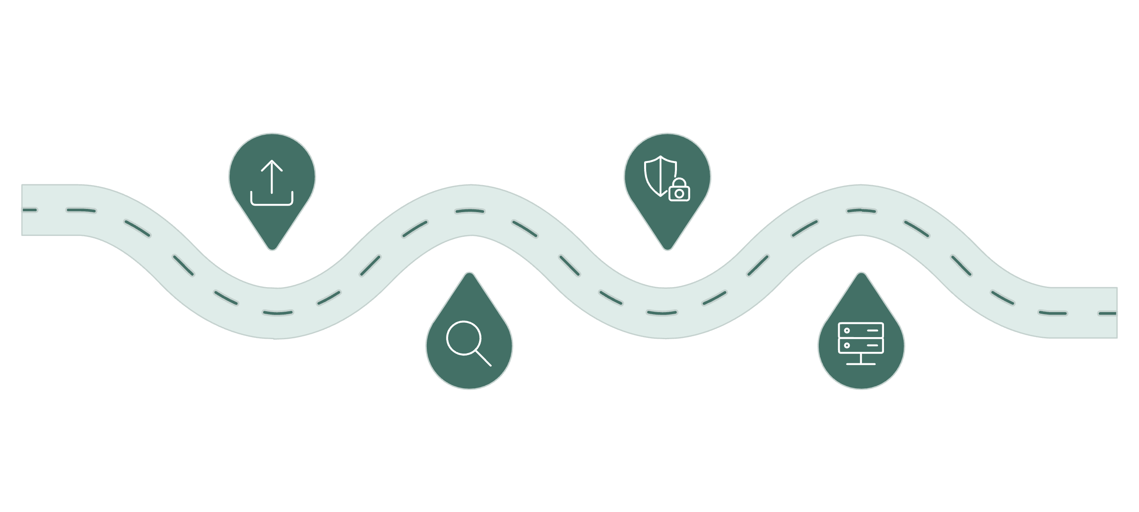
From RAG Pilot to Enterprise Platform
Pilot
Harden
Upload docs, connect LLM, demo
Security, permissions, monitoring
Validate
Scale
Test retrieval, refine chunking
Thousands of users, ops model
A proof of concept proves technical feasibility. Production introduces an entirely different set of demands: scaling to thousands of users and millions of documents, synchronizing permissions, monitoring retrieval quality, controlling costs, handling incidents, versioning models and prompts, and enabling employees to report incorrect answers. This is where many AI initiatives encounter the gap between successful demonstration and sustainable enterprise capability. The technology is only one part of crossing that gap — the rest is program execution.

Slide 19
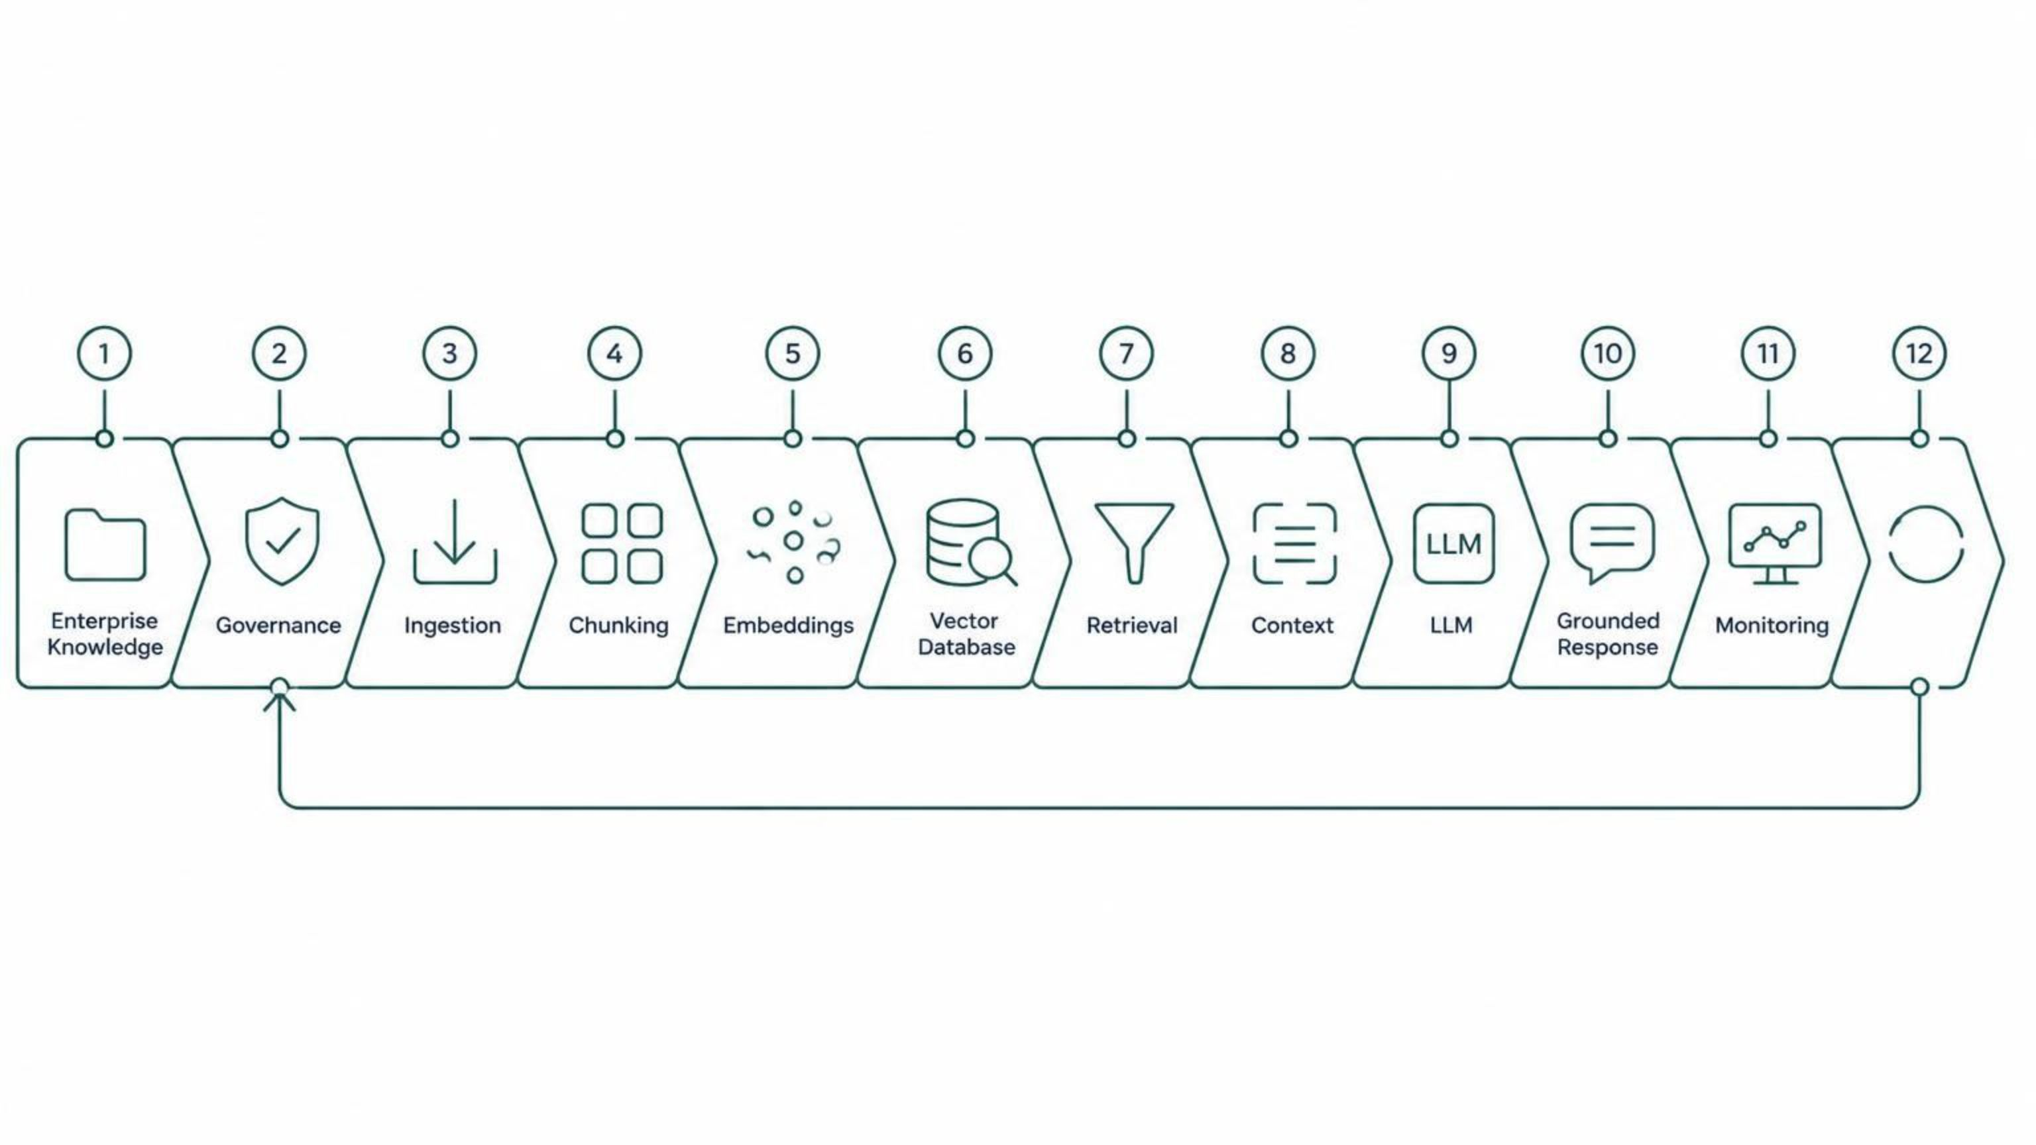
RAG Is Really Knowledge Architecture
RAG represents a fundamental shift: instead of relying entirely on what an LLM learned during training, enterprises provide controlled access to relevant organizational knowledge at the moment a user asks a question. The complete picture is far richer than a simple document connection.
Every component introduces decisions involving architecture, security, governance, ownership, performance, cost, compliance, and operational support. The organizations that succeed will not simply have the largest LLM — they will have the most trusted knowledge architecture surrounding it.

Slide 20
The Competitive Advantage Is Trusted Knowledge
Right knowledge.
Right time.
Right user.
Right controls.
The Question Is Shifting
As generative AI moves deeper into enterprise operations, the strategic question will increasingly shift from "Which AI model should we use?" to "How do we build the trusted enterprise architecture around it?"
Where Program Leadership Becomes Critical
The organizations that win with RAG will know which information is authoritative, control who can access it, continuously evaluate retrieval and response quality, monitor cost and performance, establish clear ownership — and connect everything to measurable business outcomes.
For Program Managers
Understanding RAG architecture may soon be as essential as understanding cloud migrations, Agile delivery, cybersecurity, or DevOps. And that is where experienced program leadership becomes the decisive factor.

