Slide 1


AI for Scrum Masters: Expanding the Agile Toolkit
How Scrum Masters Can Leverage AI to Elevate Facilitation, Decision-Making, and Team Performance
AGILE LEADERSHIP
AI INTEGRATION
#AIforScrumMasters #AIinAgile #AgileWithAI #ScrumAndAI #ScrumMaster #AgileLeadership #AgileCoach #ArtificialIntelligence #DigitalTransformation #FutureOfWork #ContinuousImprovement #AgileTransformation #DataDrivenLeadership #AgileExcellence #ScrumInnovation

Slide 2
The Moment Has Arrived
AI Is No Longer a Future Disruptor
Artificial Intelligence is an active participant in how teams plan, deliver, and continuously improve. For Scrum Masters, this represents a defining moment. You are no longer just facilitating ceremonies — you are enabling intelligent, data-driven delivery ecosystems.
The real opportunity? Expanding your Agile toolkit with AI — without compromising the human-centered foundation of Scrum.

Slide 3

Why AI Matters for Scrum Masters
Scrum Masters already balance multiple responsibilities — and AI enhances each one in meaningful ways.
Facilitating Collaboration
AI surfaces conversation patterns and team dynamics to make facilitation sharper and more impactful.
Removing Impediments
Early detection of blockers and dependencies keeps delivery flowing without manual investigation.
Protecting Team Focus
Automated status reporting and alerts reduce cognitive load, preserving team bandwidth for what matters.
Driving Continuous Improvement
Trend analysis and retrospective insights fuel smarter, more consistent improvement cycles.

Slide 4
Four Ways AI Amplifies Your Impact
Administrative Efficiency
Enhanced Insights
AI automates repetitive work — sprint metrics tracking, backlog refinement support, and status reporting — giving you back time to lead, coach, and influence outcomes.
AI identifies patterns that are often invisible: team performance trends, delivery bottlenecks, and behavioral signals. This shifts your role from reactive problem-solving to proactive performance optimization.
Ethical AI Adoption
Data-Driven Decisions
Ensuring AI aligns with Agile values, protecting team trust, and preventing over-reliance on automation — AI doesn't replace judgment, it requires stronger leadership.
Real-time performance indicators, predictive insights, and objective trend analysis strengthen your credibility with both teams and stakeholders.

Slide 5

CHAPTER 1
Foundations of AI in Agile
Understanding where AI fits — and where it doesn't — is the critical first step for every Scrum Master beginning this journey.
✅ AI Should...
❌ AI Should NOT...
Augment decision-making with data and pattern recognition
Enhance visibility across team performance and delivery health
Support continuous improvement with actionable insights
Replace human collaboration or team conversations
Override team autonomy or dictate outcomes without context
Become a crutch that erodes Agile principles
The foundation is simple: AI amplifies human intelligence — it never replaces it.

Slide 6
CHAPTER 2
AI-Enhanced Facilitation & Coaching
AI can dramatically improve how you facilitate key Scrum events — moving you from facilitating conversations to facilitating insight-driven conversations.
1
2
3
Sprint Planning
Daily Standups
Retrospectives
AI-driven velocity forecasting
Capacity modeling across team members
Early risk identification before commitment
Pattern detection in recurring blockers
Real-time alerts for emerging delivery risks
Sentiment shifts that signal team health concerns
Sentiment analysis of team feedback
Identification of recurring systemic issues
AI-suggested improvement actions with priority ranking

Slide 7


CHAPTER 3
Data-Driven Decision Making
AI transforms how decisions are made within Scrum teams — replacing gut-feel with grounded, evidence-based leadership.
Velocity Trends → More Accurate Forecasting
Consistent velocity analysis helps the team commit to realistic sprint goals and communicate release timelines with confidence.
Burndown Predictions → Early Risk Mitigation
Predictive burndown models surface scope or capacity issues days before they become critical, enabling early course correction.
Quality Indicators → Better Backlog Prioritization
Defect patterns and cycle time metrics help Product Owners and teams make smarter, context-aware prioritization decisions.
The key is balance: Use AI insights — but always apply human context before acting.

Slide 8



CHAPTER 4
AI for Impediment Removal & Risk Management
One of the most powerful use cases for AI in Scrum. Instead of waiting for issues to surface in standups or reviews, you can anticipate, act early, and minimize disruption.
Cross-Team Dependency Detection
Recurring Blocker Identification
Automated Escalation Signals
Machine learning identifies patterns in impediments that repeat across sprints, enabling systemic fixes rather than one-off workarounds.
When risk thresholds are crossed, AI triggers escalation alerts — ensuring the right people are informed at the right time without manual monitoring overhead.
AI scans work items and team interactions to surface hidden dependencies before they block delivery — reducing coordination surprises in scaled environments.

Slide 9
CHAPTER 5
Ethics, Transparency & Responsible AI Use
This is where Scrum Master leadership truly matters. Responsible AI adoption is not a technical problem — it is a people and culture challenge.
The Core Principle
AI Decisions Must Be Explainable
Transparency builds trust.
Trust sustains Agile success.
Teams and stakeholders deserve to understand how AI-generated insights are derived and what data drives them.
Your role as Scrum Master is to be the guardian of ethical AI adoption — championing fairness, openness, and accountability at every step of the journey.
Teams Must Understand AI Usage
Transparency about what AI is doing — and what it isn't — builds the psychological safety needed for genuine adoption.
Stakeholder Trust in Outputs
When AI recommendations are consistently validated against reality, confidence grows organically across the organization.

Slide 10


CHAPTER 6
Building AI-Ready Teams
Adoption is not just about tools — it's about mindset. Your most important role in AI transformation is cultural, not technical.
Coach Responsible Usage
Encourage Experimentation
Help teams understand AI capabilities, limitations, and the importance of validating AI outputs before acting on them.
Create space for teams to explore AI tools in low-risk environments — celebrate learning from failures as much as successes.
Maintain Psychological Safety
Ensure no team member fears being replaced by AI. Reinforce that augmentation — not automation — is the goal.
The goal is not automation — it's augmentation with trust.

Slide 11
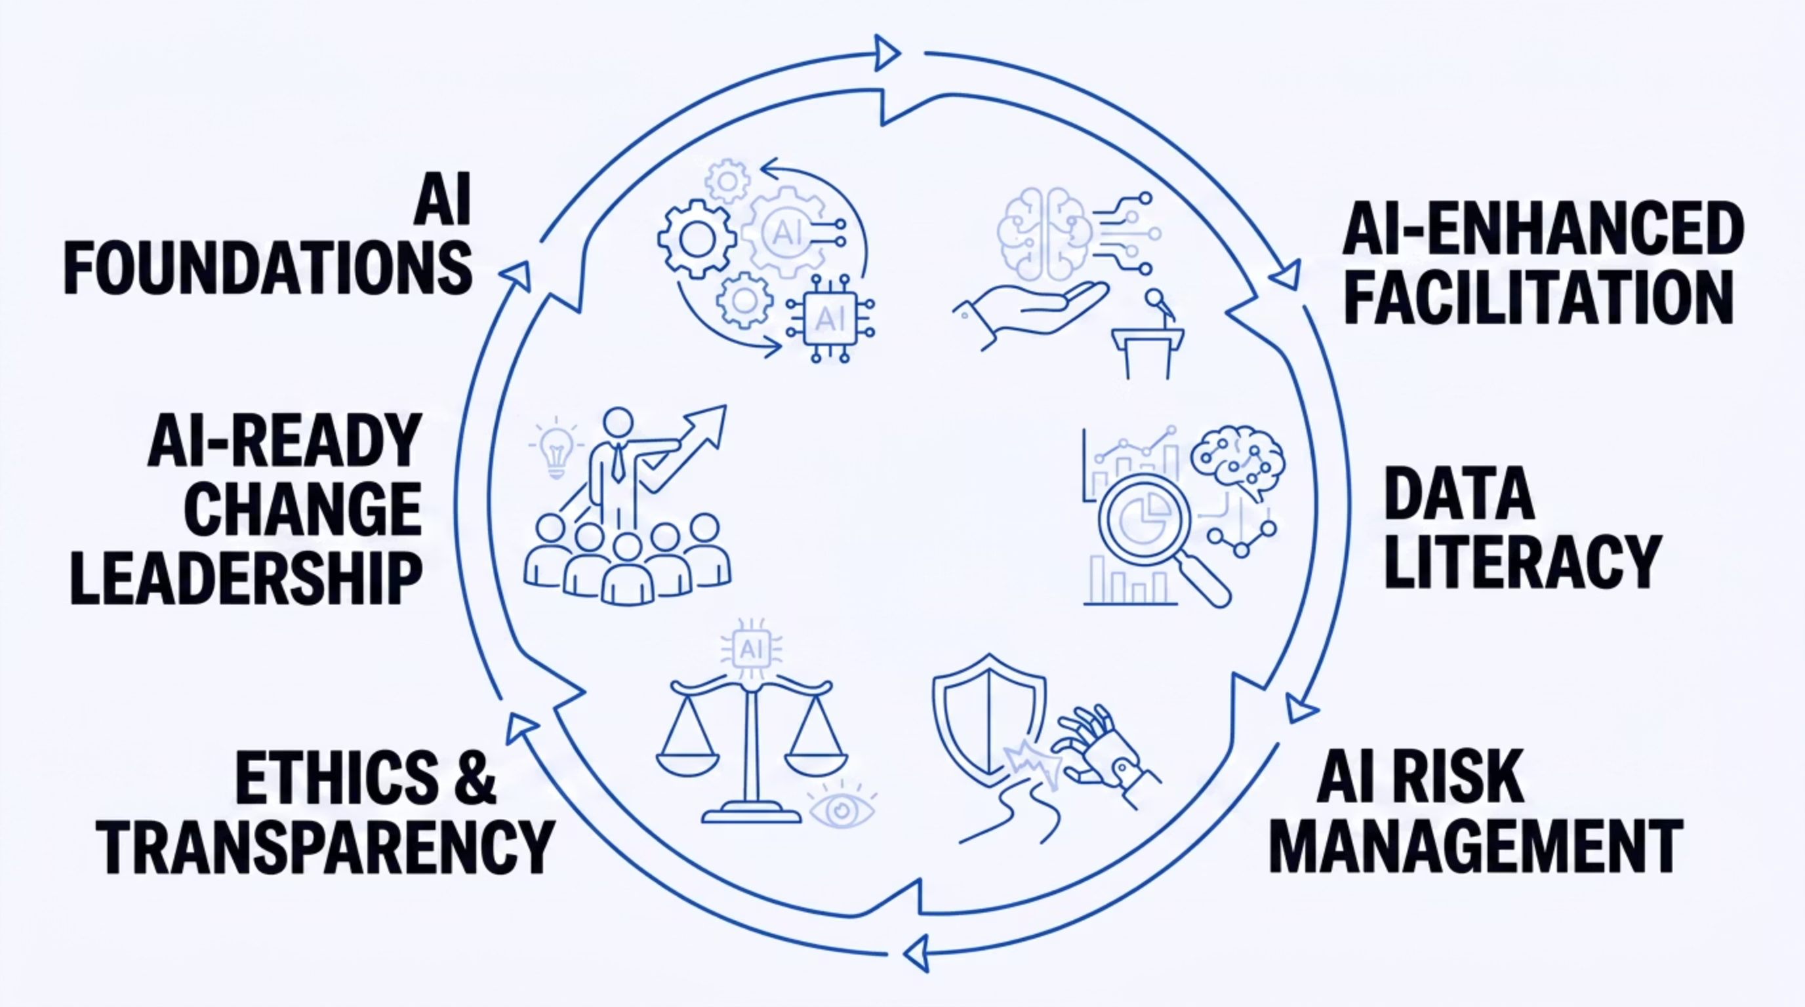

Expanding the Scrum Master Skillset
To fully leverage AI, Scrum Masters must evolve their capabilities across six interconnected competency areas.

Slide 12



Who Should Embrace This Evolution?
AI in Agile is not limited to one role — it's an ecosystem shift that elevates every member of the Agile community.
Scrum Masters
Agile Coaches & Product Owners
Agile Transformation Leaders
Expand your toolkit, increase your strategic impact, and transition from ceremony facilitator to intelligent delivery partner for your teams and organization.
Bring AI into decision-making and product strategy without losing customer focus. Use predictive insights to sharpen the product vision and prioritization discipline.
Prepare your organization for the next wave of Agile evolution. Build AI literacy at scale and embed responsible AI governance into your transformation roadmap.

Slide 13

The Future of Agile Leadership
AI is not replacing Scrum Masters — it is strengthening the role. Just as Agile successfully adapted to distributed teams, cloud transformation, and DevOps practices, it is now evolving again — into AI-assisted agility.
1
Distributed Teams
Agile scaled across geographies with remote collaboration practices
2
Cloud Transformation
Agile embraced continuous delivery and infrastructure as code
3
DevOps Practices
Agile merged development and operations into unified delivery streams
4
AI-Assisted Agility
Agile is now evolving with intelligent tools that augment every ceremony and decision

Slide 14
The Scrum Masters Who Will Thrive
The differentiator won't be technical expertise — it will be the wisdom to blend human judgment with machine intelligence.
Blend Human Intelligence with Machine Insights
Lead with Empathy and Data
Balance Speed with Responsibility
Neither pure intuition nor cold analytics alone is sufficient. The best Scrum Masters will hold both simultaneously.
Use AI to surface what data reveals — then apply empathy, context, and team knowledge to decide what it means.
AI enables faster decisions — but responsible Scrum Masters ensure that speed never comes at the cost of team trust or ethical standards.

Slide 15
Final Thought
"The most successful Scrum Masters of tomorrow will be those who learn to blend human wisdom with artificial intelligence today."
This Is Not About Being Technical
Your Next Step
You don't need to become a data scientist or AI engineer. You need to become more effective, more strategic, and more impactful — using every tool available to serve your teams.
AI is simply the next evolution in your Agile toolkit. The frameworks are ready. The tools are available. The teams are waiting for your leadership.
How you use AI — the judgment, the ethics, the coaching — that's your leadership. That's what no algorithm can replace.
AGILE LEADERSHIP
AI INTEGRATION
TEAM PERFORMANCE

