Slide 1

Expectation Management: A Guide for Project Managers
Effective expectation management is crucial for project success, especially when working with cross-functional teams. This presentation explores strategies for clarifying, controlling, and communicating expectations to foster collaboration and achieve project goals.
kW
by Kimberly Wiethoff

Slide 2




The Non-Linear Path of Expectations
Initial Expectation
Starting point of project goals and objectives
Twists and Turns
Uncertainty, complexity, and changes along the way
Final Outcome
Realized expectations after navigating challenges
The path to realizing expectations is rarely linear. It's filled with unforeseen twists, turns, and obstacles that can lead to deviations from the initial plan. This non-linear journey is influenced by uncertainty, complexity, dependencies, risks, and human dynamics.

Slide 3





Factors Influencing Expectation Realization
Uncertainty
Complexity
Dependencies
Risks
Unpredictable elements that can impact project outcomes
Intricate project components and their interactions
Interconnected tasks and resources affecting progress
Potential threats to project success and mitigation strategies
These factors contribute to the non-linear path of expectation realization, requiring careful management and adaptation throughout the project lifecycle.

Slide 4
Human Dynamics in Project Management
Communication Challenges
Conflicting Priorities
Resistance to Change
Misunderstandings and breakdowns in information sharing can lead to delays and rework.
Different stakeholders may have competing interests, requiring negotiation and alignment.
Team members or stakeholders may be reluctant to adopt new processes or ideas, impacting project progress.
Effective stakeholder management and communication are critical for addressing these human dynamics and maintaining alignment with expectations.

Slide 5

Listen and Understand
Engage with Stakeholders
Build Rapport
Establish trust through attentive and empathetic listening.
Actively listen to cross-functional teams to gain insights into their needs, concerns, and priorities.
Develop Understanding
Gain a deeper comprehension of stakeholders' expectations and motivations.
Effective expectation management begins with active listening and understanding. This foundation helps in building strong relationships with cross-functional teams.

Slide 6




Negotiate and Align Expectations
1
Identify Common Goals
2
Establish Priorities
3
Recognize Constraints
4
Find Win-Win Solutions
Collaborate with stakeholders to negotiate and align expectations, ensuring they are realistic and achievable. Be prepared to compromise and balance competing interests to establish a shared understanding of project objectives and deliverables.

Slide 7
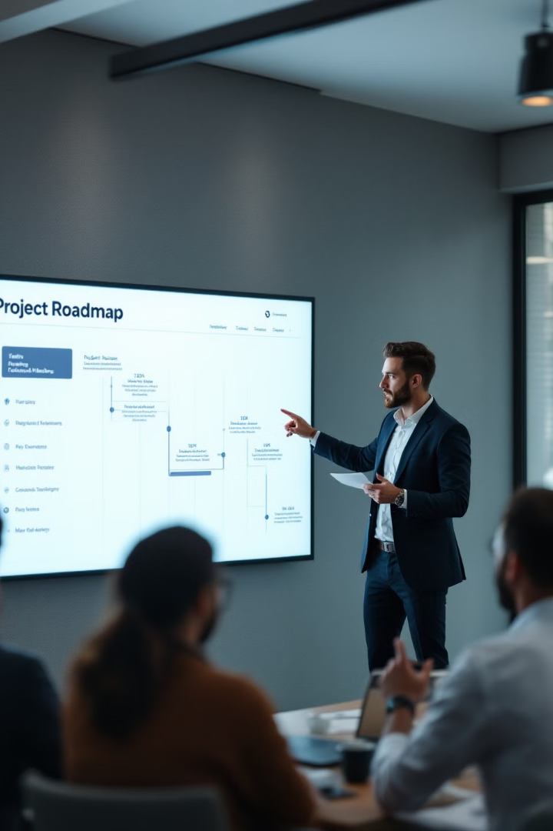
Clarify Expectations
Define Project Scope
Establish Timelines
Clearly outline the boundaries and deliverables of the project.
Set realistic deadlines and milestones for project completion.
Assign Roles and Responsibilities
Document Expectations
Use project charters and work breakdown structures to formalize agreements.
Clearly define who is responsible for each aspect of the project.
Clear communication is critical for avoiding misunderstandings. Ensure all stakeholders have a common understanding of what is expected throughout the project lifecycle.

Slide 8

Control Expectations
1
2
3
4
Monitor Progress
Address Deviations
Communicate Updates
Manage Perceptions
Regularly track project status and milestones.
Proactively manage changes and challenges that arise.
Set realistic expectations about what can be achieved within constraints.
Keep stakeholders informed about project status and any changes.
Proactively manage and control expectations throughout the project to address changes, risks, and challenges that may arise.

Slide 9




Communicate Effectively
Regular Meetings
Email Updates
Hold frequent check-ins with team members and stakeholders.
Send written communications for important project information.
Collaboration Tools
Utilize digital platforms for real-time project updates and discussions.
Effective communication is the cornerstone of expectation management. Keep lines of communication open with cross-functional teams, providing opportunities for feedback, questions, and concerns.

Slide 10
Agile Project Management
Responding to Change
Balancing Act
Prioritize adapting to new information and circumstances over rigidly following initial plans.
Navigate between flexibility and structure to meet project goals effectively.
Agile project management emphasizes the importance of responding to change over following a plan. This approach allows for greater flexibility and adaptability in managing expectations throughout the project lifecycle.

Slide 11
Key Strategies for Success
1
Active Listening
2
Clear Communication
3
Stakeholder Alignment
4
Proactive Management
Successful expectation management relies on a combination of active listening, clear communication, stakeholder alignment, and proactive management. These strategies help project managers navigate the complex landscape of cross-functional projects.

Slide 12

Conclusion: Embracing the Journey
Effective expectation management is an ongoing process that requires proactive engagement and transparent communication throughout the project lifecycle. By embracing the non-linear nature of realizing expectations, project managers can better navigate challenges, adapt to changing circumstances, and ultimately achieve successful outcomes.
Continuous Adaptation
Stakeholder Engagement
Remain flexible and ready to adjust strategies as needed.
Keep all parties informed and involved throughout the project.
Celebrate Milestones
Acknowledge progress and successes along the way.

