Slide 1
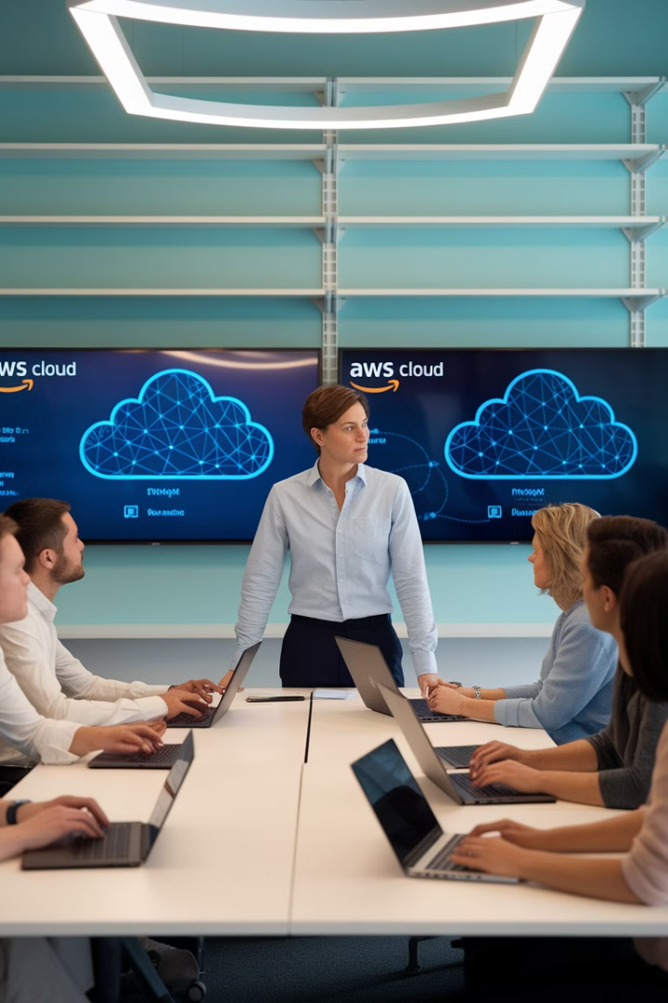
AWS for Project Managers
What You Need to Know to Lead Cloud Projects Successfully
Cloud adoption is no longer optional—it's a business imperative. Many organizations move to AWS for scalability, cost savings, and flexibility.
Project Managers don't need to be cloud experts, but understanding key AWS concepts helps you communicate with stakeholders, mitigate risks, and manage scope effectively.
kW
by Kimberly Wiethoff

Slide 2

Core AWS Services
Compute
EC2 (virtual machines), Lambda (serverless computing), and ECS/EKS (containers).
Storage
S3 (object storage), EBS (block storage), and Glacier (archival storage).
Databases
RDS (relational database), DynamoDB (NoSQL), and Redshift (data warehousing).
Networking & Security
VPC (virtual private network), IAM (identity management), and CloudTrail (audit logs).

Slide 3




PM Tip: Understanding Services
Ask Questions
See the Big Picture
Document Decisions
Speak with architects about which AWS services they plan to use and why.
Understanding service relationships helps manage dependencies and risks.
Keep track of service choices and their business justifications.

Slide 4

Business Alignment
What business problem are we solving with AWS?
Are we migrating legacy systems or building cloud-native apps?
Ensure cloud adoption addresses specific business needs, not just technical interests.
The approach differs significantly based on this strategic decision.
What are the performance, security, and compliance requirements?
What's the expected ROI on this AWS investment?
These requirements will shape your AWS architecture choices.
Define clear metrics to measure success of your cloud initiative.

Slide 5





AWS Well-Architected Framework
Security
Operational Excellence
Protect information, systems, and assets.
2
Run and monitor systems to deliver business value.
1
Reliability
Ensure a workload performs its intended function correctly.
3
Cost Optimization
5
Avoid unnecessary costs while meeting business needs.
Performance Efficiency
4
Use computing resources efficiently to meet requirements.

Slide 6
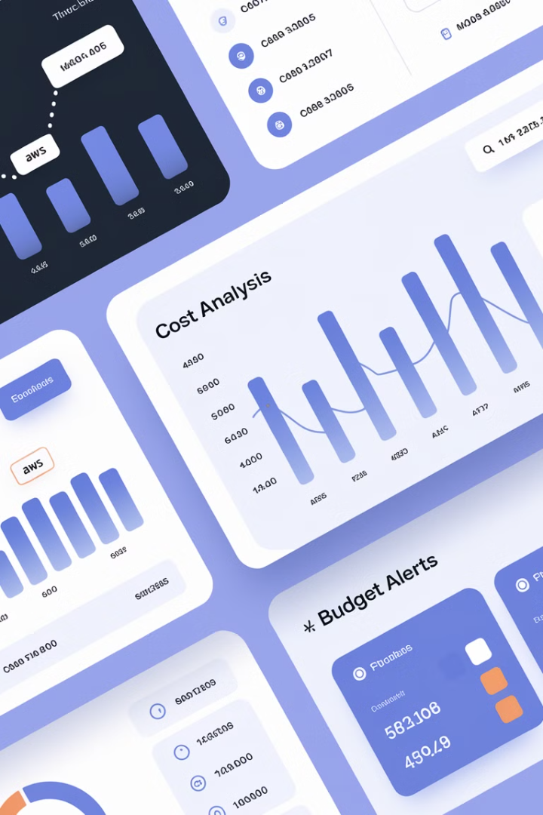




Managing AWS Costs
Track Expenses
Use AWS Cost Explorer to monitor and analyze cloud spending patterns.
Right-size Resources
Avoid over-provisioning EC2 instances and other resources.
Reserved Instances
Leverage Reserved Instances & Savings Plans for predictable workloads.
Budgets & Alerts
Set up budgets & alerts in AWS to prevent unexpected cost overruns.

Slide 7



Security & Compliance
Your Organization
1
Applications, data, access controls
Shared Responsibility
2
OS, network configuration
AWS
3
Infrastructure, hardware, global network
AWS follows a Shared Responsibility Model where AWS secures the underlying infrastructure while your organization is responsible for securing applications and data.

Slide 8
Key Security Practices
IAM Roles
Encryption
Monitoring
Compliance
Use IAM roles & least privilege access to limit permissions.
Implement encryption for sensitive data using AWS KMS.
Set up CloudWatch & GuardDuty for security monitoring.
Ensure compliance with HIPAA, SOC2, ISO27001 if needed.

Slide 9

Agile & DevOps for AWS
Automated Testing
Monitoring & Logging
Integrate AWS Lambda & API Gateway for scalable testing.
Infrastructure as Code
Implement AWS CloudWatch for performance tracking.
CI/CD Pipelines
Use Terraform or CloudFormation to manage cloud resources.
Automate deployments using AWS CodePipeline & CodeBuild.

Slide 10

Managing Cloud Teams
Shorter Sprints
Continuous Integration
Implement shorter development cycles to adapt quickly to cloud changes.
Ensure teams are leveraging automation effectively.
1
2
3
4
Cross-Functional Teams
Knowledge Sharing
Foster collaboration between developers, operations, and security teams.
Create opportunities for AWS expertise to spread across the team.

Slide 11



PM's Role in AWS Projects
Bridge the Gap
Manage Risks
Ensure Best Practices
Connect business and technology teams with clear communication.
Oversee cloud project scope, risks, and costs effectively.
Drive security, compliance, and performance standards.

Slide 12
Key Takeaways
Strategic Leadership
1
PMs are strategic leaders, not cloud engineers
Business Alignment
2
Ensure AWS implementation serves business goals
Cost Management
3
Actively monitor and optimize cloud spending
Security Focus
4
Integrate security throughout the project lifecycle
You don't need to deploy an EC2 instance or write an IAM policy, but understanding these concepts will make you a better AWS Project Manager.

Slide 13


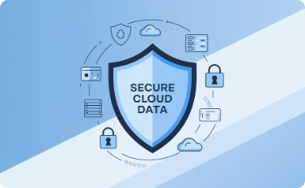

Final Thoughts
Project Managers play a crucial role in AWS implementations—not as cloud engineers, but as strategic leaders.
Bridge the Gap
Manage Cloud Resources
Ensure Best Practices
Drive Collaboration
Connect business and technology teams with clear communication and mutual understanding.
Drive security, compliance, and performance standards throughout your AWS projects.
Foster Agile teamwork for successful cloud adoption and continuous improvement.
Oversee project scope, risks, and costs effectively to ensure AWS implementations deliver value.
You don't need to deploy an EC2 instance or write an IAM policy, but understanding these concepts will make you a better AWS PM.

