Slide 1
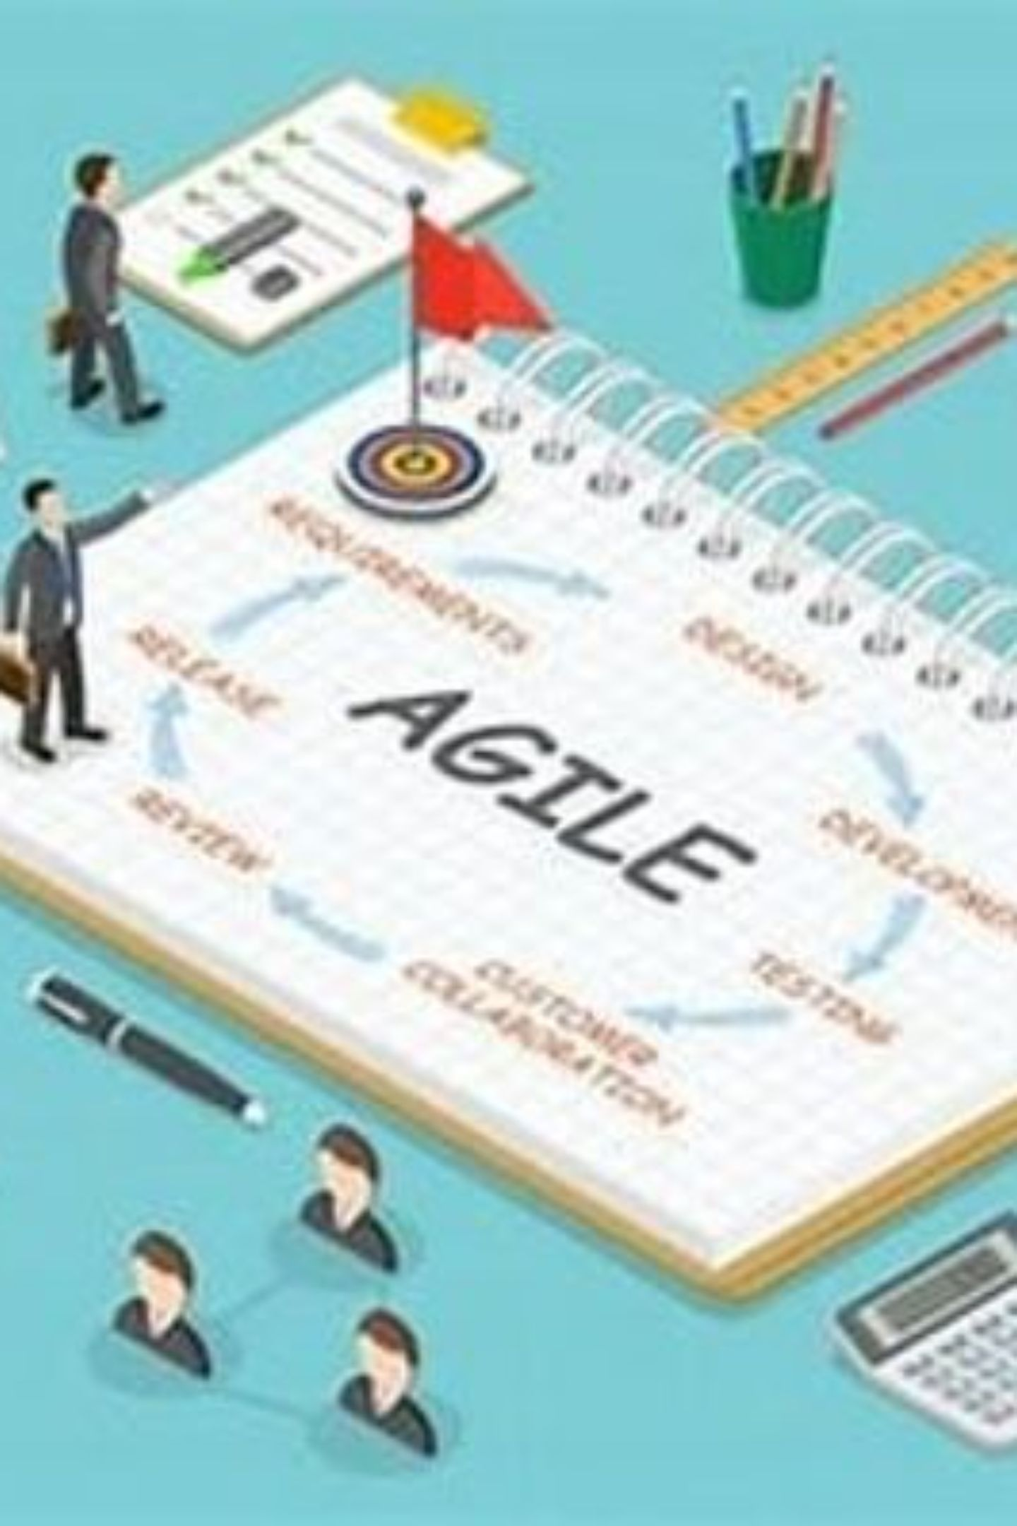
Exploring New Frontiers in Agile Project Management
Embracing Innovation for Success in Today's Fast-Paced Business Environment
By Kimberly Wiethoff, MBA, PMP, PMI-ACP
Managing Projects The Agile Way
#AgileInnovation #AgileProjectManagement #AgileLeadership #AgileAtScale #AgileMetrics #RemoteAgile #AgileTransformation #BusinessAgility #AgileMindset #AgileCulture #ContinuousImprovement #AgileTeams #AgilePractices #AgileFrameworks #AgileSuccess

Slide 2
The Agile Landscape Is Expanding
Agile methodologies have become synonymous with adaptability, collaboration, and delivering real value to stakeholders. But the discipline is far from static. As organizations grow more sophisticated in their Agile practice, new frontiers are emerging — reshaping how teams organize, measure, lead, and deliver across every type of project.
Agile at Scale
Agile Leadership
Smarter Metrics
Coordinating multiple teams across the enterprise
Cultivating culture and empowerment
Moving beyond velocity to real outcomes
Remote Agile
Agile Beyond IT
Enabling distributed teams to thrive
Applying Agile to any domain or industry

Slide 3

CHAPTER 1
Agile at Scale
Managing Large-Scale Projects Across the Enterprise

Slide 4

Coordinating Multiple Teams at Enterprise Scale
As Agile gains traction across organizations of all sizes, scaling beyond a single team introduces a new layer of complexity. Aligning priorities, maintaining strategic coherence, and preserving the speed and flexibility that make Agile valuable — all at once — is a significant challenge. The right frameworks make it achievable.
SAFe — Scaled Agile Framework
LeSS — Large-Scale Scrum
A comprehensive, prescriptive framework that organizes teams into Agile Release Trains (ARTs), aligning work to business value streams and Program Increments for enterprise-wide cadence.
A leaner approach that extends Scrum principles to multiple teams working on a single product, minimizing organizational overhead while maximizing team autonomy and direct customer focus.
Successful scaling is less about choosing the "right" framework and more about consistent application of Agile values: transparency, inspect-and-adapt, and relentless focus on customer value.

Slide 5
What Agile at Scale Looks Like in Practice
Aligned Team Autonomy
Cross-Team Dependency Management
Accelerated Enterprise Delivery
Individual teams retain the autonomy to self-organize and make local decisions, while still contributing to enterprise-level goals through shared OKRs and synchronized planning cadences.
By synchronizing multiple Agile teams through shared iterations and integrated release planning, organizations consistently shorten time-to-market and improve predictability at scale.
Scaled Agile introduces explicit mechanisms — such as Scrum of Scrums and Program Boards — to surface, track, and resolve interdependencies before they become blockers.

Slide 6

CHAPTER 2
Agile Leadership & Culture
Fostering a Culture of Continuous Innovation

Slide 7
Leadership Is the Multiplier in Agile Transformation
Agile project management is not simply about processes and tools — at its core, it is about people and the culture they operate within. Agile leadership requires a fundamental shift in mindset: from command-and-control to servant leadership, from directing work to enabling teams to do their best work.
Servant Leadership
Team Empowerment
Continuous Improvement
Agile leaders prioritize removing impediments, protecting teams from disruption, and ensuring they have everything needed to deliver. Leadership exists to serve the team — not the other way around.
Empowered teams make faster, better decisions. Leaders who delegate authority and trust their teams create environments where innovation becomes the norm rather than the exception.
A culture of inspect-and-adapt — driven from the top — ensures that both the work and the way of working are always evolving. Retrospectives become a strategic tool, not just a ritual.

Slide 8

CHAPTER 3
Agile Metrics & Performance Measurement
Moving Beyond Velocity to What Actually Matters

Slide 9
Measuring What Truly Drives Value
Velocity has long been a default metric in Agile — but it measures output, not outcomes. Modern Agile teams are adopting richer, more meaningful metrics that reveal how efficiently value flows to customers and how well the team's work aligns with real business goals.
Cycle Time
Lead Time
Time from when work begins to when it's delivered. Shorter cycle times signal a lean, responsive system with minimal waste and bottlenecks.
Total elapsed time from a request being made to delivery. A critical signal of customer experience and organizational responsiveness.
Customer Satisfaction
Business Value Delivered
NPS scores, feedback loops, and direct customer engagement data that ground team performance in real-world impact rather than internal throughput.
Measuring the actual outcomes — revenue generated, cost avoided, risk mitigated — that connect team effort to organizational strategy.
The right metrics create a feedback loop that fuels continuous improvement. Choose metrics that reflect your team's goals — and revisit them regularly as those goals evolve.

Slide 10

CHAPTER 4
Agile in Remote Work Environments
Keeping Distributed Teams Aligned, Engaged, and Productive

Slide 11
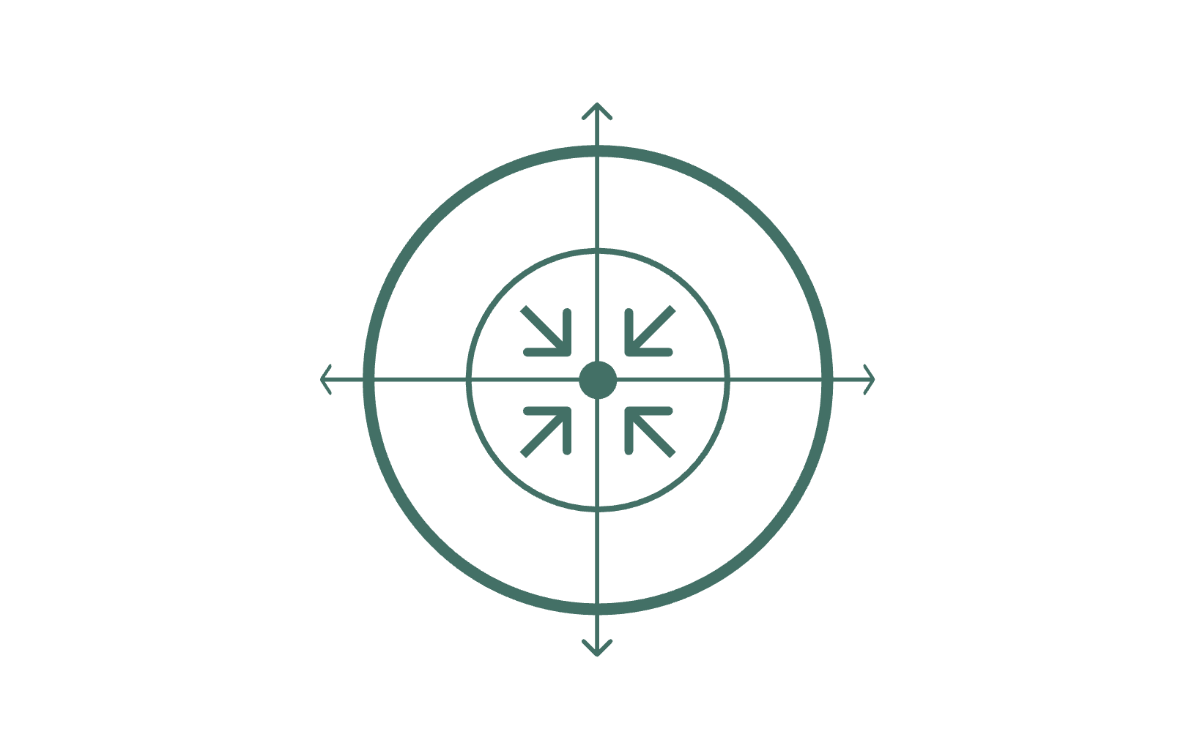
Adapting Agile Practices for the Distributed Team
The widespread shift to remote work has fundamentally changed the context in which Agile teams operate. While core Agile principles remain unchanged, their practical application requires deliberate adaptation to address the realities of virtual collaboration — from communication barriers to time zone coordination.
Digital Tooling
Central Goal
Adapted Ceremonies
Team Cohesion
Organizations that invest in the right blend of tools, rituals, and intentional communication practices consistently see remote Agile teams match — and sometimes exceed — the productivity of co-located counterparts.

Slide 12

CHAPTER 5
Agile for Non-Software Projects
Bringing Agile Principles to Every Industry and Function

Slide 13
Agile Belongs Everywhere, Not Just in IT
Agile originated in software development, but its underlying principles — iterative delivery, customer collaboration, rapid feedback, and adaptive planning — translate powerfully to virtually any domain. Forward-thinking organizations are applying Agile to drive results far beyond the engineering department.
Marketing & Product Launches
Construction & Infrastructure
Organizational Change & Strategy
Campaign teams run two-week sprints, continuously test messaging, and iterate based on real audience data — dramatically reducing time-to-impact for go-to-market initiatives.
Phased delivery, iterative design reviews, and stakeholder feedback loops enable project teams to surface issues earlier and adapt scope before costly rework accumulates.
Change management initiatives benefit from Agile's inspect-and-adapt rhythm: pilot programs, regular retrospectives, and staged rollouts replace one-time big-bang transformations.

Slide 14
The Journey Toward Agile Excellence Is Ongoing
Agile project management continues to evolve to meet the changing demands of modern organizations. The five frontiers explored here represent both the current edge of practice and a roadmap for what's ahead. Organizations that lean into these developments will be better equipped to innovate, adapt, and deliver lasting value.
Scale With Intention
Lead Differently
Measure Outcomes
Use SAFe, LeSS, or hybrid approaches to extend Agile across teams without losing agility.
Champion servant leadership, psychological safety, and a culture of continuous learning at every level.
Replace output-focused metrics with meaningful indicators of real customer and business value.
Enable Remote Teams
Expand the Tent
Build rituals, tooling, and norms that make distributed collaboration feel intentional and human.
Apply Agile principles beyond software — to any team that benefits from iteration, collaboration, and speed.
The journey toward Agile excellence is not a destination — it is an ongoing, rewarding endeavor that compounds in value the further you travel.

