Slide 1
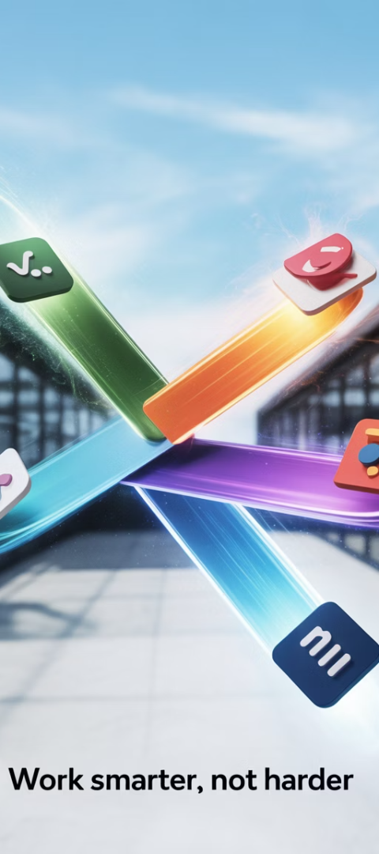
Tool Wars: Jira vs. Azure DevOps vs. Monday
Choosing the right Agile project management tool can make—or break—team productivity. Your tool should be more than a ticket tracker; it should be a collaboration catalyst.
Three popular options—Jira, Azure DevOps, and Monday.com—often top the list. Each has strengths, weaknesses, and ideal use cases. In this blog, we break down the essentials to help you make a smart, strategic decision.
kW
by Kimberly Wiethoff

Slide 2




The Decision Challenge
Strategic Choice
Top Contenders
With dozens of platforms available, selecting the right one is crucial.
Three popular options—Jira, Azure DevOps, and Monday.com—often lead the pack.
Balanced Approach
Each has strengths, weaknesses, and ideal use cases.

Slide 3
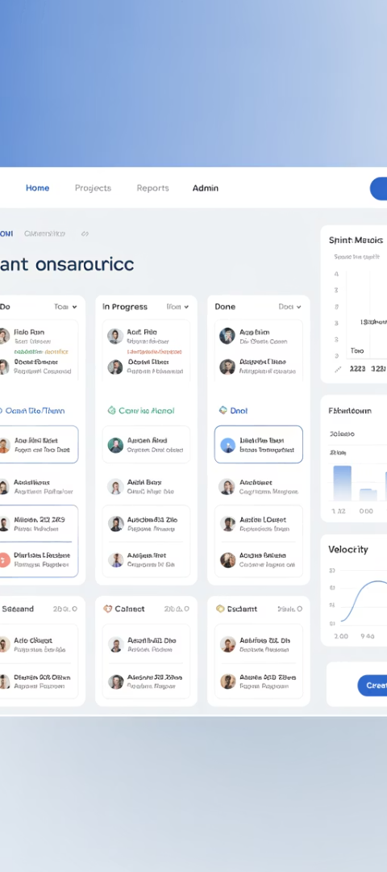
Jira: The Customizable Giant
Best For
Key Strengths
Software development teams needing detailed Agile configuration.
Built for Scrum and Kanban
Deep customization options
Powerful backlog management
Strong plugin ecosystem
Challenges
Steep learning curve
Can become complex if not maintained

Slide 4

Jira Pro Insight
Jira is ideal for technical teams who want control over every aspect of their Agile process—but be prepared to invest time in setup and governance.
5★
2★
Agile Support
DevOps Integration
Comprehensive Scrum and Kanban capabilities.
Limited native integration options.
5★
2★
Customization
Ease of Use
Unmatched workflow and automation flexibility.
Requires technical knowledge to master.

Slide 5




Azure DevOps: The Integrated Suite
Microsoft Ecosystem
Complete Toolchain
End-to-End Traceability
Strong Governance
Seamless integration with Visual Studio, GitHub, and Microsoft 365.
Built-in boards, repos, pipelines, and test plans.
Track work from requirement to deployment.
Robust permission control and security features.

Slide 6

Azure DevOps Challenges
UI Limitations
Team Size Considerations
The interface can feel clunky compared to more modern tools. Navigation sometimes requires extra clicks.
May be too heavyweight for smaller teams or business units. The full feature set can overwhelm small projects.
Teams may need training to use effectively.
Setup and maintenance require dedicated resources.
Pro insight: If you're already in the Microsoft ecosystem and need end-to-end DevOps support, Azure DevOps offers unmatched continuity.

Slide 7




Monday.com: Visual Collaboration
User-Friendly Interface
Flexible Workflows
Stakeholder Visibility
Quick Implementation
Drag-and-drop simplicity for creating and modifying processes. Adaptable to various team needs.
Highly visual UI with intuitive controls. Minimal training required for new users.
Great for high-level project visibility and executive reporting. Colorful, clear status indicators.
Fast setup with minimal technical overhead. Ready to use out of the box.

Slide 8






Monday.com Limitations
Limited Technical Depth
Basic developer features
Basic Agile Reporting
Fewer metrics than competitors
No Native Git Integration
Requires workarounds
Pro insight: Monday is excellent for Agile-adjacent teams who want clarity, speed, and ease—not deep software development integration.

Slide 9
Feature Comparison Snapshot
Feature
Jira
Azure DevOps
Monday
Agile Support
★★★★★
★★★★☆
★★★☆☆
DevOps Integration
★★☆☆☆
★★★★★
★☆☆☆☆
Customization
★★★★★
★★★★☆
★★★☆☆
Ease of Use
★★☆☆☆
★★★☆☆
★★★★★
Best For
Dev Teams
Microsoft-Centric Teams
Business/Hybrid Teams

Slide 10








Which One Is Right for You?
Team Composition
Customization Needs
Are you managing developers, marketers, or mixed teams?
Do you need heavy customization or lightweight flexibility?
Budget Constraints
Integration Requirements
What's your price range for licenses and maintenance?
How important is integration with your existing toolset?

Slide 11



The Agile Way to Choose
Start with team needs
Not trends or buzzwords
Evaluate process fit
Tools should support your workflow
Test before committing
Run pilots with real teams
Choose the right tool for the team, not the trend. Tools should support your process—not define it.

Slide 12




Tool Strengths at a Glance
Jira
Shines in customization and technical depth.
Azure DevOps
Wins in integration and end-to-end capabilities.
Monday
Excels in simplicity and visual appeal.
Your decision should be based on your team's workflow, tech stack, and stakeholder needs—not just brand names.

Slide 13




Beyond the Tools
There’s no one-size-fits-all solution when it comes to Agile tools. Jira shines in customization, Azure DevOps wins in integration, and Monday excels in simplicity. Your decision should be based on your team’s workflow, tech stack, and stakeholder needs—not just buzzwords or brand names.
Remember, tools are only as effective as the team practices and culture they support. The best tool complements your team's way of working.

Slide 14
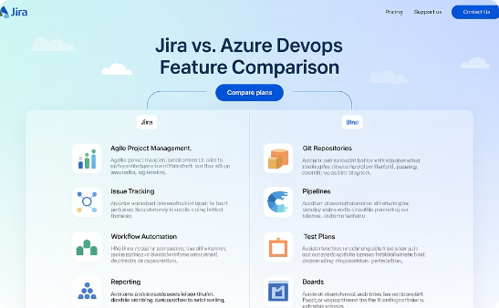
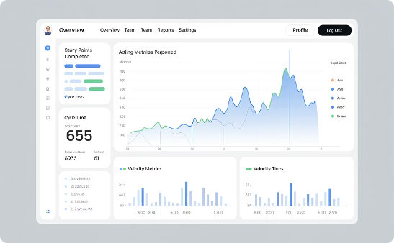
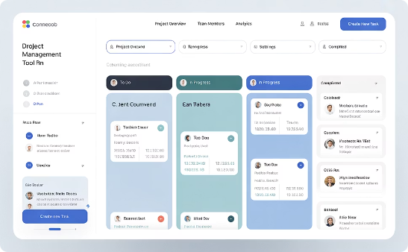
Related Resources
🔗 Related Reads from ManagingProjectsTheAgileWay.com:
Jira vs. Azure DevOps
Top 10 Agile Metrics
6 Practices
Which Tool Should IT Managers Choose for Project Management?
For Managing Scrum-Based Software Development Projects
Kanban Rules of Engagement

