Slide 1
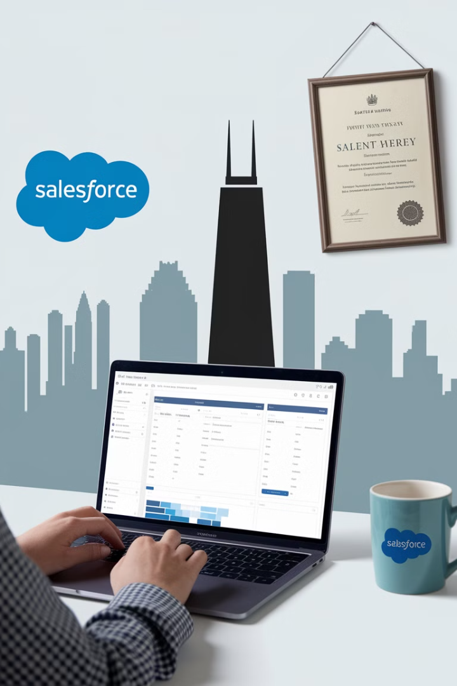
Mastering Salesforce Implementation: A Guide For Project Managers
Salesforce, a leading Customer Relationship Management (CRM) platform, empowers organizations to streamline operations across sales, service, marketing, and analytics.
As a Project Manager responsible for a Salesforce implementation, you play a crucial role in ensuring a successful deployment, balancing technical configurations, business requirements, and change management. This presentation will guide you through the essential knowledge and skills required to excel as a Salesforce Project Manager.
kW
by Kimberly Wiethoff

Slide 2
Understanding Salesforce Core Capabilities
Sales Cloud
Service Cloud
Marketing Cloud
Manages leads, opportunities, accounts, and sales automation. Provides tools for sales forecasting, pipeline management, and opportunity qualification.
Enhances customer service with case management, self-service portals, and AI-driven insights. Helps track customer interactions, prioritize issues, and improve response times.
Supports email marketing, social media engagement, and customer journeys. Enables personalized marketing campaigns, automation, and lead nurturing.
Experience Cloud
Tableau CRM (Einstein Analytics)
Revenue Cloud (CPQ & Billing)
Manages leads, opportunities, accounts, and sales automation. Provides tools for sales forecasting, pipeline management, and opportunity qualification.
Enhances customer service with case management, self-service portals, and AI-driven insights. Helps track customer interactions, prioritize issues, and improve response times.
Automates pricing, quoting, and billing processes. Provides tools for configuring products, generating quotes, and managing subscriptions.
By understanding these core capabilities, you can effectively translate business needs into technical requirements and identify the most relevant Salesforce modules for your project.

Slide 3
Key Responsibilities as a Salesforce PM
1
Project Planning & Governance: Define project scope, timelines, budget, and key milestones. Establish a clear project charter, communication plan, and risk management strategy.
2
Requirements Gathering: Identify key business processes that need to be optimized within Salesforce.
3
Stakeholder & Vendor Management: Collaborate with sales, marketing, IT teams, and Salesforce consultants. Facilitate communication, manage expectations, and ensure alignment across stakeholders.
4
Customization & Configuration Oversight: Work with Salesforce developers and admins to ensure proper workflows, automation, and integrations. Review design documents, code, and configurations to ensure quality and adherence to requirements.
5
Data Migration & Integration: Ensure seamless transfer of customer data and integration with third-party apps (ERP, email, analytics). Plan data cleansing, mapping, and validation processes to avoid data integrity issues.
6
Testing & User Training: Oversee UAT, address issues, and ensure smooth adoption. Develop user guides, conduct training sessions, and provide ongoing support to maximize user engagement.
7
Go-Live & Hypercare Support: Ensure a smooth transition and ongoing optimization post-deployment. Develop a post-implementation support plan, monitor user adoption, and identify opportunities for improvement.
By fulfilling these responsibilities, you can drive a successful Salesforce implementation that delivers value to your organization.

Slide 4
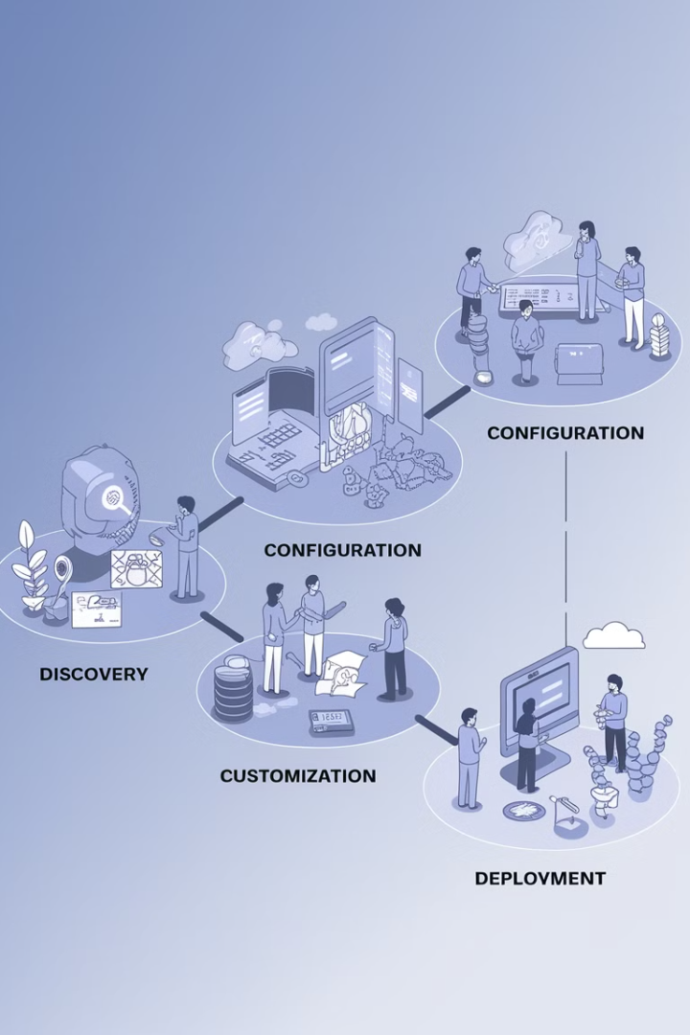
Salesforce Implementation Methodology
1
Plan
2
Discover & Design
Define project objectives, governance, and timeline. Establish a clear scope, budget, and communication plan.
Gather requirements and create the Salesforce architecture plan. Conduct workshops and interviews, and document user stories and system design specifications.
3
Build & Configure
4
Test
Set up workflows, automation, and data models. Configure Salesforce settings, develop custom code, and implement integrations with third-party systems.
Perform functional testing, UAT, and performance validation. Verify that Salesforce functions as expected and meets user requirements.
5
Deploy
6
Optimize
Launch the system and ensure business continuity. Manage the go-live process, address any issues, and ensure a smooth transition for end users.
Monitor adoption and continuously improve the platform. Track key performance indicators (KPIs), gather user feedback, and identify opportunities for ongoing enhancements.
Following this methodology helps align expectations, prevent scope creep, and ensure a successful Salesforce deployment.

Slide 5

Skills Needed for a Salesforce Project Manager
Project Management Expertise: Experience with Agile and Waterfall methodologies (PMP, PMI-ACP certifications help). Strong understanding of project planning, risk management, and stakeholder communication.
Salesforce Knowledge: Understanding of Salesforce architecture, workflows, and customization capabilities. Familiarity with Salesforce features, data models, and security settings.
Business Process Alignment: Ability to map Salesforce functionalities to sales, service, and marketing processes. Understanding of business needs and how to leverage Salesforce to improve workflows.
Data & Integration Oversight: Experience managing integrations with ERP, email systems, and analytics tools. Familiarity with data migration processes, API integrations, and data governance.

Slide 6

Skills Needed for a Salesforce Project Manager (cont.)
Change Management: Ability to drive user adoption and process improvements. Experience with communication, training, and support strategies to foster positive user engagement.
Risk & Issue Management: Anticipate challenges like data migration issues, integration delays, or resistance to change. Develop risk mitigation strategies, manage issues effectively, and maintain project momentum.
By developing these skills, you can become a highly effective Salesforce Project Manager who drives successful implementations.

Slide 7







Common Challenges & How to Overcome Them
Scope Creep: Clearly define MVP requirements and avoid excessive customizations. Establish a change control process to manage any changes to the scope.
User Adoption: Provide thorough training and communicate benefits to end users. Offer incentives, provide ongoing support, and collect user feedback to address adoption challenges.
Data Migration Issues: Clean and validate data before transferring it to Salesforce. Develop a data migration plan, implement data cleansing and validation steps, and test data integrity.
Integration Bottlenecks: Work closely with IT to ensure smooth API and third-party connections. Plan integration testing, monitor performance, and address any integration issues.
Customization Overload: Leverage out-of-the-box Salesforce capabilities before opting for heavy custom development. Explore Salesforce AppExchange for pre-built solutions and customize only when necessary.
By proactively addressing these challenges and implementing best practices, you can navigate potential pitfalls and achieve a successful Salesforce deployment.

Slide 8

Success Factors for Salesforce Implementation
1
Strong Leadership
Establish a dedicated project sponsor and a strong project team to guide the implementation process.
2
Clear Communication
Ensure consistent communication across stakeholders to manage expectations, address concerns, and promote collaboration.
3
User Engagement
Involve end users in the implementation process to gather feedback, ensure alignment, and promote adoption.
4
Data Quality
Prioritize data cleansing and validation to ensure accurate and reliable data for reporting and analytics.
5
Continuous Improvement
Monitor key performance indicators (KPIs), gather user feedback, and continuously optimize the Salesforce platform to enhance its effectiveness.
By prioritizing these success factors, you can create a robust Salesforce implementation that delivers tangible value to your organization.

Slide 9

Final Thoughts & Next Steps
Managing a Salesforce implementation demands a blend of technical understanding, business process alignment, and project management expertise. By following best practices, proactively managing risks, and leveraging the skills discussed, you can ensure a successful Salesforce deployment that enhances productivity, customer relationships, and business growth.
Remember, successful Salesforce adoption requires a strong focus on user adoption, continuous improvement, and ongoing optimization. Take the time to celebrate key milestones, acknowledge the team’s achievements, and foster a positive and supportive work environment.

