Slide 1

Turning Retrospectives into Results: Continuous Improvement in Action
Retrospectives are often called the "heartbeat of Agile"—yet too many teams treat them as routine check-ins where action items quickly fade into memory. The difference between teams that simply hold retrospectives and those that truly leverage them lies in their approach to turning reflection into tangible results.
Managing Projects The Agile Way
#AgileLeadership #ScrumEngineer #Retrospectives #ContinuousImprovement #TeamSuccess #AgileMindset #ProjectManagement #ManagingProjectsTheAgileWay

Slide 2

The Retrospective Reality Check
Most retrospectives follow a predictable pattern: teams gather, discuss what went well and what didn't, generate a few action items, then promptly forget about them by the next sprint. This cycle creates the illusion of continuous improvement while actual progress stagnates.
Research shows that only 30% of improvement actions from retrospectives are actually implemented, and even fewer are sustained long-term. This disconnect between intention and execution is what separates high-performing teams from those stuck in mediocrity.
The teams that break through this barrier understand that retrospectives aren't about having conversations—they're about creating change. They approach each retrospective as a strategic opportunity to evolve their capabilities and accelerate their impact.

Slide 3

Beyond Reflection
The real purpose of retrospectives extends far beyond looking backward. They're your team's compass for navigating toward higher performance and greater impact.

Slide 4
The Three Essential Questions
Effective retrospectives move beyond surface-level discussions about velocity and story points. They dig deeper into the questions that actually drive meaningful improvement and business impact.
Business Value Impact
Team Collaboration
Improvement Opportunities
Did our work move the needle on business value?
Did we collaborate effectively as a team?
How can we improve both outcomes and process?
This question shifts focus from activity to outcomes. Teams examine whether their completed work actually advanced business objectives, improved customer experience, or solved real problems. It's about measuring impact, not just output.
Beyond checking if everyone attended meetings, this explores the quality of interactions. Did team members support each other? Were decisions made transparently? Did communication flow smoothly across all team functions?
This dual focus ensures improvements address both what the team delivers and how they work together. It connects process enhancements directly to better results for customers and stakeholders.

Slide 5

Creating a Culture of Learning
When teams broaden their retrospective conversations from velocity and scope to value and impact, something transformative happens. They begin to see themselves not just as feature factories, but as problem solvers and value creators.
This shift in perspective cultivates a learning mindset where team members actively seek out opportunities to improve both their technical capabilities and their understanding of customer needs. They start asking better questions about their work and become more invested in the outcomes they produce.
Teams operating at this level don't just deliver software—they deliver solutions that matter. Their retrospectives become strategic sessions where business acumen meets technical excellence, creating a powerful combination that drives both team satisfaction and organizational success.
Learning-focused teams consistently outperform their peers by 25% in both velocity and quality metrics.

Slide 6
Keys to Effective Retrospectives
Four fundamental principles that transform routine meetings into engines of continuous improvement

Slide 7
1. Create a Safe Space
Psychological Safety Foundation
Establishing Trust
Encouraging Bold Ideas
Trust builds through consistent behavior over time. Scrum Masters demonstrate this by:
Safe spaces empower team members to propose radical improvements without fear of ridicule. The most transformative changes often come from ideas that initially seem too ambitious or unconventional.
Psychological safety is the bedrock of honest reflection and meaningful change. Without it, team members self-censor, avoid difficult topics, and miss opportunities for breakthrough improvements.
Never using retrospective discussions against team members in other contexts
Acknowledging their own mistakes openly
Encourage "what if" thinking and celebrate creative problem-solving, even when ideas don't immediately prove feasible.
Teams with high psychological safety are 67% more likely to implement retrospective action items successfully. They create environments where admitting mistakes is seen as learning, not failure.
Focusing on systems and processes, not individuals
Following through on commitments made during retrospectives

Slide 8
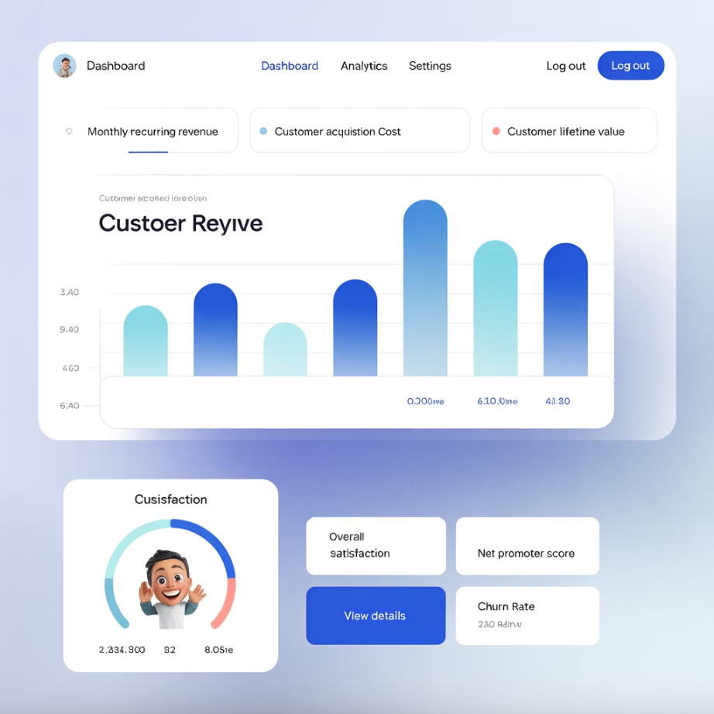

2. Focus on Outcomes, Not Just Output
The traditional focus on sprint completion and velocity metrics, while important, often misses the bigger picture. Teams can achieve 100% sprint completion while delivering features that customers don't use or value.
Outcome-focused retrospectives examine deeper questions:
Customer Impact: Did our work improve the customer experience in measurable ways?
Business Value: How did our deliverables contribute to revenue, cost reduction, or strategic objectives?
Problem Resolution: Did we solve the right problems, or just build the requested features?
Learning Velocity: How quickly are we discovering and acting on new insights about our users and market?
Pro Tip: Replace "Did we finish the sprint?" with "Did we deliver meaningful value?" This simple shift keeps retrospectives tied to business impact rather than just activity completion.
This approach transforms retrospectives from inward-looking process reviews into strategic sessions that connect daily work with organizational success. Teams begin to see themselves as contributors to business outcomes, not just executors of technical tasks.

Slide 9
3. Turn Insights into Action
The gap between good intentions and actual implementation is where most retrospectives fail. Successful teams treat improvement actions with the same rigor as feature development.
01
02
Concrete Action Items
Backlog Integration
Vague commitments like "communicate better" become specific actions like "implement daily 15-minute sync between designers and developers starting Monday." Clear actions have owners, deadlines, and success criteria.
Improvement actions earn spots in the product backlog alongside user stories. This ensures they receive proper prioritization, estimation, and tracking through completion. Treat process improvements as deliverables, not afterthoughts.
03
04
Sprint Commitment
Follow-Through Tracking
Reserve capacity in each sprint for improvement work. High-performing teams allocate 10-20% of their sprint capacity to implementing retrospective actions, ensuring continuous evolution doesn't get crowded out by feature pressure.
Every retrospective begins by reviewing progress on previous improvement actions. This creates accountability and demonstrates the team's commitment to continuous improvement. Incomplete actions are either recommitted or consciously abandoned.

Slide 10
4. Measure the Impact
25%
30%
40%
Quality Improvement
Velocity Gains
Satisfaction Boost
Teams tracking retrospective impact see average 25% reduction in defects within 3 sprints of implementing process changes
Sustained velocity improvements averaging 30% over 6 months when retrospective actions focus on removing impediments
Team satisfaction scores increase by 40% when members see their retrospective suggestions actually implemented
Continuous improvement only works when results are visible and measurable. Teams that track the impact of their retrospective actions create powerful feedback loops that reinforce the value of the practice.
Effective measurement goes beyond basic metrics. Teams track both quantitative indicators (cycle time, defect rates, velocity) and qualitative measures (team satisfaction, stakeholder feedback, customer impact). This comprehensive view ensures improvements address the full spectrum of team effectiveness.
Regular measurement also helps teams learn which types of improvements generate the most significant results, allowing them to focus future retrospectives on the highest-impact opportunities for growth.

Slide 11




The Scrum Master's Transformative Role
Scrum Masters who elevate retrospectives from routine meetings to engines of improvement master four critical capabilities that separate good facilitators from transformation leaders.
Facilitation Excellence
Strategic Prioritization
Expert Scrum Masters create dynamic conversations that surface deeper insights. They use varied retrospective formats, ask probing questions, and ensure every voice is heard. They know when to dig deeper into issues and when to redirect energy toward solutions.
Not every improvement idea should become an action item. Skilled facilitators help teams identify which changes will generate the most significant impact without overwhelming the team's capacity. They balance quick wins with transformational improvements.
Accountability Systems
Organizational Alignment
The best Scrum Masters create systems that ensure follow-through. They track action items, schedule check-ins, and celebrate progress. They make improvement work visible and maintain momentum between retrospectives.
Exceptional Scrum Masters connect team improvements to broader organizational goals. They help teams understand how process enhancements contribute to business objectives, securing support and resources for meaningful changes.

Slide 12

From Talk to Transformation
The most successful Agile teams share a common characteristic: they treat retrospectives as non-negotiable opportunities to evolve. They approach each retrospective with the same energy and preparation they bring to sprint planning or product demos.
These high-performing teams understand that every sprint carries valuable lessons—about their customers, their market, their technology, and themselves. They've learned that applying these lessons systematically, sprint after sprint, creates compound improvements that separate them from competitors.
The transformation happens gradually, then suddenly. Teams that commit to meaningful retrospectives find themselves delivering higher quality work faster, with greater satisfaction and less stress. They become the teams that others want to join and leaders want to emulate.
"Every sprint carries lessons—and applying those lessons systematically is what creates high performance."
The key insight: Retrospectives done well aren't about rehashing the past. They're about shaping the future—one sprint at a time. They're where teams forge their identity as continuous learners and relentless improvers.

Slide 13




Your Next Steps
Ready to transform your retrospectives from routine meetings into powerful engines of continuous improvement? Start with these actionable steps in your very next retrospective.
Assess Your Current State
Review your last three retrospectives. How many action items were actually implemented? What percentage of your discussion focused on business value versus process mechanics? Use this baseline to measure future improvements.
Implement the Three Questions
In your next retrospective, structure discussions around the three essential questions: business value impact, team collaboration effectiveness, and improvement opportunities. Notice how this shifts the conversation.
Create Action Accountability
Choose 1-2 concrete improvements and add them to your product backlog. Assign owners and deadlines. Reserve sprint capacity for implementation. Track progress like any other deliverable.
Measure and Iterate
After three sprints, evaluate the impact of your changes. What improved? What didn't work? Use these insights to refine your retrospective approach and focus on the highest-impact improvements.
Remember: The goal isn't perfect retrospectives—it's consistent progress toward higher performance and greater impact.

