Slide 1
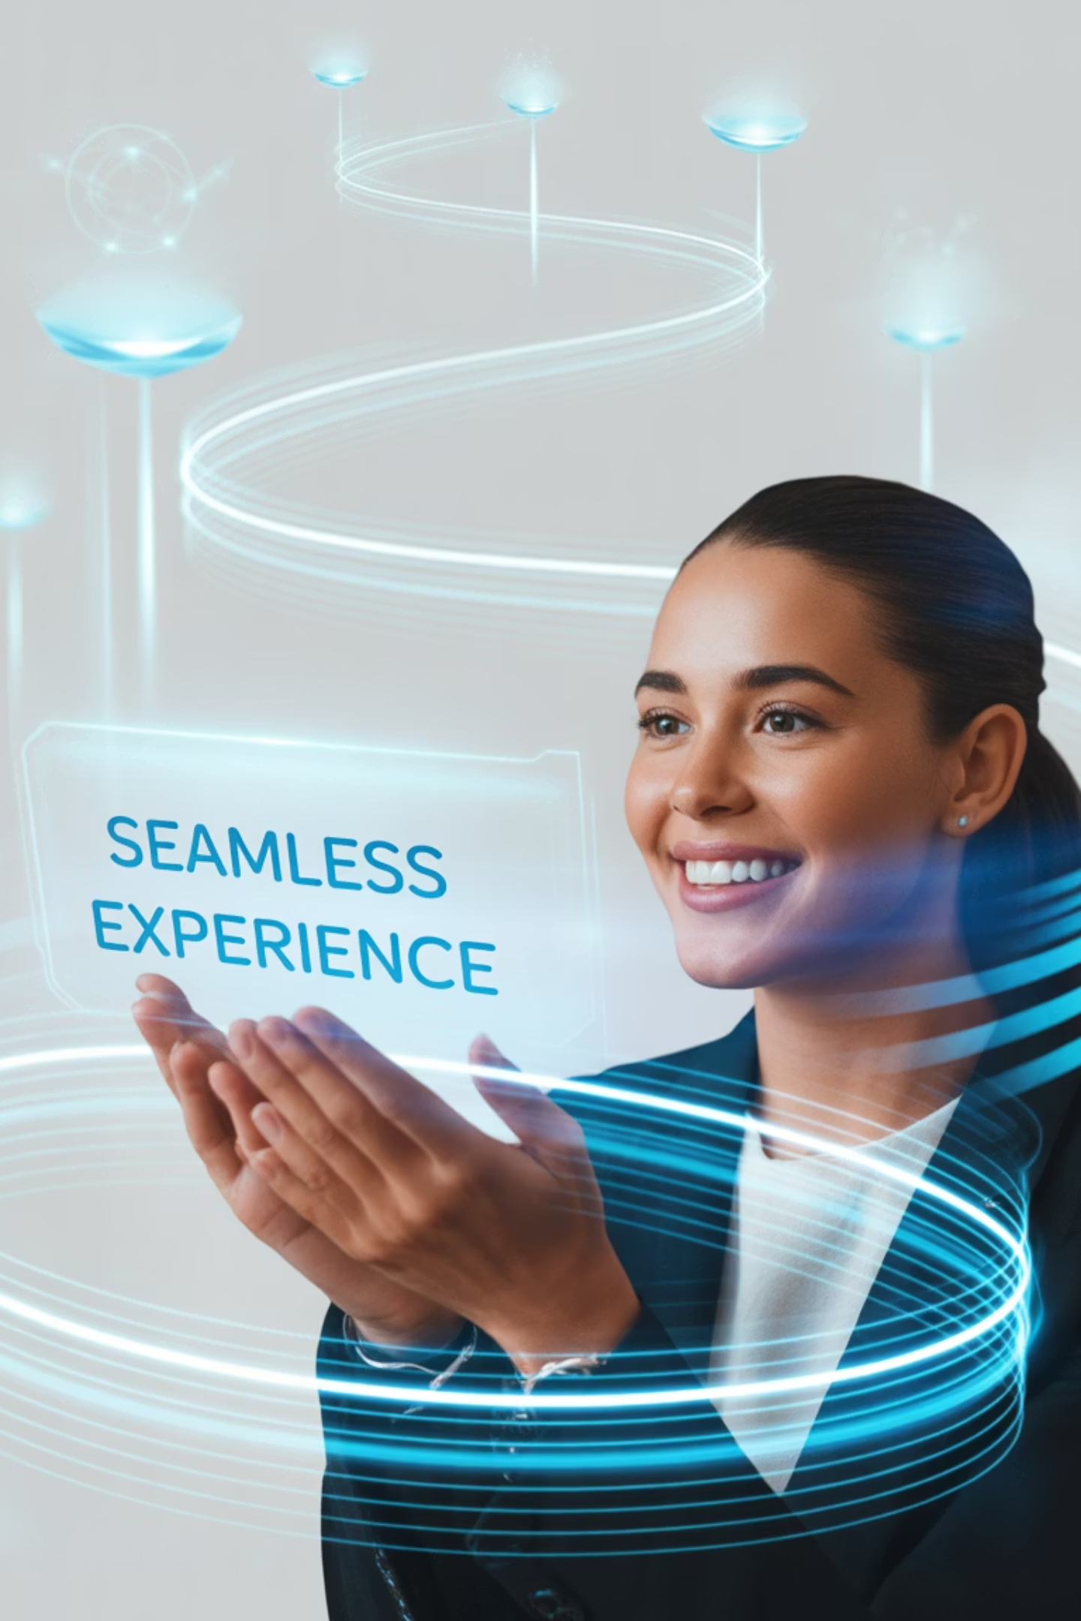
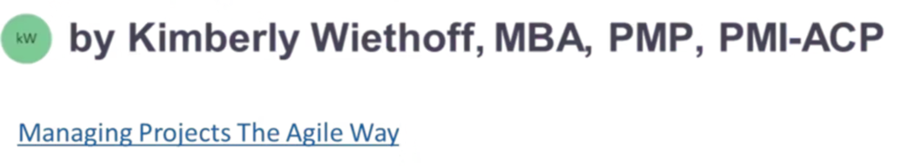
AI-Powered Personalization at Scale
How DXP Platforms are Redefining Customer Journeys
#AIinMarketing #DigitalExperiencePlatforms #AdobeExperienceCloud #Dynamics365 #SalesforceMarketingCloud #EinsteinGPT #MicrosoftCopilot #Personalization #DigitalTransformation #MarketingInnovation

Slide 2

The New Customer Reality
In today's digital marketplace, personalization isn't a luxury—it's the expectation. Modern customers demand brands to anticipate their needs, tailor content in real-time, and create seamless experiences across every touchpoint.
The challenge? Delivering this level of sophistication at enterprise scale across millions of interactions daily. Traditional marketing approaches simply cannot keep pace with these elevated customer expectations.
This is where AI-driven Digital Experience Platforms (DXPs) become game-changers, transforming how enterprises approach customer engagement.

Slide 3
The AI Revolution in Marketing
01
02
03
Traditional Marketing
AI-Powered Marketing
Proactive Orchestration
Manual segmentation rules, reactive campaign adjustments, and one-size-fits-all approaches that struggle to scale effectively.
Predictive behavior modeling, real-time content adaptation, and automated decision-making at enterprise scale.
Every customer interaction feels personal, even when managing millions of touchpoints simultaneously across all channels.
This fundamental shift moves marketing from reactive adjustments to proactive orchestration, where AI anticipates customer needs before they're even expressed.

Slide 4



Core AI Capabilities Transforming Customer Experience
Predictive Behavior Analysis
Real-Time Content Adaptation
Intelligent Automation
AI algorithms analyze vast datasets to predict customer actions—likelihood to churn, convert, or engage with specific content types—enabling proactive intervention strategies.
Dynamic personalization engines adapt emails, advertisements, and product recommendations instantly based on user behavior, preferences, and contextual signals.
Automated decision-making systems handle routine optimizations and campaign adjustments, freeing marketing teams to focus on strategic initiatives and creative innovation.

Slide 5
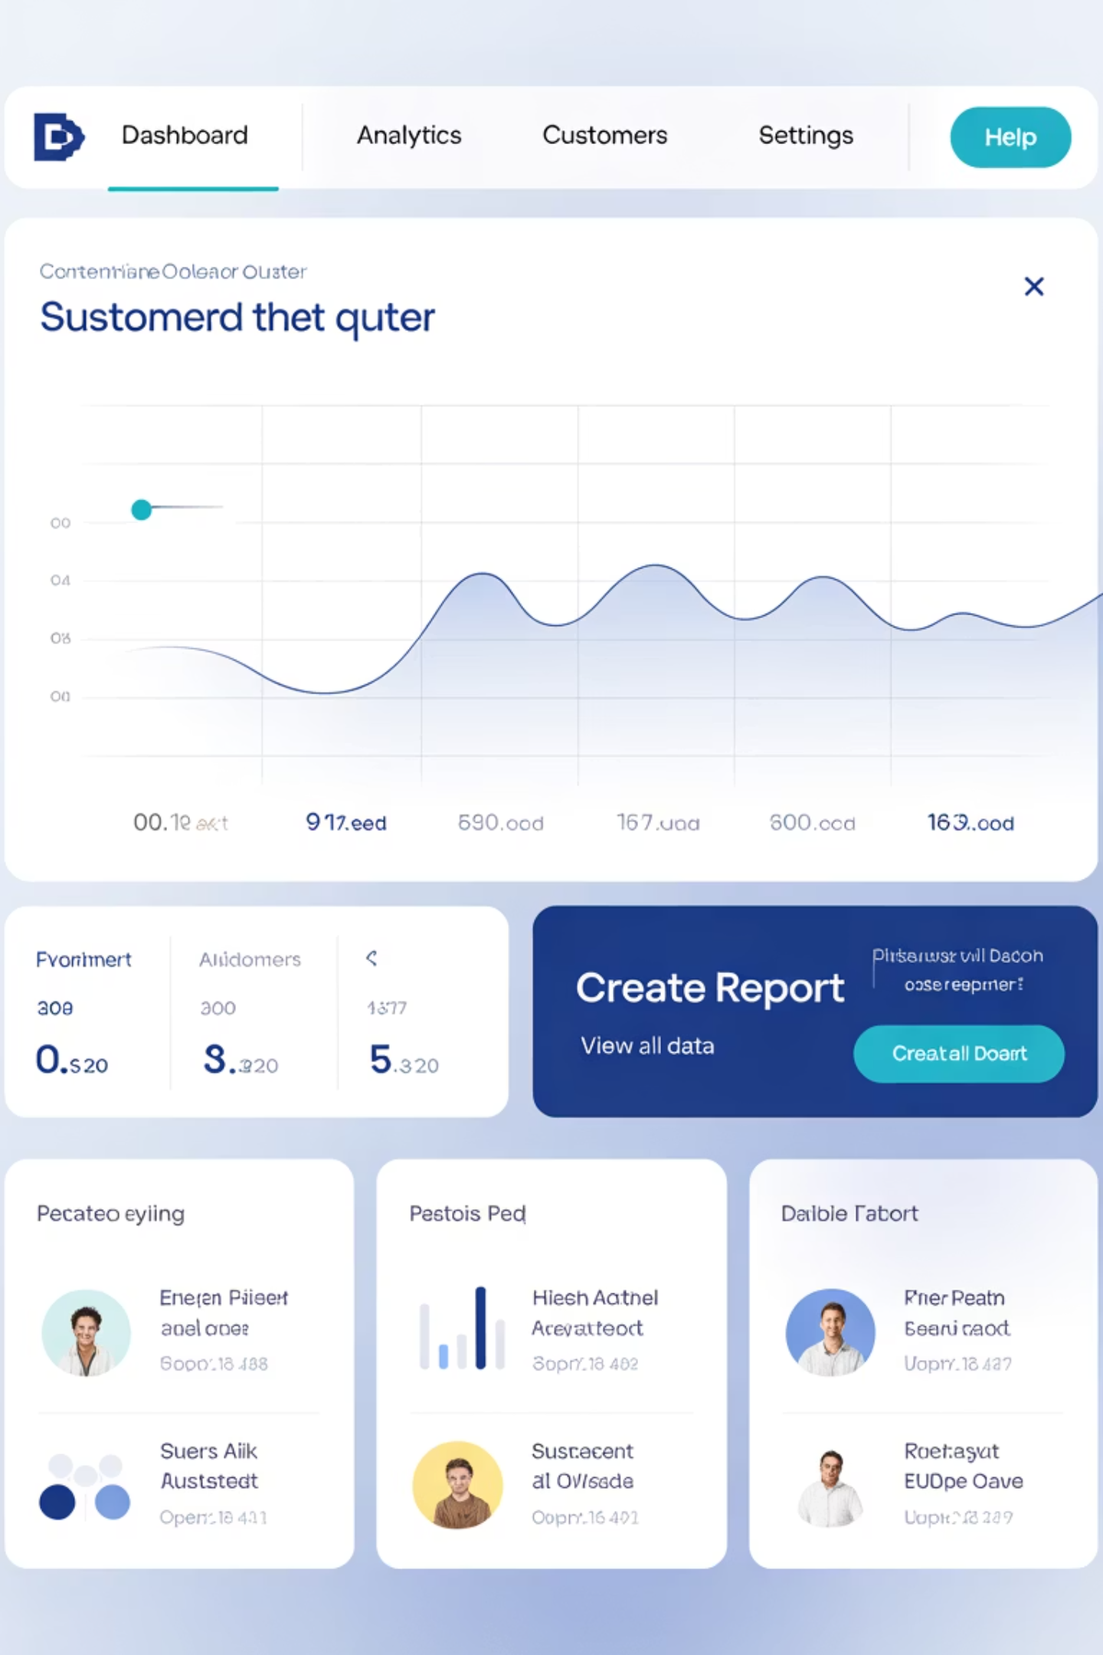



Leading DXP Platforms
Three enterprise-grade platforms are setting the standard for AI-powered customer experience delivery:
Adobe Experience Cloud
Data-driven precision through unified customer data platforms and robust analytics integration
Microsoft Dynamics 365 Copilot Studio
Human + AI collaboration with natural language interfaces and enterprise ecosystem integration
Salesforce Marketing Cloud Einstein GPT
Conversational intelligence with AI-powered content generation and predictive scoring capabilities

Slide 6
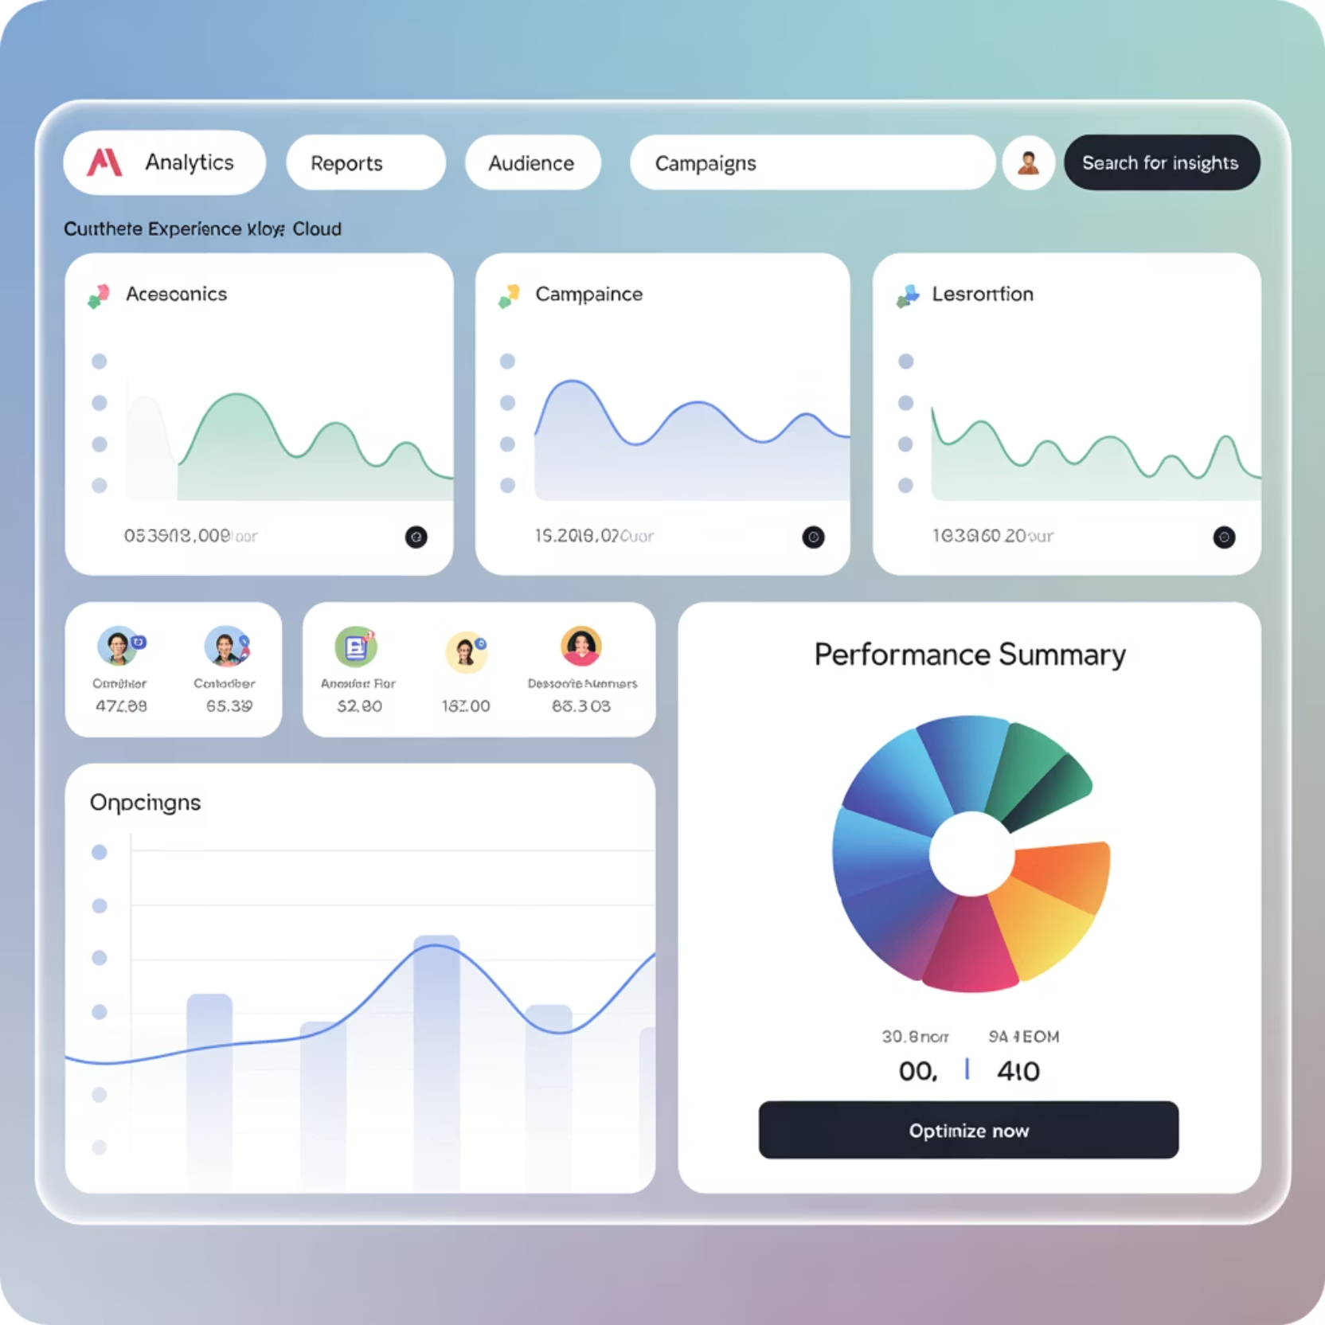

Adobe Experience Cloud: Data-Driven Precision
Powered by Adobe Sensei AI
Adobe's competitive advantage lies in its ability to unify massive volumes of customer data into actionable insights. The platform excels at creating experiences that feel curated and personal.
AI-powered product recommendations that increase conversion rates
Automated content optimization through intelligent A/B testing
Cross-channel preference prediction spanning web, email, and mobile
The result? Personalization driven by a robust Customer Data Platform (CDP) with deep analytics integration.
Key Strength: Adobe's unified data approach enables marketers to create consistent, personalized experiences across all customer touchpoints.

Slide 7
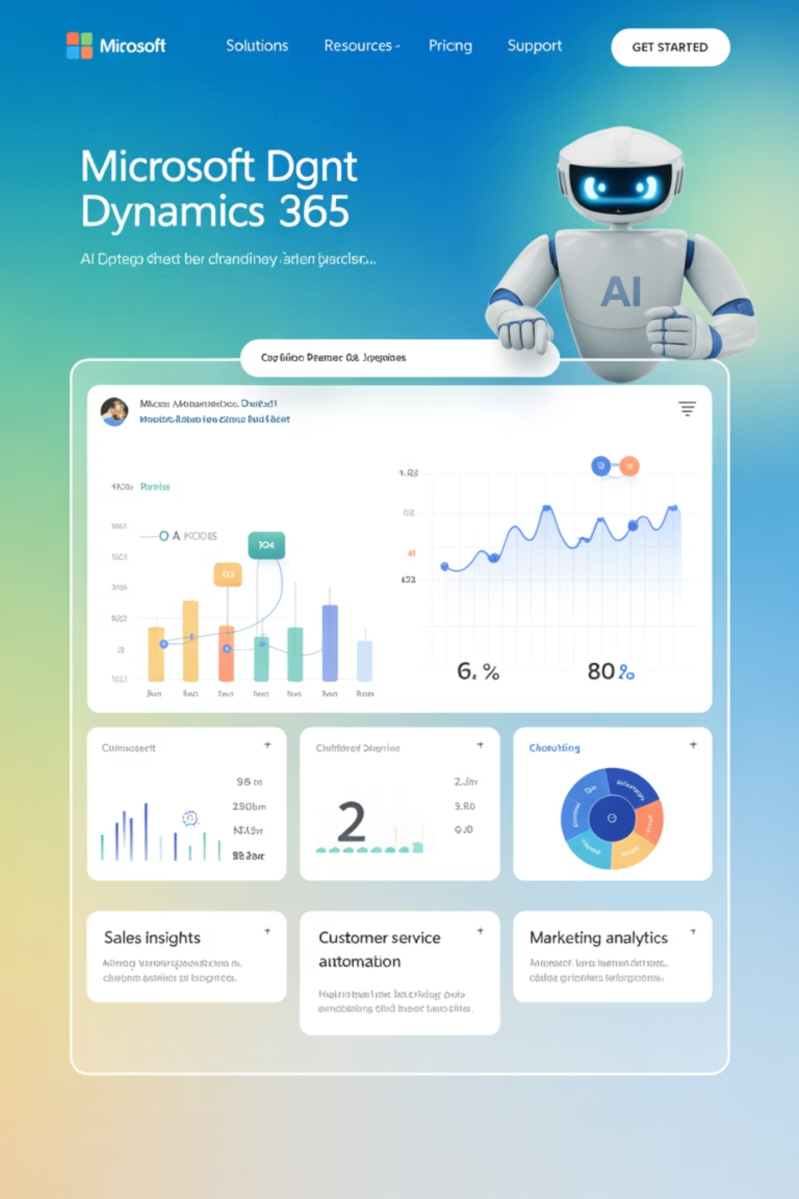



Microsoft Dynamics 365 Copilot Studio
Microsoft has embedded AI copilots throughout its ecosystem, revolutionizing how marketers interact with their platforms through natural language interfaces.
Natural Language Marketing
Generate customer journey maps and campaign strategies through conversational AI assistance
CRM Integration
Automate campaign design based on enterprise CRM data and customer intelligence
Real-Time Guidance
Provide instant recommendations for next best actions across customer touchpoints
What sets Dynamics apart is its seamless integration with Teams, Outlook, and Power Platform—ensuring marketing alignment with sales, service, and operations.

Slide 8
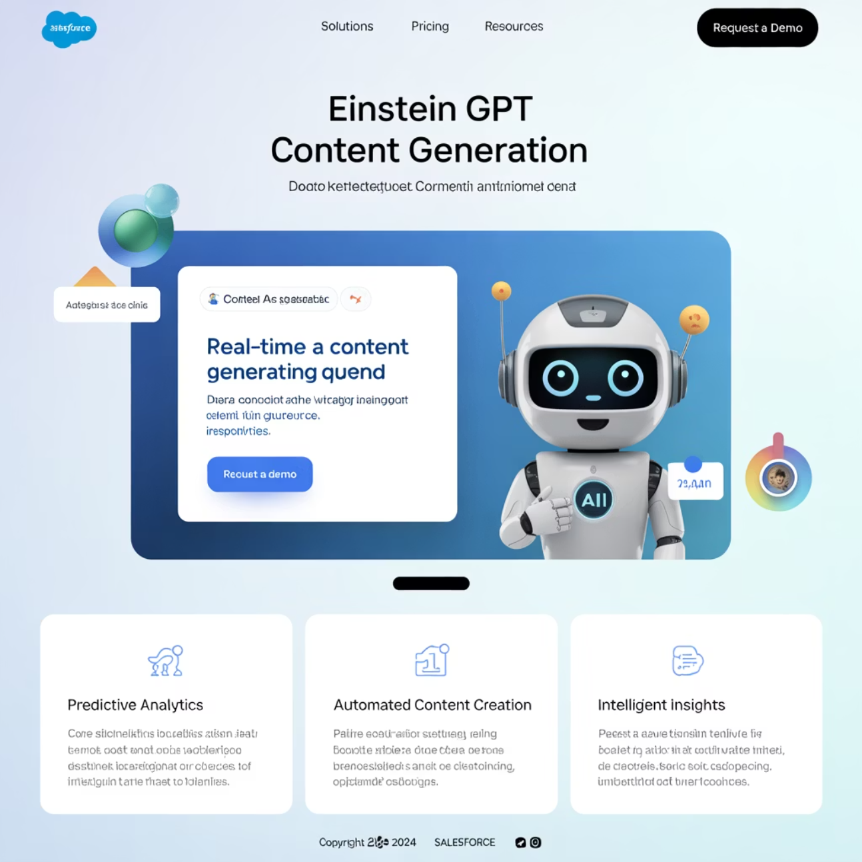
Salesforce Marketing Cloud Einstein GPT
Salesforce has infused Einstein GPT into every aspect of Marketing Cloud, bringing conversational intelligence to enterprise-scale customer engagement.
Instant Content Generation
Predictive Lead Scoring
Identify high-value leads and accounts using advanced predictive analytics
Create campaign content—emails, social posts, advertisements—instantly with AI assistance
Real-Time Personalization
Enable dynamic personalization across the full Salesforce ecosystem
Einstein GPT's advantage: Scale + conversation—bringing AI-powered personalization directly into customer-facing engagements.

Slide 9
Platform Comparison: Strengths & Focus Areas
Capability
Adobe Experience Cloud
Microsoft Dynamics 365
Salesforce Einstein GPT
Data Unification
Industry-leading CDP
CRM-centric approach
Ecosystem integration
AI Interface
Visual analytics
Natural language copilots
Conversational intelligence
Content Creation
Automated optimization
Template generation
Instant AI content
Integration Strength
Creative suite alignment
Microsoft 365 ecosystem
Sales & service unity
Each platform excels in different areas, making the choice dependent on existing technology stack and organizational priorities.

Slide 10
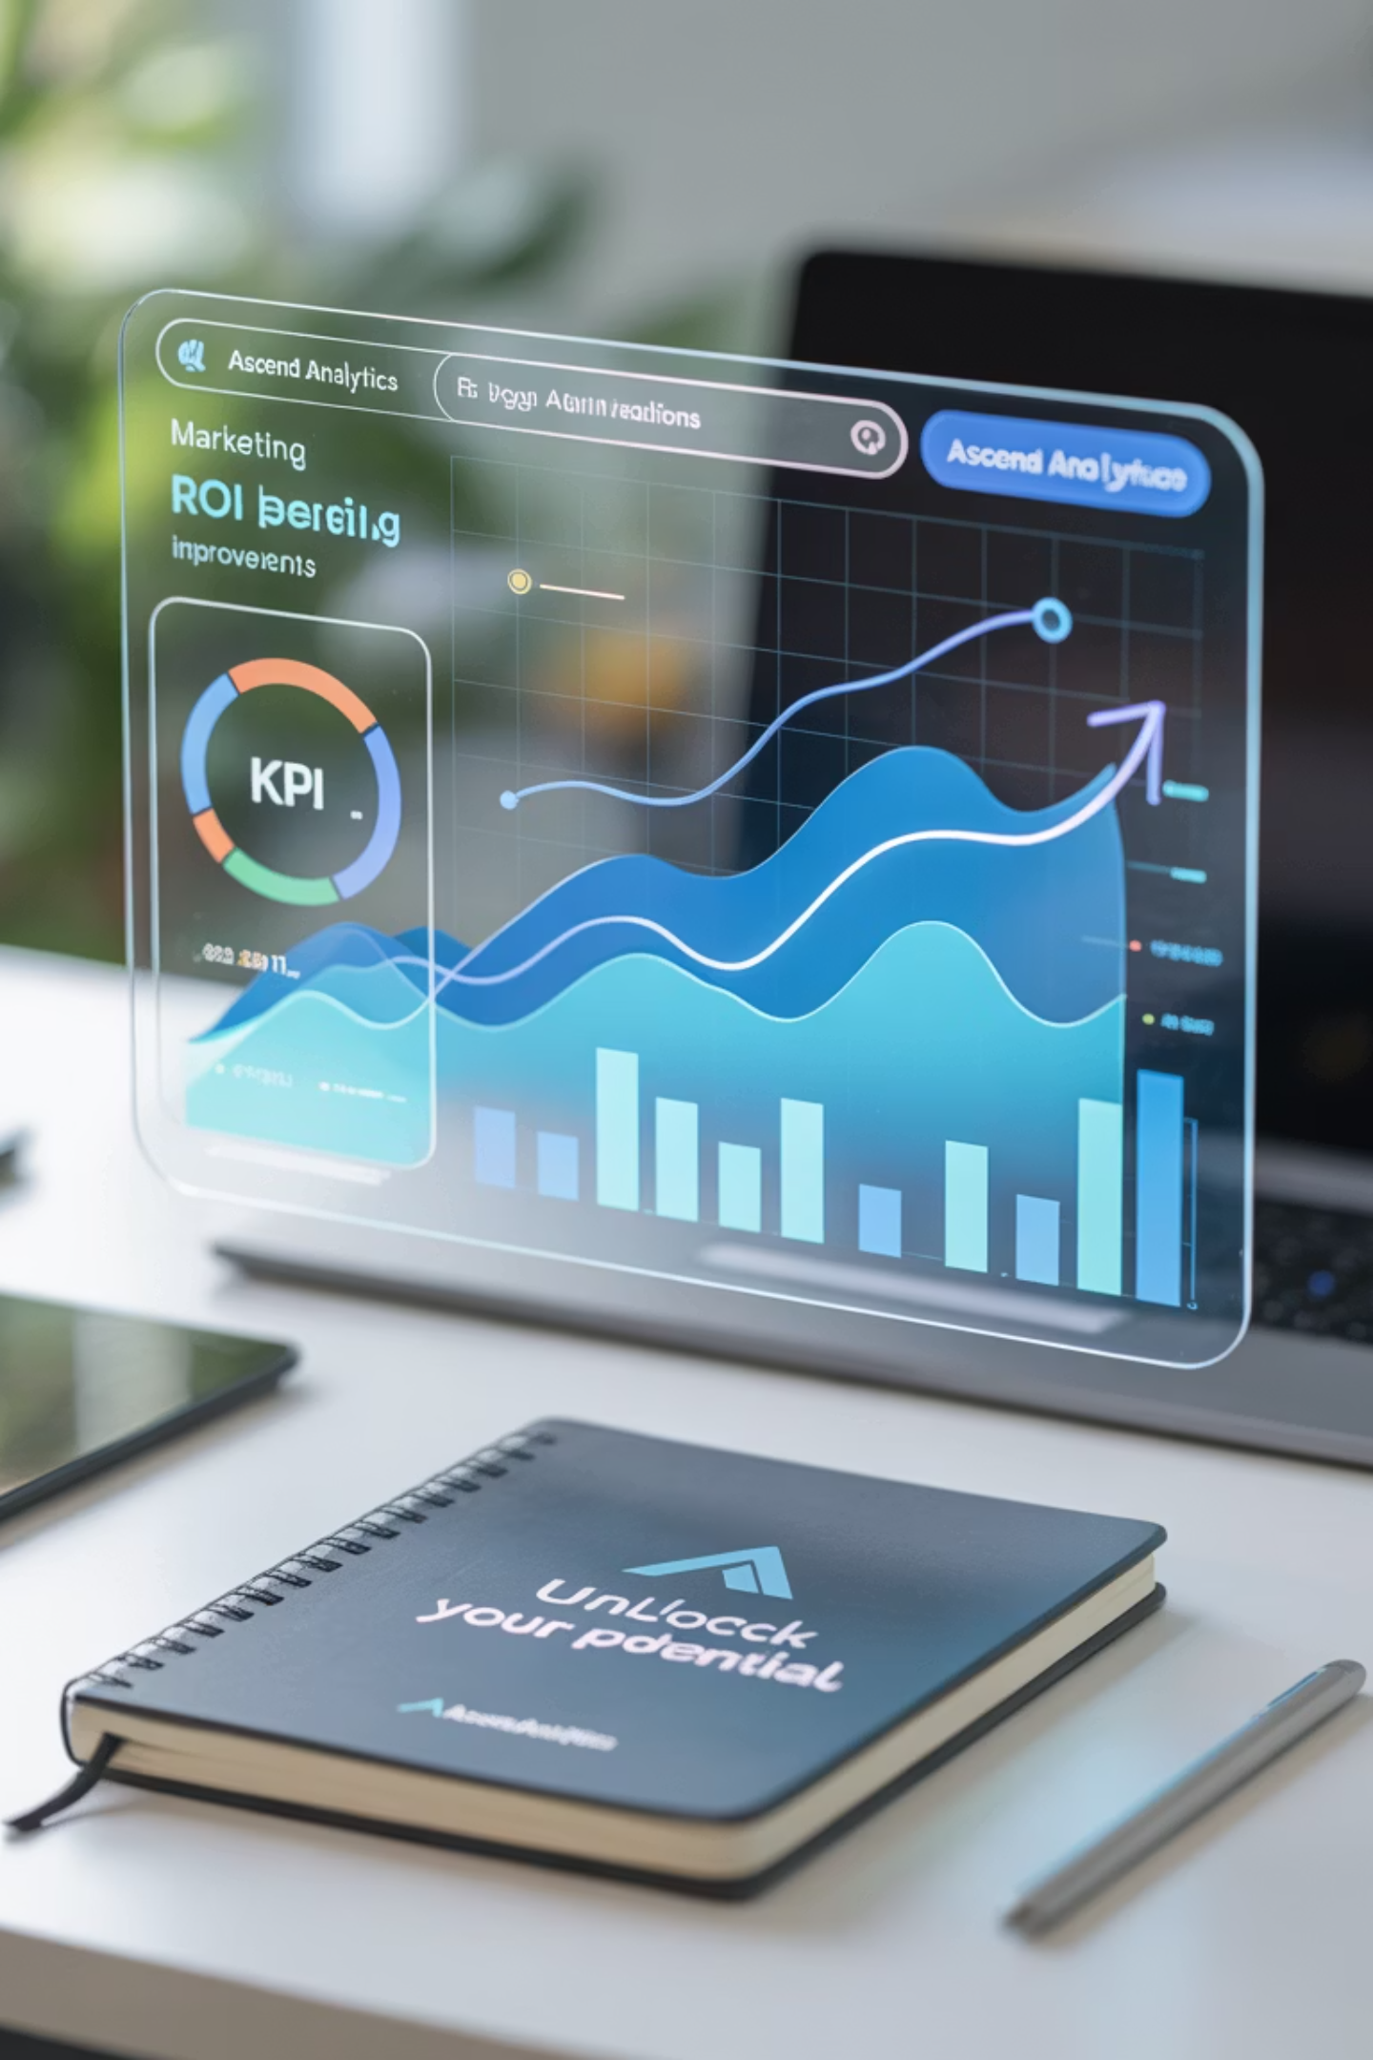
Strategic Business Impact
When deployed effectively, AI-driven DXPs deliver measurable enterprise value across key performance indicators:
3x
40%
Engagement Increase
Efficiency Gain
Personalized experiences drive higher customer engagement across all touchpoints
Automated decision-making reduces manual campaign management overhead
25%
65%
Revenue Growth
Cost Reduction
Predictive insights and personalization directly impact conversion rates
AI optimization reduces wasted ad spend and improves resource allocation

Slide 11









Implementation Success Factors
For program and project leaders, success requires orchestrating the right combination of technology, people, and processes:
Data Foundation
Cross-Functional Teams
Clean, unified customer data across all touchpoints and systems
Marketing, IT, and analytics teams working in alignment
Continuous Optimization
Governance Models
Regular model training and performance improvement cycles
Clear processes for AI decision-making and content approval
Critical Success Factor: The challenge is no longer choosing the right platform—but orchestrating people, processes, and governance models that turn AI capabilities into sustained business outcomes.

Slide 12

ROI & Competitive Advantage
Quantifiable Benefits
Consistency: Unified experiences across marketing, sales, and service touchpoints
Scalability: Personalization without proportional headcount increases
Intelligence: Data transforms into predictive and prescriptive insights
Efficiency: Resources focused on high-value opportunities
Organizations implementing AI-powered DXPs report significant improvements in customer satisfaction scores and marketing attribution accuracy.
"AI-driven personalization has transformed our customer engagement from reactive to predictive. We're now anticipating customer needs rather than responding to them."

Slide 13
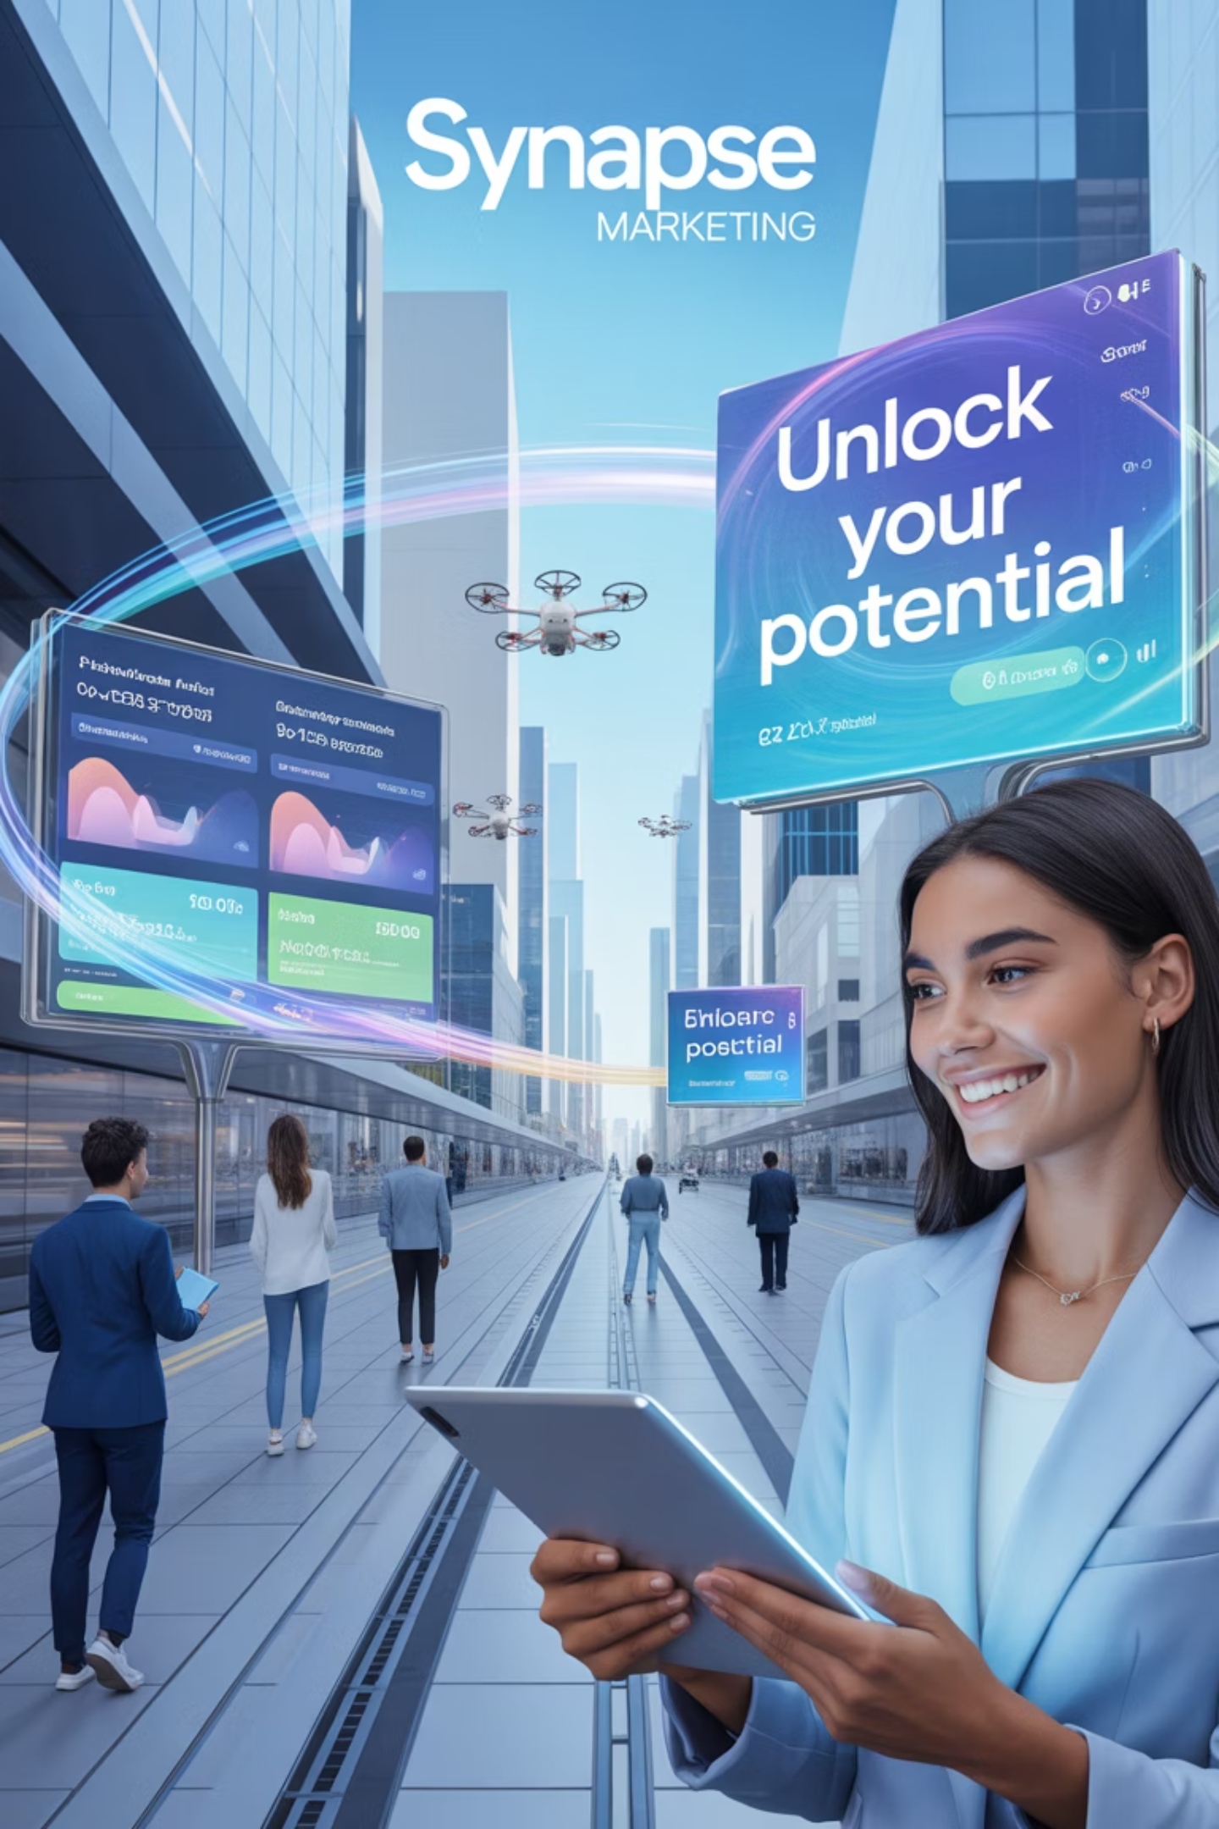
The Future is Now
AI is no longer a "feature"—it's the foundation of modern customer engagement
Adobe Experience Cloud
Microsoft Dynamics 365
Data-driven precision for unified customer experiences
Natural language AI collaboration across enterprise systems
Salesforce Einstein GPT
Conversational intelligence at enterprise scale
By leveraging these platforms strategically, enterprises can move from vision to reality—delivering personalization at scale that feels authentic, relevant, and timely.
The question isn't whether to embrace AI-powered DXPs, but how quickly you can transform your customer engagement strategy to meet tomorrow's expectations today.

