Slide 1

Optimizing Warehouse Management: RFID SaaS Solutions Comparison
As warehouse operations continue to evolve, RFID technology has become a critical component of efficient inventory management. Selecting the right Software as a Service (SaaS) solution to support RFID functionality is essential for real-time tracking, data analysis, and process automation.
This presentation compares leading SaaS vendors offering RFID-enabled solutions for warehouse management, analyzing their features, benefits, and potential limitations to help you make an informed decision for your operation.
kW
by Kimberly Wiethoff

Slide 2








Essential Evaluation Criteria for RFID SaaS Solutions
Strategic Value
ROI and competitive advantage
Security & Compliance
Data protection and industry standards
Integration & Technical Fit
Compatibility with existing systems
Operational Foundations
Scalability, deployment ease, and support
Selecting the right RFID SaaS vendor requires evaluating multiple criteria across these four levels. The foundation starts with operational capabilities like scalability and ease of deployment. Technical integration with existing WMS and ERP systems forms the next level, followed by security considerations. At the top, assess the strategic value each solution brings to your warehouse operations.

Slide 3
Cost Structure Analysis: RFID SaaS Pricing Models
Subscription-Based
Usage-Based
Tiered Licensing
Monthly or annual fees based on user counts or warehouse size. Typically includes regular updates and basic support. Offers predictable operating expenses without large upfront costs.
Charges based on transaction volume, number of RFID tags processed, or data storage requirements. Scales directly with your operations and allows you to pay only for what you use.
Different feature packages at various price points. Allows warehouses to start with essential functionality and add premium features as needs evolve, providing flexibility for growth.
When evaluating different pricing models, consider not just the immediate costs but the total cost of ownership over a 3-5 year period. Factor in implementation costs, hardware requirements, training expenses, and potential customization fees that may not be included in the base pricing.

Slide 4




Impinj: RFID Specialist with Cloud Architecture
Cloud-Based Platform
Advanced Analytics
Highly scalable architecture capable of processing billions of RFID events daily with minimal latency, ensuring real-time inventory visibility even during peak operational periods.
Proprietary algorithms that transform raw RFID data into actionable insights, including inventory velocity metrics, dwell time analysis, and predictive stockout warnings.
Hardware Ecosystem
Developer-Friendly APIs
Comprehensive suite of readers, antennas, and tags designed to work seamlessly together, reducing integration complications and optimizing read accuracy in dense warehouse environments.
Robust API library allowing for custom integrations with existing warehouse systems and enabling specialized workflow automations tailored to unique operational requirements.
Impinj specializes exclusively in RFID solutions, making them particularly well-suited for warehouses prioritizing advanced RFID capabilities over broader WMS functionality. Their platform excels in high-volume environments where tag read accuracy and processing speed are critical concerns.

Slide 5








SOTI Connect: IoT Management Platform with RFID Support
Remote Management
Diagnostics
Control RFID devices from anywhere
Proactive issue identification
Analytics
Automation
Performance and operational insights
Rule-based operational workflows
SOTI Connect differentiates itself through comprehensive IoT device management, treating RFID readers as part of a broader connected ecosystem. The platform excels at monitoring device health and performance, allowing IT teams to proactively address potential hardware issues before they impact operations.
For warehouses managing a diverse set of connected devices beyond just RFID equipment, SOTI offers unified management capabilities that can significantly reduce IT complexity and maintenance overhead.

Slide 6

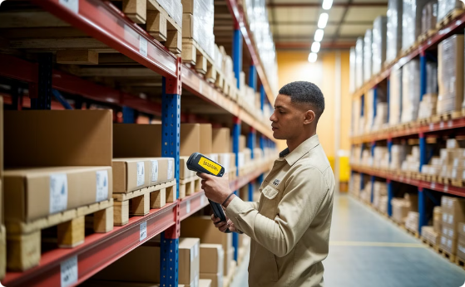

Zebra MotionWorks: End-to-End RFID Asset Tracking
Real-Time Location Services
Hardware Integration
Workforce Analytics
Zebra's proprietary location engine provides sub-meter positioning accuracy, enabling precise tracking of assets throughout the warehouse. The system updates locations in near real-time, giving managers immediate visibility into inventory movements.
As both a hardware and software provider, Zebra offers tightly integrated scanners, printers, and mobile computers that work seamlessly with the MotionWorks platform, eliminating many of the compatibility issues found with multi-vendor solutions.
Beyond asset tracking, MotionWorks provides insights into labor movement and efficiency. The system can identify bottlenecks in warehouse processes and suggest workflow optimizations based on actual movement data.
Zebra's strength lies in its complete ecosystem approach, offering end-to-end solutions that include both the software platform and the physical RFID hardware. This integration reduces implementation complexity but may limit flexibility for warehouses with existing non-Zebra equipment.

Slide 7
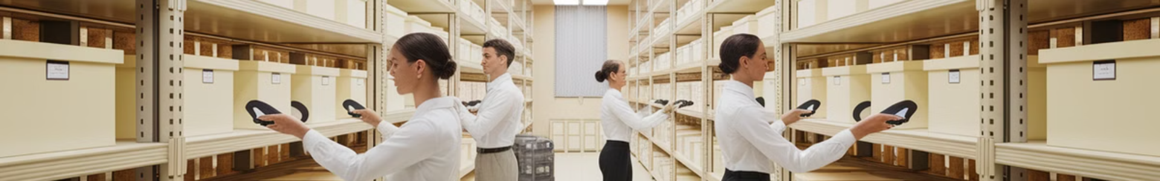




Fishbowl Inventory: RFID-Enhanced WMS for SMBs
Receiving
Inventory Control
Order Fulfillment
Reporting
Automated RFID scanning during intake process
Real-time stock level monitoring and alerts
Guided picking with RFID verification
Comprehensive inventory analytics
Fishbowl Inventory targets small to mid-sized businesses seeking to implement RFID without the complexity and cost of enterprise solutions. The platform emphasizes ease of use with intuitive interfaces and guided workflows, making it accessible to warehouse teams without extensive technical training.
While lacking some of the advanced features of enterprise-grade solutions, Fishbowl offers excellent value for smaller operations, particularly those transitioning from manual or barcode-based systems to RFID technology for the first time.

Slide 8




Oracle NetSuite WMS: Enterprise-Grade RFID Integration
Unified Data Architecture
Seamless integration between RFID data and core ERP functions creates a single source of truth for inventory across the entire enterprise, eliminating data silos and reconciliation issues.
Multi-Location Support
Sophisticated handling of complex warehouse networks allows synchronized inventory management across multiple facilities, supporting cross-docking and transfer optimization.
Role-Based Access
Granular permission controls enable appropriate access levels for different warehouse roles, from associates to managers, ensuring data security while providing necessary visibility.
Automation Engine
Advanced workflow automation capabilities allow for complex conditional processes triggered by RFID events, creating highly efficient warehouse operations with minimal manual intervention.
Oracle NetSuite WMS represents the high end of the RFID SaaS market, offering enterprise-grade capabilities integrated within a comprehensive ERP ecosystem. This solution is particularly well-suited for large organizations managing complex supply chains across multiple warehouse locations.

Slide 9
Integration Capabilities Comparison
Vendor
API Quality
ERP Connectors
WMS Integration
IoT Support
Impinj
Excellent
Limited
Good
Excellent
SOTI Connect
Good
Moderate
Moderate
Excellent
Zebra MotionWorks
Good
Good
Excellent
Good
Fishbowl
Basic
Limited
N/A (is a WMS)
Limited
Oracle NetSuite
Excellent
Excellent
N/A (is a WMS)
Good
Integration capabilities vary significantly across vendors. Impinj offers superior IoT and RFID-specific integrations but has more limited ERP connections. SOTI Connect excels in managing diverse device ecosystems but offers moderate WMS integration. Zebra provides excellent WMS integration, particularly with its own hardware.
Fishbowl, as an entry-level solution, offers more basic integration capabilities, while Oracle NetSuite provides enterprise-grade connectivity across all systems but with corresponding implementation complexity.

Slide 10




Security and Compliance Considerations
Data Encryption
Compliance Certifications
Access Controls
Cloud Security
Evaluate whether the vendor employs end-to-end encryption for RFID data in transit and at rest. Enterprise-grade solutions should utilize AES-256 encryption and secure key management practices to protect sensitive inventory information.
Assess the granularity of permission settings, support for multi-factor authentication, and ability to create role-based access profiles. Robust audit logging capabilities are essential for tracking who accessed inventory data and when.
For cloud-based solutions, investigate the vendor's data center security, backup procedures, and disaster recovery capabilities. Regular penetration testing and vulnerability assessments demonstrate commitment to security.
Look for vendors with relevant certifications like SOC 2 Type II, ISO 27001, and industry-specific compliance such as GDPR or CCPA if you operate internationally. These certifications verify that vendors maintain appropriate security controls.
When handling inventory data through RFID systems, security cannot be an afterthought. The right solution should protect not only your inventory information but also any connected customer or supply chain data that flows through the system.

Slide 11




Implementation Strategy: Pilot Testing Approach
Define pilot scope
Select specific area and inventory types
Establish timeline and metrics
Set clear objectives and KPIs
Train warehouse personnel
Develop skills for new system
Evaluate and scale
Measure results against baseline
A structured pilot testing approach reduces implementation risk when deploying RFID SaaS solutions. Begin by defining a limited scope that covers key warehouse processes without disrupting the entire operation. Select a representative inventory sample that includes various product types and packaging materials to test read accuracy across your full inventory range.
During the pilot, maintain parallel systems to compare performance against your baseline metrics. Document challenges encountered and work closely with the vendor to resolve issues before proceeding to full-scale implementation. This methodical approach prevents costly mistakes and builds internal expertise.

Slide 12
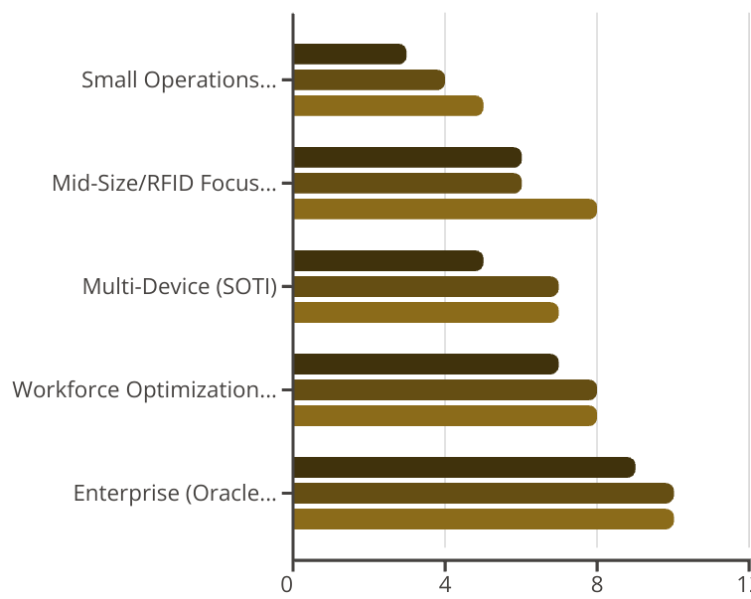
Final Vendor Recommendations by Warehouse Profile
The optimal RFID SaaS solution depends significantly on your warehouse profile and specific requirements. For small operations with straightforward inventory tracking needs, Fishbowl offers the best balance of functionality and cost. Mid-sized warehouses specifically focused on RFID capabilities will find Impinj's specialized platform most effective.
SOTI Connect excels in environments managing diverse IoT devices beyond just RFID readers. Zebra MotionWorks is ideal for operations prioritizing workforce optimization alongside inventory tracking. For enterprise-scale warehouses with complex integration requirements, Oracle NetSuite's comprehensive but costlier solution provides the most robust capabilities despite higher implementation complexity.
Implementation Complexity S...
Relative Cost (1-10)
Feature Richness (1-10)

