Slide 1

NetSuite for Project Managers: Functionality, Capabilities, and Implementation Best Practices
As a Project Manager implementing NetSuite, you need a clear understanding of its functionality, capabilities, and best practices to ensure a smooth rollout. NetSuite, a cloud-based ERP solution, provides powerful tools for financials, resource planning, inventory management, and project tracking—making it a valuable asset for businesses across industries.
This guide will walk you through the key NetSuite features for project management, its benefits, and best practices for a successful implementation.
kW
by Kimberly Wiethoff

Slide 2
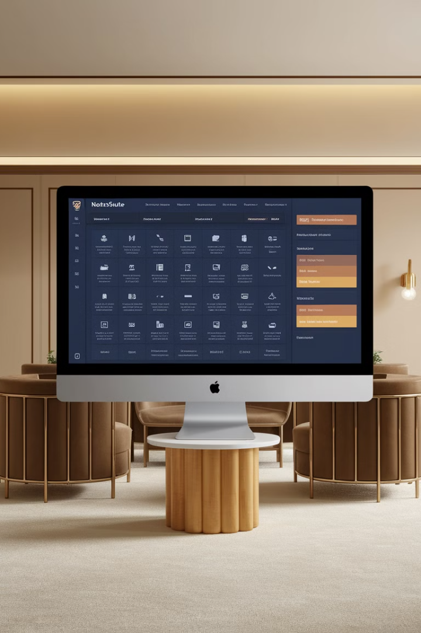
What is NetSuite?
1
Cloud-based ERP Platform
NetSuite is designed to integrate multiple business processes into a single system, including Financial Management, Customer Relationship Management (CRM), Human Capital Management (HCM), Supply Chain & Inventory Management, and Project & Resource Management.
2
Project Management Tools
For Project Managers, NetSuite provides robust tools to manage project timelines and deliverables, resource allocation and capacity planning, financial forecasting and budgeting, and billing, invoicing, and revenue recognition.

Slide 3




NetSuite Project Management Module
Gantt Charts
Role-based Dashboards
Automated Workflows
Track project milestones and task dependencies visually.
Access real-time project insights tailored to specific roles.
Streamline approvals and task assignments for increased efficiency.
The NetSuite Project Management Module helps PMs track project progress, allocate resources, and manage budgets effectively. These features provide a comprehensive view of project health and streamline project management processes.

Slide 4
Resource Management in NetSuite
Resource Allocation Tools
Time Tracking Integration
Forecasting Capabilities
Efficiently assign and balance workloads across teams based on availability and skills. This ensures optimal resource utilization and prevents overallocation.
Seamlessly integrate time tracking for accurate billing and payroll processing. This feature ensures that all project hours are accounted for and properly billed.
Anticipate resource needs in advance, allowing for proactive staffing decisions and better long-term project planning.

Slide 5

Financial Management & Budgeting
Real-time Tracking
Automated Invoicing
Monitor project costs, budgets, and profitability in real time, allowing for quick adjustments and informed decision-making.
Streamline invoicing and revenue recognition based on project milestones, improving cash flow and financial accuracy.
Multi-currency Support
Manage multi-currency and multi-subsidiary accounting for global operations, simplifying complex financial scenarios.

Slide 6

Timesheet & Expense Tracking
1
Submission
Employees submit time and expense reports directly in NetSuite, streamlining the process and reducing errors.
2
Approval
Project Managers can easily approve, track, and bill project-related expenses, maintaining control over project costs.
3
Integration
Seamless integration with payroll ensures accurate compensation based on project hours, simplifying administrative tasks.

Slide 7
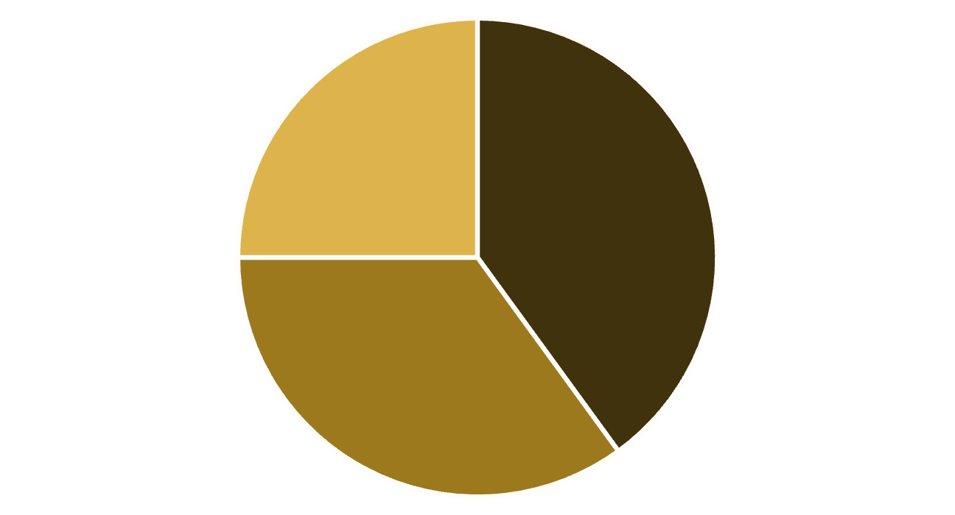
Reporting & Analytics in NetSuite
Project Health Metrics
Custom Reports
AI-powered Insights
NetSuite's custom dashboards provide comprehensive reporting and analytics capabilities. Project health metrics, including burn rates and budget utilization, give real-time insights. Custom reports for project profitability, expenses, and resource utilization offer detailed analysis. AI-powered insights predict project risks and suggest optimizations, enhancing decision-making.

Slide 8
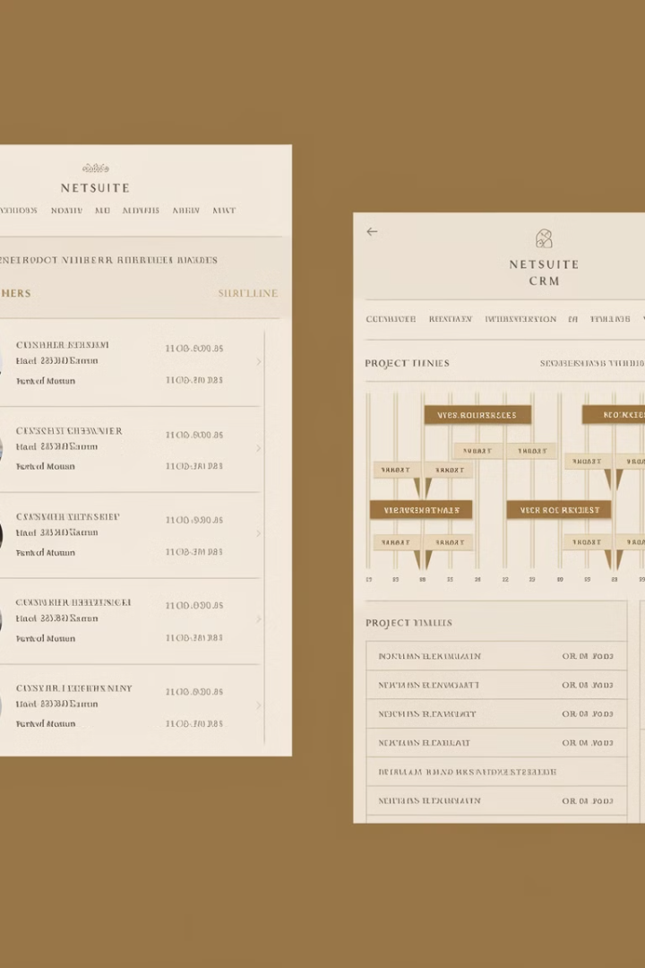



NetSuite CRM & Sales Integration
Align Project Timelines
Synchronize project timelines with customer expectations, ensuring deliverables meet client needs.
Automate Contract Renewals
Streamline contract renewals and billing cycles, improving customer relationships and cash flow.
Visibility into Project Costs
Provide clear insights into project costs for more accurate client pricing and improved profitability.

Slide 9




Benefits of NetSuite for Project Management
One Integrated System
Cloud-Based Access
Scalability
Eliminates siloed data by unifying project, financial, and resource management.
Secure, remote accessibility for globally distributed teams.
Supports businesses of all sizes, from startups to enterprises.
Real-Time Visibility
Provides live data updates, ensuring better decision-making.
NetSuite offers numerous benefits for project management, including automation and efficiency through reduced manual tasks and automated workflows and approvals.

Slide 10

Best Practices for Implementing NetSuite
Define Clear Objectives
Align business goals with NetSuite capabilities, identify core pain points, required customizations, and key stakeholders.
Engage Stakeholders Early
Include Finance & Accounting, HR & Resource Managers, and IT Teams in the implementation process.
Configure, Customize & Test
Start with standard features, conduct pilot testing, and use sandbox environments for validation.
Data Migration Strategy
Perform data cleansing, map fields correctly, and run parallel testing to validate data.

Slide 11
Training and Optimization
Train End-Users & Drive Adoption
Monitor Performance & Optimize
Develop training sessions and knowledge bases for different user roles. Offer ongoing support to address issues post-launch and gather feedback for continuous improvement.
Set KPIs to measure NetSuite's impact on project efficiency and cost control. Use dashboards and analytics to drive continuous improvement and stay updated on NetSuite enhancements.

Slide 12




Is NetSuite Right for Your Projects?
Unparalleled Visibility
Automation Capabilities
1
Gain comprehensive insights across all project aspects.
Streamline operations and reduce manual tasks.
2
Long-term Value
4
Integration Features
Drive successful implementations with lasting benefits.
3
Connect all business processes in one platform.
For Project Managers handling complex implementations, NetSuite offers powerful tools to manage financials, resources, and project timelines. By following best practices and leveraging NetSuite's full potential, PMs can drive successful implementations that deliver long-term value.

