Slide 1
Kanban vs. Scrum: Choosing the Right Agile Path
In today's fast-paced project environments, choosing the right Agile methodology is crucial for success. This presentation explores the key differences between Scrum and Kanban frameworks.
kW
by Kimberly Wiethoff

Slide 2
Agile Fundamentals
Value Delivery
Prioritizing customer value above all
Continuous Improvement
Consistently refining processes
Team Collaboration
Cross-functional teams working together
Transparency
Visibility into all work processes
Both Scrum and Kanban share these core Agile principles. They differ in how they implement these fundamentals.

Slide 3
Scrum Framework Overview
Defined Roles
Time-Boxed Iterations
Scrum Master, Product Owner, and Development Team work together with clear responsibilities.
Work organized into sprints, typically 2-4 weeks long with fixed commitments.
Structured Ceremonies
Sprint Planning, Daily Stand-ups, Sprint Reviews, and Retrospectives provide rhythm.
Scrum provides a structured framework with clear boundaries and expectations.

Slide 4
Kanban Framework Overview
Visualize Work
Make all work visible on a Kanban board
Limit WIP
Restrict work in progress to improve flow
Manage Flow
Optimize for smooth delivery of items
Improve Continuously
Use metrics to guide incremental changes
Kanban emphasizes visualizing workflow and optimizing the flow of work items.

Slide 5
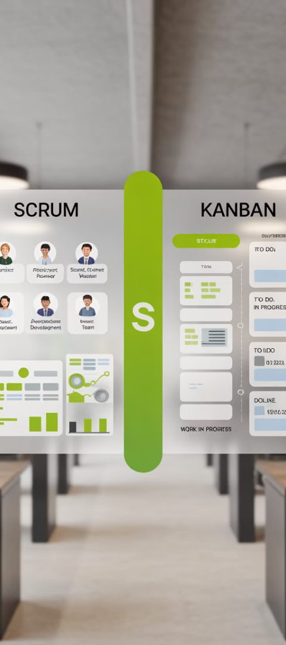
Head-to-Head Comparison
Feature
Scrum
Kanban
Iterations
Fixed sprints (2-4 weeks)
Continuous flow
Roles
3 defined roles
No mandatory roles
Commitments
Sprint backlog is fixed
Can change priorities anytime
Metrics
Velocity, burndown charts
Lead time, cycle time, throughput
Changes
Not during sprint
Anytime
These differences highlight how each framework handles work management, roles, and flexibility.

Slide 6
When to Choose Scrum
New Product Development
When building products with defined releases and features.
Teams Needing Structure
For teams that benefit from clear roles and responsibilities.
Predictable Delivery Cycles
When stakeholders need regular, predictable delivery windows.
Cross-Functional Teams
When a team has all skills needed to deliver end-to-end.
Scrum provides the framework needed for complex product development with many unknowns.

Slide 7
When to Choose Kanban
Support & Operations
For teams handling incoming requests with varying priorities.
Unpredictable Work
When work items and priorities change frequently.
Process Improvement Focus
For teams focused on optimizing workflow and reducing bottlenecks.
Specialized Teams
When work requires handoffs between specialized teams.
Kanban excels in environments where flow is more important than iteration boundaries.

Slide 8
Scrumban: The Hybrid Approach
Visualized Workflow
Time-Boxed Planning
Use Kanban-style board with columns
Retain sprint-like planning cadence
Team Roles
WIP Limits
Maintain some Scrum roles as needed
Apply work-in-progress constraints
Scrumban combines the structure of Scrum with the flow optimization of Kanban.

Slide 9
Decision Factors
Team Factors
Project Factors
Work Factors
Team size and composition
Scope stability
Work predictability
Experience with Agile
Timeline constraints
Task interdependencies
Need for defined roles
Delivery expectations
Required planning horizon
Collaboration maturity
Stakeholder involvement
Change frequency
Consider these factors when determining which framework will work best.

Slide 10
Implementation Roadmap
Assessment
Preparation
Implementation
Evaluate team and project characteristics against framework requirements.
Set up tools, train the team, and establish initial processes.
Begin using the selected framework with close monitoring and support.
Analyze work patterns
Configure task boards
Start with basic practices
Assess team readiness
Define workflow states
Review stakeholder needs
Establish metrics baselines
Review progress frequently
Adjust based on feedback
A thoughtful implementation plan increases the likelihood of a successful transition.

Slide 11
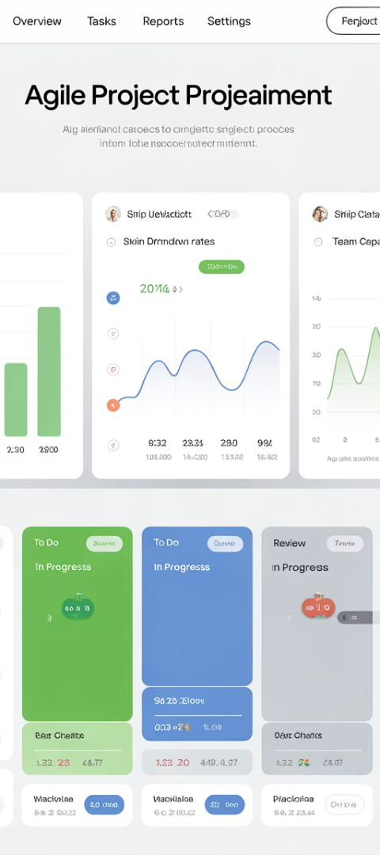
Measuring Success
20%
35%
Faster Delivery
Quality Improvement
Average cycle time reduction after proper implementation
Reduction in defects and rework
40%
25%
Team Satisfaction
Stakeholder Value
Increase in team engagement scores
Improvement in customer satisfaction
Track these metrics to ensure your chosen framework is delivering the expected benefits.

Slide 12
Key Takeaways
No Single "Best" Framework
Adapt and Evolve
Choose based on your specific needs, not popularity or trends.
Be prepared to modify your approach as team and project needs change.
Focus on Principles
Measure Outcomes
Remember the Agile values that underpin both frameworks.
Track metrics that matter to ensure the framework is working.
The right Agile path depends on your unique context. Start with your project and team needs, then choose the framework that best supports them.

