Slide 1


Getting Started in AI: Beginner-Friendly Certifications
Artificial Intelligence is transforming industries across the board. The path to learning AI doesn't have to be overwhelming.
Let's explore top beginner-friendly AI certifications that require little to no prior experience.
#ArtificialIntelligence #AIForBusiness #AILeadership #DigitalTransformation #FutureOfWork #CareerGrowth #Upskilling #AIcertification #MachineLearningBasics #CloudComputing #TechLeadership #Innovation #ProjectManagement #AgileLeadership #ManagingProjectsTheAgileWay

Slide 2





Why Consider AI Certifications?
Career Advancement
Demystify Complex Topics
Open doors to roles in data, cloud, and automation.
Break down AI concepts into understandable components.
Industry Recognition
No Technical Background Required
Gain credentials valued by employers worldwide.
Many certifications are designed for complete beginners.

Slide 3
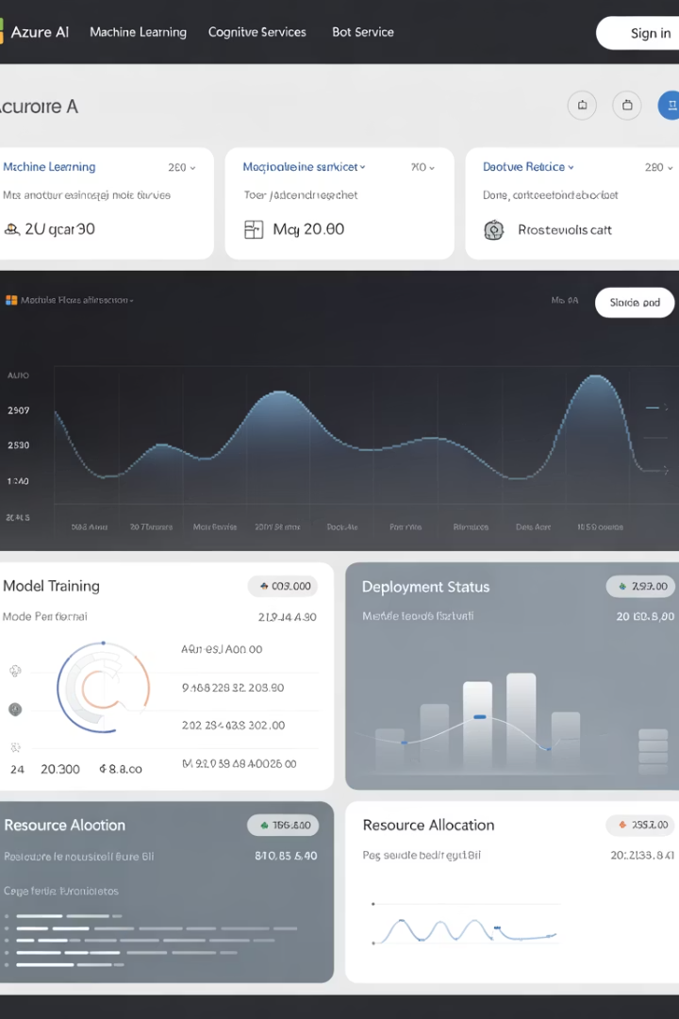
Microsoft Azure AI Fundamentals (AI-900)
Target Audience
Key Topics
Beginners, business stakeholders, and aspiring AI professionals.
AI workloads, machine learning basics, Azure AI tools.
Benefits
Globally recognized certification that introduces core AI concepts.

Slide 4
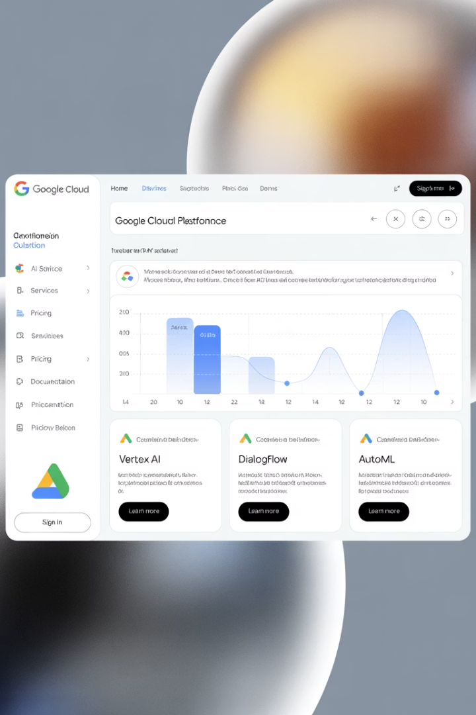



Google Cloud Digital Leader Certification
Cloud Integration
Enterprise Focus
No Prerequisites
Understand AI applications in business environments.
No technical background required to start.
Learn how AI and ML work within Google Cloud Platform.

Slide 5
IBM AI Foundations for Everyone
Platform
Learning Outcomes
Hosted on Coursera and developed by IBM.
Core AI concepts
Audience
Ethical implications
Real-world use cases
Non-technical users, team leaders, and business professionals.

Slide 6








AI For Everyone by Andrew Ng
Business Strategy
Target Audience
Strategic insights for implementing AI in organizations.
Executives, managers, marketers, and curious minds.
AI Concepts
Clear explanations of fundamental AI principles.
Accessibility
No math or coding required.

Slide 7
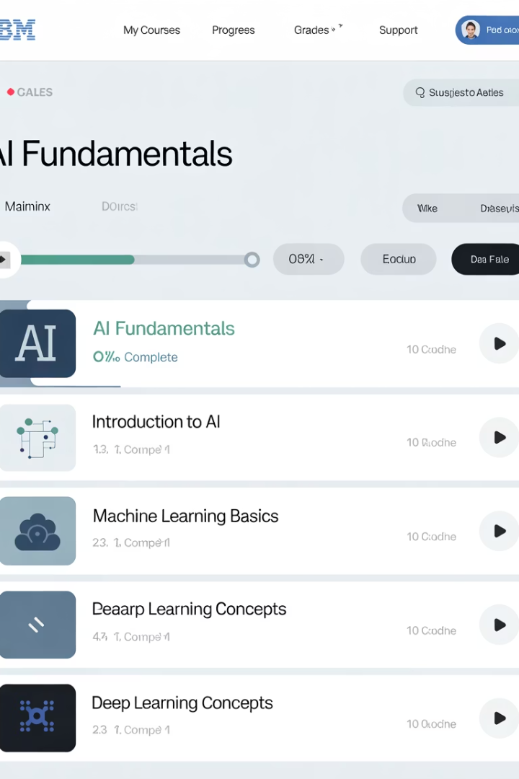




Introduction to Artificial Intelligence (edX – IBM)
AI Fundamentals
Learn basic AI terminology and concepts.
AI vs. ML vs. Deep Learning
Understand the differences between related technologies.
Applications & Trends
Explore how AI is used across industries.
Ethics & Implications
Consider the societal impact of AI technologies.

Slide 8








Elements of AI
Global Reach
Available in multiple languages
Massive Adoption
Used by over 1 million learners
Academic Quality
Created by University of Helsinki
Free Access
No cost to participate

Slide 9

Choosing the Right Certification
If you're a...
Consider starting with...
Business professional or manager
AI-900 or AI For Everyone
Student or career switcher
Elements of AI or IBM AI Foundations
Focused on cloud platforms
AI-900 (Azure) or Google Cloud Digital Leader
Interested in free options
Elements of AI

Slide 10




Benefits of AI Certification
Entry Point
Get your foot in the door of a growing field
Common Language
Speak confidently about AI concepts
Career Network
Connect with other AI professionals
Career Growth
Build foundation for advanced learning

Slide 11





No Technical Background Required
Complete Beginner
Start with zero technical knowledge
Learn Fundamentals
Understand key AI concepts
Apply Knowledge
See how AI fits in your field
Earn Certification
Validate your new skills

Slide 12
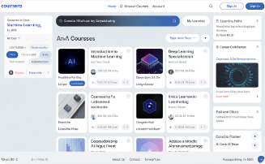
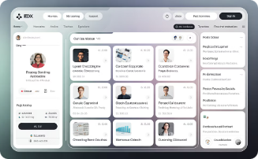
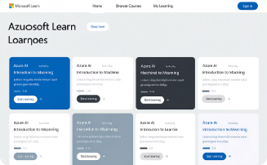
Learning Platform Comparison
Coursera
Hosts IBM AI Foundations and Andrew Ng's AI For Everyone. Structured courses with certificates.
edX
Features IBM's Introduction to AI. Academic-style content with completion certificates.
Microsoft Learn
Home to AI-900 certification. Interactive modules with hands-on labs.

Slide 13

AI Certification Growth Trends
1M+
63%
Elements of AI Learners
Career Advancement
Global participants in this free course
Professionals reporting career benefits
37%
Salary Increase
Average boost after AI certification

Slide 14


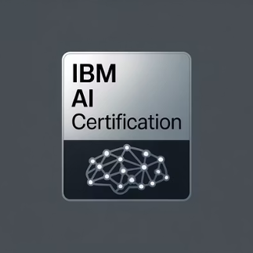
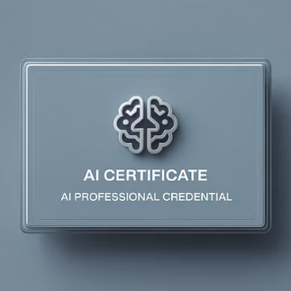
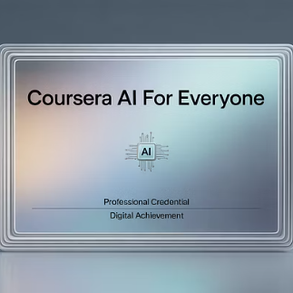
Start Your AI Learning Journey Today
You don't need a PhD or programming background to get started with AI. These beginner-level certifications will demystify complex topics and boost your confidence.
Choose the path that fits your goals and take the first step into the future of technology.

