Slide 1
Elevate Your PMO Career with the PMI-PMOCP™ Certification
Transform your PMO leadership capabilities with the industry-recognized credential that validates your strategic expertise. Designed for professionals ready to drive organizational value through effective project governance.
kW
by Kimberly Wiethoff

Slide 2
The Evolution of PMOs
Administrative Support
Traditional PMOs focused on documentation and basic reporting.
Performance Center
Evolved to track metrics and standardize methodologies.
Strategic Partner
Today's PMOs drive innovation and organizational transformation.
Value Catalyst
Modern PMOs directly influence business outcomes and strategy.

Slide 3
What is the PMI-PMOCP™?
Specialized Credential
Certification specifically designed for PMO leadership professionals.
Industry Recognition
Backed by PMI, the global authority in project management standards.
Career Accelerator
Validates your ability to create and lead high-performing PMOs.
Community Access
Join a network of elite PMO professionals worldwide.

Slide 4
Is This Certification Right for You?
Current PMO Leaders
Portfolio/Program Managers
Directors and managers seeking to validate strategic expertise and enhance their PMO's value proposition.
Professionals managing multiple projects who want to advance into PMO leadership roles.
PMP® Certificate Holders
PMO Strategists
Project managers ready to scale their impact from individual projects to organizational governance.
Analysts and consultants who establish or transform PMOs across different business contexts.

Slide 5
Core Exam Domains
Organizational Development
Strategic Elements
Strategic integration (16%)
Vision and KPIs (18%)
People
PMO Design
Leadership and culture (15%)
Models and frameworks (18%)
Enhancement
Operation & Performance
Continuous improvement (18%)
Tools and processes (15%)

Slide 6
Exam Format & Structure
120
165
Questions
Minutes
Multiple-choice format testing application of knowledge
Time allotted to complete the examination
6
700
Domains
Passing Score
Core knowledge areas covering the PMO lifecycle
Minimum score required on a scale of 100-1000

Slide 7
Eligibility Requirements
Education
Secondary degree (or global equivalent)
Experience
3+ years project-related or active PMP® certification
Training
10 hours of PMO-specific education
All requirements must be met before sitting for the exam. The 10-hour education requirement can be fulfilled through PMI's official exam prep course.

Slide 8
Investment Details
Certification Fees
Additional Considerations
PMI Membership: $129/year
PMI Members
$520 USD
Exam Prep Course: $445 for members
Non-Members
$670 USD
Practice Guide: $49 for members
One-time examination fee with free retest within one year if needed.
Membership provides significant savings on certification and resources.

Slide 9
Preparation Pathway
Study the Fundamentals
Review the PMO Practice Guide and Exam Content Outline
Complete Required Training
Take the 10-hour PMI-PMOCP™ Exam Prep Course
Join Study Groups
Connect with PMI chapters and PMO communities
Practice with Mock Exams
Test your knowledge with sample questions

Slide 10
Key Study Resources
PMO Practice Guide
Exam Content Outline
Essential reference covering strategic and practical PMO topics.
Detailed breakdown of test domains and knowledge requirements.
Online Prep Course
Practice Questions
Interactive modules fulfilling the 10-hour education requirement.
Sample questions reflecting the exam's format and difficulty.

Slide 11
Maintaining Your Certification
30 PDUs Required
3-Year Cycle
Professional development units
Certification renewal period
Ways of Working
Technical project skills
Power Skills
Leadership and influence
Business Acumen
Strategic understanding

Slide 12
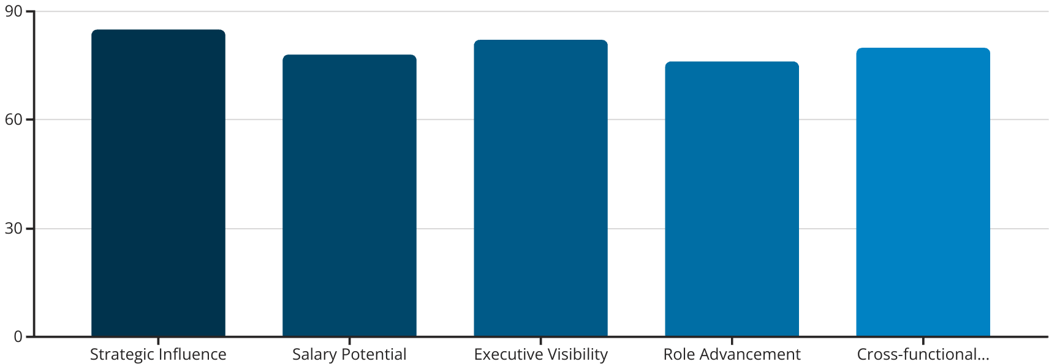
Career Impact
The PMI-PMOCP™ certification significantly enhances your professional profile. It positions you for strategic leadership roles with greater organizational impact.

Slide 13
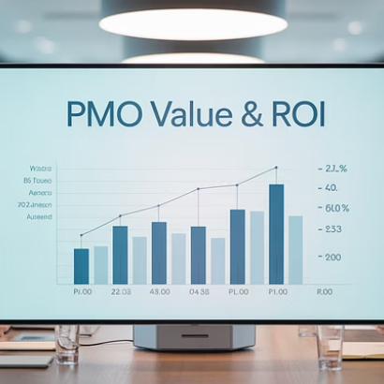
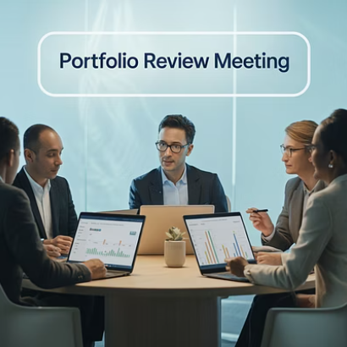
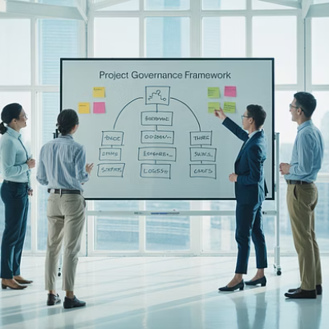
PMO Excellence in Action
PMO Certified Professionals lead high-performing teams. They transform project governance into measurable business outcomes across industries.

Slide 14
Your Next Steps
Evaluate Your Readiness
Review your experience against eligibility requirements. Identify any gaps in your PMO knowledge or experience.
Register with PMI
Create an account on PMI.org. Consider membership for discounted rates on certification and resources.
Complete Required Training
Enroll in the 10-hour prep course. Study the PMO Practice Guide and create a personal study plan.
Apply and Schedule
Submit your application. Once approved, schedule your exam within the one-year eligibility period.

Slide 15
Final Thoughts
The PMI-PMOCP™ certification fills a much-needed gap for professionals leading project governance and portfolio alignment. It elevates the role of the PMO from tactical support to strategic catalyst.
If you're ready to take your PMO career to the next level—one that influences business outcomes, earns executive trust, and adapts to change—then the PMI-PMOCP™ is your next career-defining move.

