Slide 1
Agile Project Management for E-Commerce Success
The pace of change in e-commerce is relentless. Customer expectations shift overnight, new competitors emerge weekly, and technology stacks evolve constantly. In this dynamic environment, traditional project management methods often fall short. That’s why Agile project management has become the go-to approach for successful e-commerce development.
From faster time to market to better collaboration between cross-functional teams, Agile is helping e-commerce businesses deliver smarter, faster, and with greater flexibility.
Transform your e-commerce development with Agile methodologies. Navigate change faster, deliver customer value sooner, and stay ahead of competitors.
kW
by Kimberly Wiethoff

Slide 2
Today's E-Commerce Challenges
Rapid Market Changes
Traditional Limitations
Customer expectations shift overnight. New competitors emerge weekly. Technology stacks evolve constantly.
Waterfall models can't keep pace. Linear sequences create bottlenecks. By launch time, solutions are often outdated.
Integration Complexity
Payment gateways, inventory systems, and marketing tools must work seamlessly. Coordination failures cost sales.

Slide 3
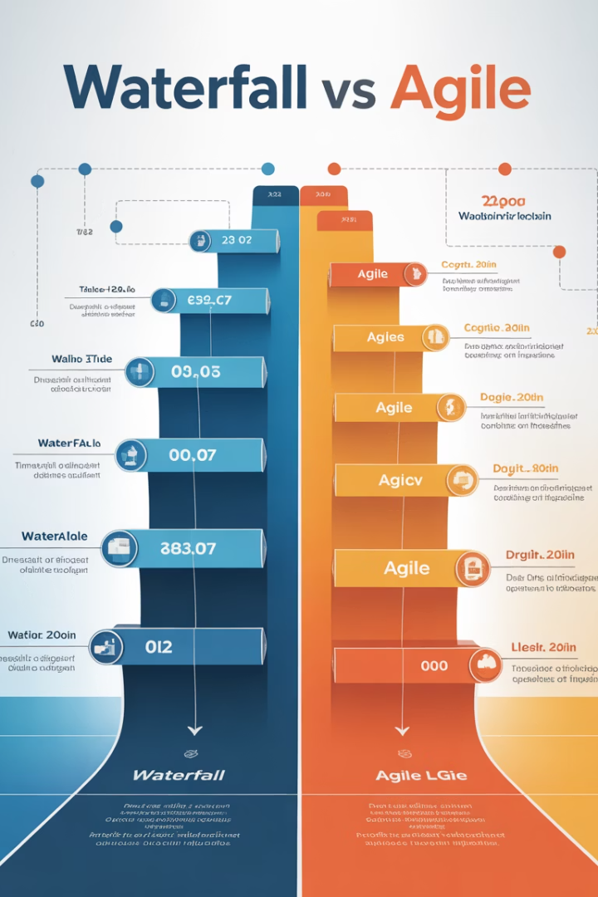
Why Waterfall Falls Short
Requirements Gathering
Rigid specifications become outdated quickly in e-commerce.
Design Phase
Extended design periods mean missed market opportunities.
Development
Isolated coding without feedback leads to misaligned features.
Testing
Late-stage testing discovers critical issues too late.

Slide 4
The Agile Advantage
1
Faster Delivery
Launch features in 1-2 week sprints instead of months-long cycles.
2
Customer Feedback
Incorporate user testing and analytics into each iteration.
3
Team Collaboration
Break silos between developers, designers, and marketers.
4
Early Risk Detection
Identify and solve problems before they affect customers.

Slide 5
Agile & Customer-Centricity
Discover
Design
Research customer pain points and opportunities.
Create solutions based on customer insights.
Test & Learn
Develop
Gather data and iterate based on user behavior.
Build working features in short sprints.

Slide 6
Team Collaboration Benefits
Faster Innovation
Cross-functional perspectives spark creative solutions.
Improved Communication
Daily standups and sprints create transparency.
Shared Ownership
Everyone contributes to product quality.

Slide 7
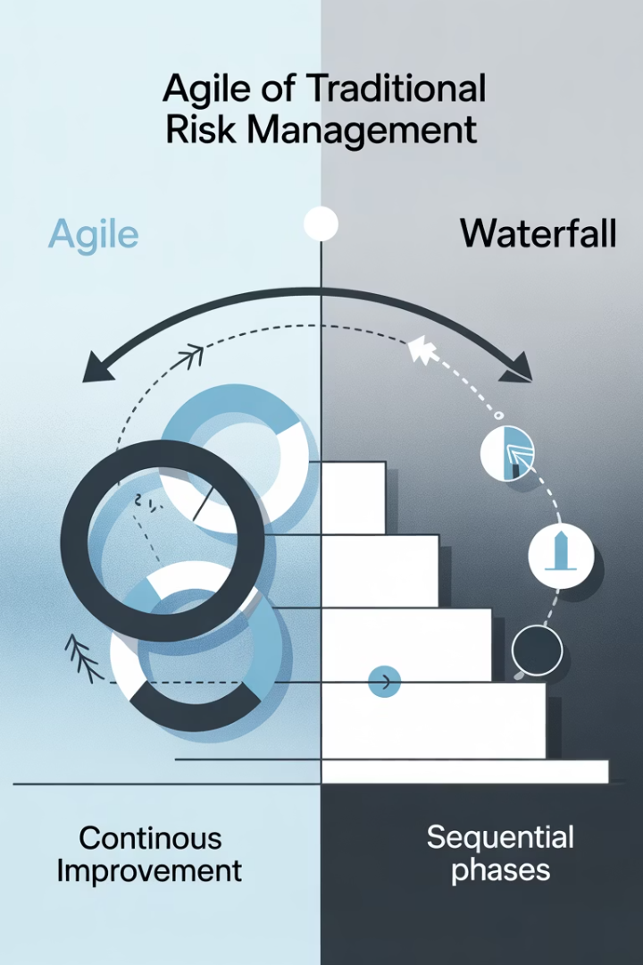
Risk Management with Agile
Traditional Approach
Agile Approach
Late-stage testing
Continuous testing
Big-bang launches
Incremental releases
Reactive problem-solving
Proactive risk identification
Siloed responsibility
Shared team accountability

Slide 8
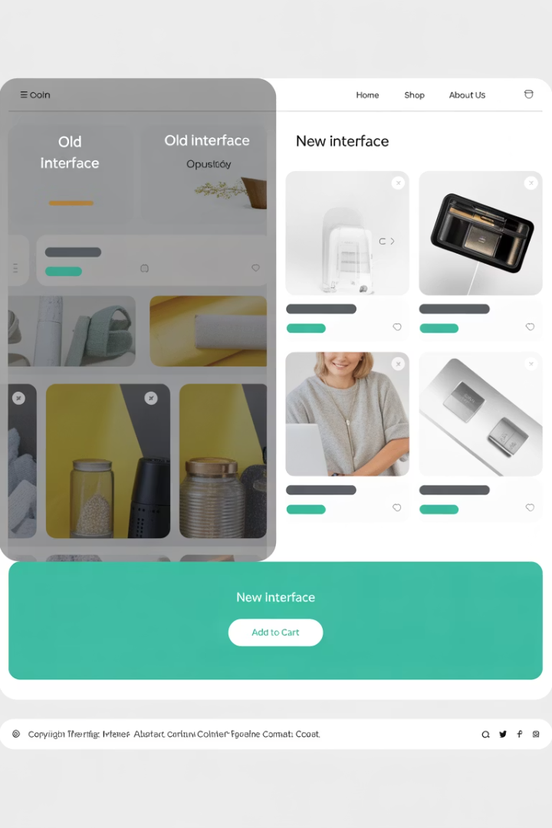
Platform Migration Success
1
Break Project into User Stories
Map customer journeys and prioritize high-impact features first.
2
Focus on Critical Pathways
Ensure payment flows and product imports work flawlessly.
3
Test Third-Party Integrations
Verify connections with payment gateways and shipping services.
4
Incremental Data Migration
Move and validate data in manageable chunks.

Slide 9
Mobile Optimization Case Study
Performance Audit
Identify speed bottlenecks and UX issues.
Progressive Enhancements
Implement image optimization and lazy loading.
A/B Testing
Compare conversion rates between design variants.

Slide 10
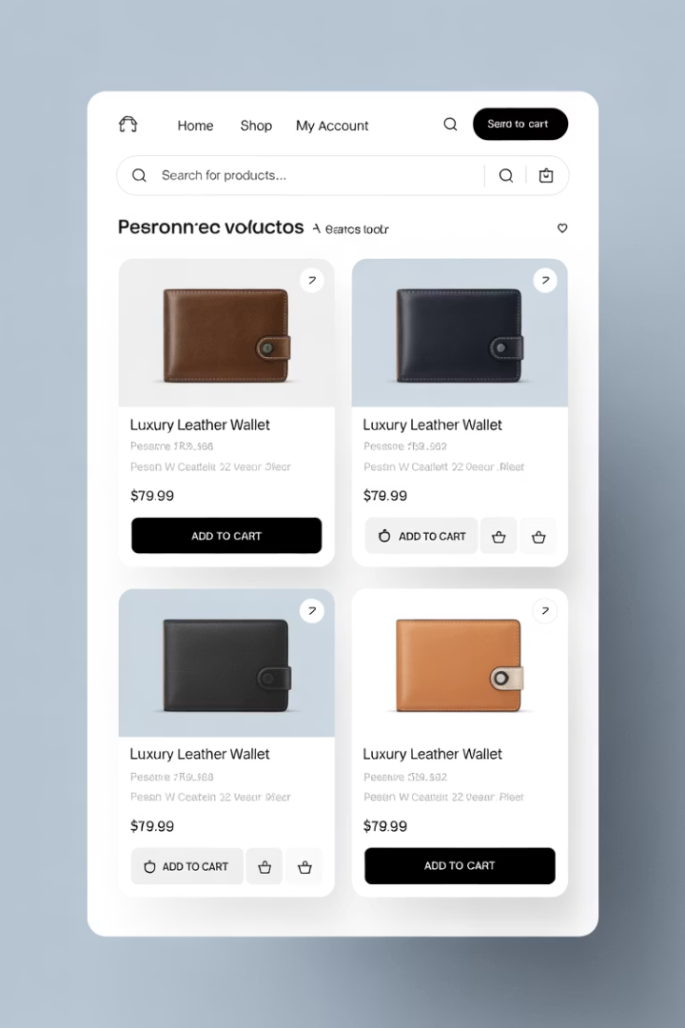
Personalization Engine Rollout
Data Collection Sprint
Implement user behavior tracking across touchpoints.
Focus on key metrics like click patterns and purchase history.
Algorithm Development
Build recommendation engine with machine learning.
Train models on existing customer segments.
UI Implementation
Design and develop personalized content blocks.
Create adaptive product carousels and banners.

Slide 11
Campaign Launch Framework
Sprint Planning
Align timing with marketing calendar. Set clear launch objectives.
Task Assignment
Coordinate designers, developers, and copywriters. Track progress daily.
Performance Tracking
Monitor conversions in real-time. Optimize based on early results.

Slide 12
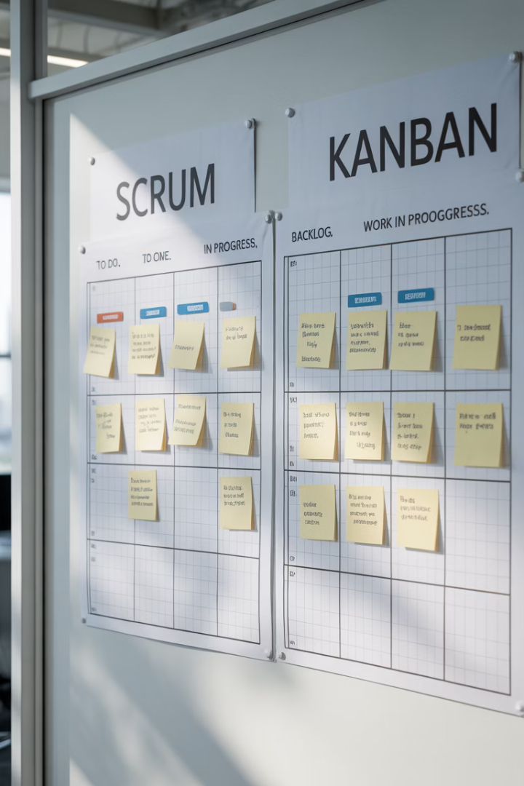
Choosing Your Agile Framework
Feature
Scrum
Kanban
Time Periods
Fixed sprints (1-2 weeks)
Continuous flow
Best For
Development teams
Marketing & support
Planning
Sprint planning meetings
On-demand prioritization
Changes
Between sprints
Anytime

Slide 13
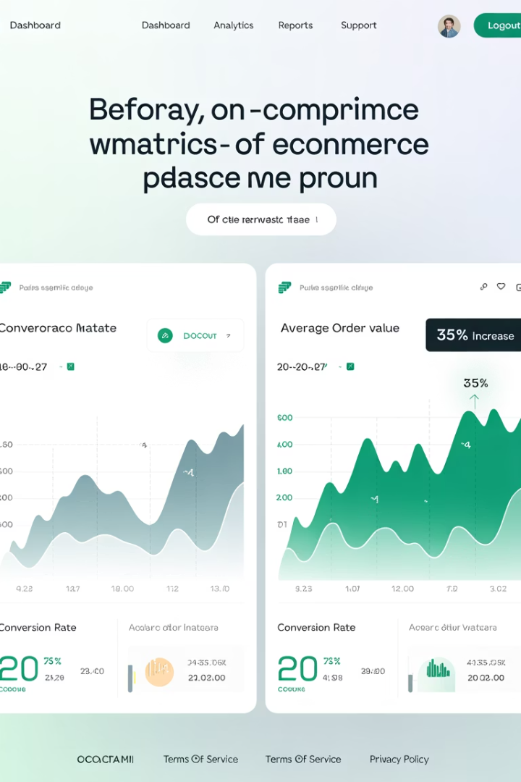
Implementation Results
42%
68%
Faster Delivery
Issue Reduction
Average reduction in time-to-market for new features.
Fewer post-launch bugs with continuous testing.
27%
Conversion Boost
Average increase from rapid iteration on user experience.

Slide 14
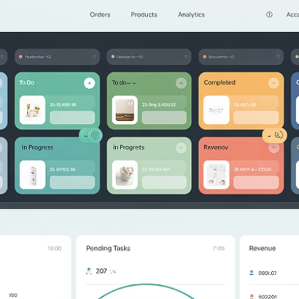
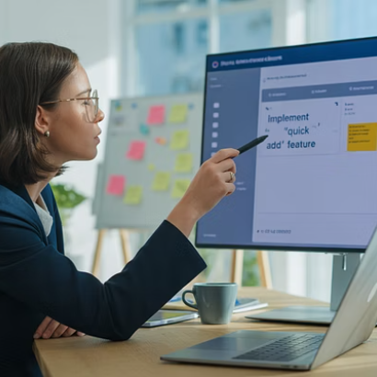
Next Steps for Your Business
Start small with a pilot project. Train your team on Agile principles. Choose appropriate tools like Jira or Trello. Measure results and scale your approach.

Slide 15
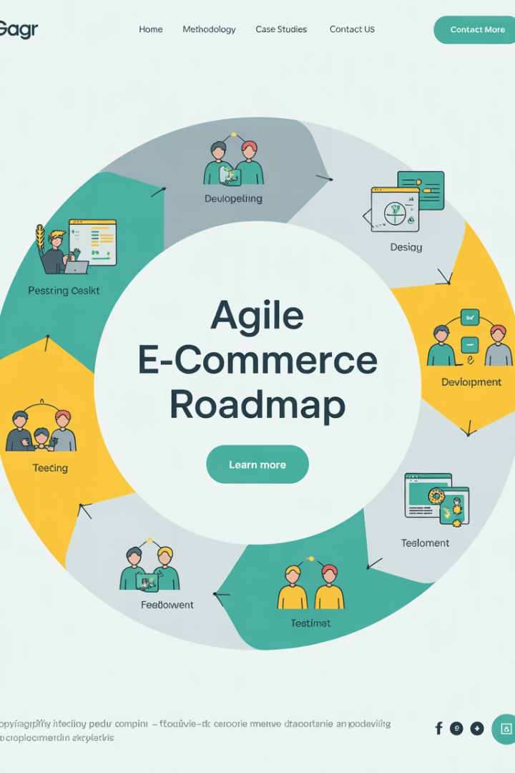
Final Thoughts
Agile isn't just for software developers anymore. It's a mindset—and a toolkit—that empowers e-commerce project managers to stay flexible, customer-focused, and delivery-driven. Whether you're managing a storefront refresh, backend integration, or omnichannel rollout, Agile helps you respond to change, reduce risk, and ship faster.
In a world where customers expect seamless experiences across every device and touchpoint, Agile isn't optional—it's essential.
Agile is reshaping the way e-commerce projects are delivered—faster, smarter, and more customer-focused. Learn how iterative development, real-time feedback, and cross-functional collaboration are driving success.

