Slide 1

30 Companies Hiring Remote-First in 2025
Remote work has solidified its place in the modern workforce. In 2025, remote-first companies are no longer the exception—they're the new standard.
kW
by Kimberly Wiethoff

Slide 2
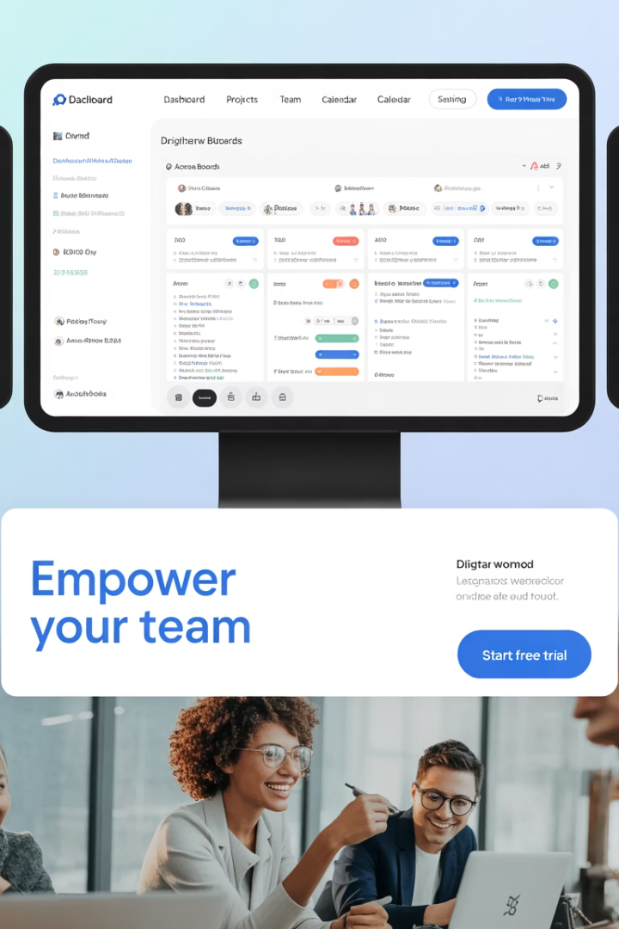
Why Remote-First Matters
True Remote Culture
Better Tools
Remote-first organizations design operations, communication, and culture with remote employees in mind.
Companies invest in digital infrastructure that supports distributed teams.
Equal Opportunity
Less bias toward office workers means fair treatment for all team members.

Slide 3





Benefits for Job Seekers
Global Opportunities
Access roles regardless of your location or time zone.
Built-in Flexibility
Work-life balance is part of the company DNA.
Career Growth
Focus on results rather than office presence.
Work From Anywhere
Many roles aren't tied to specific countries or regions.

Slide 4








Tech Companies Leading Remote-First
Automattic
GitLab
WordPress, Tumblr, and WooCommerce
DevOps and remote operations pioneer
Buffer
Zapier
Social media management
No-code workflow automation

Slide 5





Productivity & Project Management
Doist
Toggl
Basecamp
InVision
Productivity apps (Todoist)
Time tracking and project management
Project management software
Digital product design and collaboration

Slide 6
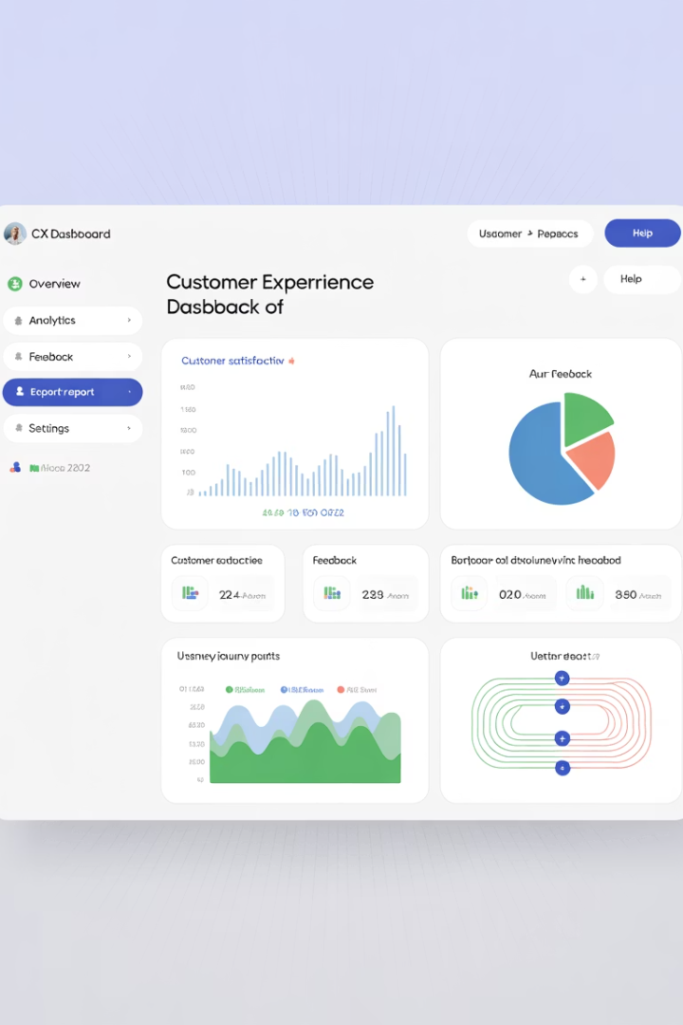



Customer Experience & Marketing
Help Scout
Customer support software
ConvertKit
Email marketing for creators
Hotjar
Behavior analytics and user feedback

Slide 7
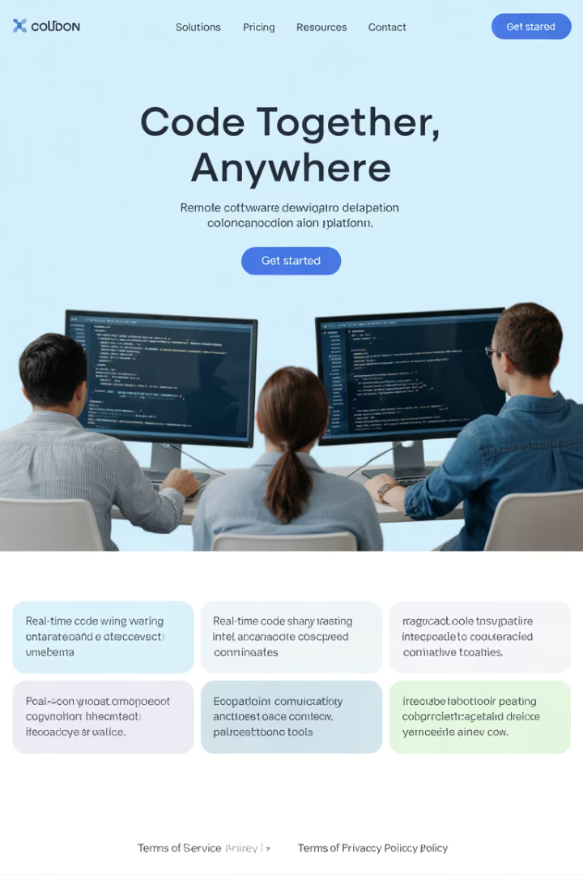




Development & Engineering
GitHub
Remote-first culture within Microsoft
Clevertech
Custom software development
10up
Web development agency
X-Team
Remote developer teams

Slide 8






Collaboration & Knowledge Sharing
Trello (Atlassian)
Visual collaboration tool
MURAL
Visual collaboration workspace
Slite
Knowledge sharing for remote teams

Slide 9




Specialized Industries
Alpine Health
Healthcare tech solutions
Omnipresent
Global employment infrastructure
TaxJar
Tax compliance for e-commerce
Revolut
Remote-first fintech for global banking

Slide 10
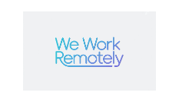
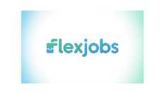
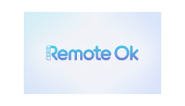

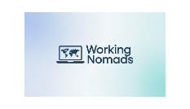
Where to Find Remote-First Jobs
These platforms specialize in remote-first companies actively hiring across industries. Set alerts to stay ahead of the latest openings.

Slide 11








Standing Out in Remote Applications
Work Independently
Communicate Effectively
Show ability to manage tasks without supervision
Demonstrate clear written and asynchronous communication
Show Accountability
Master Remote Tools
Emphasize metrics and results-focused approach
Highlight experience with collaboration platforms

Slide 12
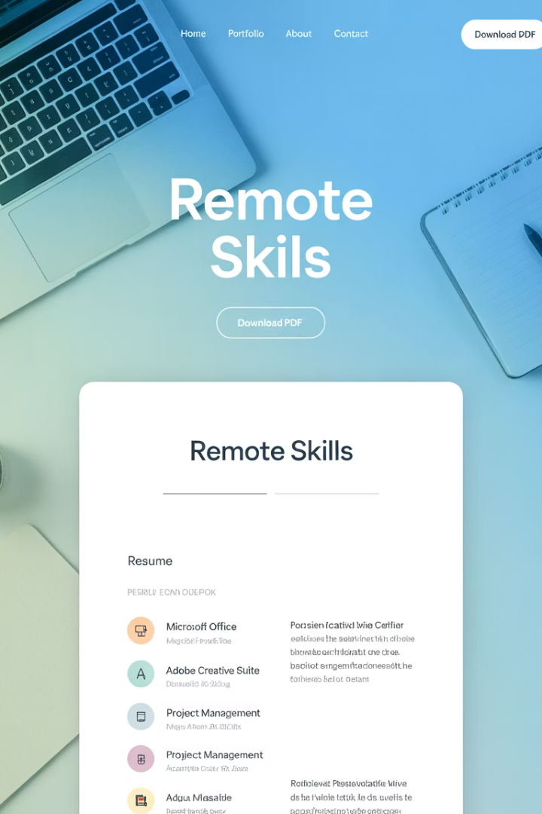
Remote Skills to Highlight
Digital Collaboration
Experience with Zoom, Slack, Notion, and other remote tools.
Time Zone Management
Ability to coordinate across global teams and schedules.
Self-Discipline
Track record of meeting deadlines without direct supervision.
Digital Communication
Clear writing skills and documentation practices.

Slide 13



The Future is Remote-First
Work From Anywhere
Global Collaboration
Work-Life Integration
Remote-first companies offer true geographic freedom.
Connect with talented colleagues worldwide.
Design your ideal lifestyle around your career.
As the workplace continues to decentralize, remote-first companies are becoming the employers of choice for professionals who value flexibility and global opportunity.

Slide 14

Final Thoughts
As the workplace continues to decentralize, remote-first companies are becoming the employers of choice for skilled professionals who value flexibility, autonomy, and global opportunity. By targeting these companies and tailoring your resume to reflect remote-readiness, you can take your career beyond geographic limits.
Whether you're a seasoned remote worker or just making the shift, now is the time to explore companies that are built for remote success—and ready to hire in 2025.

