Slide 1

When Agile Goes Remote: Building Engaging, Distributed Scrum Ceremonies
Agile was born in a world of co-located teams. Today, distributed teams are the norm. Remote Agile isn't just possible—it can thrive through intentional ceremony design.
kW
by Kimberly Wiethoff

Slide 2
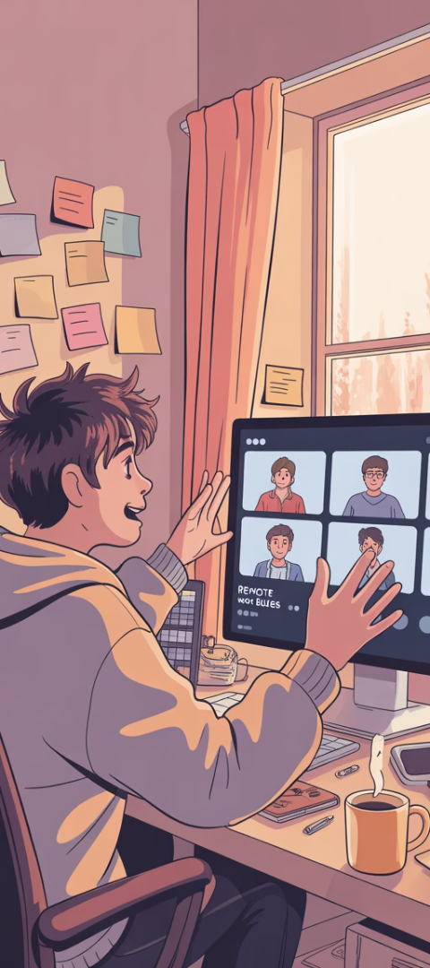




The Remote Agile Challenge
Spanning Time Zones
Teams work across multiple continents and time zones.
Virtual Connection
Face-to-face interactions are replaced by video calls.
Missing Physical Tools
No shared whiteboards or physical sticky notes.
Maintaining Engagement
Keeping ceremonies collaborative and high-impact is harder.

Slide 3
Remote Standups That Actually Stand Out
Lightweight Tools
Rotate Facilitators
Sentiment Checks
Use Parabol, Range, or Standuply to guide structure and keep focus.
Change who leads the standup each sprint or week.
Add quick 1-word check-ins, emojis, or traffic lights.
These tools can collect updates asynchronously before the meeting.
This keeps energy high and makes everyone feel included.
These surface blockers that might not appear in the backlog.

Slide 4
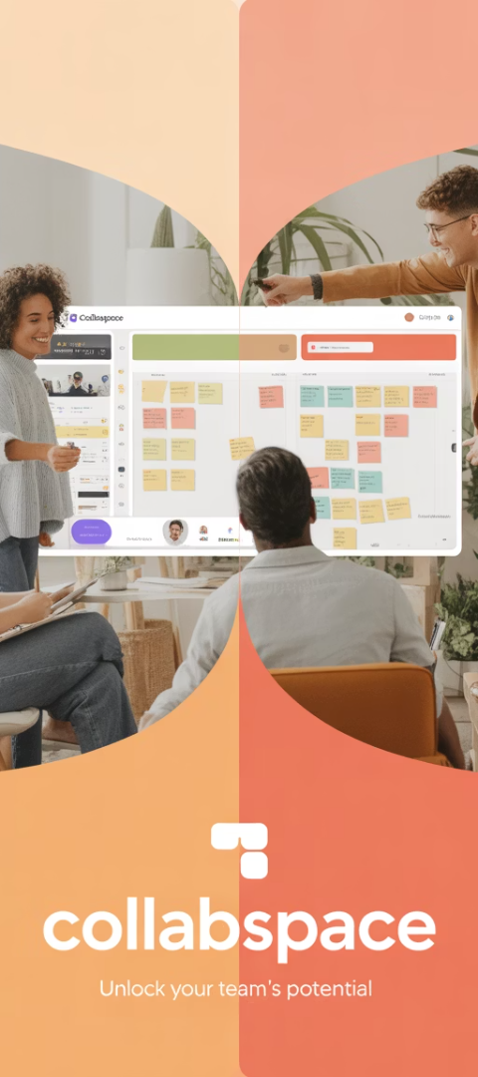
Remote Planning That Feels Collaborative
Use Shared Visual Boards
Utilize Miro, MURAL, or EasyRetro for real-time story mapping.
These replace physical whiteboards and enable collaborative planning.
Break Into Small Groups
Use breakout rooms for estimation and detailed task planning.
This creates space for deeper discussions in smaller settings.
Screen-Share With Clear Roles
Display the backlog while Scrum Master, PO, and Dev Leads facilitate.
Record sessions for team members in different time zones.

Slide 5








Retros That Go Beyond "What Went Well"
Rotate Formats
Anonymous Feedback
Try Start/Stop/Continue, Lean Coffee, or Sailboat to keep retros fresh.
Use TeamRetro or FunRetro to surface difficult truths safely.
Build Safety
Deep Dive Discussions
Psychological safety is the foundation of remote Agile culture.
Allocate time to discuss issues deeply, not just surface voting.

Slide 6





Make Sprint Reviews Showcases—Not Just Demos
Invite Stakeholders
Narrated Walkthroughs
Include business stakeholders and customers via Zoom or Teams.
Use short, compelling demos tied back to user stories.
Capture Feedback
Celebrate Wins
Use shared docs or polls like Google Forms or Slido.
Visually celebrate progress to reinforce momentum.

Slide 7

Building Team Culture Remotely
Weekly Coffee Chats
Shared Team Dashboard
Start the week with informal team gatherings. Share memes, weekend stories, or just chat.
Create a virtual space for goals, fun facts, birthdays, and kudos.
This becomes your team's "water cooler" for asynchronous connection.
These unstructured moments build relationships beyond work tasks.
Recognition Rituals
End sprints with peer recognition. Celebrate both work and personal achievements.
This reinforces team bonds across physical distance.

Slide 8

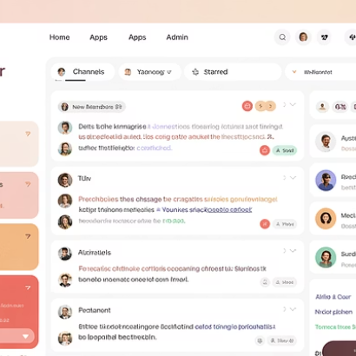
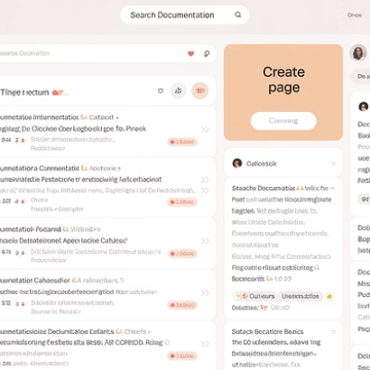

Asynchronous Communication Tools
Use asynchronous tools like Loom for video updates, Slack threads for discussions, and Confluence for documentation. These support communication outside meetings and across time zones.

Slide 9



Addressing Time Zone Challenges
Core Hours
Establish 2-4 overlap hours for all team members.
Rotating Meeting Times
Share the inconvenience of odd-hour meetings across the team.
Record Key Sessions
Make recordings available for those who can't attend live.
Time zones remain one of remote Agile's biggest challenges. Balance synchronous and asynchronous work to create an inclusive environment for all team members regardless of location.

Slide 10
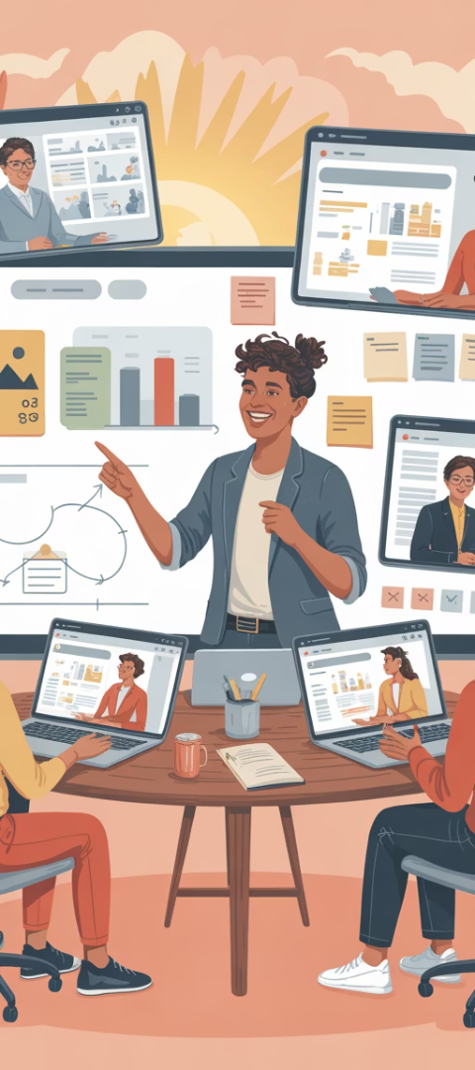




Remote Facilitation Techniques
Check For Understanding
Use quick polls or reactions to gauge comprehension.
Watch for non-verbal cues that signal confusion.
Create Participation Protocols
Establish clear ways to contribute (hand raising, chat).
Ensure everyone speaks at least once per ceremony.
Manage Time Intentionally
Use timers visible to all participants.
Start and end on schedule to build trust.
Capture Insights Real-Time
Document decisions and action items where everyone can see.
Share notes immediately after ceremonies.

Slide 11








Technology Stack for Remote Agile
Video Communication
Zoom, Microsoft Teams, Google Meet
Collaboration & Chat
Slack, Microsoft Teams, Discord
Agile Management
Jira, Azure DevOps, Trello, Monday
Visual Collaboration
Miro, MURAL, Figma, Lucidspark
The right tools make remote Agile possible. Choose integrated platforms that reduce context switching and create a seamless experience.

Slide 12

Final Thought: Connection Creates Agility
Distance doesn't diminish agility—disconnection does.
86%
24/7
3x
Higher Engagement
Global Coverage
Talent Access
Well-designed remote ceremonies increase team engagement.
Distributed teams can provide around-the-clock productivity.
Remote teams can access talent from anywhere in the world.
Great Agile ceremonies aren't tied to geography. They're anchored in engagement, transparency, and trust. With intentional design, remote Agile can thrive.

