Slide 1


How AI Transforms Project Scheduling in Project Management
Discover how artificial intelligence is revolutionizing the way we plan, execute, and optimize project schedules in today's dynamic business environment.
#AIinProjectManagement #ProjectScheduling #IntelligentScheduling #PredictiveAnalytics #ResourceOptimization #AgileDelivery #DigitalTransformation #FutureOfWork #ProgramManagement #RiskManagement #Automation #EnterprisePMO #TechLeadership #PMP #PMIACP #ManagingProjectsTheAgileWay

Slide 2
The Scheduling Challenge
Traditional Methods Fall Short
The Need for Innovation
Project scheduling has always been the cornerstone of successful project management. Yet traditional approaches struggle with the complexity of modern projects, where multiple dependencies, resource constraints, and constantly shifting priorities create a web of challenges.
In fast-paced environments, static scheduling methods can't keep up. Project managers need tools that can process vast amounts of data, predict potential roadblocks, and adjust plans in real-time.
This is where artificial intelligence enters the picture, offering a transformative solution that promises to reshape how we approach project scheduling entirely.
Teams face difficulties in allocating resources optimally, managing interdependencies, and adapting to unforeseen changes—all while trying to meet critical deadlines.

Slide 3
Five Ways AI Revolutionizes Scheduling
01
02
03
Intelligent Resource Allocation
Dynamic Schedule Optimization
Predictive Analytics for Risk Management
Optimal distribution of talent and assets
Real-time adjustments to evolving needs
Anticipate delays before they happen
04
05
Automated Task Prioritization
Adaptive Learning & Continuous Improvement
Focus on what matters most
Getting smarter with every project

Slide 4




Intelligent Resource Allocation
One of the most persistent challenges in project scheduling is ensuring that resources—people, equipment, and budget—are allocated in ways that maximize efficiency while minimizing delays and bottlenecks.
AI-powered scheduling tools revolutionize this process by analyzing multiple dimensions simultaneously: project requirements, resource availability, individual skill sets, current workload distribution, and team member expertise levels.
Skill Matching
Availability Analysis
Optimization Engine
Pairs tasks with team members who have the right expertise
Considers current workload and capacity constraints
Recommends allocation strategies that improve productivity
The result? Resources are utilized more effectively, leading to smoother project execution, reduced idle time, and significantly improved team productivity.

Slide 5

Dynamic Schedule Optimization
Flexibility in Real-Time
Today's business environment doesn't stand still. Priorities shift, resources become unavailable, unexpected obstacles emerge, and stakeholder requirements evolve. Static project schedules quickly become obsolete.
AI enables dynamic schedule optimization by continuously monitoring project data and making intelligent adjustments in real-time. The system can automatically reschedule tasks, reallocate resources, and revise timelines based on current conditions.
This ensures that project schedules remain flexible and responsive, minimizing disruptions while maintaining alignment with project goals and maximizing overall efficiency.

Slide 6
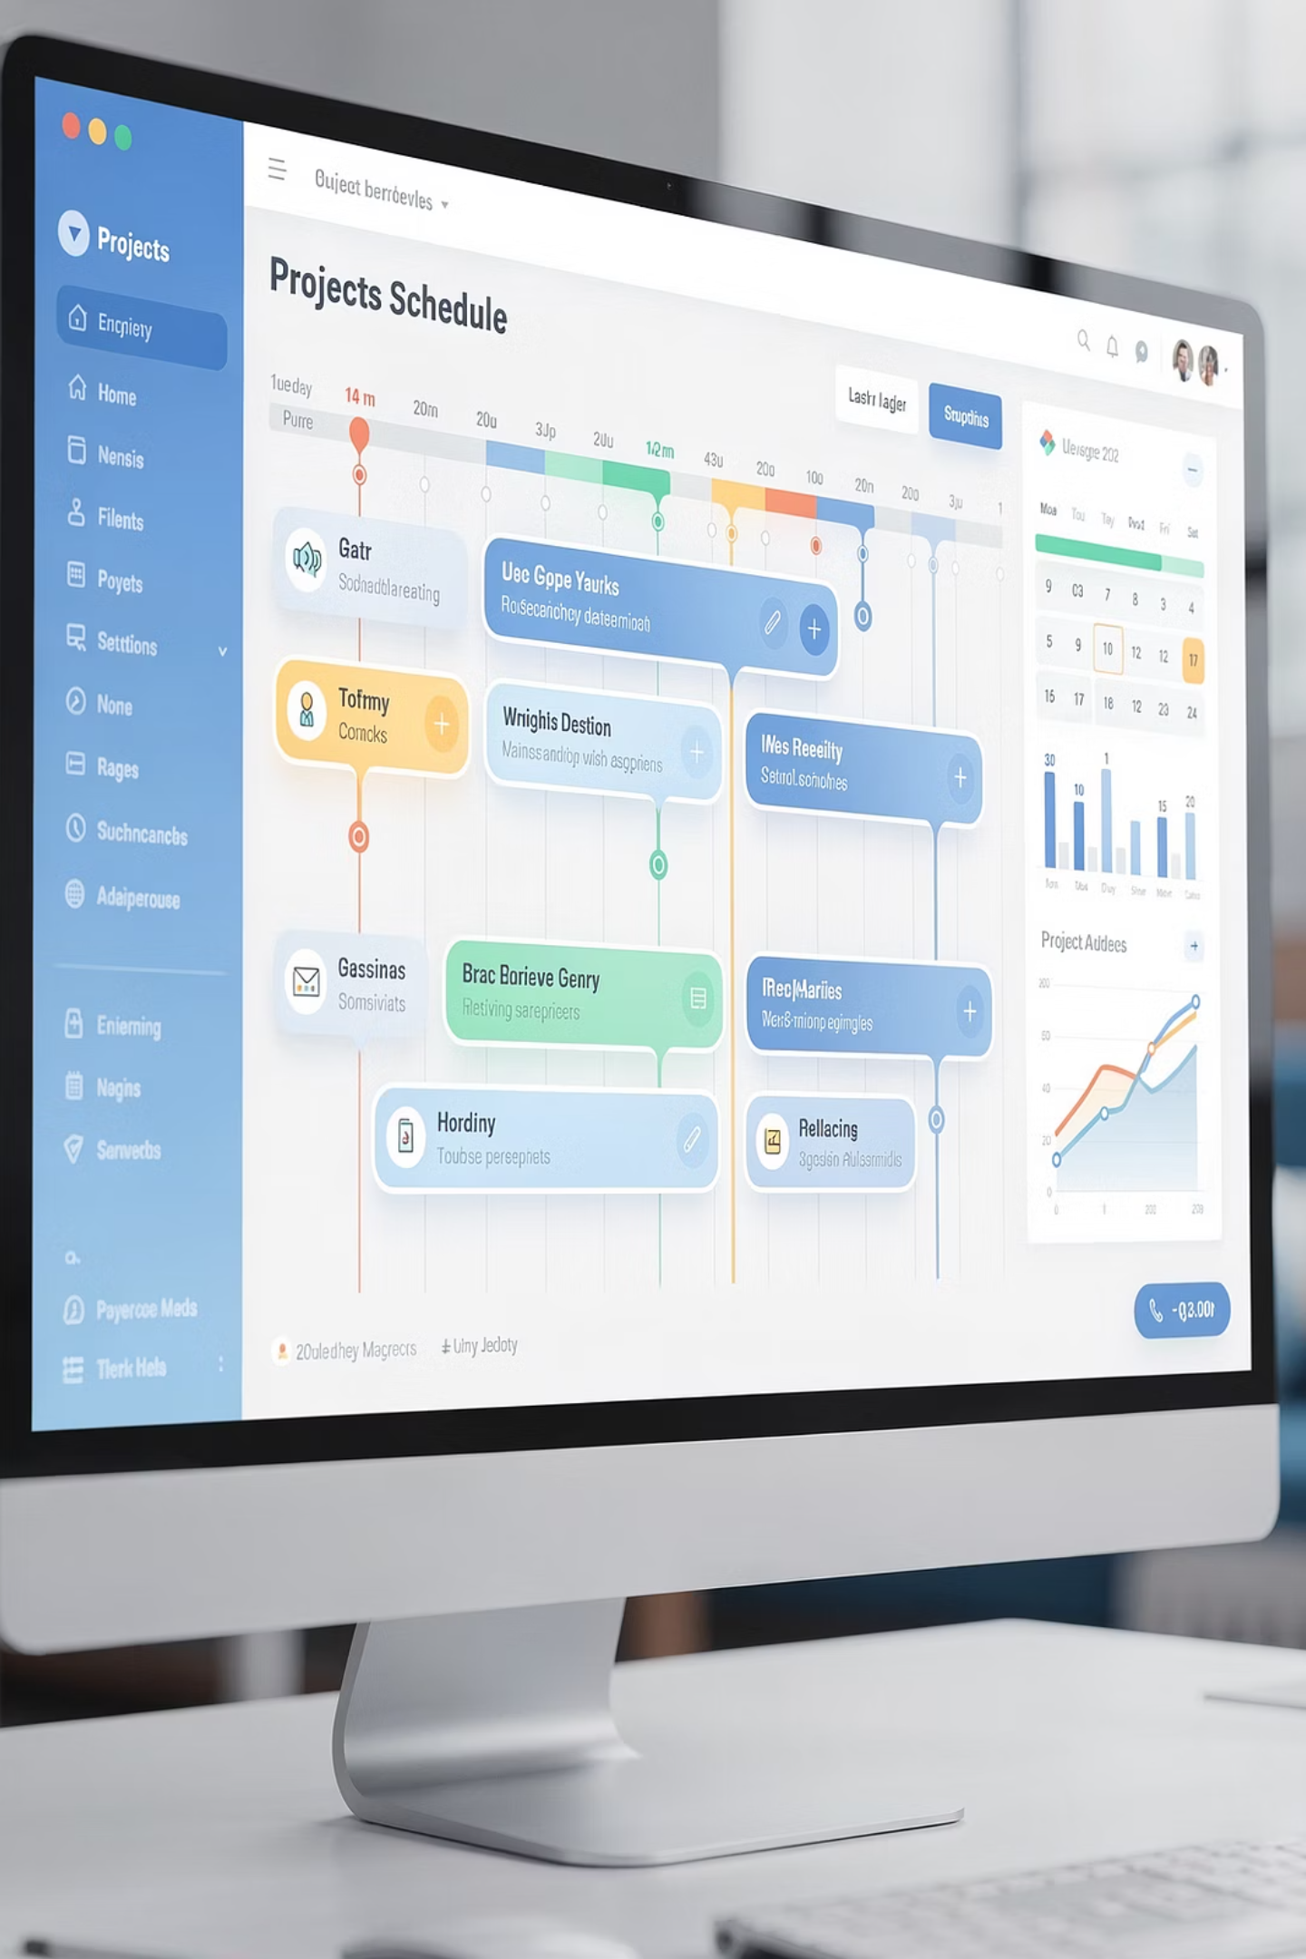



The Power of Real-Time Adaptation
Continuous Monitoring
AI constantly analyzes project progress, tracking actual performance against planned schedules
Change Detection
Identifies deviations, resource conflicts, and emerging constraints automatically
Intelligent Adjustment
Generates optimized schedule modifications that accommodate changes while preserving objectives

Slide 7
Predictive Analytics for Risk Management
What if you could see schedule delays coming before they actually happen? AI-powered scheduling tools make this possible through sophisticated predictive analytics.
Data Collection
Impact Prediction
Gathers historical project data, external factors, and dependency information
Forecasts how risks will affect schedules and project outcomes
1
2
3
4
Pattern Recognition
Proactive Mitigation
Identifies risk factors and correlations that indicate potential problems
Enables early intervention with targeted strategies
By analyzing historical project data, external market conditions, resource dependencies, and countless other variables, AI algorithms can identify potential risks and predict their impact on project timelines. This proactive approach allows project managers to implement mitigation strategies preemptively, significantly reducing the likelihood of schedule overruns and ensuring smoother project execution from start to finish.

Slide 8

Risk Identification in Action
Resource Bottlenecks
Dependency Chains
External Factors
AI identifies when key team members are overallocated or when critical skills may become unavailable at crucial project phases.
Complex task dependencies are analyzed to pinpoint where delays in one area could cascade throughout the project.
Seasonal patterns, market conditions, and historical trends are incorporated to anticipate external impacts on schedule.

Slide 9




Automated Task Prioritization
Focus on What Matters Most
Critical Path
Not all tasks are created equal. Some are critical to project success, while others can be deferred if necessary. The challenge lies in making these prioritization decisions correctly and consistently.
Tasks that directly impact delivery date
High Impact
Activities with significant value delivery
AI-driven scheduling tools automate task prioritization by analyzing multiple factors simultaneously: project goals and strategic objectives, task dependencies and critical paths, deadline urgency, and potential impact on overall project success.
Supporting Work
Important but flexible tasks
Deferred Items
By prioritizing critical path tasks and high-impact activities, AI algorithms ensure that project resources are focused where they matter most, enabling teams to achieve project milestones on time while maintaining flexibility for less critical work.
Nice-to-have, non-urgent activities

Slide 10








Adaptive Learning & Continuous Improvement
Perhaps the most powerful aspect of AI in project scheduling is its ability to learn and improve over time. Unlike static tools that remain unchanged, AI-powered scheduling systems evolve with each project, becoming increasingly accurate and effective.
Collect Data
Analyze Patterns
Gather information from completed projects and ongoing schedules
Identify what worked well and what didn't across multiple projects
Apply Learning
Refine Algorithms
Implement improved strategies in future scheduling decisions
Adjust scheduling recommendations based on insights and feedback
By analyzing scheduling patterns, identifying optimization opportunities, and incorporating feedback from project managers, AI algorithms continuously refine their recommendations to better align with organizational goals and project-specific requirements.

Slide 11
The Compound Benefits of AI Scheduling
40%
35%
50%
Efficiency Gain
Fewer Delays
Better Utilization
Reduction in time spent on manual scheduling tasks
Decrease in schedule overruns through predictive risk management
Improvement in resource allocation and capacity optimization
When organizations embrace AI-driven scheduling, they experience compounding benefits: improved resource utilization leads to cost savings, better risk prediction reduces costly delays, and continuous learning makes each subsequent project more successful than the last. The result is a virtuous cycle of improvement that transforms project management effectiveness across the entire organization.

Slide 12

A Paradigm Shift in Project Management
Beyond Technology Adoption
The integration of AI into project scheduling represents more than just adopting new technology—it signifies a fundamental paradigm shift in how we approach project planning, execution, and management.
By leveraging AI-driven analytics, intelligent automation, and sophisticated predictive modeling, organizations can optimize resource utilization, minimize risks, and enhance productivity across all project management processes.
Embracing AI in project scheduling means embracing a mindset of innovation, using technology to unlock new possibilities for efficiency and success that were previously unimaginable.

Slide 13
The Future of Project Scheduling
A Brighter Tomorrow
As we embrace the transformative potential of artificial intelligence in project management, the future of project scheduling has never looked brighter. AI doesn't replace the expertise and judgment of skilled project managers—it amplifies their capabilities, freeing them from tedious manual tasks to focus on strategic decisions and stakeholder relationships.
Strategic Focus
Competitive Advantage
Continuous Evolution
Project managers can concentrate on high-value activities while AI handles routine scheduling optimization
Organizations that embrace AI scheduling gain significant advantages in speed, efficiency, and reliability
AI systems improve with every project, creating a trajectory of ever-increasing effectiveness
The question is no longer whether to integrate AI into project scheduling, but how quickly organizations can adapt to harness its full potential. Those who move decisively will position themselves at the forefront of project management excellence.

