Slide 1

Unlocking Success: Essential Soft Skills for Project Management
Welcome to this comprehensive guide on the essential soft skills that set exceptional project managers apart. While technical expertise is critical, it's the interpersonal and self-management abilities that truly enable project managers to navigate complex challenges and lead teams to success.
Throughout this presentation, we'll explore seven key soft skills that can transform your project management approach, illustrated with practical examples and actionable strategies for improvement. Whether you're an aspiring project manager or looking to enhance your existing skillset, these insights will help you cultivate the attributes needed for excellence in this dynamic field.
by Kimberly Wiethoff
kW

Slide 2














The Complete Soft Skills Toolkit
Before diving into individual skills, it's important to understand how these capabilities work together as an integrated toolkit. Successful project managers don't excel in just one area—they develop proficiency across multiple soft skills that complement each other. These skills form the foundation of effective leadership in project environments. They enable managers to build rapport with stakeholders, navigate uncertainty, resolve conflicts constructively, and ultimately deliver results that satisfy business objectives while maintaining team cohesion and morale.
The most effective project managers continuously develop these skills through deliberate practice, reflection, and adaptation throughout their careers.
Leadership
Communication
Inspiring and empowering teams
Clear articulation and active listening
Adaptability
Embracing change effectively
Collaboration
Fostering teamwork across groups
Problem-Solving
Creative and analytical thinking
Time Management
Emotional Intelligence
Prioritizing tasks effectively
Understanding self and others

Slide 3
Communication: The Foundation of Project Success
Effective communication serves as the cornerstone of successful project management. Project managers must master both verbal and written communication, tailoring their message to different audiences and circumstances. This includes the ability to translate technical concepts for non-technical stakeholders and ensuring expectations are clearly understood by all parties.
Communication failures account for approximately 30% of project failures, highlighting its critical importance. Strong communicators proactively share information, create comprehensive documentation, and establish clear channels for team members to voice concerns or share updates.
Articulate Complex Ideas Simply
Practice Active Listening
Document Effectively
Tailor Communication Style
Create comprehensive project documentation with clear action items, responsibilities, and timelines.
Translate technical concepts into clear, accessible language for stakeholders at all levels of technical understanding.
Demonstrate engagement through body language, clarifying questions, and summarizing discussions to confirm understanding.
Adapt your approach based on audience preferences, cultural considerations, and communication medium.

Slide 4
Leadership: Guiding Teams to Excellence
Leadership in project management extends beyond formal authority—it's about inspiring teams to achieve shared objectives with enthusiasm and commitment. Effective project leaders create environments where team members feel valued, understand how their contributions impact overall success, and are motivated to perform at their highest potential.
Great project leaders balance providing clear direction with empowering team members to solve problems independently. They demonstrate integrity, take responsibility for outcomes, and remain composed during challenging situations, serving as role models for their teams.
Lead by Example
Delegate Effectively
Demonstrate the work ethic, professionalism, and dedication you expect from your team. Show resilience during challenges and maintain positive energy even when facing setbacks.
Assign tasks based on team members' strengths and development needs. Provide clear expectations while allowing autonomy in execution. Trust your team while maintaining appropriate oversight.
Recognize and Celebrate
Provide Constructive Feedback
Acknowledge individual and team achievements consistently. Celebrate milestones to maintain motivation and create a positive team culture that values both effort and outcomes.
Deliver timely, specific feedback focused on behaviors rather than personalities. Create development opportunities that help team members grow professionally through project experiences.

Slide 5




Adaptability: Thriving Amid Change
In today's rapidly evolving business environment, adaptability has become an essential attribute for project managers. The ability to pivot strategies, adjust timelines, and reallocate resources in response to changing circumstances often determines whether projects succeed or fail when faced with unexpected challenges.
Adaptable project managers maintain a positive outlook during transitions, model flexibility for their teams, and help stakeholders understand and accept necessary changes. They balance adherence to project fundamentals with the flexibility to modify approaches when warranted by new information or shifting priorities.
Anticipate Changes
Assess Impact
Develop Alternatives
Implement Changes
Evaluate effects on scope, timeline, and resources
Identify potential shifts before they occur
Create multiple options for moving forward
Execute new plans with clear communication

Slide 6





Problem-Solving: Turning Challenges into Opportunities
Effective problem-solving is what separates exceptional project managers from merely competent ones. Projects inevitably encounter obstacles, and the ability to systematically identify, analyze, and resolve these challenges is crucial for maintaining momentum and achieving objectives.
Strong problem-solvers approach challenges with curiosity rather than frustration. They gather data, identify patterns, consider multiple perspectives, and evaluate potential solutions before implementing the most promising approach. They also document lessons learned to prevent similar issues in future projects.
Define the Problem
Gather Information
Generate Solutions
Clearly articulate the issue without assuming causes or solutions
Collect relevant data and insights from multiple sources
Brainstorm multiple approaches without immediate judgment
Evaluate Options
Implement & Monitor
Assess each solution against criteria including feasibility and impact
Execute the chosen solution and track its effectiveness

Slide 7




Emotional Intelligence: Human Element of Project Management
Emotional intelligence (EQ) encompasses the ability to recognize, understand, and manage your own emotions while also effectively navigating the emotions of others. In project environments, where stress levels can run high and diverse personalities must collaborate effectively, EQ serves as a critical differentiator for successful leadership.
Project managers with high emotional intelligence build stronger relationships, defuse tension before it escalates into conflict, and create psychologically safe environments where team members feel comfortable sharing ideas and concerns. This leads to greater innovation, more effective collaboration, and higher team satisfaction.
Social Regulation
Social Awareness
Self-Regulation
Self-Awareness
Influencing others' emotions constructively
Empathy and organizational understanding
Managing emotions and impulses effectively
Recognizing your emotions and their impact

Slide 8
Time Management: Mastering the Project Clock
Effective time management is essential for delivering projects within schedule constraints while maintaining work-life balance for team members. Project managers must not only manage their own time efficiently but also help teams prioritize tasks appropriately and avoid the common pitfalls of scope creep and procrastination.
Skilled time managers establish realistic timelines with built-in buffers for unexpected issues. They identify and focus on high-impact activities, minimize time-wasting practices like excessive meetings, and regularly evaluate how time is being used across the project to identify opportunities for improvement.
25%
40%
Focus Time
Collaborative Time
Dedicated to high-concentration tasks requiring uninterrupted attention
Meetings, brainstorming sessions, and direct team coordination
20%
15%
Administrative Time
Buffer Time
Documentation, reporting, and project governance activities
Reserved for unexpected issues and learning opportunities

Slide 9








Collaboration: Harnessing Collective Expertise
Project success rarely comes from individual brilliance—it emerges from effective collaboration across diverse team members, departments, and sometimes organizations. Project managers must create environments where collaboration flourishes naturally, breaking down silos and fostering knowledge-sharing across boundaries.
Strong collaborators establish clear roles and responsibilities while encouraging cross-functional problem-solving. They recognize diverse perspectives as assets rather than obstacles and create systems that make collaboration convenient rather than cumbersome. This approach leads to more innovative solutions and greater stakeholder buy-in.
Build Relationships
Share Information
Foster trust before collaboration is needed
Establish transparent knowledge systems
Recognize Team Success
Align Goals
Celebrate collaborative achievements
Create shared objectives across groups

Slide 10
Skills in Action: Real-World Application
Understanding these soft skills conceptually is only the beginning—their true value emerges when applied effectively in real-world project scenarios. Let's examine how these skills work together to address common project management challenges that you're likely to encounter in your career.
Each scenario demonstrates how different combinations of soft skills can be leveraged to navigate complex situations. The most successful project managers develop the ability to identify which skills are most relevant to a given challenge and deploy them appropriately, often using multiple skills in concert.
Challenge
Primary Skills Needed
Effective Approach
Scope creep threatening timeline
Communication, Leadership
Clearly articulate impacts, propose alternatives, lead stakeholders to consensus
Team conflict disrupting progress
Emotional Intelligence, Problem-Solving
Address underlying concerns, facilitate constructive dialogue, find mutually beneficial resolution
Unexpected budget reduction
Adaptability, Collaboration
Engage team in reprioritizing, identify creative resource solutions, adapt plan collaboratively
Critical resource reassignment
Time Management, Leadership
Reassess timeline, redistribute workload effectively, maintain team motivation

Slide 11
Developing Your Communication Skills
While some people seem naturally gifted at communication, these skills can be systematically developed with deliberate practice and feedback. Effective project managers continuously refine their communication abilities through training, self-assessment, and application in increasingly challenging situations.
Start by identifying your specific communication strengths and growth areas. Are you more comfortable with written or verbal communication? Do you excel at technical explanations but struggle with emotional conversations? Understanding your baseline helps target development efforts for maximum impact.
Assess Your Current Skills
Build Structured Development Plan
Practice Deliberately
Refine Through Reflection
Gather feedback from colleagues and stakeholders about your communication effectiveness. Use assessment tools to identify specific strengths and improvement areas. Record presentations or meetings to review your verbal and non-verbal communication patterns.
Seek progressively challenging communication situations. Prepare thoroughly for important communications. Request immediate feedback after significant interactions. Join organizations like Toastmasters to practice in supportive environments.
Maintain a communication journal documenting successes and challenges. Review recordings of important presentations or meetings. Regularly update your development plan based on new insights and changing project demands.
Set specific, measurable communication goals based on your assessment. Identify resources including courses, books, mentors, and practice opportunities. Create a timeline with regular checkpoints to evaluate progress.

Slide 12
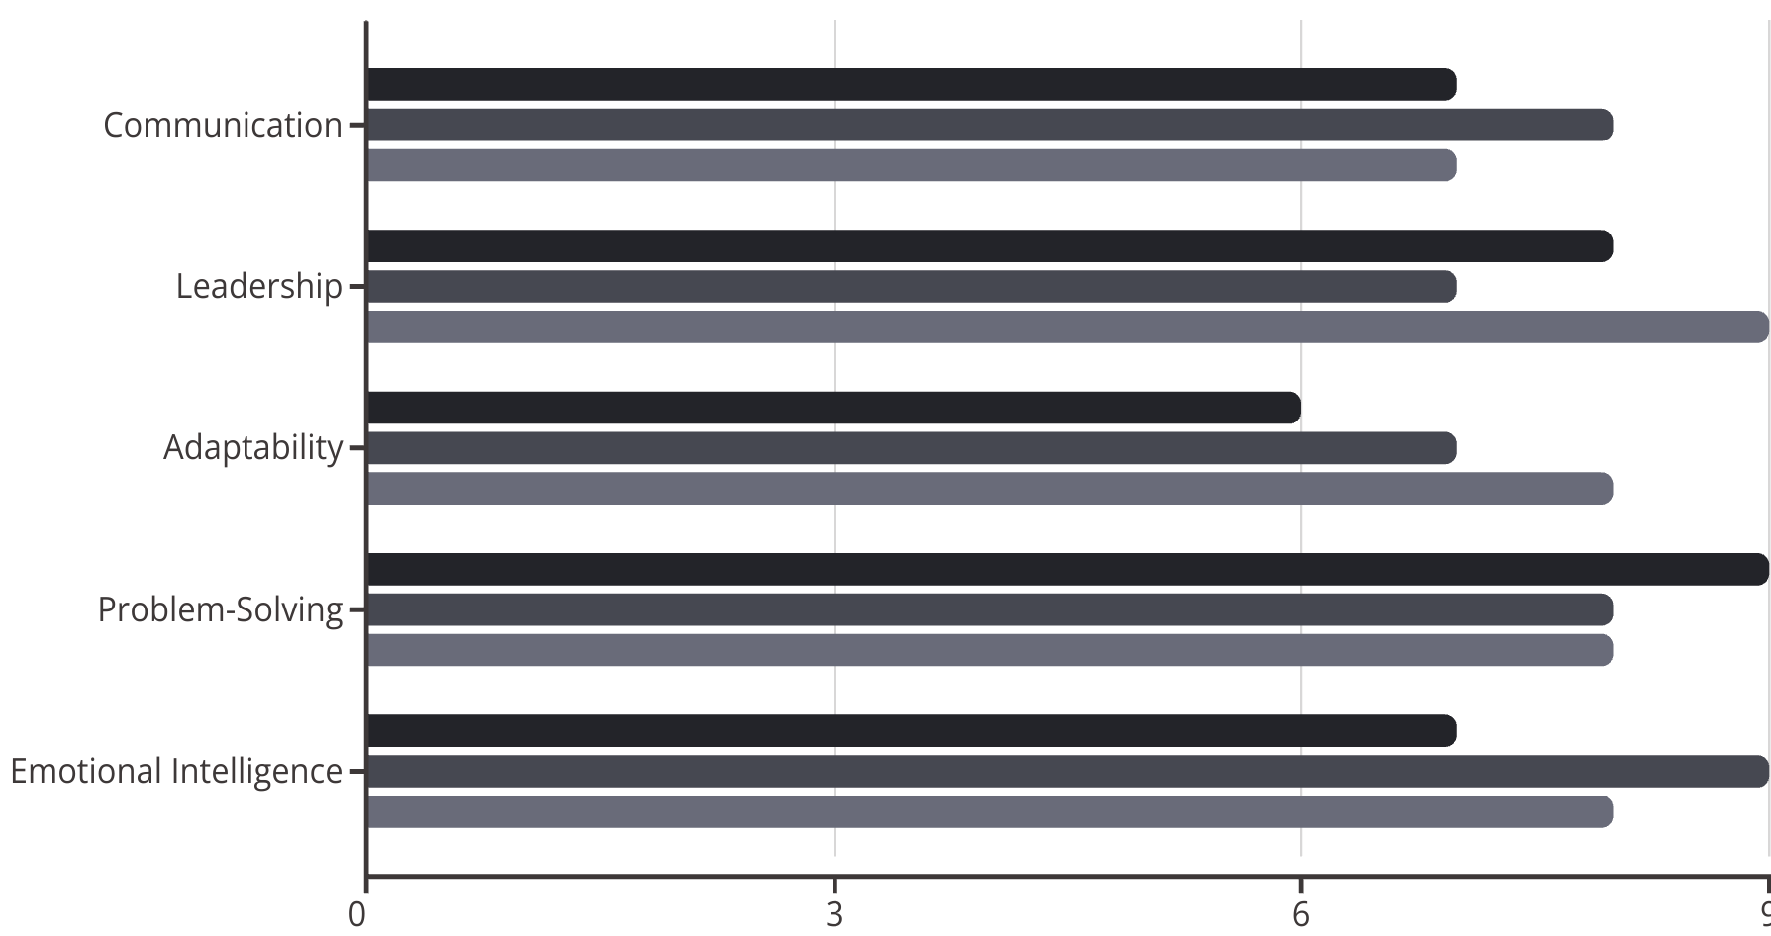
Measuring Soft Skills Development
Unlike technical skills that can be easily assessed through certifications or demonstrable outputs, soft skills development requires more nuanced measurement approaches. However, with the right metrics and feedback mechanisms, you can track meaningful progress in these critical areas.
Effective measurement combines self-assessment with external feedback from multiple sources. This 360-degree perspective helps identify blind spots and confirms when genuine improvement has occurred. Measurements should focus on both behavioral changes and outcome improvements.
Self-Rating
Peer Rating
Manager Rating

Slide 13
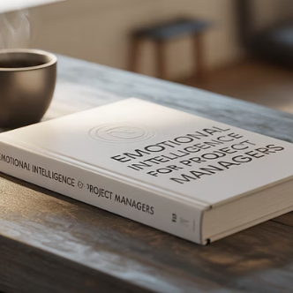
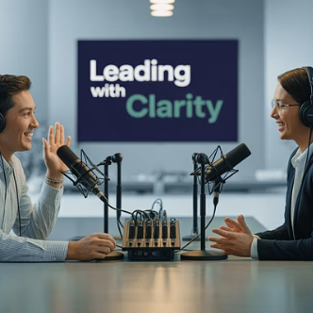
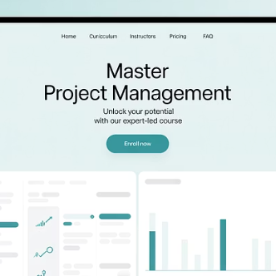


Resources for Continuous Improvement
Developing soft skills is a lifelong journey that requires ongoing commitment and access to quality resources. Fortunately, there's an abundance of excellent materials available to support your development in each of the key skill areas we've discussed.
The most effective approach combines multiple learning methods—formal education, self-directed study, practical application, and reflective practice. Creating a personalized development plan that leverages diverse resources will accelerate your growth and help you become a more well-rounded project manager.

Slide 14
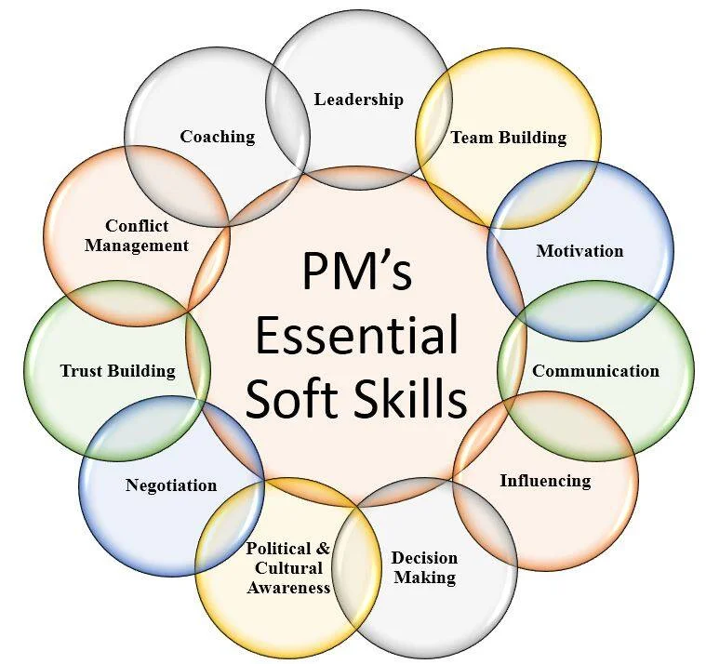
Final Thoughts
In conclusion, while technical skills are undoubtedly important in project management, it's the soft skills that truly distinguish exceptional project managers. By honing their communication abilities, leadership qualities, adaptability, problem-solving skills, emotional intelligence, time management techniques, and collaborative mindset, project managers can navigate the complexities of project management with finesse and achieve outstanding results. So, aspiring project managers, take note: mastering these soft skills is the key to unlocking success in the ever-evolving world of project management.

