Slide 1
Remote-First: The Competitive Advantage for Modern Companies
In a rapidly evolving business landscape, the debate over remote work continues, but evidence increasingly points to a clear advantage for companies embracing a remote-first approach. This presentation explores why forward-thinking organizations are restructuring their operations to make remote work the default—not just an option—and how this strategy delivers measurable benefits to both businesses and employees.
By examining key advantages from talent acquisition to sustainability, we'll demonstrate how a remote-first environment positions companies for long-term success in an increasingly digital world.
kW
by Kimberly Wiethoff

Slide 2
What Does "Remote-First" Really Mean?
Beyond Work-From-Home
Digital By Default
Outcome-Focused
Remote-first means structuring the entire organization to function optimally in a distributed environment, not just allowing occasional remote work.
All processes, communication channels, and collaboration methods are designed assuming team members are distributed geographically.
Success metrics shift from time spent working to actual results produced, empowering employees through greater autonomy.
Remote-first isn't simply allowing employees to work from home—it represents a fundamental shift in organizational design. Rather than adapting traditional office-based processes for remote workers, remote-first companies build their entire operational framework around distributed teams from the ground up.

Slide 3
Global Talent Access: Breaking Geographic Barriers
Wider Talent Pool
Access skilled professionals regardless of location or proximity to offices
Enhanced Diversity
Greater variety of perspectives and cultural inputs driving innovation
Strategic Scaling
Ability to grow teams across multiple time zones for round-the-clock operations
When geography no longer limits hiring decisions, companies gain a remarkable competitive advantage. Remote-first organizations can recruit the ideal candidate for every role, regardless of where that person lives. This expanded talent pool enables businesses to build teams with specialized skills that might be unavailable or prohibitively expensive in their local market.

Slide 4
Productivity Gains: The Evidence Is Clear
Remote Workers
Office Workers
Contrary to traditional assumptions, research consistently shows that remote work enhances productivity. Stanford University's 2023 study revealed remote workers were 13% more productive than in-office colleagues, challenging the notion that physical supervision improves performance.
Remote employees benefit from customized work environments, fewer interruptions, and the elimination of commuting time. When companies focus on outcomes rather than monitoring hours, they see higher engagement, better quality work, and increased efficiency.

Slide 5
The Financial Upside: Cost Savings for Everyone
Office Space
Business Travel
Relocation
Employee Savings
Elimination or reduction of costly commercial real estate and associated utilities
Reduced need for in-person meetings and related travel expenses
No more costly employee relocation packages for new hires
Workers save on commuting, professional wardrobe, and meal expenses
Remote-first models deliver significant financial benefits to both companies and employees. Organizations can dramatically reduce overhead costs associated with maintaining physical offices, including rent, utilities, maintenance, cleaning services, and office supplies. For a mid-sized company, these savings can amount to millions annually.
Employees equally benefit from reduced expenses related to commuting, professional wardrobes, and dining out, often saving thousands of dollars each year while improving overall financial well-being.

Slide 6
Work-Life Balance: The Key to Employee Retention
Flexible Scheduling
Personalized Environment
Family Integration
Reduced Burnout
Employees can optimize work hours around personal productivity rhythms and family needs
More time with loved ones and ability to be present for important moments
Lower stress from commuting and workplace politics improves mental health
Workers create comfort-optimized spaces that enhance focus and reduce stress
Remote-first workplaces foster unprecedented flexibility, allowing employees to design their work environment and schedule according to personal needs. This fundamental shift from rigid traditional structures to adaptable working arrangements significantly improves job satisfaction and loyalty.
Companies embracing remote-first models report higher retention rates and deeper employee engagement. When workers can seamlessly integrate professional responsibilities with personal priorities, they experience reduced burnout and increased commitment to organizational goals.

Slide 7
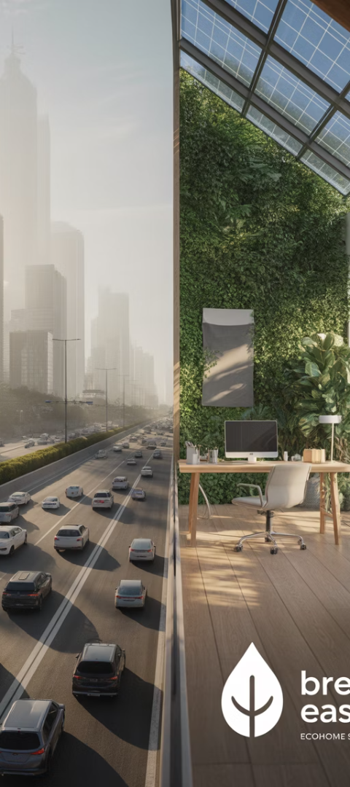
Environmental Impact: The Sustainability Advantage
54%
77M
30%
Commute Reduction
Tons of Greenhouse Gas
Energy Savings
Percentage decrease in carbon emissions when employees work remotely
Annual reduction if all eligible US workers went remote half-time
Average reduction in overall energy consumption for remote companies
Remote-first companies make a significant positive environmental impact by eliminating daily commutes for thousands of employees. The reduction in carbon emissions from transportation alone represents a major contribution to sustainability goals.
Beyond transportation, remote work reduces energy consumption in large office buildings, decreases paper usage and waste production, and minimizes the environmental footprint of corporate operations. For organizations with environmental commitments, remote-first policies offer a tangible way to demonstrate corporate social responsibility.

Slide 8
Attracting Modern Talent: Meeting Workforce Expectations
Millennial & Gen Z Priorities
Inclusive Hiring
Experienced Talent Retention
Remote-first policies enable companies to hire talented individuals with mobility challenges, caregiving responsibilities, or those living in underserved communities.
Younger professionals consistently rank flexibility and work-life balance among their top job considerations, often prioritizing these benefits over higher compensation.
Senior professionals with valuable institutional knowledge often remain longer with companies offering location independence and flexible arrangements.
The modern workforce increasingly expects flexible work arrangements as a standard offering rather than a special perk. Companies maintaining rigid office requirements find themselves at a disadvantage in competitive talent markets, while remote-first organizations enjoy expanded candidate pools and improved hiring outcomes.
As digital natives comprise a growing percentage of the workforce, organizations embracing remote-first models position themselves to attract top talent who value autonomy, results-oriented environments, and technology-enabled collaboration.

Slide 9
Handling Challenges: Communication and Collaboration
Documentation Culture
Structured Interaction
Prioritize written communication and thorough documentation
Establish clear meeting cadences and communication protocols
Right Tools
Intentional Connection
Invest in appropriate collaboration software and virtual workspaces
Create deliberate opportunities for team bonding and culture building
Successful remote-first organizations address potential communication challenges through deliberate practices and appropriate tools. By cultivating a strong documentation culture, companies ensure knowledge sharing occurs asynchronously, reducing dependency on real-time meetings and enabling team members across time zones to stay informed.
Structured interaction protocols—including regular check-ins, clear communication expectations, and appropriate collaboration platforms—create predictability and accountability in distributed teams. When supported by intentional connection opportunities, these practices foster cohesive remote company cultures.

Slide 10
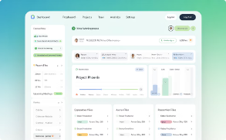
Technology Investments: Building the Digital Workplace
Collaboration Platforms
Comprehensive digital workspaces and project management tools that facilitate seamless teamwork across locations and time zones. These platforms centralize communication, document sharing, and task management.
Communication Technologies
High-quality video conferencing, virtual whiteboarding, and asynchronous messaging systems that recreate the benefits of in-person interaction while accommodating flexible schedules.
Security Infrastructure
Robust cybersecurity measures including VPNs, endpoint protection, and secure authentication systems that maintain data integrity across distributed work environments.
Remote-first companies must strategically invest in digital infrastructure that enables distributed teams to work effectively. Beyond basic communication tools, comprehensive technology stacks should include cloud-based workspaces, document collaboration platforms, project management systems, and secure access protocols.

Slide 11
Remote-First Culture: Building Connection Across Distance
Trust
Foundation of remote-first success
Transparency
Open communication of expectations and decisions
Results Focus
Measuring outcomes rather than activity
Intentional Community
Deliberate efforts to foster belonging
Building a strong remote-first culture requires intentional design and continual nurturing. The foundation begins with trust—leaders must demonstrate confidence in employees' ability to perform without direct supervision, while team members must trust that their contributions are valued regardless of location.
Successful remote-first organizations create spaces for both formal and informal interaction, including virtual social events, recognition programs, and occasional in-person gatherings. By fostering psychological safety and belonging across digital channels, companies build cohesive teams despite geographic separation.

Slide 12
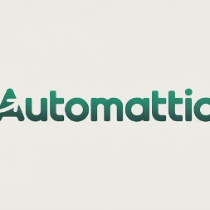
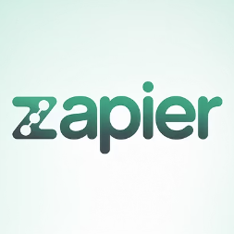
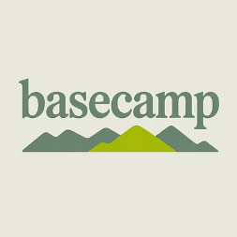
Success Stories: Companies Thriving With Remote-First
Early Adopters
Pandemic Adapters
Innovation Leaders
Companies like Automattic (WordPress) have operated on remote-first principles since 2005, demonstrating sustainable success across market cycles. These pioneers developed remote practices long before they became mainstream.
Organizations that successfully pivoted during COVID-19 and maintained remote options, including Twitter, Shopify, and Slack, have seen improvements in recruiting, retention, and employee satisfaction.
GitLab, Zapier, and Buffer have not only implemented remote-first models but have openly documented their practices, becoming thought leaders in distributed work innovation.
These successful remote-first companies demonstrate that effective implementation transcends industry boundaries and company size. Their documented benefits include lower operating costs, higher employee satisfaction scores, and improved ability to attract specialized talent.

Slide 13
Implementation Roadmap: Transitioning to Remote-First
Assess Readiness
Develop Strategy
Evaluate current processes, technologies, and team capabilities
Create comprehensive transition plan addressing technology, communication, and culture
Implement & Iterate
Prepare Teams
Roll out changes incrementally and refine based on feedback
Train managers and employees on remote work best practices
Transitioning to a remote-first model requires thoughtful planning and incremental implementation. Organizations should begin by assessing their current processes, identifying which functions are already location-independent and which will require modification to thrive in a distributed environment.
Most successful transitions involve pilot programs with specific departments before company-wide implementation. Throughout the process, regular feedback collection and willingness to adapt are essential. Remote-first is not a static endpoint but an evolving approach that requires continuous refinement.

Slide 14
The Future Is Remote-First: Gaining Your Competitive Edge
Key Benefits
Strategic Implications
Global talent access
Competitive hiring advantage
Increased productivity
Enhanced operational efficiency
Significant cost savings
Improved profit margins
Better work-life balance
Higher talent retention
Environmental sustainability
Strengthened corporate reputation
Organizations that embrace remote-first principles position themselves for long-term success in an increasingly digital business landscape. By removing geographic limitations, optimizing for outcomes rather than processes, and leveraging technology effectively, these companies gain significant advantages over traditional office-centric competitors.
The most successful businesses of the next decade will be those that adapt to changing workforce expectations and leverage the flexibility, efficiency, and talent benefits that a remote-first approach provides. Rather than resisting this transformation, forward-thinking leaders should view it as an opportunity to build more resilient, inclusive, and high-performing organizations.

Slide 15
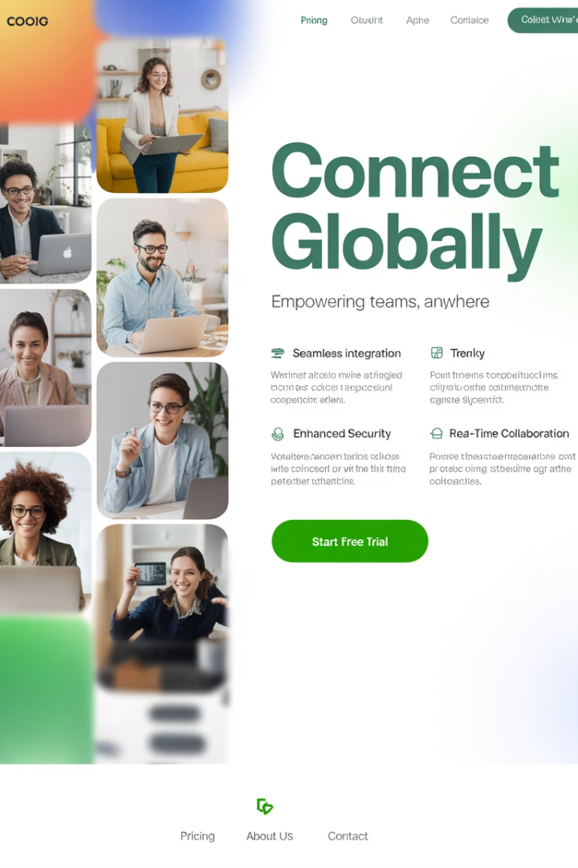
Final Thought
The companies that thrive in the next decade will be those that adapt to the changing nature of work. A remote-first environment fosters innovation, productivity, and inclusivity, setting organizations up for long-term success.
Rather than resisting change, businesses should embrace the flexibility, efficiency, and talent benefits that a remote-first culture provides.

