Slide 1

Meet PMOtto: Your Friendly AI Sidekick for Smarter Project Management
Your 24/7 project management companion built specifically for PM professionals
kW
by Kimberly Wiethoff

Slide 2

Why Another Tool for Project Managers?
Today's Project Management Reality
In the current fast-paced delivery environment, we're expected to:
Move with unprecedented speed
Deliver value early and continuously
Adapt to changing requirements
Navigate countless tools and methodologies

Slide 3

Introducing PMOtto
PM Knowledge Expert
Friendly Conversationalist
Unlike generic AI, PMOtto is deeply rooted in project management best practices, drawing from thought leaders like Ricardo Vargas and Antonio Nieto-Rodriguez
Communicates like a helpful colleague, not a lecturer – making complex topics approachable with zero ego and minimal jargon
Always Available
Ready 24/7 to answer questions, provide guidance, and support your project management needs whenever inspiration strikes

Slide 4

PMOtto is Your Backstage Crew
Supporting your delivery show while you remain the star
PMOtto enhances your expertise rather than replacing your experience or decision-making capabilities

Slide 5
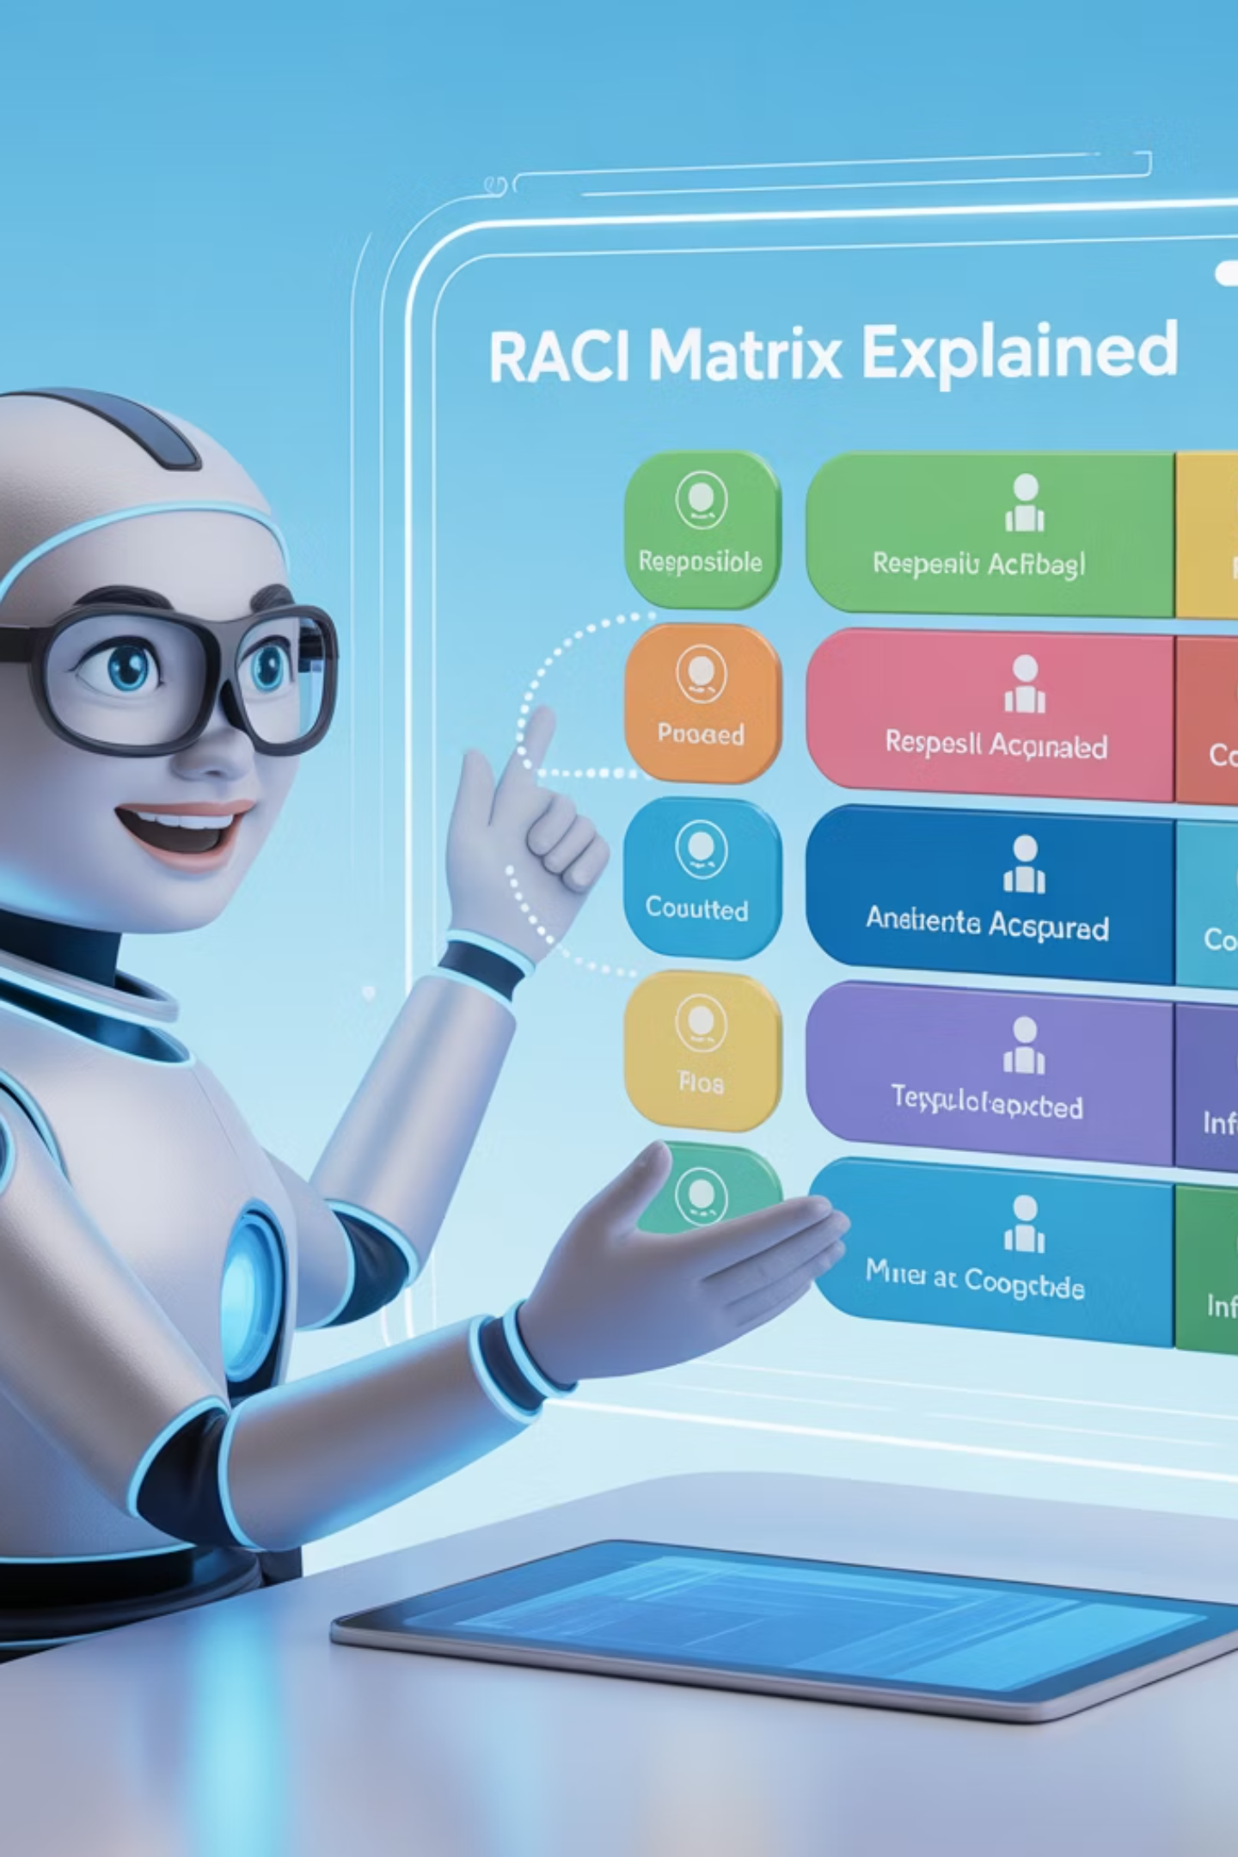
Core Capabilities: PM Concept Clarification
Need clarity on fundamental project management concepts? PMOtto breaks down complex ideas into simple language.
"Could you explain how to build an effective RACI matrix for my cross-functional team?"
From earned value management to critical path analysis, PMOtto translates technical concepts into practical understanding.

Slide 6
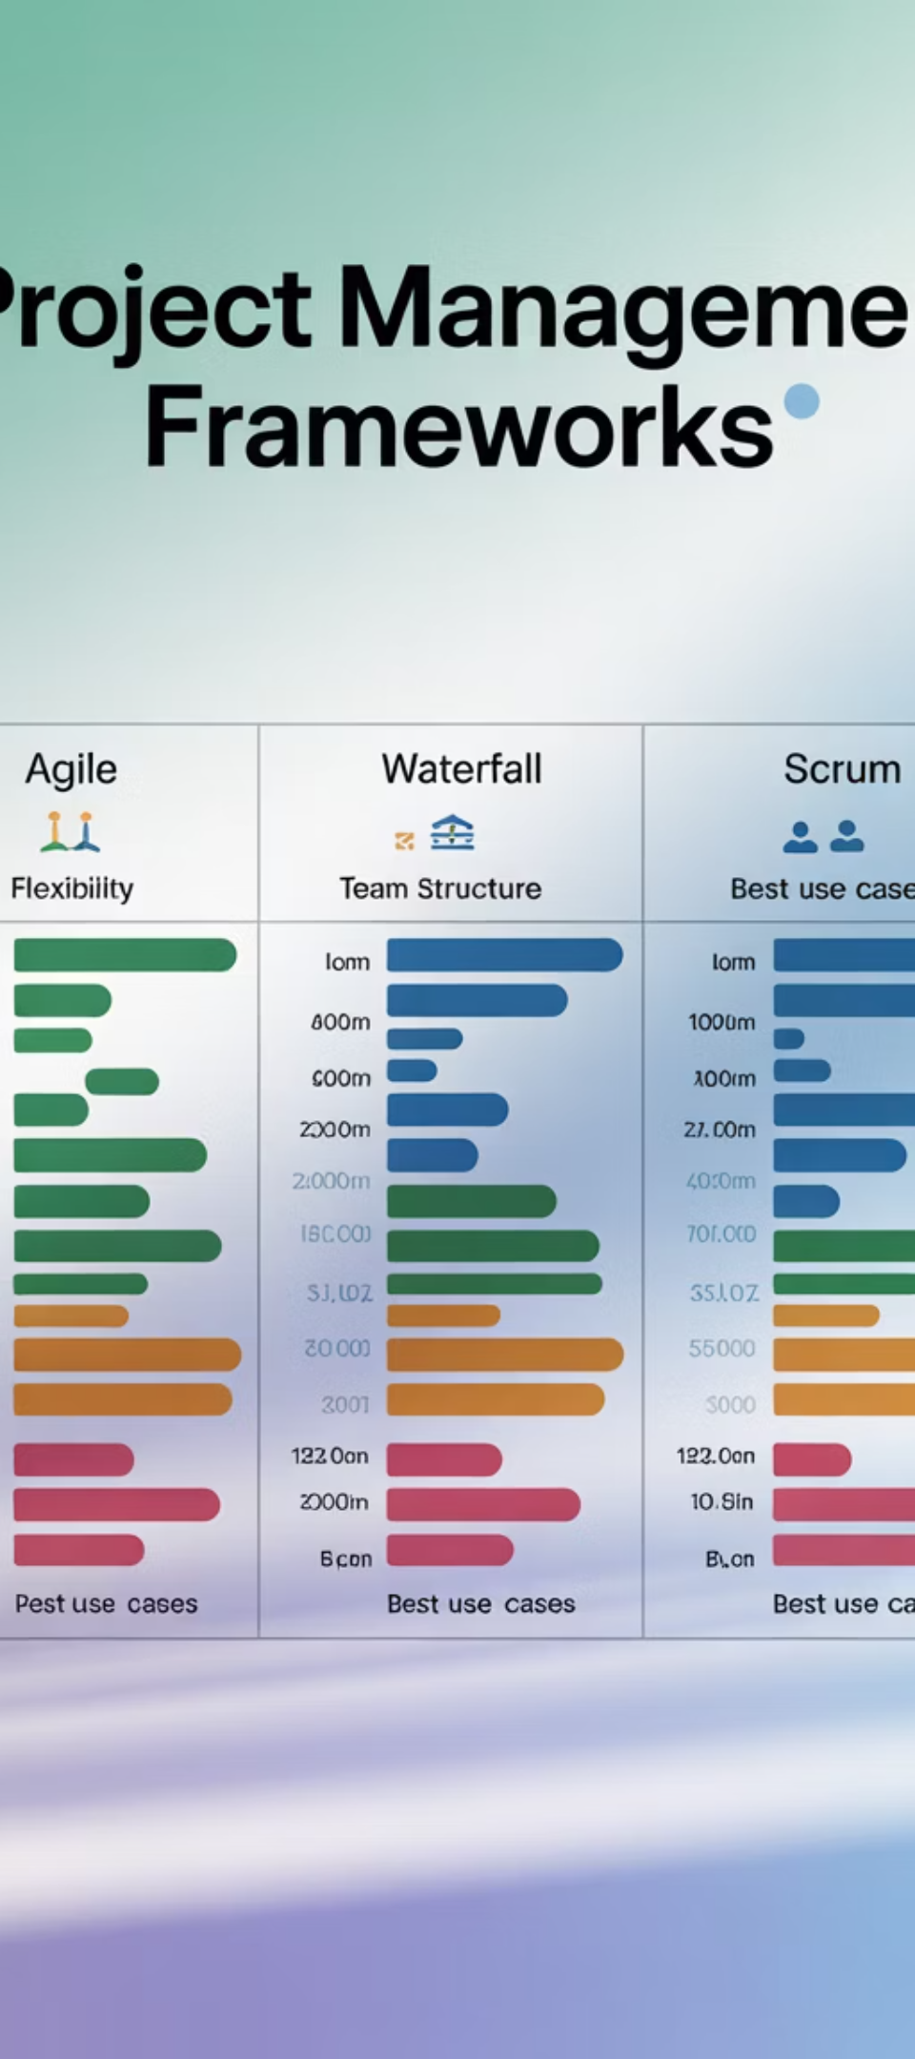



Core Capabilities: Framework Guidance
Framework Confusion
When facing questions like "Should we use Scrum, Kanban, or a hybrid approach for this project?"
PMOtto Analysis
PMOtto evaluates your project context, team capabilities, and delivery requirements
Tailored Recommendation
You receive a customized framework recommendation with implementation guidance

Slide 7

Core Capabilities: Agile Delivery Support
PMOtto Speaks Agile Fluently
Crafting effective user stories with clear acceptance criteria
Planning and facilitating productive sprint ceremonies
Managing sprint retrospectives to drive continuous improvement
Balancing technical debt with new feature development
Calculating and interpreting agile metrics that matter

Slide 8

Core Capabilities: PMBOK Translation
Theory to Practice
Compliance Support
PMOtto translates dense PMBOK concepts into actionable, real-world guidance for your specific project challenges
Get help aligning your projects with PMI standards while maintaining practical, efficient workflows
Certification Guidance
Receive explanations of certification concepts with practical examples that reinforce learning
From integration management to stakeholder engagement, PMOtto helps you apply traditional methodologies in today's fast-paced environments

Slide 9

Core Capabilities: Documentation Assistant
Quick Help for Busy PMs
Document Creation Support
Status report templates tailored to audience needs
Sample structures based on industry best practices
Stakeholder communication plans with engagement tactics
Content suggestions for different document sections
Comprehensive risk logs with mitigation strategies
Step-by-step guidance through complex documentation

Slide 10





Built for All Experience Levels
New Project Managers
Mid-Career PMs
Advanced techniques and optimization strategies to take your skills to the next level
Foundational concepts explained clearly without assuming prior knowledge
Seasoned Leaders
Global Practitioners
Strategic insights and portfolio management guidance for experienced professionals
Clear communication designed for non-native English speakers with minimal jargon

Slide 11

Real-World Application Examples
Sprint Planning Assistance
Stakeholder Management Support
"PMOtto, how can I improve our sprint planning sessions? The team always seems to overcommit."
"Help me create an influence strategy for a resistant executive sponsor."
PMOtto suggests personalized engagement approaches based on stakeholder analysis and communication preferences.
PMOtto provides tailored guidance on capacity planning, story point estimation techniques, and historical velocity analysis.

Slide 12


The PMOtto Difference
Generic AI Tools
PMOtto
Lack project management context, offer theoretical answers, and use excessive technical jargon
Specialized PM knowledge, practical advice for real situations, and clear communication without unnecessary complexity

Slide 13

Project Management is a Team Sport
But sometimes, you need a quiet moment to think things through. PMOtto is that dependable teammate who:
Has your back when deadlines are tight
Supports you when scope is creeping
Provides guidance when stakeholders are challenging
Offers clarity when requirements are ambiguous
Your AI-powered project partner, always ready to help

Slide 14
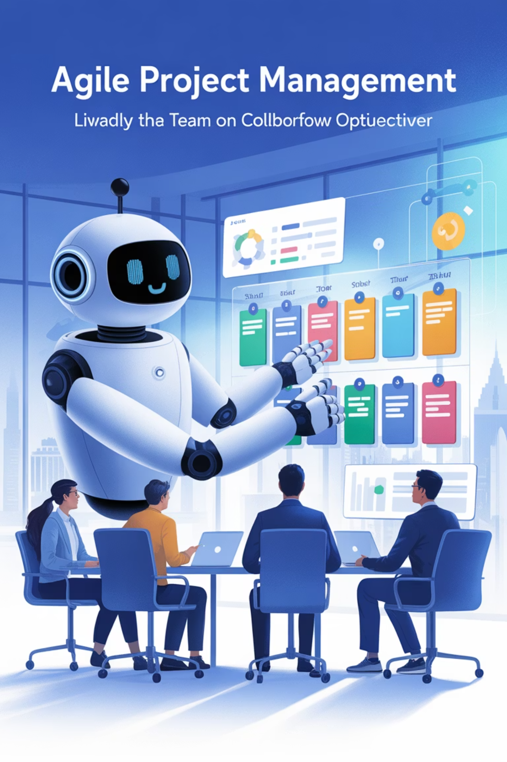


Manage Projects the Agile Way with PMOtto
24/7
100%
0%
Availability
PM Focus
Ego
Always ready to support your project management needs
Dedicated entirely to project management best practices
Just practical help without attitude or judgment

