Slide 1

Mastering Your Interview: Guide for IT Management Roles
Preparing for an IT management job interview requires more than just technical skills. It demands a strategic approach encompassing understanding the job description, showcasing relevant experience, and demonstrating cultural fit. This guide will help you ace your interview, with a special focus on leveraging ChatGPT for preparation.
kW
by Kimberly Wiethoff

Slide 2

Understanding the Job Description
1
Analyze Key Responsibilities
2
Highlight Relevant Experience
Thoroughly dissect the job description, focusing on primary duties and required qualifications.
Identify instances from your career that align with the job requirements, such as leadership and project management.
3
Leverage ChatGPT
Use ChatGPT to generate tailored questions and gain additional insights on specific role requirements.

Slide 3




Emphasizing Leadership Skills
Showcase Experience
Highlight instances of leading teams, driving initiatives, and making strategic decisions.
Provide Examples
Offer specific scenarios where you motivated team members and achieved goals effectively.
Use ChatGPT
Refine your leadership narratives and simulate interview scenarios to demonstrate your management style.

Slide 4



Highlighting Relationship Building
Cross-functional Collaboration
2
Emphasize your ability to work across departments and build consensus.
Stakeholder Communication
1
Discuss effective communication with executives, technical teams, and end-users.
ChatGPT Practice
Use ChatGPT to brainstorm and articulate relationship-building experiences clearly.
3

Slide 5

Demonstrating Technical Expertise
Relevant Technologies
Problem-Solving Examples
Discuss your experience with tools and methodologies mentioned in the job description.
Provide specific instances where you applied technical knowledge to solve complex issues.
ChatGPT Enhancement
Use ChatGPT to brush up on technical concepts and simulate discussions to test your understanding.

Slide 6

Cultural Fit and Company Values
1
Research
Investigate the company culture and values beforehand.
2
Align Responses
Tailor your answers to demonstrate how you would fit into the organization.
3
Highlight Adaptability
Showcase your willingness to learn and commitment to teamwork.
4
ChatGPT Assistance
Use ChatGPT to generate questions that show genuine interest in the company's mission.

Slide 7




Preparing Questions for the Hiring Manager
Company Approach
Team Collaboration
Professional Development
Ask about specific aspects mentioned in the job description.
Inquire about how IT management works with other departments.
Ask about opportunities for growth within the organization.
Use ChatGPT to refine these questions and ensure they align with the interview's tone and objectives.

Slide 8





Key Performance Indicators (KPIs) for IT Management
Project Delivery Metrics
1
On-time delivery, budget adherence
2
Customer Satisfaction
Ratings and feedback
3
Team Performance
Productivity and efficiency
4
System Reliability
Uptime and technical performance
5
Compliance
Adherence to regulatory standards and security protocols

Slide 9

Utilizing ChatGPT for Interview Preparation
Address Concerns
Generate Questions
Use ChatGPT to identify and prepare for potential weaknesses or concerns.
Refine Job Summary
Ask ChatGPT to provide potential interview questions.
Input Information
Use ChatGPT to create a concise summary of the position.
Provide job description, resume, and DISC assessment to ChatGPT.

Slide 10
Leveraging Personal Assessments
DISC Assessment
Strengths and Weaknesses
Cultural Fit
Use your DISC profile to understand your personality and work ethic. Leverage ChatGPT to interpret how these traits align with the job requirements and company culture.
Ask ChatGPT to analyze your resume and DISC assessment to identify potential strengths and areas for improvement. Prepare to discuss these during the interview.
Use ChatGPT to generate statements that demonstrate your cultural fit based on your personal assessments and the job description.

Slide 11

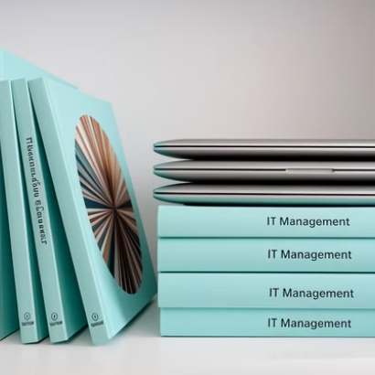

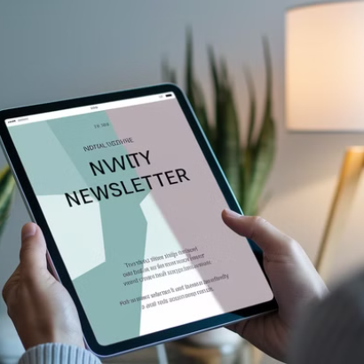
Staying Current in IT Management
To stay current in the rapidly evolving field of IT management, engage in continuous learning through online courses, attend industry conferences, participate in professional networks, and regularly read industry publications and blogs. Use ChatGPT to identify trending topics and resources in IT management.

Slide 12

Conclusion: Acing Your IT Management Interview
1
Thorough Preparation
Understand the job description, highlight relevant experience, and demonstrate cultural fit.
2
Showcase Skills
Emphasize leadership, technical expertise, and relationship-building abilities.
3
Leverage Tools
Use ChatGPT and personal assessments to enhance your interview readiness.
4
Continuous Learning
Stay current with industry trends and best practices in IT management.

