Slide 1
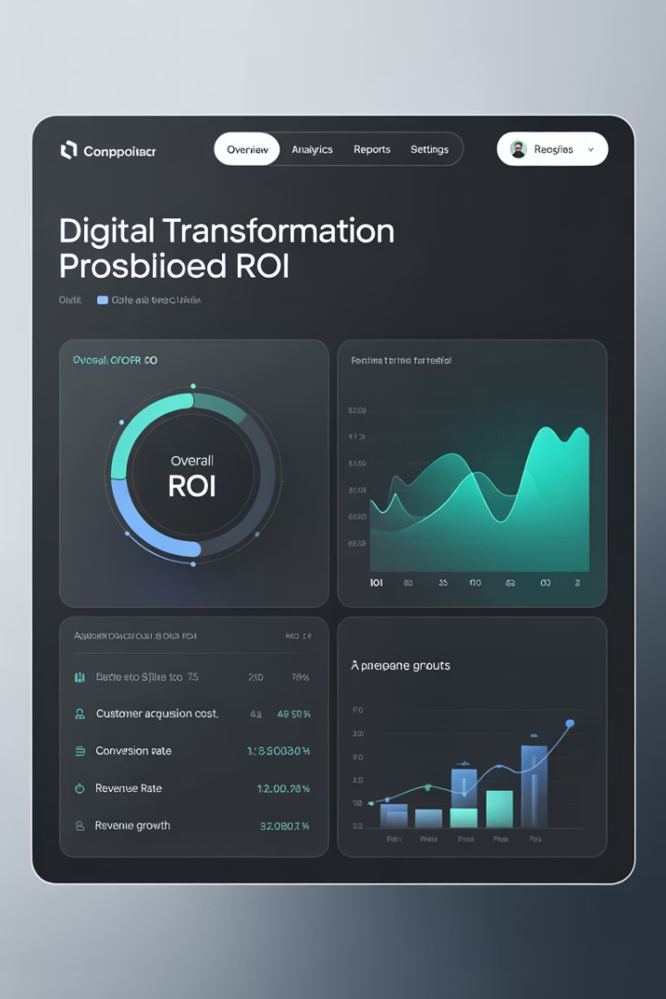

Digital Transformation Metrics That Matter
Proving ROI to executives requires metrics that speak their language. This presentation reveals how to measure and communicate digital transformation value in ways that secure trust, budget, and buy-in.
#DigitalTransformation #ITMetrics #ProvingROI #ExecutiveReporting #AgileLeadership #ProgramManagement #TechStrategy #CustomerExperience #OperationalExcellence #DataDriven #ManagingProjectsTheAgileWay

Slide 2

Why Metrics Matter
The Executive Challenge
The Solution
Digital transformation initiatives often speak tech language. Executives think in business terms.
Align metrics with executive priorities. Measure what matters to the business.
Connect technical achievements to business outcomes. Prove value in their language.
They ask one critical question: "What's the ROI?"

Slide 3





Time-to-Value (TTV)
Why It Matters
Executives don't want long timelines with vague promises. They want to see progress quickly.
How To Measure
Track lead time from project kickoff to first release.
Early Wins
Highlight pilot deployments, automated workflows, or successful MVPs.
Supporting Tools
Use Agile burndown charts or velocity trends to visualize progress.

Slide 4
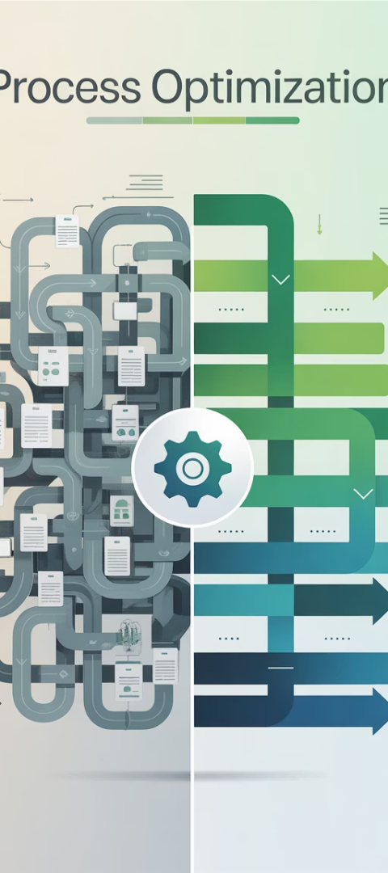




Operational Efficiency Gains
Identify Bottlenecks
Map existing processes. Find manual touchpoints and redundancies.
Implement Solutions
Apply automation, AI, and cloud tools to streamline workflows.
Measure Improvements
Track reduced cycle times. Measure increased throughput.
Calculate Value
Translate time savings into cost reductions and productivity gains.

Slide 5








Customer Experience Improvements
Self-Service Adoption
Support Metrics
Measure increased usage of digital portals, apps, and tools.
Monitor reduced support tickets. Track shorter call center wait times.
Satisfaction Scores
Track NPS and CSAT improvements. Compare before and after implementation.
Retention Impact
Calculate improved customer retention rates and lifetime value.

Slide 6

Revenue Impact & Cost Avoidance
New Revenue Streams
Cost Reductions
Digital products and services
Lower licensing fees
Reduced infrastructure costs
Subscription models
Data monetization opportunities
Decreased maintenance expenses
Risk Mitigation Value
Avoided compliance penalties
Prevented outage costs
Security breach prevention

Slide 7

Adoption & Engagement Metrics
85%
92%
Active Users
Training Completion
Percentage of eligible users regularly using new systems
Employees who completed digital skills training
47%
78%
Feature Utilization
Positive Sentiment
Advanced features being regularly used
Users reporting satisfaction with new tools

Slide 8
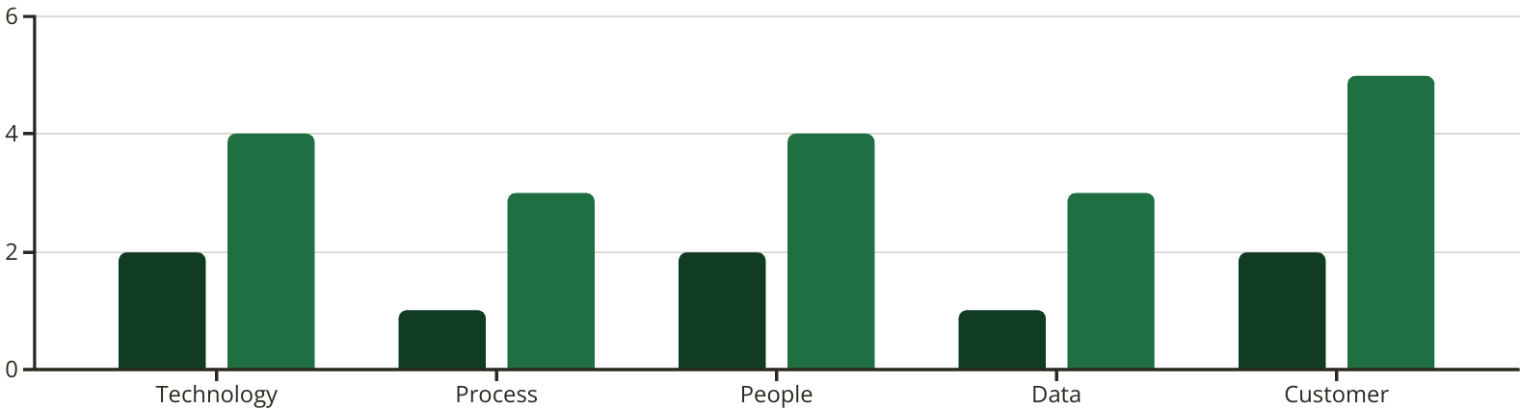
Digital Maturity Assessment
A comprehensive evaluation measuring your organization's progress across five critical dimensions of digital transformation. The radar chart below shows significant improvements post-implementation.
Before
After
The assessment reveals dramatic improvement in all areas, with the most significant gains in Customer experience (150% increase) and moderate progress in Process and Data capabilities (200% increase). These metrics provide a quantifiable baseline for tracking ongoing transformation efforts and identifying future investment priorities.

Slide 9








Risk Reduction & Compliance
Enhanced Security
Vulnerabilities remediated and attack surface reduced
Improved Compliance
Regulatory requirements met with automated controls
Better Documentation
Audit-ready systems with comprehensive logging
Reduced Exposure
Financial and reputational risk minimized

Slide 10
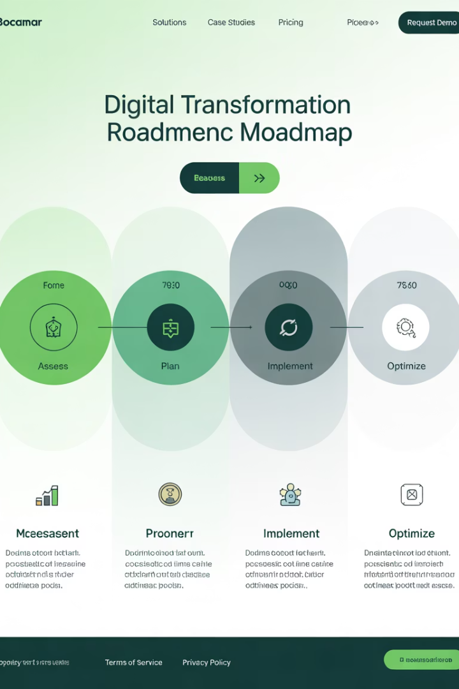




Implementation Roadmap
Baseline Assessment
Establish current metrics. Identify key improvement opportunities.
Goal Setting
Define specific KPIs. Align with business objectives.
Implementation
Deploy solutions. Gather data continuously.
Analysis & Reporting
Measure outcomes. Communicate results to executives.

Slide 11




Industry Benchmarks
Industry Leaders
Setting new standards for digital performance
High Performers
Exceeding industry averages across metrics
Average Performers
Meeting typical industry standards
Laggards
Falling behind competitive benchmarks

Slide 12

Executive Communication Framework
Link to Strategic Goals
Connect metrics to company vision. Show how transformation supports key initiatives.
Present Business Impact
Lead with financial outcomes. Translate technical wins into business language.
Provide Context
Compare to industry benchmarks. Show progress over time.
Offer Clear Next Steps
Recommend actions based on data. Present a forward-looking roadmap.

Slide 13








Key Takeaways
Measure What Matters
Quantify Value
Focus on metrics that align with executive priorities
Translate technical achievements into financial impact
Build Momentum
Communicate Effectively
Use metrics to secure ongoing support for transformation
Use visuals and business language that resonates

