Slide 1
Return-to-Office Mandates in 2025
As we move into 2025, companies are increasingly mandating returns to physical workplaces. This shift comes after years of remote work becoming not just accepted, but expected.
What's driving this reversal? Let's explore the key factors behind this significant workplace trend.
kW
by Kimberly Wiethoff

Slide 2
The Collaboration Argument
Spontaneous Innovation
Team Dynamics
Organic Conversations
Physical proximity strengthens relationships and improves communication flow.
Executives believe in-person interaction fosters creativity and impromptu problem-solving.
Chance encounters in hallways often lead to valuable insights and solutions.

Slide 3
Building Company Culture
Shared Experiences
New Employee Integration
Leaders argue that culture is built in hallways, not just in Zoom meetings.
Early-career professionals struggle to connect with organizational values remotely.
Physical spaces create opportunities for informal bonding and relationship building.
In-person mentoring helps transmit unwritten cultural norms and expectations.

Slide 4
Productivity Concerns
Initial Remote Boost
Many knowledge workers saw productivity increases during early remote work.
Declining Output
Some employers now report inconsistent performance in certain roles.
Coordination Challenges
Roles requiring tight teamwork suffer most from distance.
Hybrid Solution
Part-time office work aims to boost results while maintaining flexibility.

Slide 5
Management and Accountability
Visibility
Some leaders equate seeing employees with productivity.
Oversight
Direct supervision feels more natural in physical spaces.
Management Skills
Not all managers have adapted to remote leadership.
Managing remote teams requires new skill sets and robust digital workflows. For many organizations, returning to the office provides a more familiar environment.

Slide 6
Financial Considerations
$23B
42%
$14K
Annual Office Costs
Vacancy Rates
Per-Employee Cost
Major corporations maintain expensive long-term leases.
Empty buildings represent significant financial waste.
Average annual expense for office space per worker.
Companies want to justify real estate expenses. Empty offices aren't just inefficient—they're financial liabilities.

Slide 7
Career Development Benefits
Impromptu Mentorship
Casual interactions lead to valuable guidance and advice.
Executive Face Time
Physical presence increases visibility to leadership.
Learning Opportunities
Junior employees absorb knowledge through observation and proximity.
Career Advancement
In-office employees often receive more promotion opportunities.

Slide 8
Combating Disengagement
Isolation
"Quiet Quitting"
Remote work can lead to feelings of disconnection.
Some employees do minimum requirements without engagement.
Renewed Engagement
Return Mandate
Physical presence aims to reignite motivation and commitment.
Companies implement in-office requirements to boost connection.

Slide 9
Employee Reactions
Enthusiastic
Accepting
Reluctant
Resistant
While some professionals welcome structure and social interaction, many have built lives around remote flexibility. Forcing returns creates friction and potential attrition.

Slide 10
Balancing Act for Companies
Operational Goals
Maintaining productivity and collaboration standards.
Cultural Cohesion
Building shared identity and organizational values.
Employee Autonomy
Respecting personal needs and work-life balance.
Companies enforcing mandates must find equilibrium between business needs and workforce preferences. Those that don't risk losing talent to flexible competitors.

Slide 11
Redefining Office Purpose
Collaboration Hubs
Cultural Centers
Offices evolving from individual workstations to team meeting spaces. Focus on activities that benefit from in-person interaction.
Physical spaces designed primarily for community building and social connection. Less emphasis on daily individual work.
Learning Environments
Offices reimagined as development centers where knowledge transfer happens naturally. Structured mentoring programs become central.

Slide 12
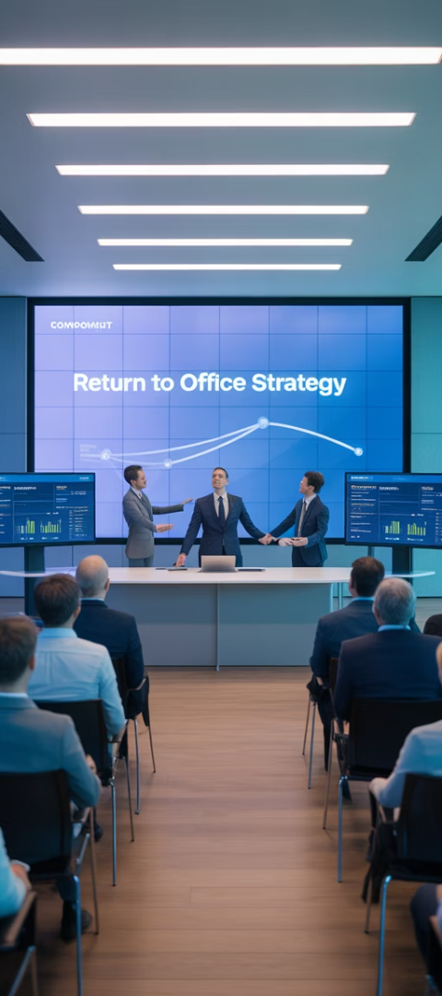
Communication Strategies
Clear Rationale
Successful companies explain specific benefits of in-person work. They avoid vague mandates without supporting evidence.
Employee Input
Gathering feedback before finalizing policies increases buy-in. Workers feel heard when their concerns shape implementation.
Flexible Implementation
Phased approaches with team-specific adaptations work better than one-size-fits-all mandates. Reasonable accommodations show respect.

Slide 13
Industry Variations
Technology
Financial Services
Healthcare
Tech firms face strongest resistance to RTO mandates. Many offer permanent remote options to attract talent.
Banks and financial institutions lead the return push. Client relationships and regulatory concerns drive in-person requirements.
Mixed approach based on role. Patient-facing positions return while administrative functions remain flexible.

Slide 14
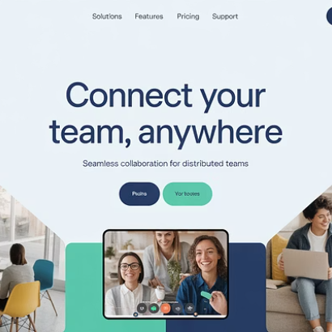
The Future of Work
The most successful organizations won't just bring people back—they'll redefine what "office" means in a flexible-first world. The future combines in-person collaboration with remote autonomy.

Slide 15
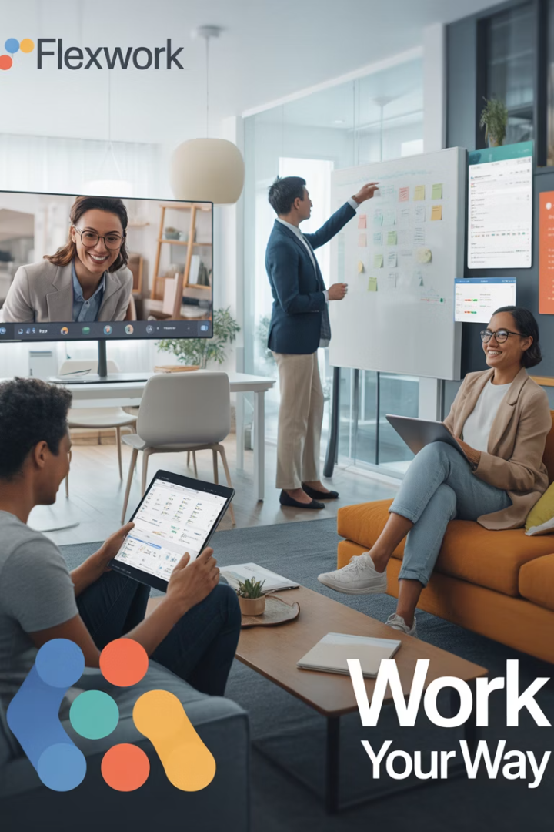
Final Thoughts
The return-to-office movement is complex—fueled by concerns over collaboration, culture, performance, and real estate investments. While some mandates are rooted in valid strategic goals, success will depend on how well companies communicate, listen, and adapt. In 2025, the most successful organizations won't just bring people back to the office—they'll redefine what the office means in a flexible-first world.

