Slide 1

How to Measure the ROI of AI Projects
From AI Experimentation to Measurable Business Value
KIMBERLY WIETHOFF, MBA, PMP, PMI-ACP
AI GOVERNANCE · PMO · BENEFITS REALIZATION
Managing Projects The Agile Way
#AI #ArtificialIntelligence #AIROI #EnterpriseAI #AITransformation #ProgramManagement #ProjectManagement #PMO #PMOLeadership #BusinessValue #BenefitsRealization #AIGovernance #AgenticAI #DigitalTransformation #AILeadership #ManagingProjectsTheAgileWay

Slide 2

The Question Every Executive Is Asking
The Technology Is Advancing Rapidly
But the Harder Question Is Now:
Organizations are investing in copilots, intelligent automation, predictive analytics, generative AI, machine learning, and increasingly, AI agents capable of performing work — not just assisting with it.
During a pilot, success feels easy. A model produces an impressive result. An agent completes a workflow in seconds. Everyone sees the potential.
Are these investments actually creating measurable business value?
Once organizations move from experimentation to enterprise deployment, executives eventually ask: "What value did we actually receive from the investment?"
That is where many AI initiatives struggle. It is relatively easy to demonstrate that AI works. It is much harder to prove that AI improved the business enough to justify the investment.
Benefits realization needs to begin before the project starts — not after go-live.

Slide 3

AI Success ≠ Business Success
Technical and adoption metrics can look impressive — and still tell you nothing about ROI.
Technical Performance
Adoption Metrics
95% model accuracy. Chatbot answered 50,000 questions. 10,000 agent tasks completed.
Tells us whether the technology works.
85% of licenses activated. 100,000 prompts generated. Pilot launched on schedule.
Tells us whether people are using it.
Business Outcomes
Lower costs. Faster processes. Higher productivity. Increased revenue. Fewer errors.
Tells us whether the investment mattered.
Executives are not investing in prompts, models, agents, tokens, or licenses. They are investing because they expect something in the organization to improve. The PMO's job is to connect the technology investment to those outcomes.

Slide 4
Start With the Business Problem, Not the AI Solution
One of the most common mistakes in AI programs: beginning with the technology instead of the outcome.
❌ Solution-First Framing
✅ Outcome-First Framing
"We need an AI assistant."
"We should build an AI agent."
"We need a generative AI strategy."
"Reduce employee search time by 30%."
"Cut reporting prep from 6 hours to 2 hours weekly."
"Resolve 40% of routine inquiries without human intervention."
These describe potential solutions. They do not describe business problems.
Now you have something measurable. The AI becomes the solution. The business outcome becomes the goal.
That distinction fundamentally changes how the project is governed — and how success is defined from day one.

Slide 5
Establish the Baseline Before Implementing AI
You cannot prove improvement if you do not know where you started. Before implementing AI, capture the current state of the process — even if it is messy and inconsistent.
Don't Wait for a Perfect Baseline
Different teams may perform the same work differently. Some employees complete a task in 20 minutes; others take an hour. Establish a credible baseline range instead.
Measure across multiple employees, teams, transaction types, time periods, and performance levels. Then document the variation.
What to Measure
Hours required to complete the process
Cost per transaction
Cycle time and error rate
Customer and employee satisfaction
Rework, escalation, and defect rates
Revenue conversion and compliance incidents
Example: "Current reporting preparation time: 4–7 hours per week, median 5.5 hours."
That is far more useful than pretending the organization has a perfectly standardized process. The goal is credible evidence — not mathematical perfection.

Slide 6
Define the Value Hypothesis
Before funding any AI initiative, document a simple, structured value hypothesis that gives the steering committee something concrete to evaluate.
If we implement [AI capability], we expect [business metric] to improve from [baseline] to [target], creating approximately [business value] within [time period].
Example in Practice
If we implement AI-assisted project reporting, we expect reporting preparation time to decrease from an average of five hours per program manager per week to two hours — creating approximately 3,000 hours of additional annual delivery capacity.
The Problem
The Baseline
The Target
The Value
Defined and scoped
Measured and documented
Specific and time-bound
Estimated and governed

Slide 7
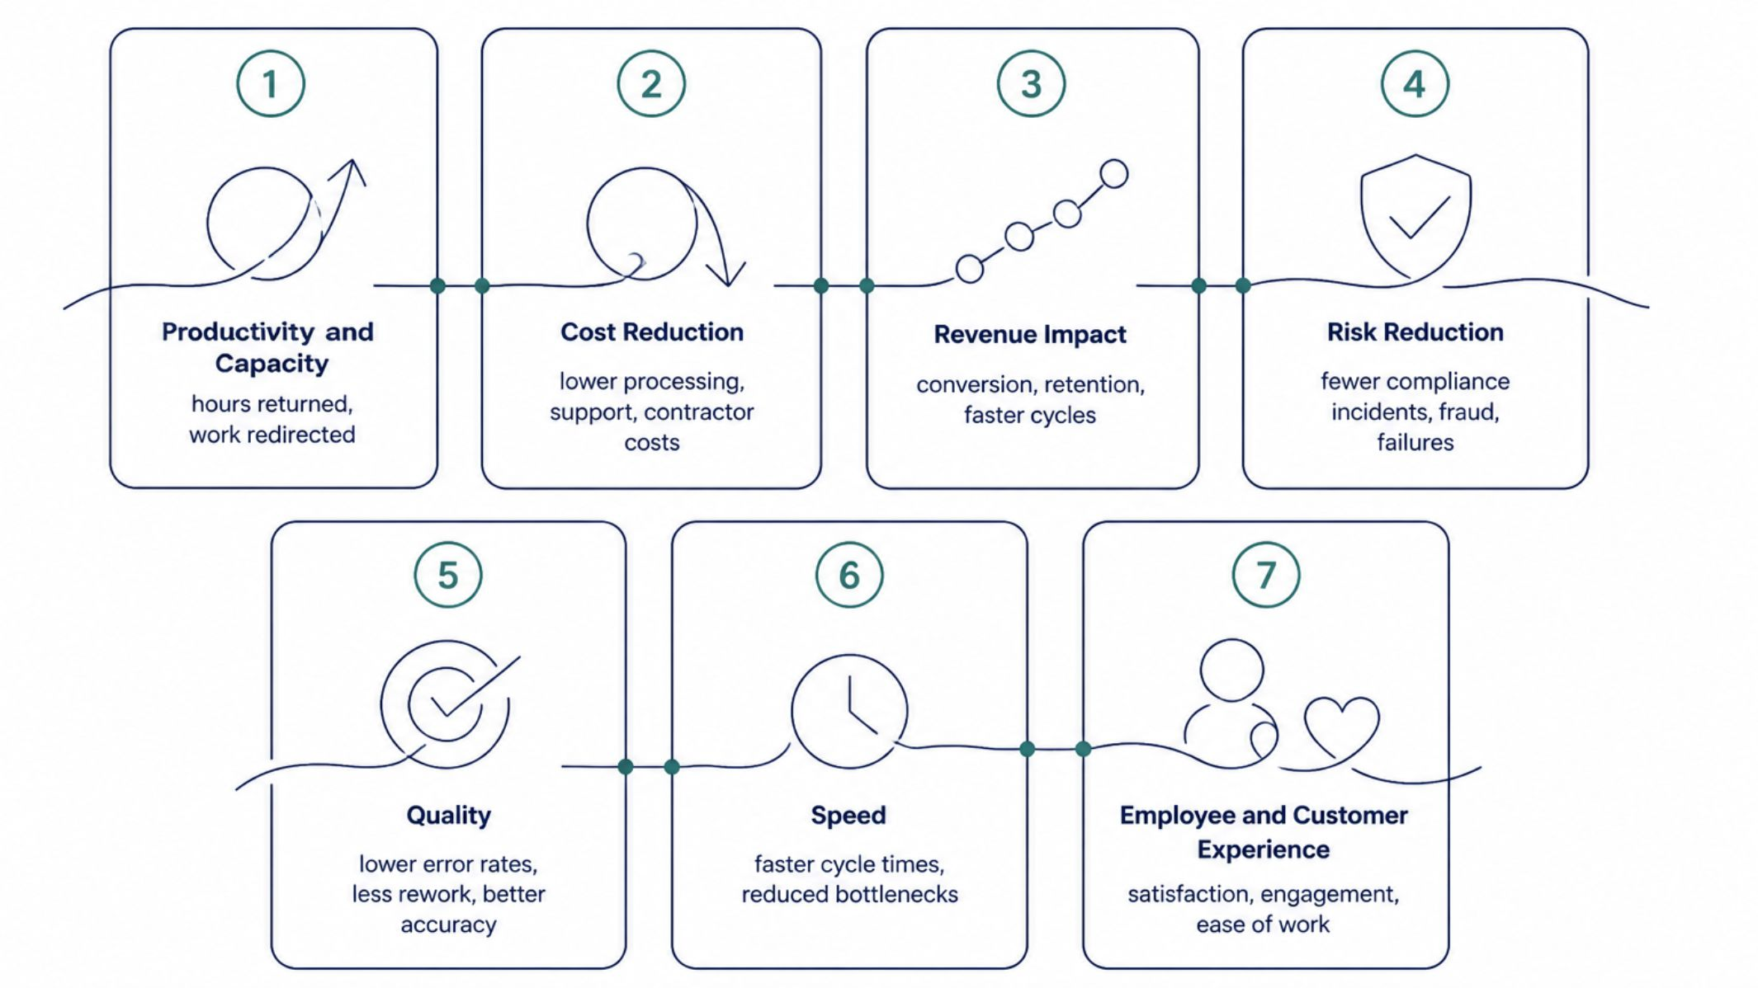
Seven Dimensions of AI Value
AI value does not always fit neatly into one financial metric. Evaluate investments across multiple dimensions to build a complete and credible business case. The traditional ROI formula (ROI = (Benefit − Cost) ÷ Cost × 100) remains the foundation. But a $500K investment yielding $900K in measurable benefits (80% ROI) only tells part of the story. Capture value across all seven dimensions for a complete picture.

Slide 8

Productivity: Capacity Created vs. Money Saved
The Calculation
A Critical Distinction
Suppose 20 program managers each spend five hours per week preparing reports — 100 hours per week. AI reduces that to two hours per person.
60 hours are returned to the organization every week. Across 52 weeks: 3,120 hours of additional capacity annually.
Time saved is not automatically money saved.
If no salaries change and no positions are eliminated, the organization did not "save" the salary equivalent of those hours.
What it created was capacity — and that capacity is genuinely valuable when redirected toward higher-value work.
What That Capacity Enables
Risk and dependency management
Stakeholder engagement and coaching
Strategic planning and benefits realization
Vendor management and delivery improvement
Claiming millions in "savings" based on hours never removed from the cost structure is one of the fastest ways to undermine an AI business case.

Slide 9
Risk Reduction: Measuring What Didn't Happen
Some of the most valuable AI systems create value by preventing something — fraud, compliance violations, operational failures, safety incidents. This can be difficult to quantify, but there is a practical approach.
The Framework
The AI Improvement
Why It Matters
Expected Risk Exposure = Probability of Event × Financial Impact
An operational failure with a 20% annual probability and $5M impact carries $1M in expected annual exposure.
If AI-enabled monitoring reduces that probability from 20% to 5%, expected exposure drops to $250,000.
Estimated risk reduction: $750,000 — not a check received, but a material reduction in financial exposure.
For highly regulated or operationally complex organizations, risk reduction can be AI's most important form of value — often exceeding the direct productivity or cost savings from the same investment.

Slide 10


Don't Forget the Full Cost of AI
One of the biggest mistakes in AI business cases is underestimating the denominator. The cost of AI is not simply the software license — and production economics are very different from pilot economics.
Infrastructure & Platform
Governance & Compliance
People & Change
Training and change management
Human review and support operations
Integration and data preparation
AI platform and API costs
Cloud infrastructure and data storage
Model consumption at scale
Cybersecurity and AI governance
Testing, validation, and compliance
Model monitoring and maintenance
A pilot might serve 50 users. Enterprise deployment might serve 10,000. Production changes the economics — always evaluate total cost of ownership, not just the cost of experimentation.

Slide 11
AI Agents Change the ROI Equation
Traditional AI
Agentic AI
Assists employees. Answers questions. Generates drafts. Reduces search time. Humans retain control of every workflow step.
Value measured in: time saved, quality improved, user satisfaction.
Performs portions of workflows autonomously. Completes tasks, not just recommendations. Organizations can now measure entirely new metrics.
Percentage of workflow completed autonomously
Human interventions per transaction
Cost per autonomous transaction
Agent failure and escalation rates
What Strong Agent Reporting Looks Like
"The agent successfully completed 72% of eligible service requests without human intervention, reduced average handling time by 63%, lowered cost per transaction by 28%, and maintained customer satisfaction above the established threshold."
That tells executives what the agent accomplished for the business — not just how many tasks it ran.

Slide 12
Build an AI Value Scorecard
Every significant AI initiative should have a value scorecard that gives leadership a real-time view of business outcomes — not just delivery milestones.
Metric
Baseline
Target
Current
Trend
Process cycle time
5 days
2 days
2.4 days
📈 Improving
Error rate
12%
6%
7%
📈 Improving
User adoption
0%
80%
76%
📈 Improving
Cost per transaction
$18
$12
$13
📈 Improving
Customer satisfaction
84%
90%
91%
✅ Above Target
Annual value realized
$0
$1.5M
$1.1M forecast
⚠️ At Risk
The scorecard shifts the governance conversation from "How is the AI project going?" to "Are we achieving the outcomes we funded?" — a fundamentally more strategic question.

Slide 13
Leading vs. Lagging Indicators
A mature AI value framework tracks both. Relying only on one type leaves your governance blind to half the story.
Leading Indicators
Lagging Indicators
Tell us whether the organization is moving toward value. Monitor early and often.
Tell us whether value was actually realized. Measured at defined checkpoints.
Adoption and usage rates
Model accuracy and agent success rates
Process compliance and training completion
Employee engagement with the tool
Cost savings and revenue increase
Cycle-time and error reduction
Customer and employee satisfaction
Productivity improvement and risk reduction
Leading indicators tell us what may happen.
Lagging indicators tell us what did happen.
Track value across a defined cadence: Pilot → 30 Days → 90 Days → 6 Months → 12 Months. At each checkpoint, assess whether to continue, adjust, scale, or stop.

Slide 14
When AI Doesn't Deliver Expected ROI
Not every AI initiative will succeed — and continuing to invest because of sunk cost is the bigger failure. When value is not materializing, investigate systematically.
1
Diagnose the Root Cause
2
Identify the Right Intervention
3
Be Willing to Stop
Is adoption too low? Is the data poor? Are users bypassing the solution? Is the model underperforming? Are AI outputs requiring too much human correction? Were assumptions unrealistic?
Sometimes the answer is to improve the solution, redesign the workflow, change the model, or strengthen adoption. Each situation requires a different response.
Stopping a low-value AI initiative is not failure — it can be excellent portfolio management. The goal is to direct investment toward initiatives creating the greatest strategic value, not to keep every AI project alive.

Slide 15
The PMO's Role: From Project Status to Value Status
The PMO Can Own Benefits Realization - AI teams focus on whether the technology works. Business teams focus on whether the process works. Finance focuses on the investment. Cybersecurity focuses on risk. Executives focus on strategy. The PMO can connect all of them — making benefits realization one of the most important PMO opportunities in enterprise AI transformation.
What the PMO Should Establish
Go-live is a delivery milestone — not proof of business value. Benefits realization continues until the organization can answer: "Did we receive the value we expected?"
Value hypotheses and measurement frameworks
Benefits owners and governance checkpoints
Executive scorecards and scale/stop decisions
Business outcome definitions and baseline requirements
The New Executive Dashboard
Expected Annual Value $2.4M
Value Realized to Date $1.1M
Productivity Improvement 31%
Autonomous Completion 68%
ROI Forecast
137% — On Track
Leadership is no longer reviewing whether projects were delivered. They are evaluating whether investments are successful.

Slide 16
The Organizations That Will Win With AI
The most successful organizations will not necessarily be the ones with the most AI pilots, copilots, models, or agents.
Start With the Problem
Measure What Matters
Define the business outcome first. Let AI be the solution, not the starting point.
Establish baselines, define value hypotheses, and track business outcomes — not just adoption or accuracy.
Account for Full Cost
Govern the Portfolio
Evaluate total cost of ownership across platform, governance, people, and change — especially at production scale.
Scale what works. Improve what's struggling. Stop what isn't creating value. Direct investment toward the greatest strategic return.
They will be the organizations that know which AI investments are creating value, which ones are not — and where they should invest next.
By Kimberly Wiethoff, MBA, PMP, PMI-ACP — Senior Program Manager and AI Transformation Leader · Managing Projects the Agile Way

