Slide 1
Integrating RFID with WMS & ERP: Transforming Warehouse Operations
The convergence of RFID technology with Warehouse Management Systems (WMS) and Enterprise Resource Planning (ERP) solutions is revolutionizing how warehouses operate. This integration creates a powerful ecosystem that delivers real-time inventory visibility, process automation, and data-driven insights.
Throughout this presentation, we'll explore how RFID integration with WMS and ERP systems can transform your warehouse operations, examining the benefits, components, challenges, and best practices for successful implementation.
kW
by Kimberly Wiethoff

Slide 2
The Power of Real-Time Inventory Visibility
Enhanced Inventory Accuracy
Complete Supply Chain Visibility
RFID technology enables real-time tracking with up to 99.9% accuracy, drastically reducing inventory discrepancies and eliminating manual counting errors.
Track items from procurement to delivery with end-to-end transparency, allowing for better coordination and reduced stockouts.
Data-Driven Decision Making
Access real-time analytics on inventory levels, movement patterns, and warehouse performance to optimize stock levels and resource allocation.

Slide 3
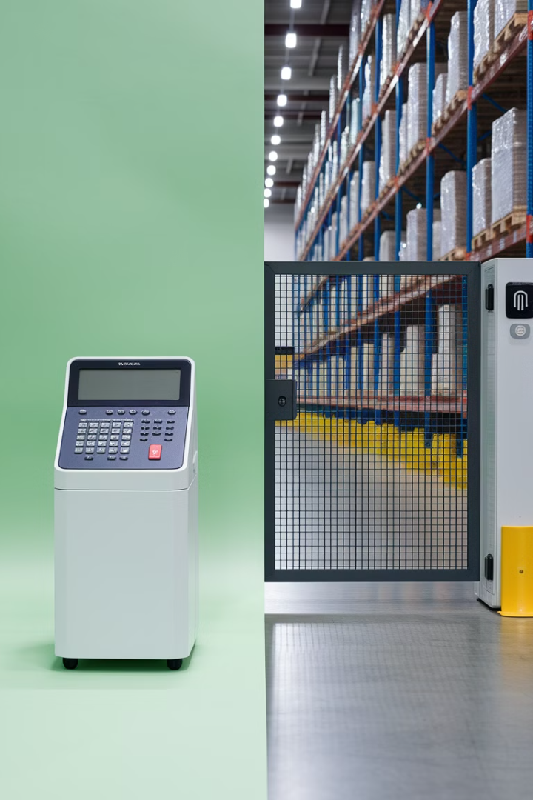
Operational Efficiency Enhancements
Receiving
Put-Away
RFID portals can scan entire pallets simultaneously, reducing receiving time by up to 90% compared to manual barcode scanning.
Automated verification ensures items are stored in optimal locations based on WMS logic, improving space utilization by 20-30%.
Picking
Shipping
RFID-enabled picking carts verify correct items are picked, reducing errors by up to 80% and increasing picking speed by 40%.
Automated verification confirms order accuracy as items pass through RFID-enabled dock doors, reducing returns due to shipping errors by 65%.

Slide 4
Key Components for Successful Integration
ERP System
Enterprise-wide planning and resource management
WMS Software
Warehouse-specific inventory and process management
Middleware/APIs
Data translation and communication layer
RFID Infrastructure
Tags, readers, antennas, and networking equipment
A successful RFID integration requires all components to work in harmony. The RFID infrastructure forms the foundation, collecting data that flows through middleware to your WMS and ultimately to your ERP system for enterprise-wide visibility and decision-making.

Slide 5
RFID Hardware Considerations
RFID Tags
RFID Readers
Passive UHF tags for standard inventory (30¢-50¢ each)
Fixed readers for dock doors and conveyors ($1,000-$2,500)
Active tags for high-value assets ($5-$25 each)
Handheld readers for manual operations ($1,500-$3,000)
Consider read range, mounting surface, and environmental factors
Consider read accuracy, range, and network connectivity
Durability requirements based on handling conditions
Ensure compatibility with existing network infrastructure
Optimal Placement
Strategic reader positioning for maximum coverage
Avoid metal interference and signal obstruction
Position antennas to capture tag movement optimally
Consider facility layout and traffic flow

Slide 6
Software Integration Architecture
RFID Data Capture
Data Filtering & Processing
Readers collect tag data and transmit to middleware
Middleware filters duplicate reads and formats data
ERP Synchronization
WMS Integration
WMS communicates changes to ERP for broader business intelligence
Processed data updates inventory and location information
The middleware layer is critical for successful integration, serving as the translator between RFID hardware and your management systems. It filters raw RFID data, eliminates duplicate reads, and formats the information into a structure that your WMS and ERP systems can process efficiently.

Slide 7
Compatible WMS and ERP Solutions
Leading WMS Solutions
Compatible ERP Platforms
Integration Approaches
These warehouse management systems offer strong RFID integration capabilities:
These enterprise resource planning solutions work well with RFID data:
Methods for connecting RFID with these systems:
SAP S/4HANA
Native RFID modules
Manhattan Associates WMS
Oracle NetSuite
API-based integration
Blue Yonder (formerly JDA)
Microsoft Dynamics 365
Third-party middleware
SAP Extended Warehouse Management
Infor CloudSuite
Custom development
Epicor
HighJump
Infor SCM

Slide 8
Implementation Challenges
System Compatibility
Legacy WMS and ERP systems may lack native RFID support
Data Management
2
RFID generates massive data volumes requiring efficient processing
Implementation Costs
Hardware, software, and integration services can be expensive
Security Concerns
RFID systems need protection from cyber threats
While RFID integration offers substantial benefits, organizations must overcome these challenges during implementation. Many legacy systems require custom interfaces or middleware solutions to properly communicate with RFID infrastructure. Additionally, the volume of data generated can overwhelm unprepared systems, requiring effective filtering and management strategies.

Slide 9
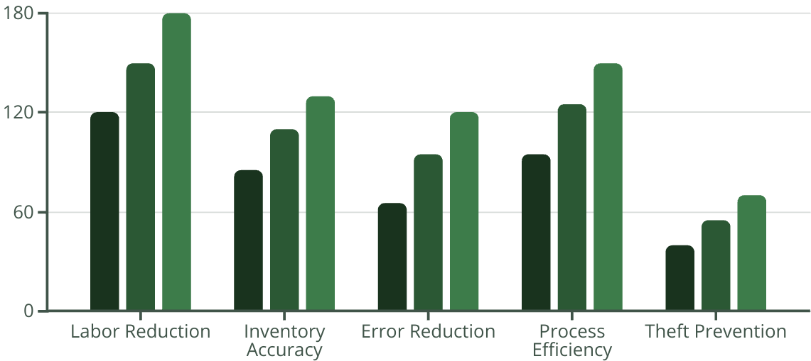
ROI Assessment: Making the Business Case
A typical RFID integration with WMS and ERP systems shows positive ROI within 12-18 months. Initial investments range from $150,000 to $500,000 for a mid-sized warehouse, depending on complexity and existing infrastructure. The chart shows projected savings across key benefit categories, demonstrating how the investment compounds over time.
Year 1 Savings ($K)
Year 2 Savings ($K)
Year 3 Savings ($K)

Slide 10
Best Practices for Successful Implementation
Conduct a System Audit
Choose Scalable Solutions
Thoroughly assess existing WMS and ERP capabilities to identify integration requirements and potential gaps. Document current workflows and pain points that RFID could address.
Select RFID hardware and software that can grow with your business needs. Plan for increasing tag volumes and additional read points as operations expand.
Implement in Phases
Ensure Data Quality
Start with a pilot program in one area of the warehouse to test integration and refine processes before full deployment. Use lessons learned to optimize the broader implementation.
Implement filtering techniques to eliminate duplicate or irrelevant RFID reads. Establish data validation protocols and regular system checks to maintain accuracy.

Slide 11
Training and Change Management
Role-Based Training
Process Documentation
Internal Champions
Continuous Improvement
Develop customized training programs for different user groups, from warehouse floor staff to IT administrators and management. Focus on practical skills relevant to each role's interaction with the RFID-WMS-ERP system.
Identify and develop RFID champions within each department who can provide peer support and promote adoption. These champions become the first point of contact for questions and feedback.
Create clear, visual documentation of new workflows incorporating RFID technology. Include troubleshooting guides and quick reference materials that staff can easily access during their work.
Establish regular feedback sessions to collect user input on system performance and usability. Use this information to refine processes and address pain points promptly.

Slide 12
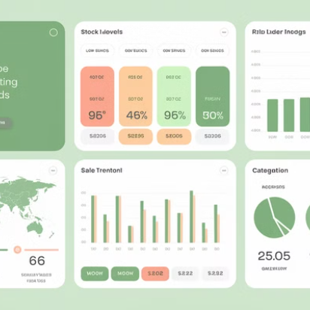
Future-Proofing Your RFID Integration
The future of RFID integration extends beyond current capabilities. Emerging technologies like autonomous mobile robots with built-in RFID readers will further automate warehousing tasks. Augmented reality interfaces will leverage RFID data to guide workers with visual overlays showing inventory information.
Blockchain technology will enhance security and traceability of RFID data across supply chains, while artificial intelligence will analyze RFID-generated data patterns to predict inventory needs and optimize warehouse layouts. Building your integration with these future capabilities in mind ensures long-term relevance and value.

