Slide 1
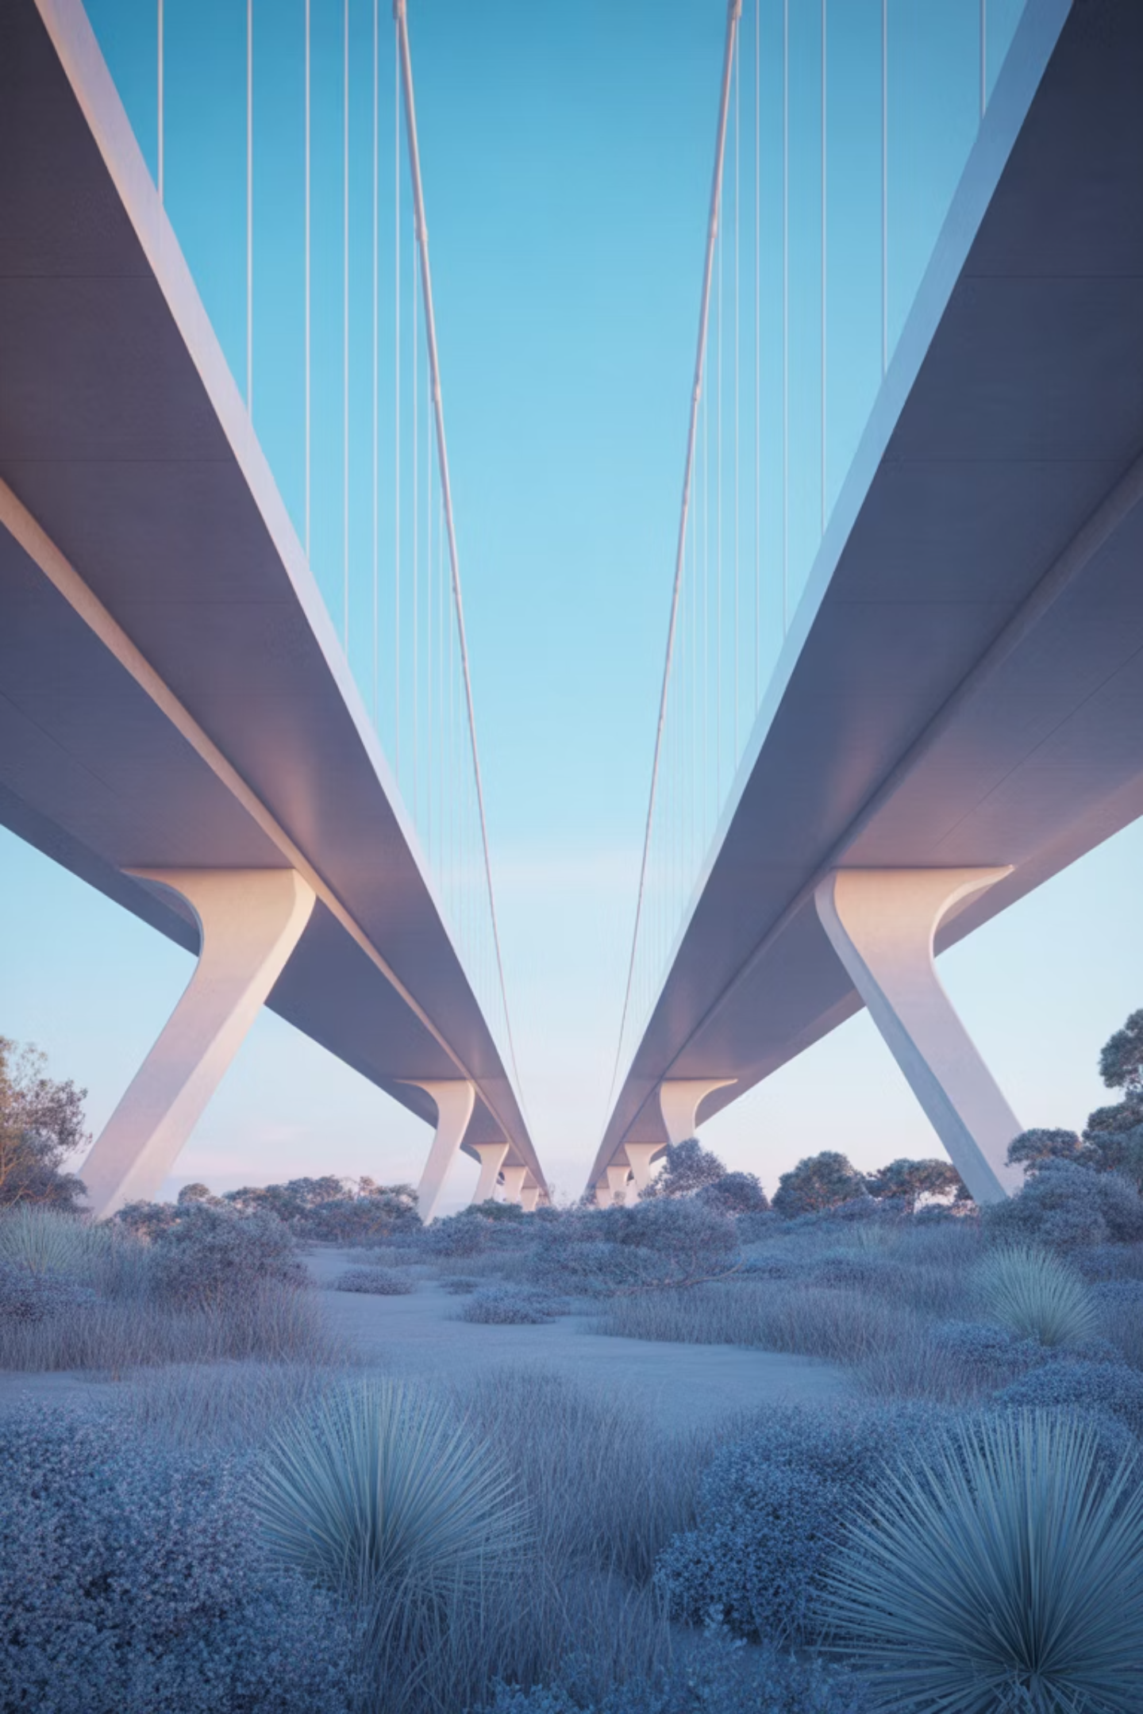
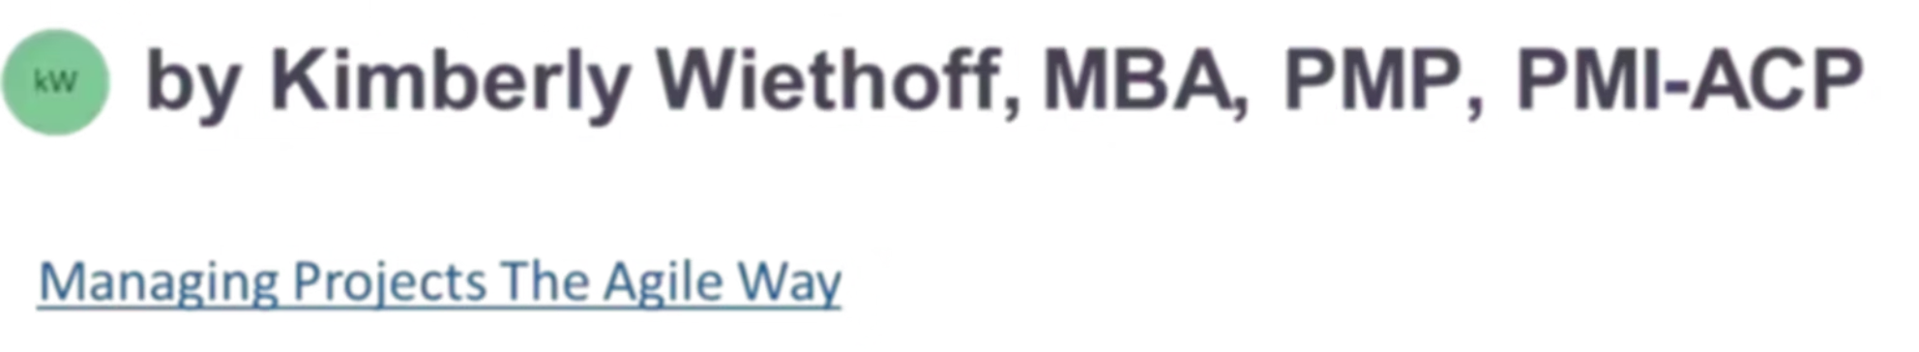
Bridging the Gap: Applying Agile Mindsets in Waterfall Project Environments
Discover how to blend the best of both worlds: disciplined structure with adaptive flexibility.
#ManagingProjectsTheAgileWay #AgileLeadership #HybridProjectManagement #WaterfallToAgile #BusinessAgility #PMO #ProjectDelivery #ChangeManagement #ServantLeadership #ContinuousImprovement

Slide 2

The Challenge We Face Today
Traditional Waterfall Strength
Modern Business Reality
In today's fast-paced landscape, rigid plans often clash with reality. Requirements evolve, priorities shift, and teams are expected to deliver faster with fewer resources. Adaptability has become essential.
For decades, Waterfall has provided the foundation for disciplined project delivery—a structured approach that emphasizes documentation, governance, and control. It offers predictability and clear milestones.

Slide 3



The Solution: An Agile Mindset
Enter the Agile mindset—not as a methodology to replace Waterfall, but as a philosophy to enhance it. When applied thoughtfully, Agile principles can breathe flexibility, collaboration, and responsiveness into even the most traditional project environments.
Flexibility
Collaboration
Responsiveness
Adapt to change without losing control
Build trust-based partnerships across teams
Deliver value faster and reduce rework
Let's explore how to bridge the gap between structure and adaptability—and make Waterfall projects work smarter.

Slide 4
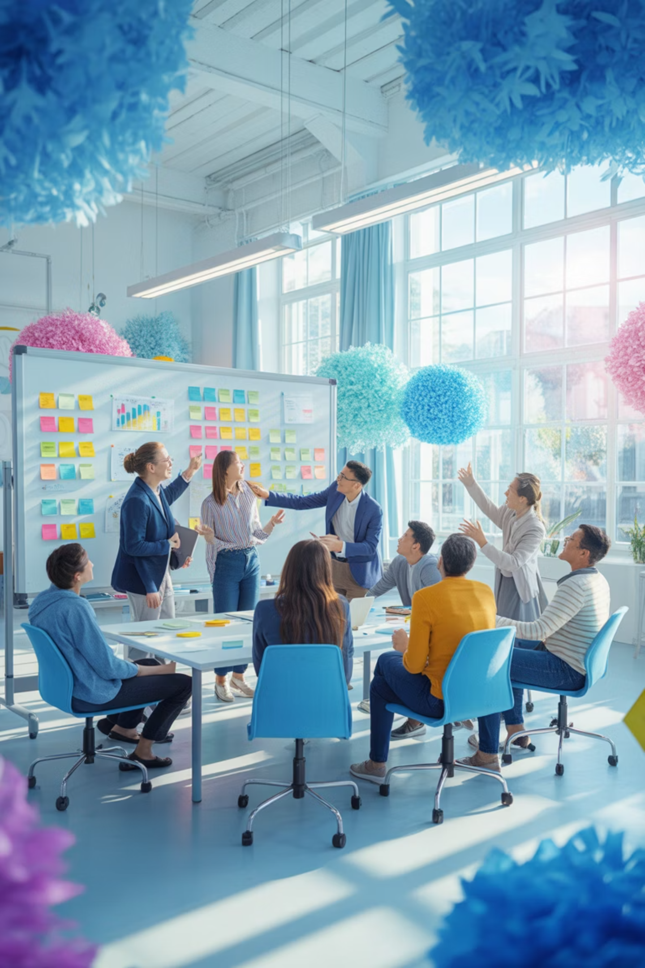

Principle #1: Start with the "Why" of Agility
Agility isn't about adopting Scrum ceremonies or Kanban boards—it's about embracing continuous learning, adaptability, and collaboration.
Frame Agile not as a "methodology change," but as a cultural enhancement: a way to deliver value faster, improve stakeholder satisfaction, and reduce rework.
Before introducing Agile practices into a Waterfall setting, help your team understand why you're doing it. Once teams grasp the "why," they'll naturally start looking for better ways to collaborate and respond to change. This foundation creates buy-in and reduces resistance.

Slide 5
Principle #2: Shift the Focus from Process to Value
In Waterfall projects, process compliance can sometimes overshadow value delivery. By adopting an Agile mindset, project managers can reframe success around outcomes, not outputs.
Does this deliver measurable value to the customer?
Can we validate this sooner rather than later?
What's the simplest path to achieve the desired result?
Focus on impact rather than just completing tasks
Seek early feedback to reduce risk and rework
Eliminate unnecessary complexity and bureaucracy
This mindset shift encourages teams to think critically about priorities—and to pivot when something no longer adds value. It transforms project management from gatekeeping to value optimization.

Slide 6

Principle #3: Foster Collaboration Over Command
Traditional projects often follow a top-down flow of direction and approval. Agile mindsets flip this dynamic by encouraging shared ownership and servant leadership.
In Waterfall environments, this can look like:
Facilitating collaborative workshops instead of siloed reviews
Empowering teams to surface risks early without fear
Engaging stakeholders continuously rather than only at milestones
The goal is not to erase hierarchy but to create trust-based partnerships across all levels of the project. When people feel heard and valued, they contribute their best thinking.

Slide 7

Embrace Change as a Constant

Slide 8
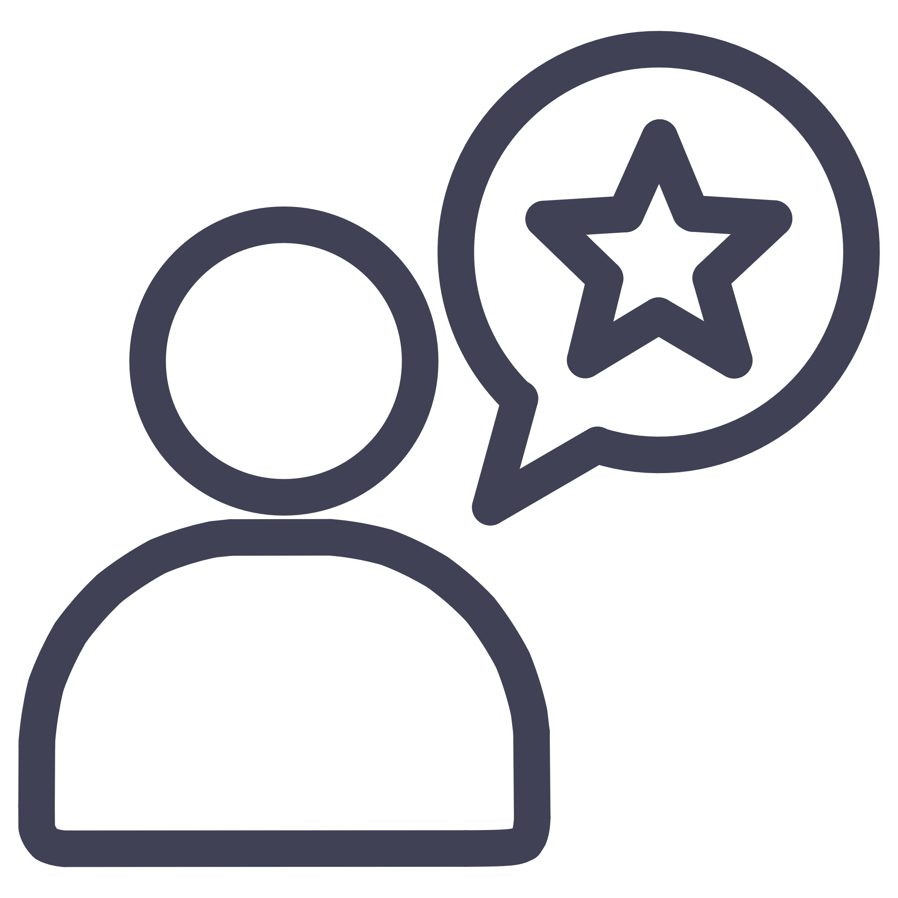
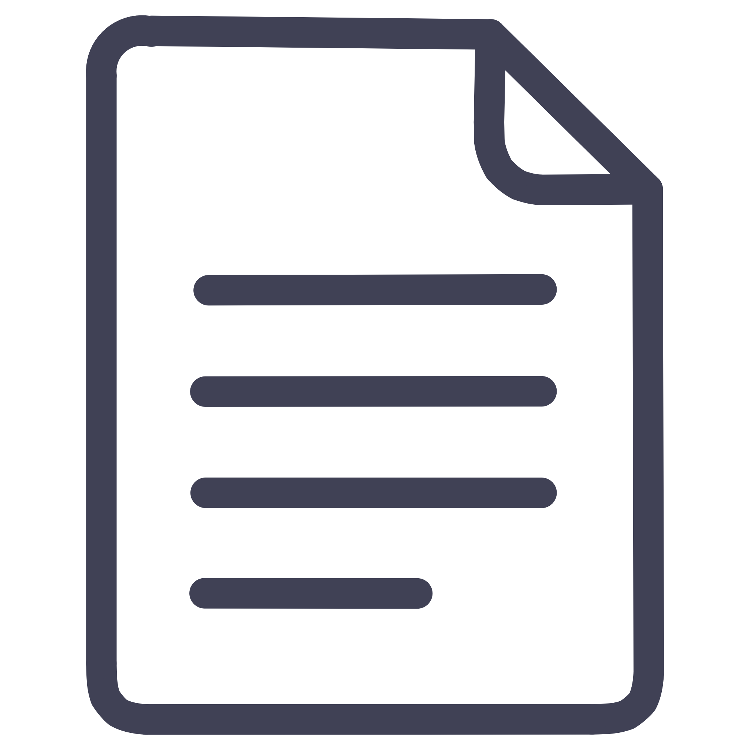
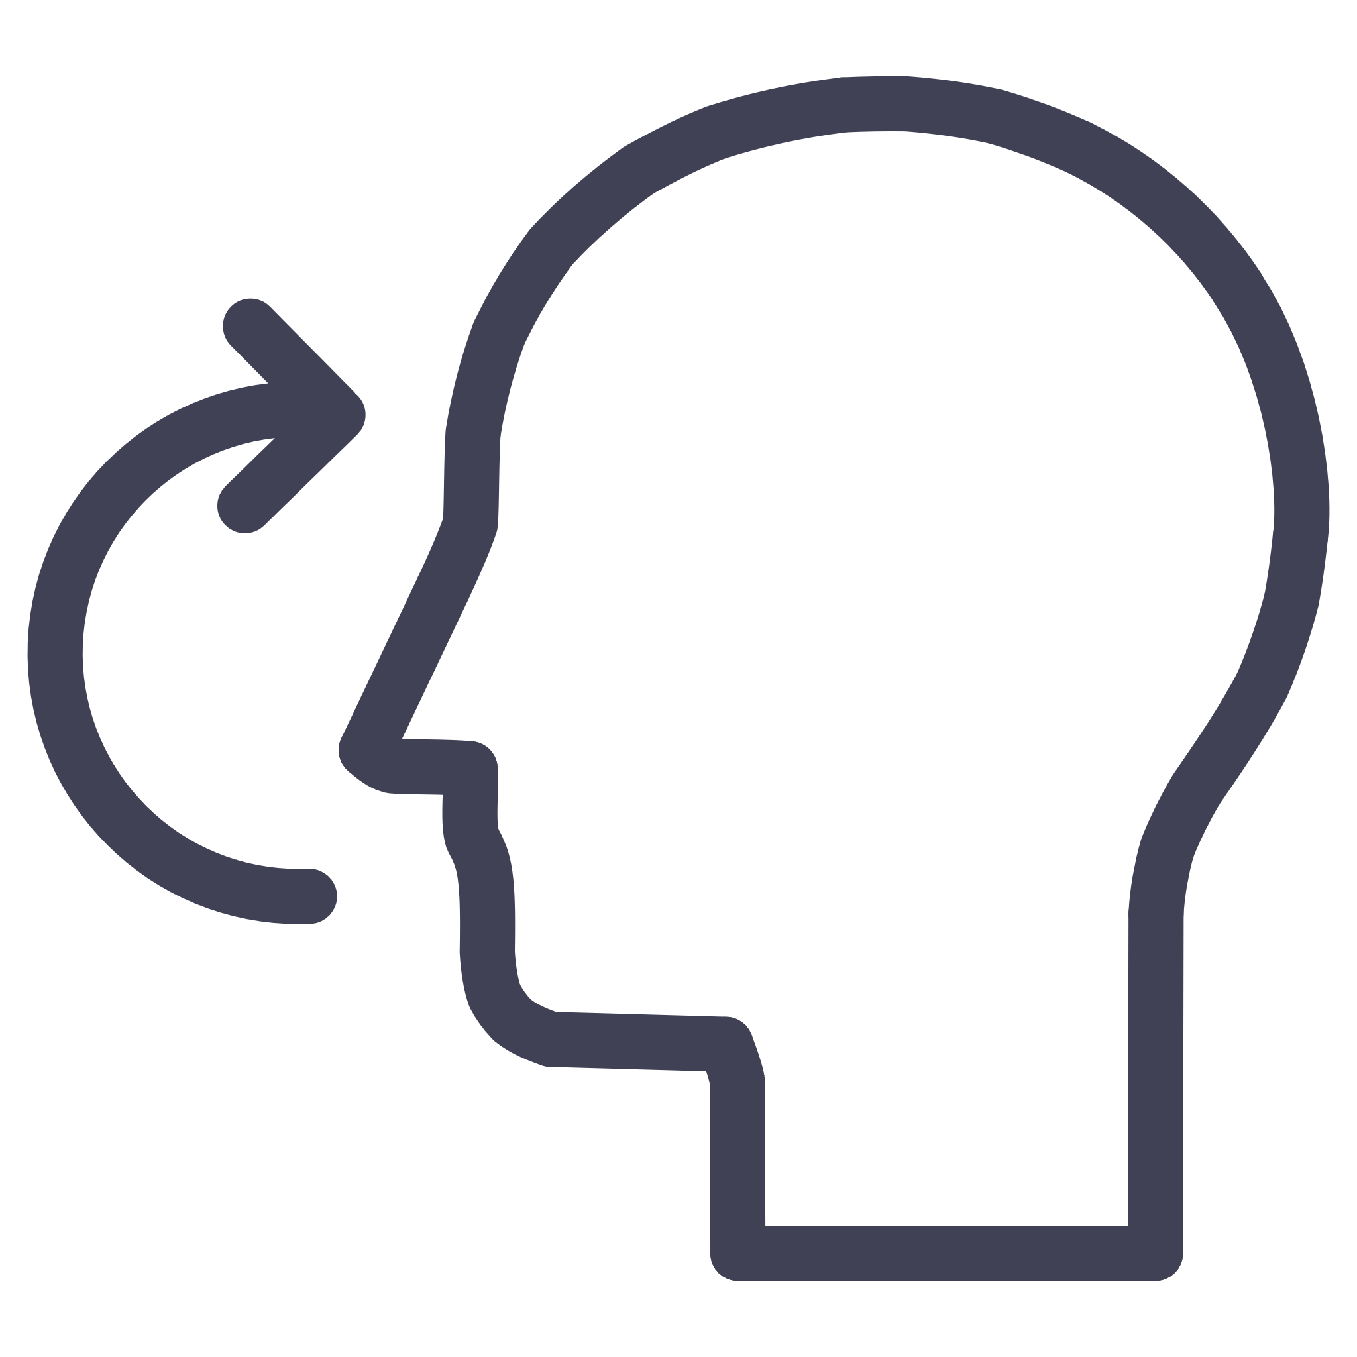
Principle #4: Building Change Resilience
Change is often seen as a threat to scope, schedule, and cost—but in Agile thinking, it's seen as an opportunity for improvement. Even within Waterfall, you can build change resilience.
Continuous Feedback
Real-Time Documentation
Create regular feedback loops between teams and customers to validate assumptions early
Mini Retrospectives
Capture lessons learned in real time, not just at project close, when memories are fresh and actionable
Hold brief reflection sessions after each major deliverable to identify what worked and what didn't
By normalizing change as part of progress, you turn uncertainty into strategic advantage. Teams become more resilient and responsive to evolving business needs.

Slide 9

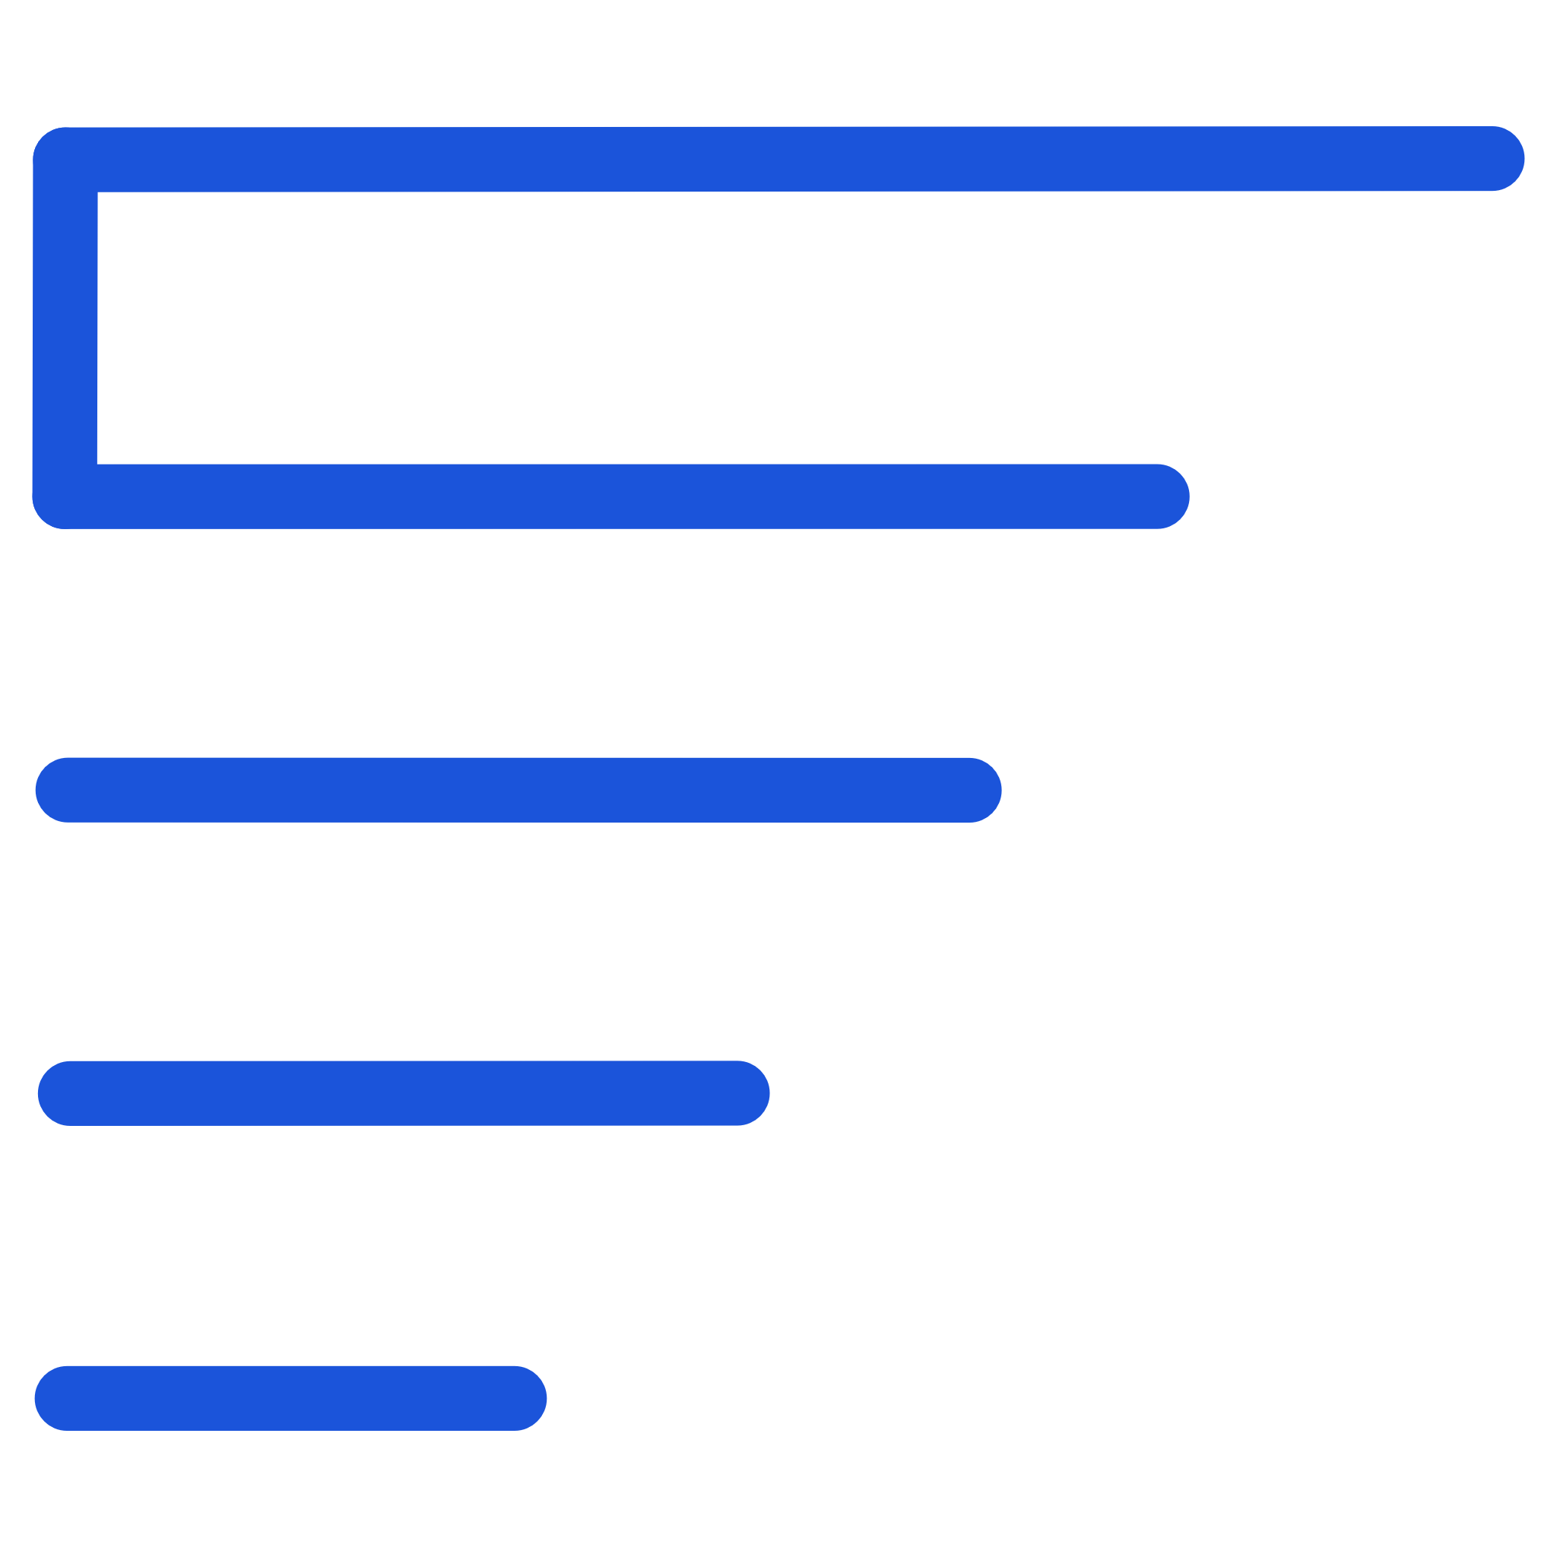
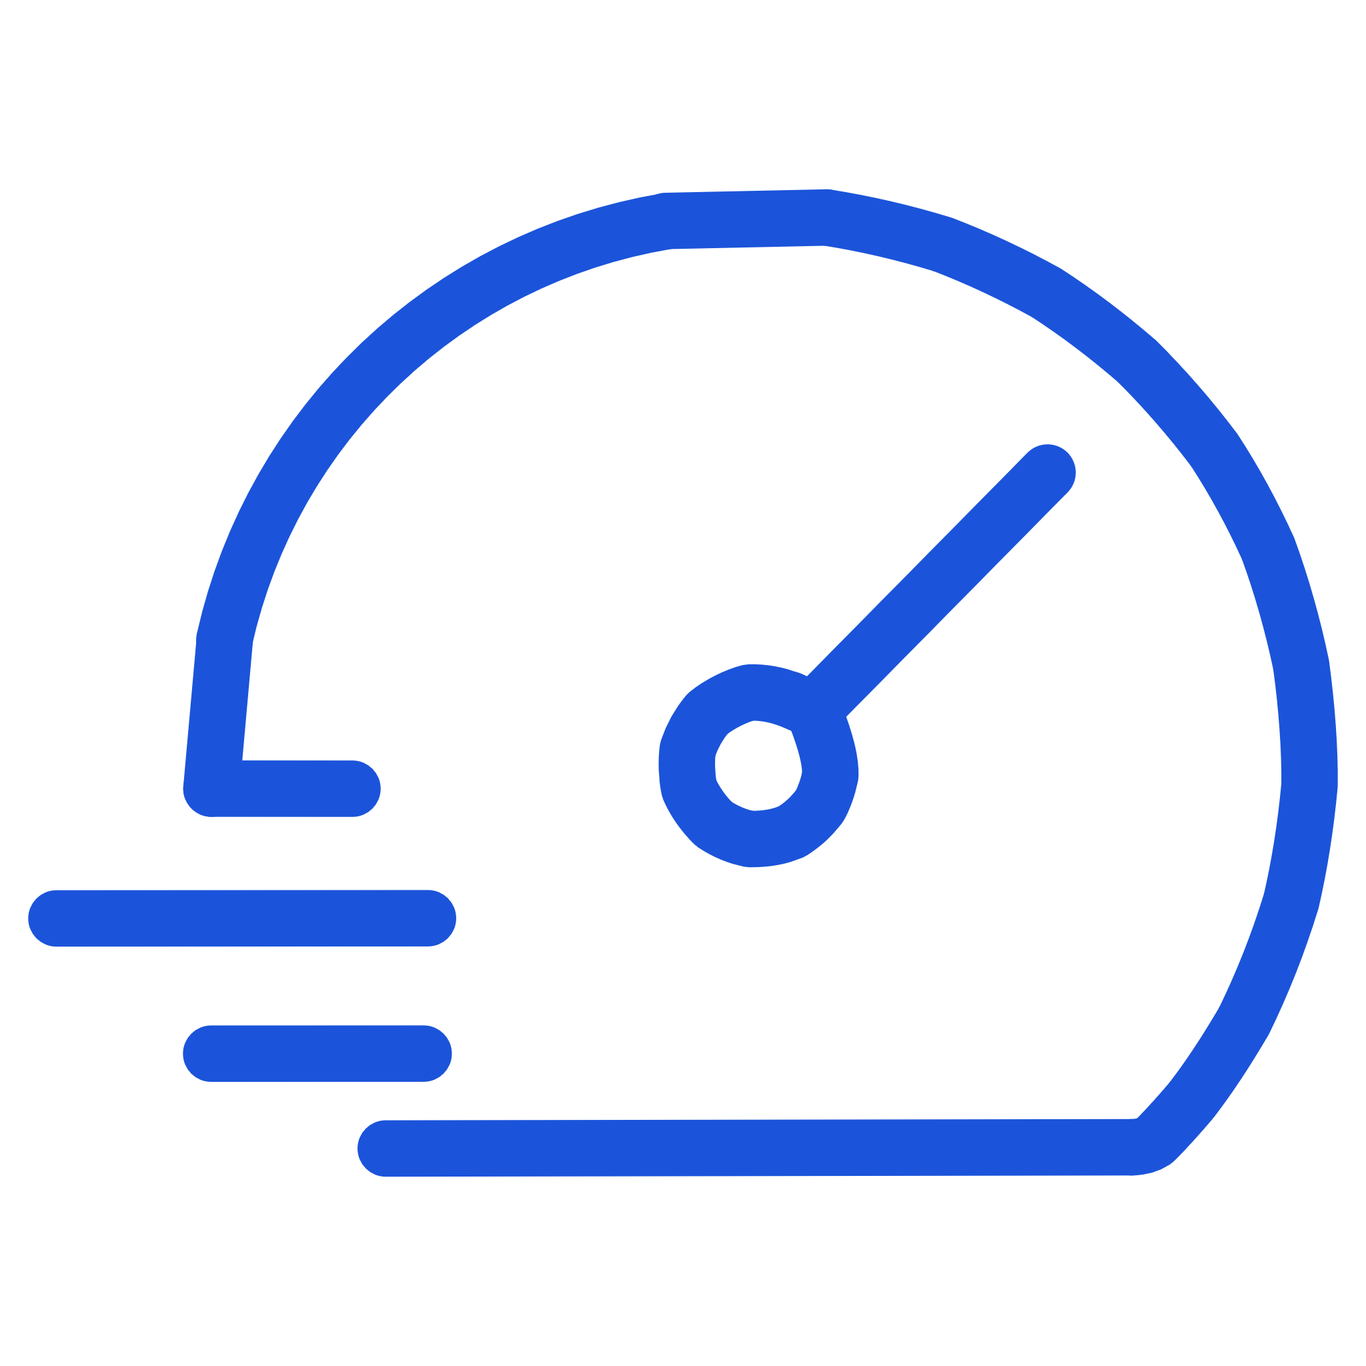
Principle #5: Use Agile Tools to Enhance Visibility
Agile tools like Kanban boards, user stories, and backlogs aren't exclusive to Agile teams. When applied to Waterfall projects, they can increase transparency, engagement, and predictability.
Visual Workflow
Build Alignment
Increase Speed
A simple visualization helps teams and executives understand what's in motion, what's blocked, and what's next
Visibility creates shared understanding across stakeholders, reducing miscommunication
When everyone sees the same picture, decisions happen faster and bottlenecks get resolved quickly

Slide 10

Principle #6: Lead with Empathy and Experimentation
Agile mindsets thrive in cultures of psychological safety—where people feel safe to experiment, question, and learn. In Waterfall environments, this means encouraging curiosity and acknowledging that improvement often comes from trial and error.
Leaders who model humility and openness create teams that are more innovative, engaged, and resilient. Agility begins not with process reform, but with human reform—a shift in how we think, communicate, and collaborate.
"The most powerful leadership tool you have is your own personal example." — John Wooden

Slide 11
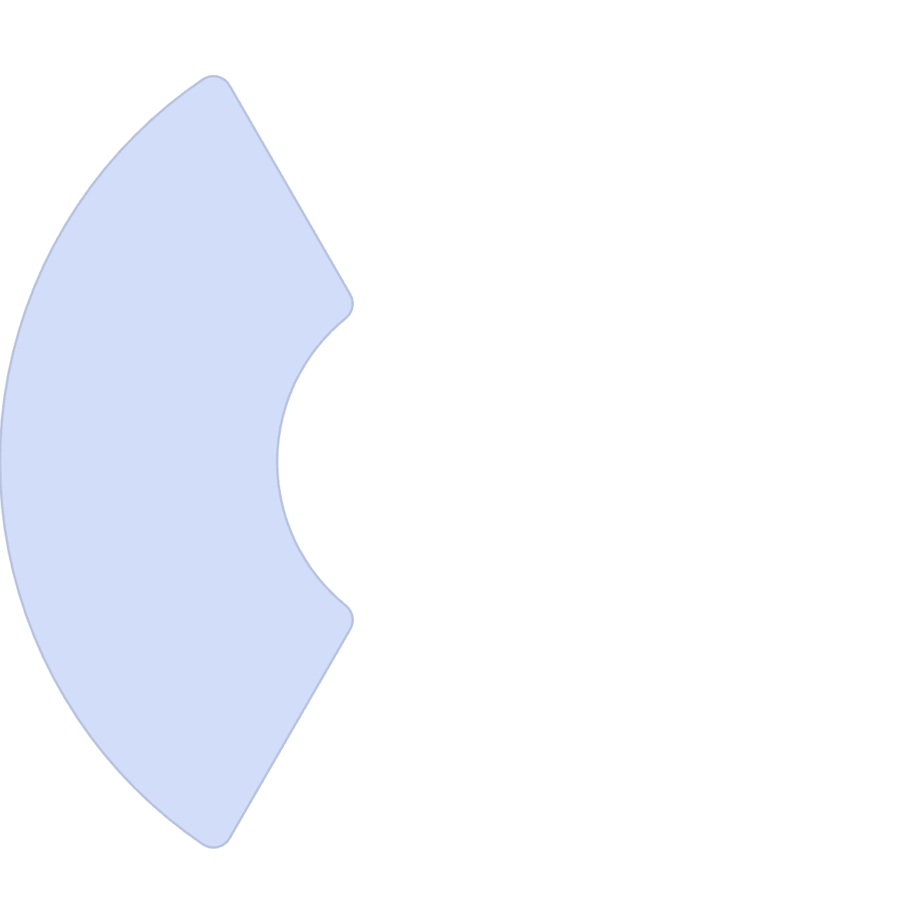
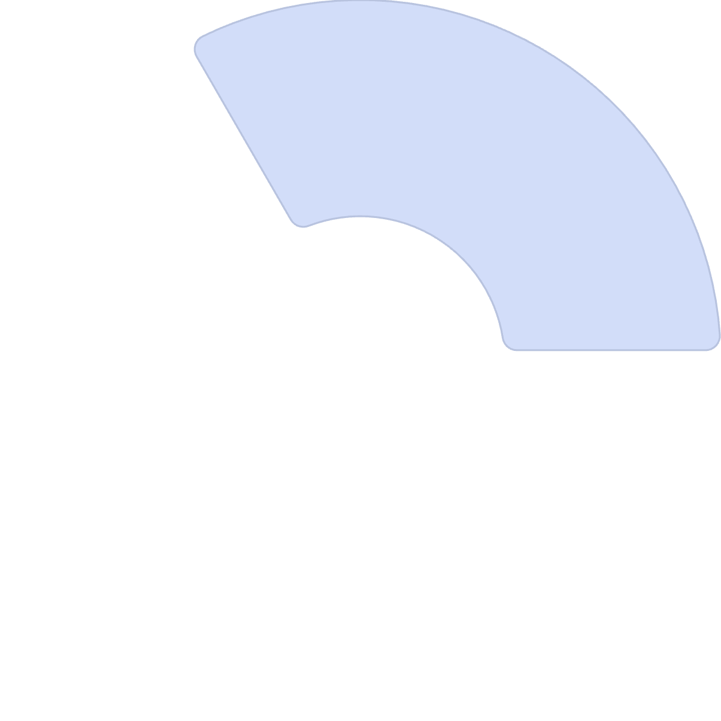

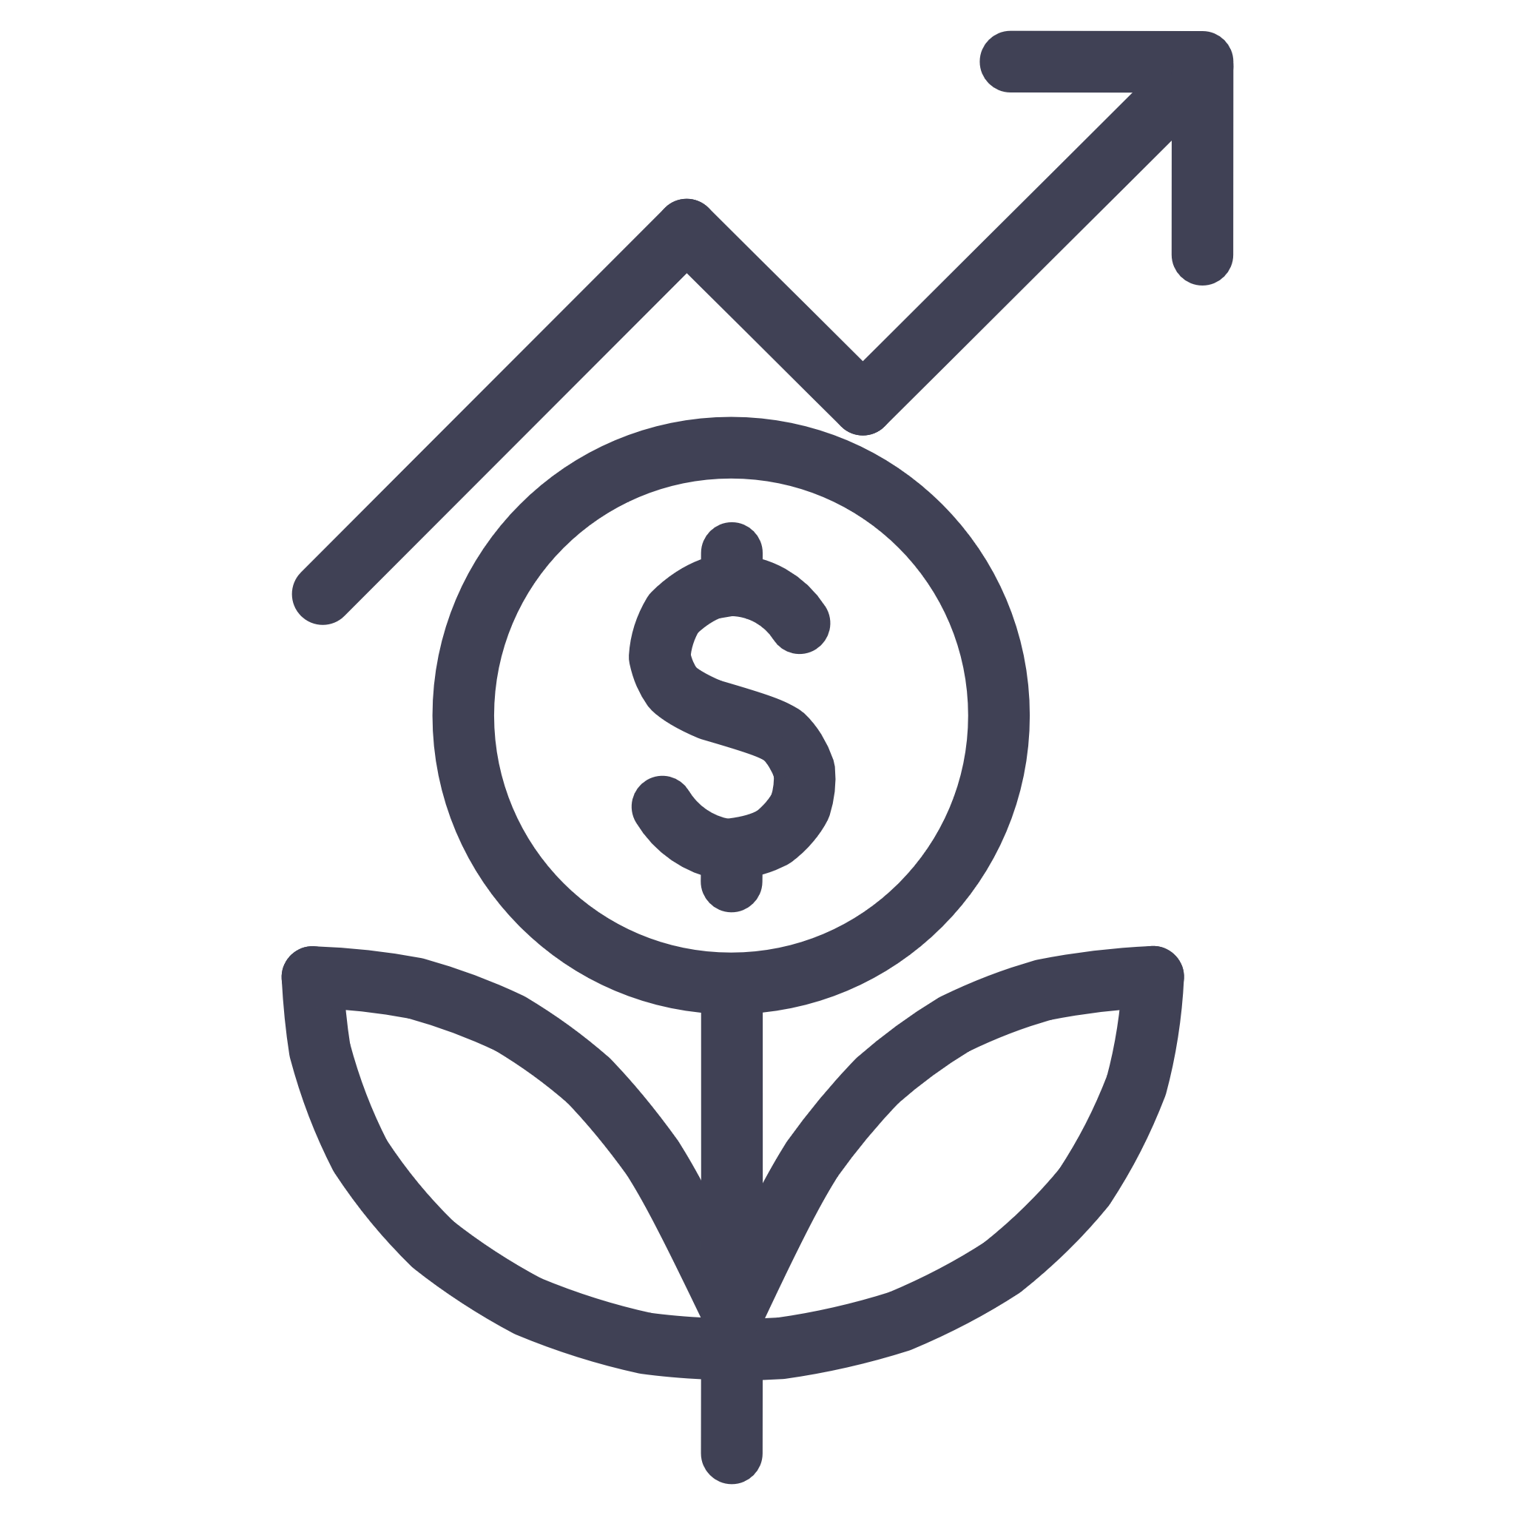
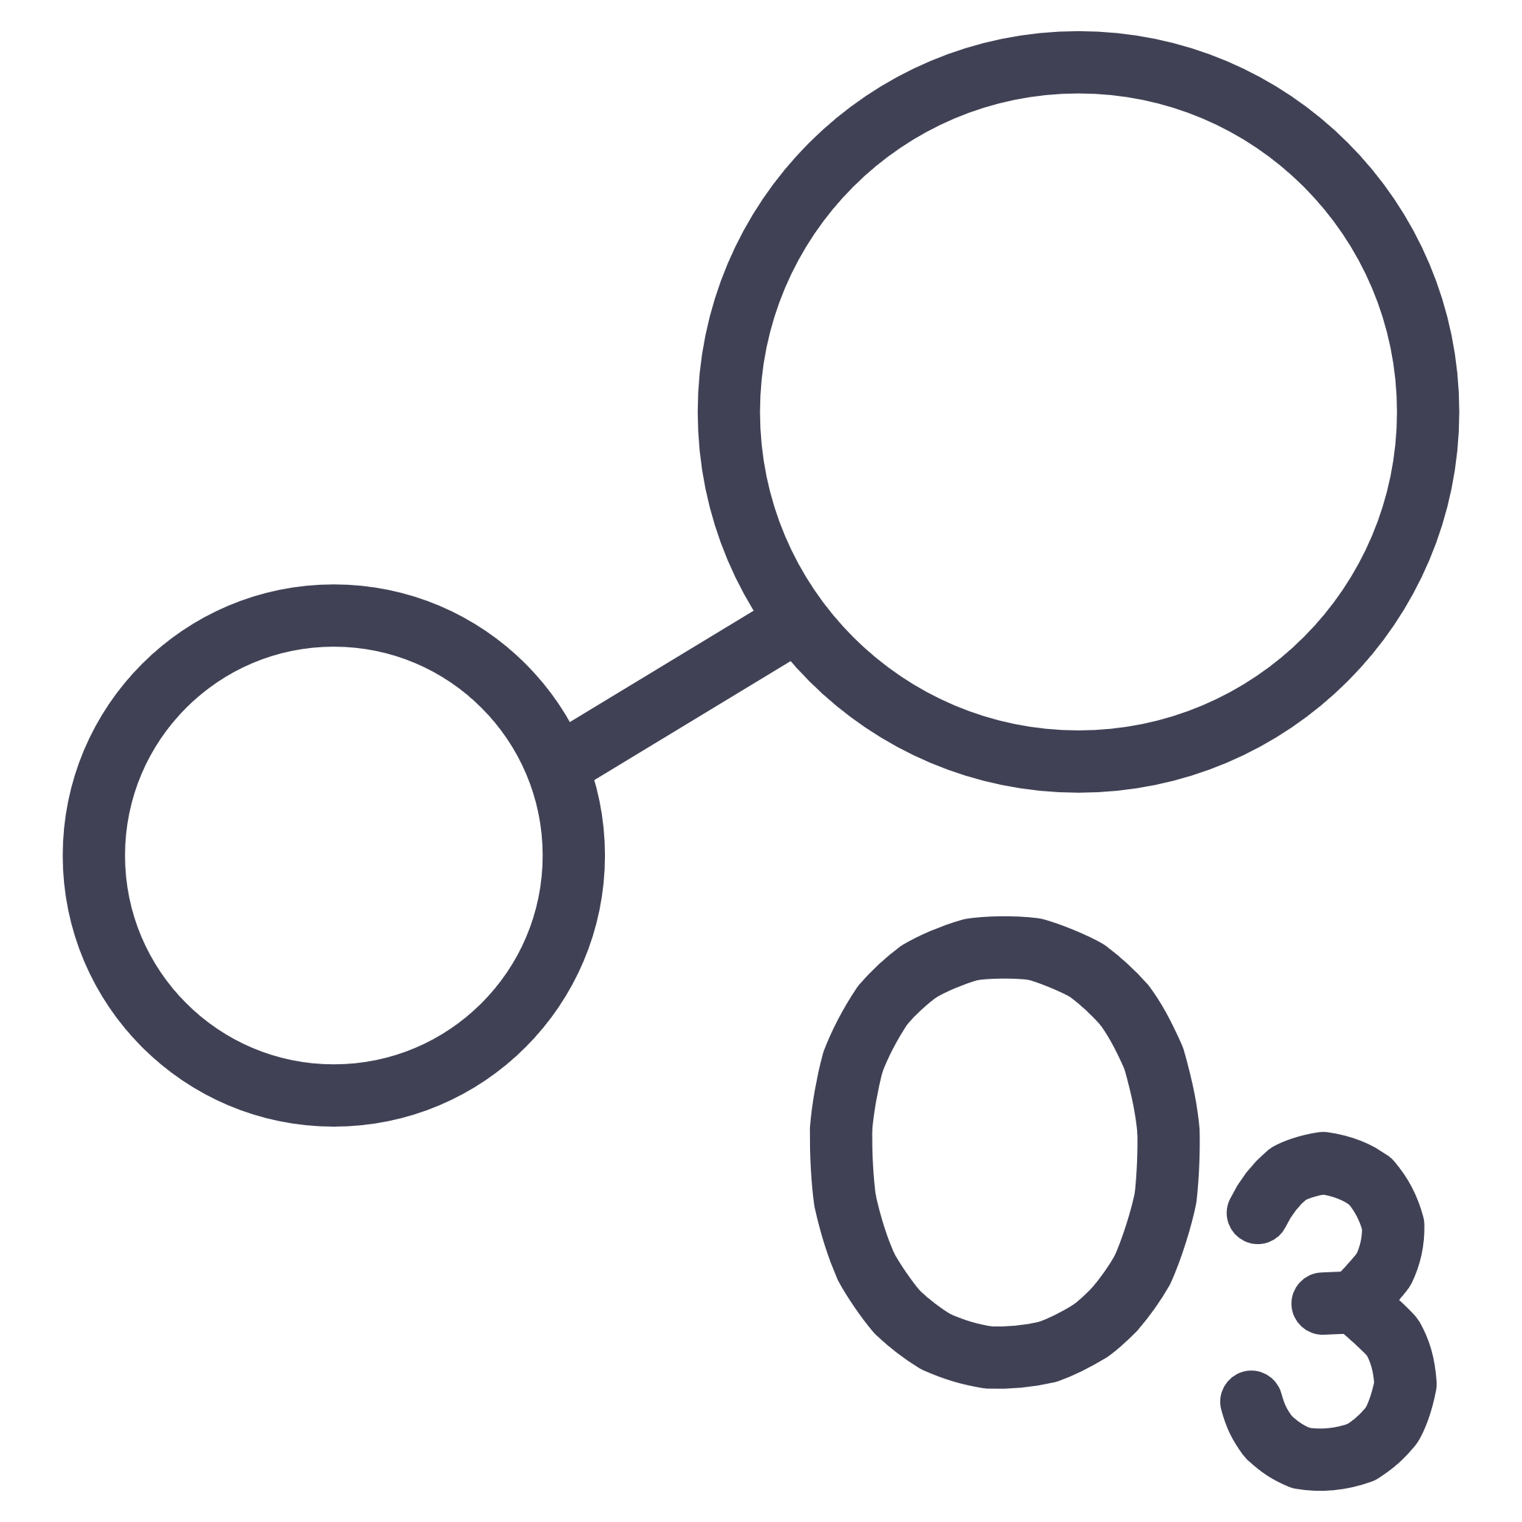

The Hybrid Advantage
Bridging the gap between Agile and Waterfall isn't about blending frameworks—it's about blending philosophies. When project managers infuse Agile mindsets into structured delivery, they create the best of both worlds.
Governance with Growth
Control outcomes while enabling innovation
Discipline with Adaptability
Maintain governance while staying flexible
Control with Creativity
Balance structure with creative problem-solving

Slide 12
Your Path Forward
In a world where change is constant, the most successful leaders aren't purely Agile or purely Waterfall—they're strategically hybrid.
01
02
03
Build Understanding
Start Small
Measure Impact
Start with education on the "why" behind Agile principles
Pilot one or two practices in a low-risk project area
Track improvements in delivery speed, quality, and team satisfaction
04
05
Scale Gradually
Iterate Continuously
Expand successful practices across more teams and projects
Refine your approach based on feedback and results

Slide 13
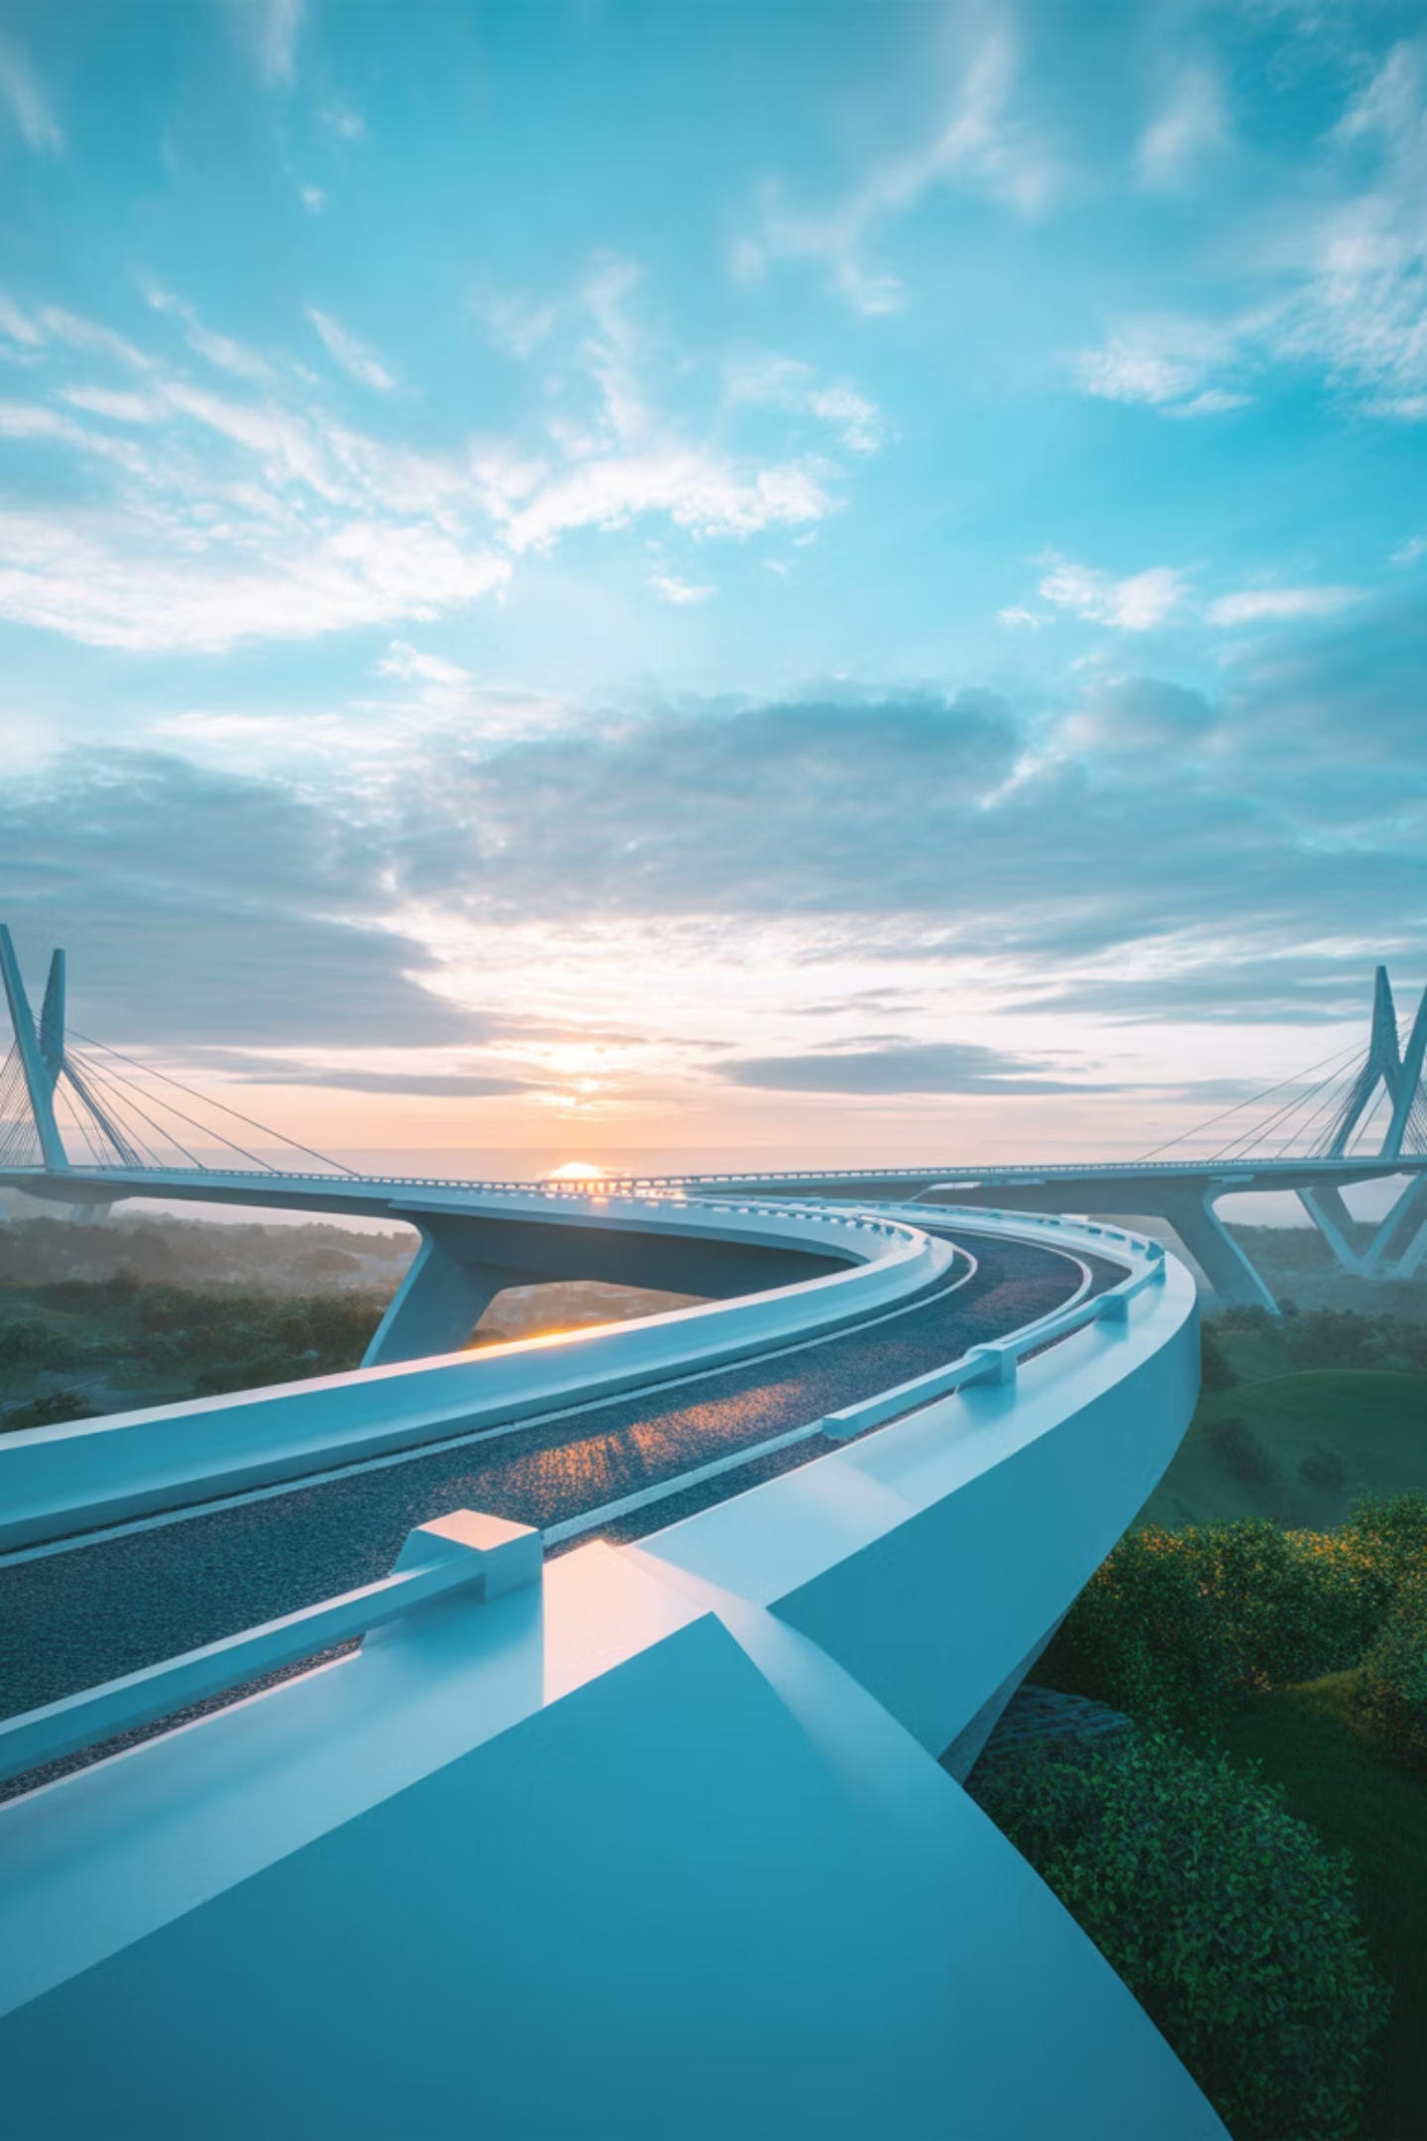
The Future is Hybrid
You don't need to choose between structure and flexibility. By applying Agile mindsets within Waterfall frameworks, you can deliver projects that are both disciplined and dynamic—projects that meet today's needs while adapting to tomorrow's opportunities.
The bridge is yours to build.

