Slide 1
Optimizing Your Mentorship Profile
Mentorship is a powerful tool for professional growth. Whether you’re an experienced leader looking to give back or an aspiring project manager seeking guidance, optimizing your profile can significantly impact your mentorship experience.
kW
by Kimberly Wiethoff

Slide 2
Choosing the Right Mentorship Platform
For Mentors
For Mentees
Consider ADPList, MentorCruise, PMI Mentoring, or GrowthMentor. These platforms provide high-quality mentorship opportunities.
Platforms like Plato, ADPList, MentorCruise, and PMI Mentoring are great options for structured mentorship.

Slide 3
Crafting a Compelling Mentor Profile
1
Headline
2
Bio
Clearly state your expertise. Example: Senior IT Project Manager | Agile Coach | Leadership Mentor.
Highlight your experience, showcase success stories, and share your mentorship philosophy.
3
Skills
Agile, IT Project Management, PMO Leadership, ERP Implementations, Cybersecurity, Leadership Development.

Slide 4
Crafting a Compelling Mentee Profile
Headline
Bio
Showcase your aspirations. Example: Aspiring IT Project Manager | Learning Agile & Leadership.
Mention your current role, what you want to learn, and any challenges you’re facing.
Skills
Agile & Scrum, Stakeholder Communication, Risk Management, Career Growth in Project Management.

Slide 5
Optimize Profile Engagement
Upload a professional photo. A clear, friendly image builds trust.
Use bullet points for clarity. Makes your profile easy to read.
Be proactive in sending messages. Request mentorship sessions.

Slide 6
Engaging as a Mentor
Structured Sessions
Offer structured sessions. Example: Career roadmap, Agile deep dive.
Provide Resources
Share resources like books, templates, and tools.
Encourage Action
Encourage mentees to take action between sessions.

Slide 7
Engaging as a Mentee
2
Apply Feedback
1
Prepared Questions
Show Appreciation
3

Slide 8
Skills/Topics For Agile Mentors
1
Agile (Scrum, Kanban, SAFe)
2
IT Project & Program Management
3
Team Dynamics & Leadership Development
4
Cybersecurity & Compliance Projects

Slide 9
Skills/Topics For Project Management Mentees
Career Growth
Stakeholder Communication
Agile & Scrum

Slide 10
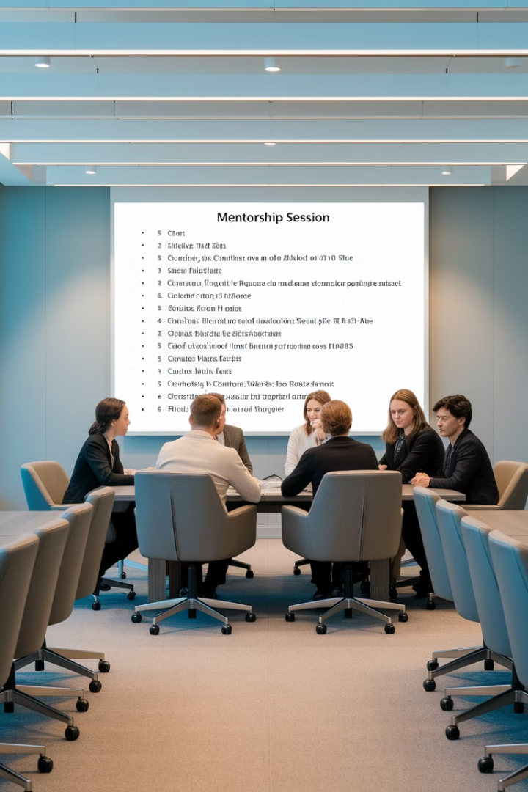
Structured Mentorship Sessions
Session
Topic
1
Career Roadmap
2
Agile Deep Dive
3
Risk management strategies

Slide 11
Mentorship: A Two-Way Street
Guiding the next generation of project managers.
Seeking insights from an industry expert.

Slide 12
Take Your Career to the Next Level
1
2
Set Up Profile
Engage
Create an account
Seek mentor
3
Grow
Advance career

Slide 13
Final Thoughts
Mentorship is a two-way street. Whether you're guiding the next generation of project managers or seeking insights from an industry expert, optimizing your profile and engaging effectively will set you up for success. By following these steps, you'll maximize the value of your mentorship experience and contribute to a thriving professional community.
Are you ready to start your mentorship journey? Set up your profile today and take your career to the next level!

