Slide 1

SAFe vs Agile: Choosing the Right Path
Welcome to our exploration of how SAFe and Agile methodologies compare. This presentation will help project managers understand key differences and make informed implementation decisions.
kW
by Kimberly Wiethoff

Slide 2
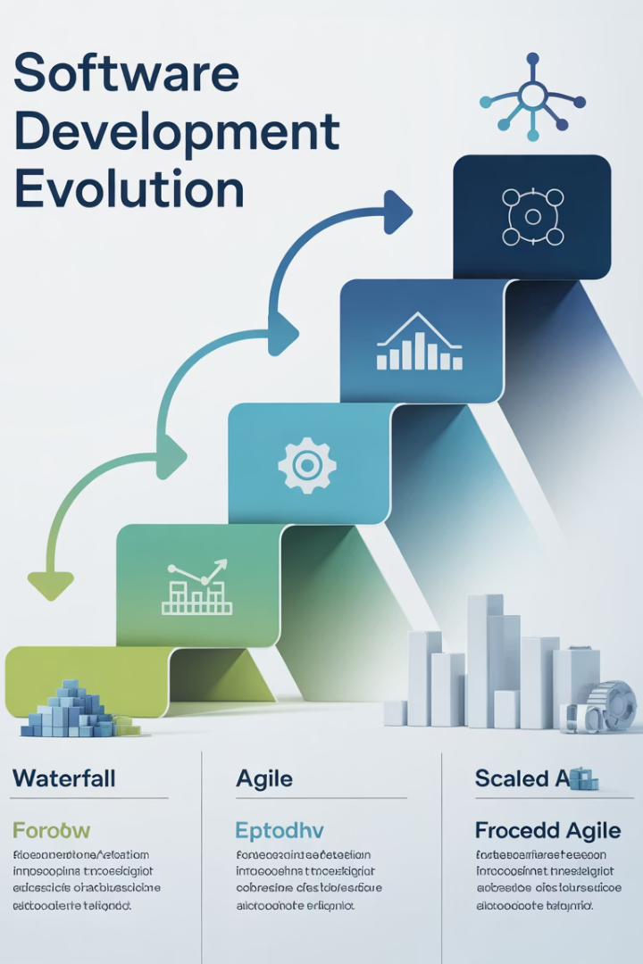



Project Management Evolution
Traditional PM
Sequential phases with strict documentation. Limited flexibility after project initiation.
Agile Methods
Iterative approach with small teams. Focus on customer value and adaptability.
Scaled Frameworks
Enterprise-level coordination. SAFe emerged to bring structure to multi-team environments.

Slide 3

Scale of Implementation
Agile Project Management
SAFe
Built for large enterprises with multiple coordinated teams. Introduces Agile Release Trains.
Designed for single teams with 5-9 members. Ideal for startups and isolated initiatives.
Coordinates work across dozens or hundreds of practitioners. Aligns teams toward shared goals.
Teams manage their own backlog and ceremonies. Focus on team autonomy and rapid delivery.

Slide 4
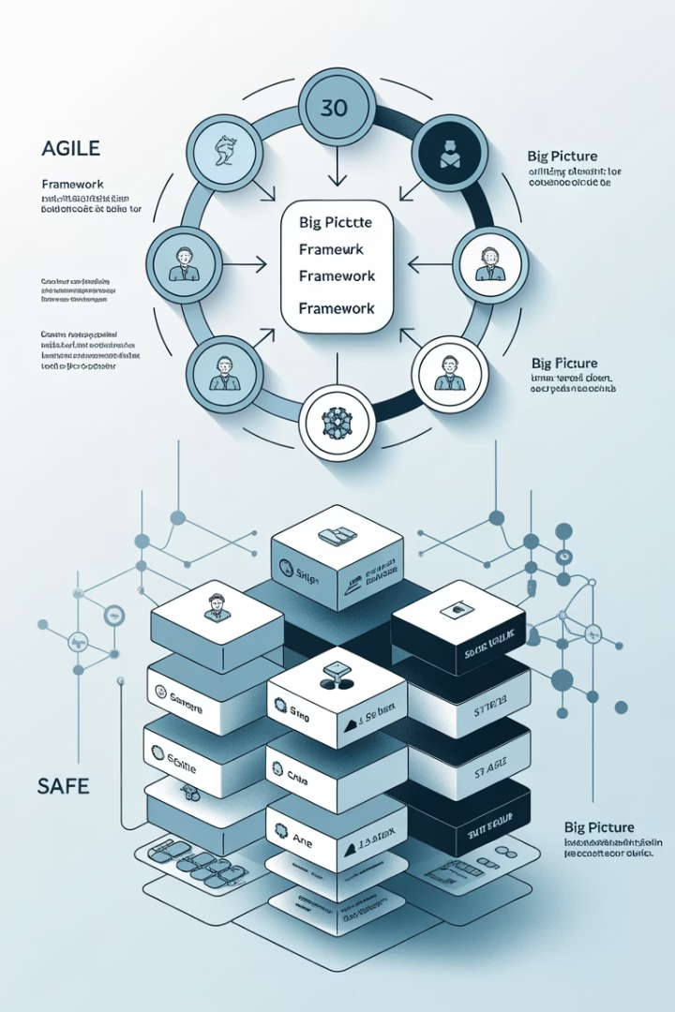
Framework Structure
Agile Approach
SAFe Structure
Flexible implementation based on Agile Manifesto principles. Teams customize workflows to suit their needs.
Prescriptive framework with defined patterns. Includes specific events, roles, and artifacts.
Lightweight with minimal overhead. Focuses on delivering value quickly with few constraints.
Structured blueprint for enterprise-wide implementation. Scales from team to portfolio level.
Key Distinction
Agile is team-centric; SAFe is organization-centric. SAFe standardizes practices across the enterprise.

Slide 5








Roles & Responsibilities
Agile Roles
SAFe Roles
Scrum Master, Product Owner, Development Team. Simple structure with clear boundaries.
Adds Release Train Engineer, System Architect, Business Owners. More specialized positions.
Governance
Organizational Impact
SAFe adds formal governance structures. Lean Portfolio Management connects strategy to execution.
SAFe distributes leadership across multiple levels. Creates alignment from team to portfolio.

Slide 6



Planning Cadence
Daily Stand-ups
Both use daily sync meetings
Sprint Planning
2-week planning cycles in Agile
Program Increments
8-12 week planning in SAFe
Agile teams plan independently in short sprints. SAFe introduces Program Increments with synchronized multi-team planning events.

Slide 7





Governance & Strategy
Strategic Themes
Business objectives that guide portfolio decisions and investments.
Portfolio Kanban
Visualizes and limits work in progress across the enterprise.
Lean Budgeting
Funds value streams rather than projects. Enables rapid pivoting.
Metrics & Reporting
Enterprise-wide visibility into program performance and outcomes.

Slide 8
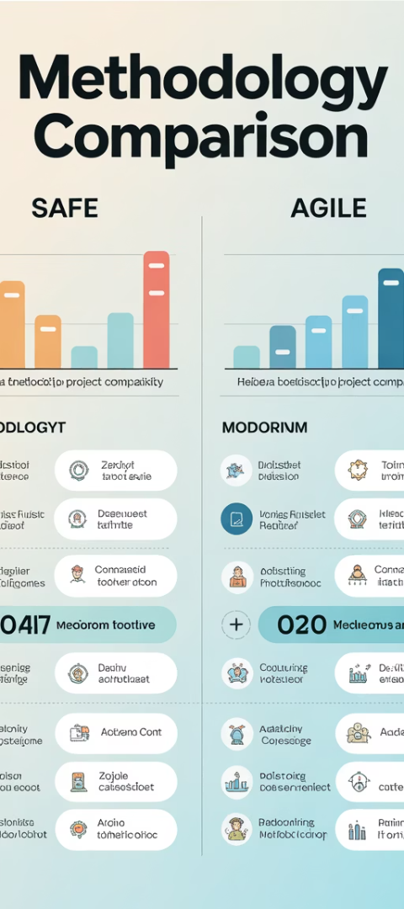
Framework Comparison
Criteria
Agile PM
SAFe
Team Size
Small teams (5-9)
Large programs/enterprises
Structure
Lightweight, flexible
Prescriptive, layered
Roles
Scrum Master, PO, Team
RTE, Business Owner, Architects
Planning
2-week sprints
8-12 week Program Increments
Governance
Minimal, team-led
Lean governance, strategic alignment

Slide 9





When to Choose Agile PM
Small Organizations
Startups and small businesses with single-product focus. Limited organizational complexity.
Need for Speed
Projects requiring rapid delivery and frequent pivots. Low bureaucracy environments.
Autonomous Teams
Self-organizing teams that can deliver independently. Projects with clear boundaries.
Learning Environments
Organizations new to Agile. Start small before scaling practices.

Slide 10








When to Choose SAFe
Enterprise Scale
Organizations with 50+ developers across multiple teams
Complex Dependencies
Products requiring coordination across many components
Regulatory Requirements
Industries needing compliance and governance
Organizational Transformation
Companies transitioning from traditional methods

Slide 11





Implementation Challenges
Cultural Resistance
Training Investment
Both frameworks require mindset shifts. SAFe faces more resistance due to its scope.
SAFe requires significant training across multiple roles. Agile needs less upfront education.
Over-Engineering
Implementation Cost
SAFe can become bureaucratic if implemented rigidly. Agile may lack structure at scale.
SAFe transformations typically cost more and take longer. Agile can start immediately.

Slide 12
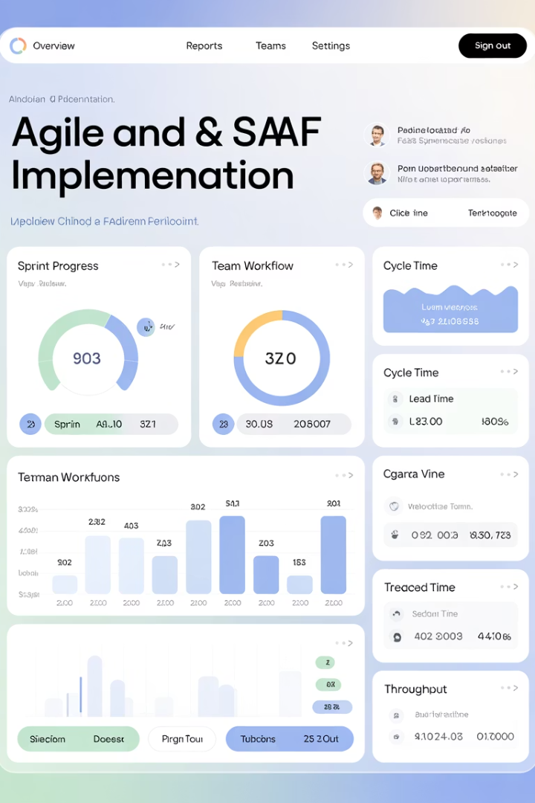
Success Metrics
30%
50%
Productivity Gain
Time-to-Market
Average improvement after successful Agile implementation
Typical reduction in delivery time with SAFe
35%
25%
Quality Improvement
Employee Engagement
Defect reduction in mature Agile/SAFe organizations
Average increase in team satisfaction scores

Slide 13
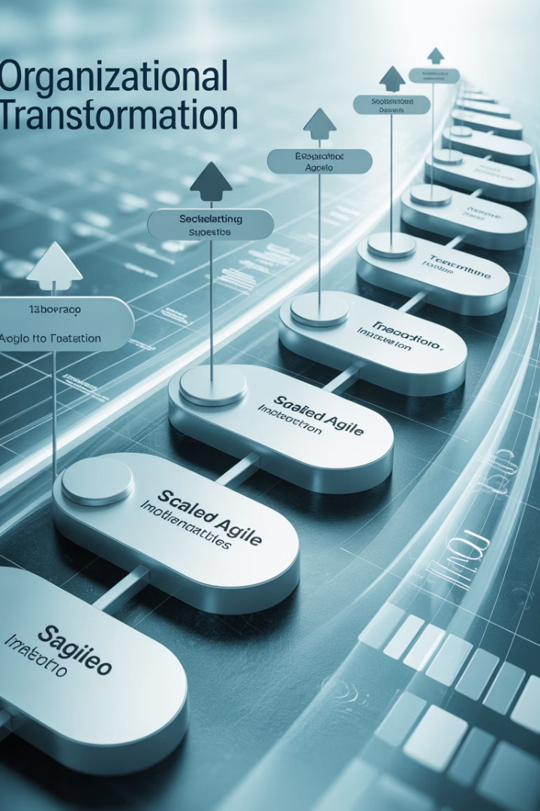
Next Steps on Your Journey
Assess Your Context
Evaluate your organization's size, complexity, and culture. Determine if you need scale or agility.
Start With Fundamentals
Begin with Agile basics before scaling. Master team-level practices first.
Incremental Implementation
Adopt SAFe elements gradually if scaling is needed. Don't try to transform overnight.
Measure And Adapt
Track metrics that matter to your business. Be prepared to adjust your approach.

Slide 14
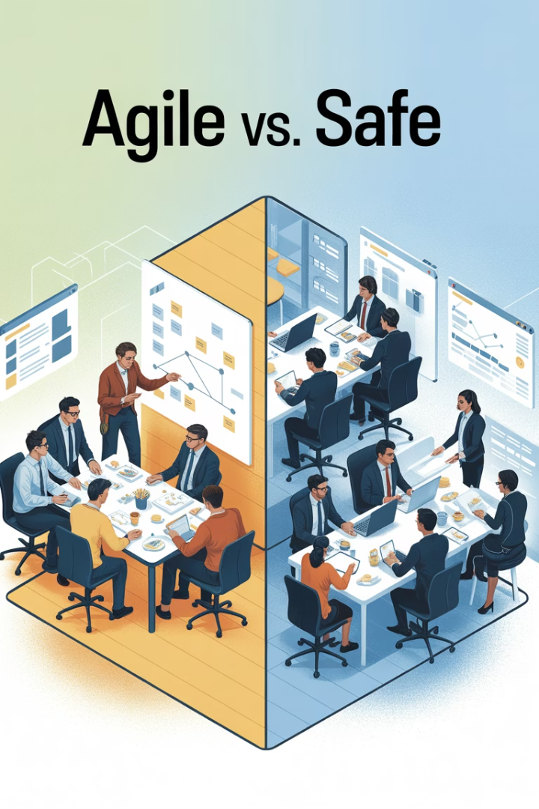
Final Thoughts
Both SAFe and Agile project management share a common DNA rooted in the Agile Manifesto, but their applications diverge based on scale, complexity, and organizational needs. Agile PM is perfect for small, nimble teams looking for speed and autonomy. SAFe is ideal for large organizations seeking alignment, coordination, and governance across dozens of Agile teams.
As a project manager, understanding these differences will empower you to adapt your leadership style, choose the right framework for your context, and drive Agile transformation with confidence.

