Slide 1

Leading an Enterprise Cybersecurity Program
What the Program Manager Actually Owns
By Kimberly Wiethoff, MBA, PMP, PMI-ACP
Managing Projects the Agile Way
An enterprise cybersecurity program brings together teams with fundamentally different priorities — and one role is responsible for making them work together. This is a practical guide to what that role actually entails.
#Cybersecurity #CybersecurityProgramManagement #ProgramManagement #ITLeadership #SecurityGovernance #RiskManagement #EnterpriseSecurity #StakeholderManagement #CybersecurityLeadership #ManagingProjectsTheAgileWay

Slide 2

Competing Priorities, One Coherent Plan
Every stakeholder in an enterprise cybersecurity program brings a legitimate but distinct agenda. The program manager's job is to hold all of them in balance and translate competing priorities into an executable plan with clear ownership.
🔒 Security
🏗️ Infrastructure
Reduce exposure and close vulnerabilities across the enterprise attack surface.
Maintain stable, available services without disruptive or unplanned change.
📱 Application Owners
📊 Executives
Keep business workflows running and avoid impact to critical service delivery.
Demonstrate that cybersecurity investment is producing measurable, reportable results.
The program manager turns those competing priorities into an integrated plan — with clear ownership and decision authority at every level.

Slide 3
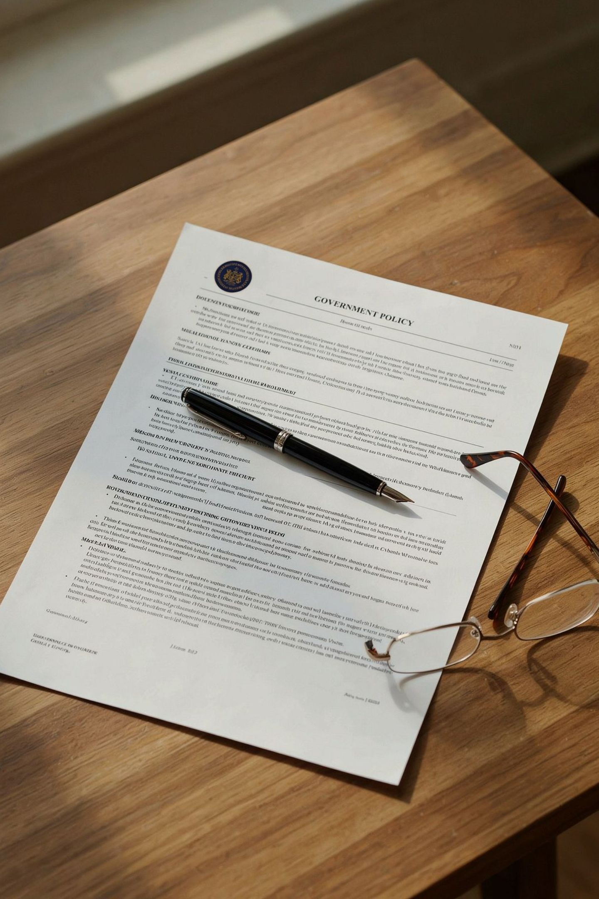
Governance Is Part of the Security Effort
NIST's Cybersecurity Framework 2.0 explicitly emphasizes establishing cybersecurity responsibilities, authorities, policies, and oversight. Governance is not an administrative formality — it is a core security discipline.
What CSF 2.0 Requires
What This Means for the PM
Defined cybersecurity responsibilities at every level
Clear authority structures for security decisions
Formal policies that reflect organizational risk tolerance
Ongoing oversight mechanisms with accountability
The program manager does not simply track task completion. Under CSF 2.0 governance expectations, the PM is responsible for ensuring the right roles hold the right authorities — and that those authorities are exercised at the right moments in the delivery lifecycle.

Slide 4

Establish Ownership Before Committing to Delivery
Before the program makes commitments on scope, schedule, or cost, every accountability must be assigned to a named role. The structure below is a practical starting point — exact titles vary by organization, but the accountabilities are consistent.
Role | Typical Accountability
Executive Sponsor | Business objectives, funding, and organizational support
Security Architect | Security design and alignment with architecture standards
Engineering Leads | Implementation, technical testing, and engineering estimates
Application / Service Owner | Business requirements and service validation
Authorized Risk Owner | Acceptance of residual risk within delegated authority
Change Authority | Production change authorization
Program Manager | Integrated delivery, dependencies, governance, financials, and escalation
A program manager can coordinate a risk decision, but cannot substitute for the authority delegated to the authorized risk owner.

Slide 5

Own the Connections Between Workstreams
Individual teams will report progress against their own plans. But integrated readiness is a different question — and it belongs to the program manager.
The Scenario
The Problem
Your Responsibility
The network team is ready to restrict communication to a financial application. The application team has not yet tested its month-end interfaces. Infrastructure has not validated recovery access.
Each team reports progress. No single team sees the full picture. The combined change is not ready — but no alarm sounds unless the PM is actively tracking cross-workstream dependencies.
Expose dependencies before they become incidents. Assign owners to every integration point. Make the consequences of proceeding visible — with enough lead time to act.

Slide 6
Make Decisions Concrete When You Escalate
Escalation is only effective when decision-makers receive the right information in the right format. Vague escalations produce delayed or uninformed decisions. Structure every escalation around five elements:
1
The decision required — and its deadline
2
Available options
3
Security, operational, cost, and schedule implications
Present realistic alternatives, not just the preferred path.
Be explicit about what must be decided and when the window closes.
Quantify trade-offs across all four dimensions so the decision-maker can weigh them fully.
4
Your recommendation
5
The person authorized to decide
State a position clearly. Ambiguity at escalation forces others to make uninformed calls.
Name the role with delegated authority — do not leave this implicit.

Slide 7

"Proceeding Friday leaves the month-end interface unvalidated. I recommend moving this application to the next wave while releasing the other applications that meet readiness criteria."
An Escalation in Practice
This example demonstrates what a well-structured escalation looks like. It is specific about the risk, proposes a concrete path forward, and separates the application with the unresolved dependency from those that are cleared to proceed — protecting both the security program and business operations.
Name the Risk Precisely
Decouple Where Possible
Anchor to the Decision Window
The month-end interface is unvalidated — not "testing is incomplete." Precision makes the risk visible and actionable.
Releasing ready applications while deferring the unready one preserves program momentum without accepting hidden risk.
Naming Friday as the constraint forces the decision before it becomes a crisis, not after.

Slide 8
The Four Questions Every PM Must Be Able to Answer
At any point in the program lifecycle, the program manager should have clear, documented answers to these four governance questions. If any answer is "unclear" or "TBD," that is a program risk — not an open action item.
Who approves the design?
Who validates the business service?
The security architect and change authority must have formally accepted the technical approach before implementation begins.
The application or service owner must sign off on readiness — not engineering leads acting as proxies.
Who accepts remaining risk?
Who can stop the cutover?
The authorized risk owner must formally accept residual risk within their delegated authority before cutover.
The change authority holds this power. The PM must know this contact and confirm their availability for every change window.

Slide 9

What "I Own This" Actually Means
The program manager's ownership is integrative, not technical. It spans delivery, dependencies, governance, financials, and escalation — across every workstream simultaneously.
The PM Does Own
The PM Does Not Own
Integrated delivery across all workstreams
Dependency identification and cross-team resolution
Governance compliance and decision routing
Financial tracking and schedule integrity
Escalation with evidence and recommendation
Acceptance of residual risk (delegated to risk owner)
Security architecture decisions (security architect)
Production change authorization (change authority)
Business service validation (application owner)
Engineering estimates and technical testing (engineering leads)

Slide 10

Key Takeaways for Enterprise Program Managers
Cybersecurity program management at enterprise scale is a governance discipline as much as a delivery discipline. These are the principles that separate effective PMs from coordinators.
Establish accountability before making commitments
Manage the integrations, not just the tasks
Every role, authority, and decision right must be named before scope and schedule are locked. Gaps discovered mid-delivery become incidents.
Individual workstream progress does not equal combined readiness. The PM's unique value is seeing — and resolving — what no single team can see alone.
Escalate with structure and a recommendation
Know your interview answer
Decision-makers need options, implications, deadlines, and a named authority — not status updates. Own the framing, not just the alert.
"I own the integrated delivery process and make sure technical and business decisions reach the right authority with enough evidence to act."

