Slide 1
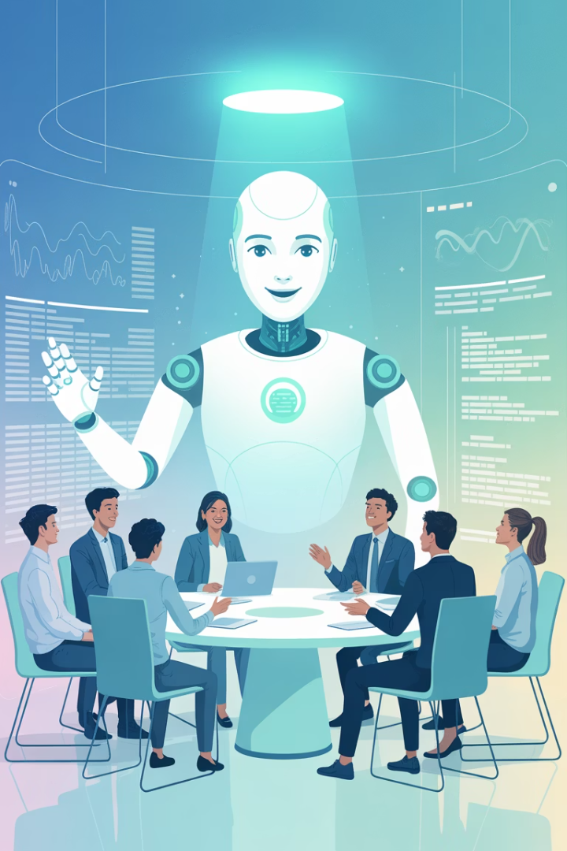
Smarter Standups: How AI Assistants Are Streamlining Agile Ceremonies
Transform your Agile workflows with cutting-edge AI tools designed to make ceremonies more efficient, productive, and insightful.
kW
by Kimberly Wiethoff

Slide 2
The Agile Ceremony Challenge
Time Drain
Inconsistent Value
Traditional ceremonies consume valuable development hours with status updates and manual tracking.
Meetings often lack focus, with important issues buried under routine reporting.
Remote Challenges
Distributed teams struggle with engagement and meaningful collaboration during ceremonies.

Slide 3
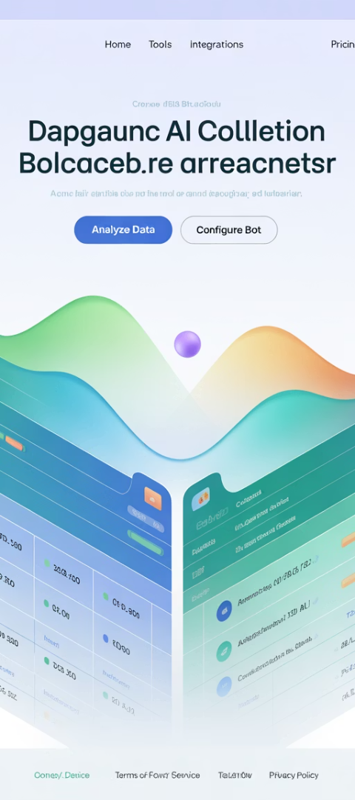
Automated Standup Intelligence
Auto-Collection
AI tools gather updates from Jira, GitHub, and other platforms automatically.
Smart Filtering
Algorithms identify what's relevant and what needs team attention.
Focus Shifting
Teams spend less time reporting and more time solving real problems.

Slide 4
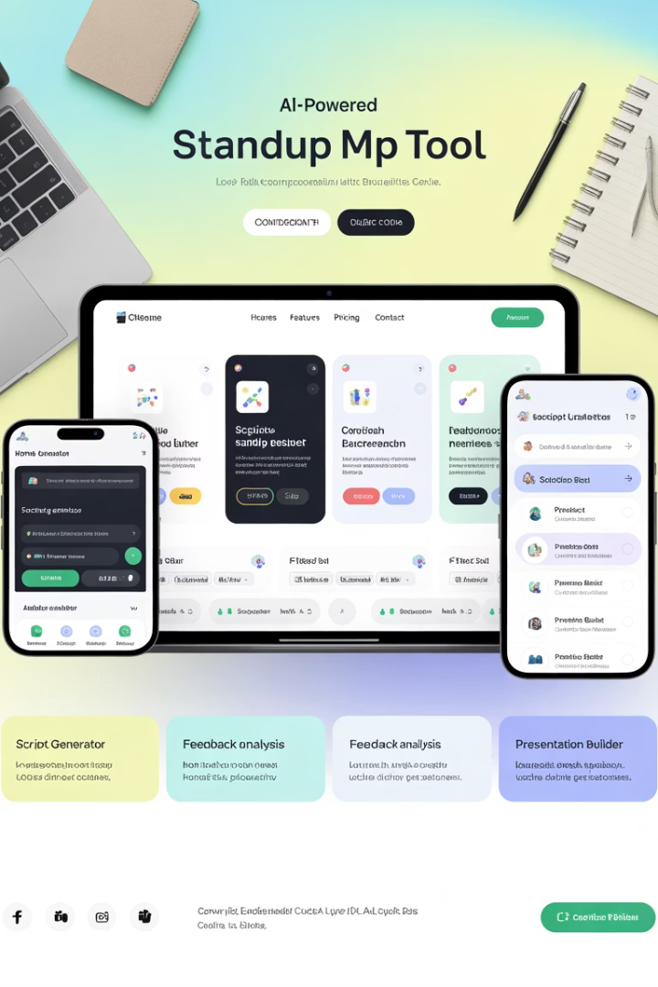
Leading AI Standup Tools
Standuply
Geekbot
Integrates with Slack to collect async updates and generate team reports with customizable questions.
Creates automated standup routines with smart scheduling and blocker detection for remote teams.
Range
Combines status tracking with team building through mood check-ins and integration with planning tools.

Slide 5
Real-Time Sprint Analytics
Continuous Scanning
Risk Detection
AI monitors sprint progress across all connected work management tools.
Algorithms flag scope creep, velocity drops, and bottlenecks early.
Smart Recommendations
Proactive Alerts
AI suggests task reassignments based on capacity and historical performance.
Teams receive notifications before issues impact sprint goals.

Slide 6
Data-Driven Retrospectives
Traditional Retros
AI-Enhanced Retros
Rely on memory and perception
Incorporate objective metrics
Miss underlying patterns
Reveal hidden bottlenecks
Subjective assessments
Track sentiment trends
Hard to measure improvement
Quantify progress over time

Slide 7
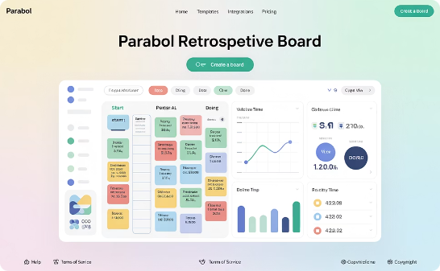
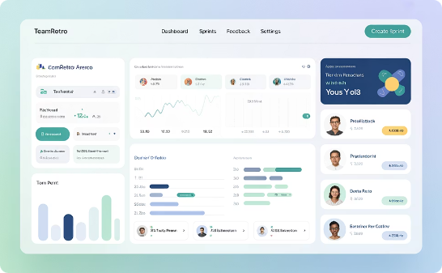
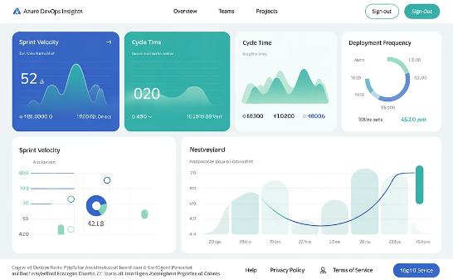
Top Retro Enhancement Tools
Parabol
TeamRetro
Azure DevOps Insights
Combines remote-friendly retrospectives with integration to your work tracking systems.
Offers AI-powered insights that correlate team sentiment with delivery performance.
Provides deep metrics directly integrated with your development workflow.

Slide 8
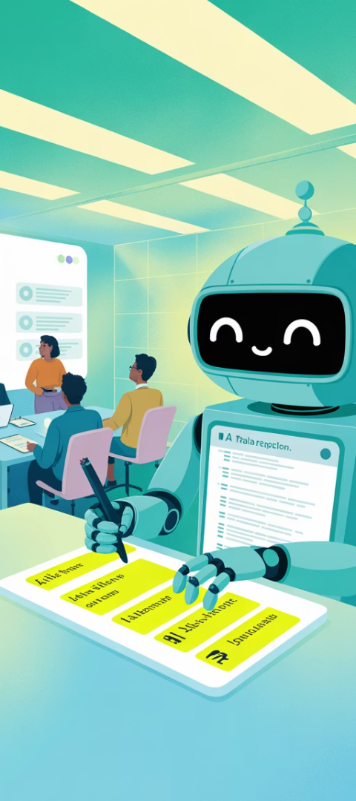
Meeting Transcription & Action Tracking
Automated Transcription
AI captures every word spoken in ceremonies without human note-taking.
Smart Summarization
Algorithms identify key points and decisions from lengthy discussions.
Action Item Extraction
AI detects commitments and automatically creates trackable tasks.
Integration & Follow-up
Tasks flow directly into work management tools with automated reminders.

Slide 9
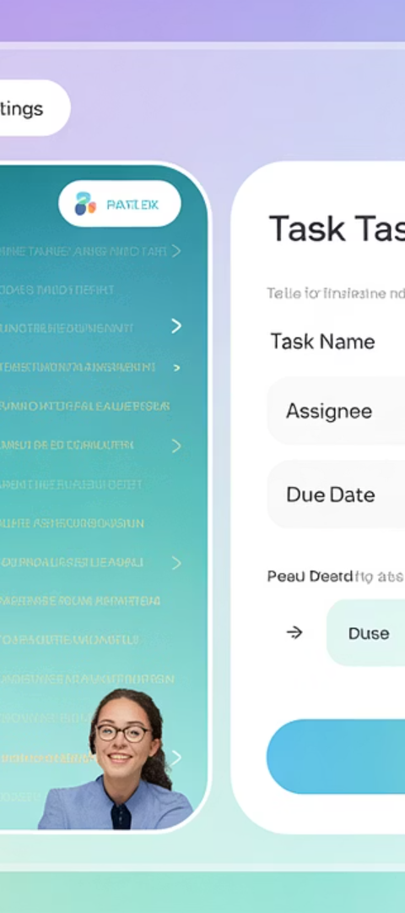
AI Meeting Assistants
Otter.ai
Real-time transcription with speaker identification and automated summary generation.
Fireflies.ai
Records, transcribes and helps search across all your meetings with AI-powered insights.
Notion AI
Transforms meeting notes into structured action plans with assignable tasks.

Slide 10
Behavioral Analytics for Coaches
Pattern Recognition
Identify recurring issues across multiple ceremonies
Contribution Analysis
Measure participation balance and engagement trends
Bottleneck Identification
Pinpoint where work consistently stalls
Communication Metrics
Track healthy team interaction patterns

Slide 11
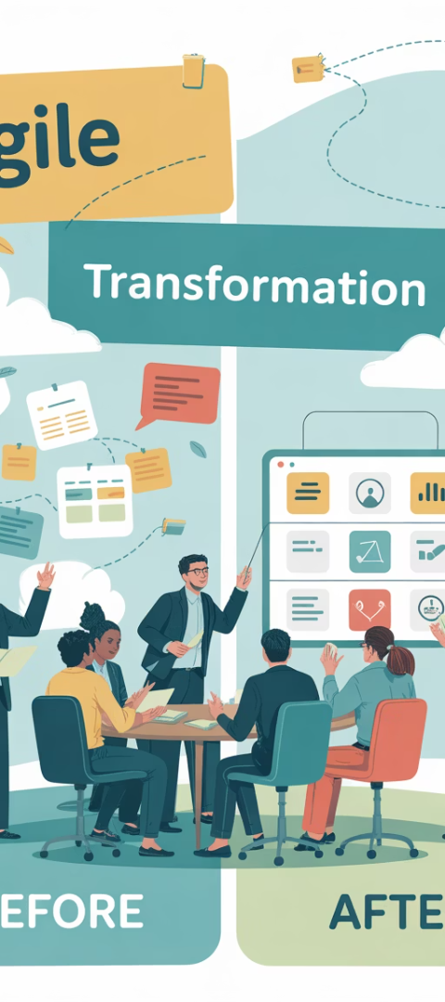
The Impact on Agile Teams
37%
42%
89%
Time Saved
Issue Resolution
Follow-through
Reduction in ceremony duration with AI assistance
Completion rate of AI-tracked action items
Improvement in blocker identification and resolution

Slide 12
Implementation Strategy
Start Small
Begin with one ceremony and one AI tool
Integrate Thoughtfully
Connect with existing workflows and tools
Measure Impact
Track time savings and team satisfaction
Expand Gradually
Add more AI capabilities as team adapts

Slide 13
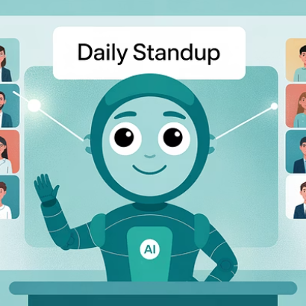
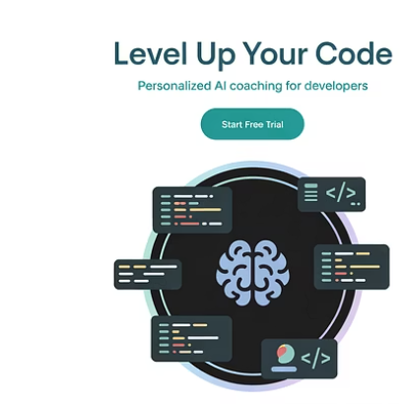
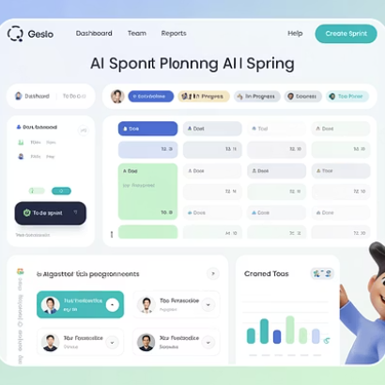
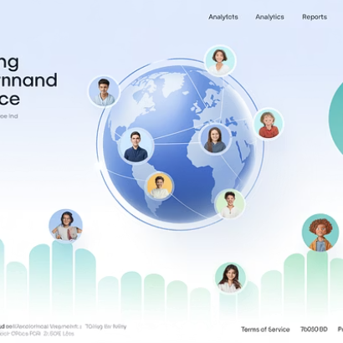
The Future of Agile Ceremonies
AI isn't replacing Agile ceremonies—it's making them intentional and outcome-focused. Teams that embrace these tools will spend less time reporting and more time delivering exceptional software.

Slide 14
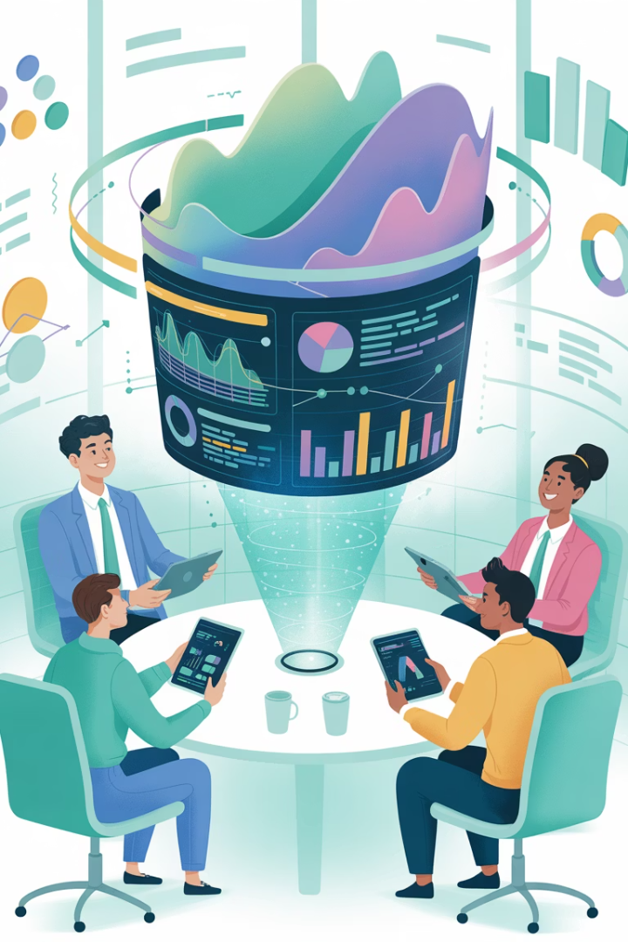
Final Thoughts
AI isn't making Agile ceremonies obsolete—it's making them intentional. By automating routine tasks and amplifying what really matters, AI-powered tools are helping Agile teams stay lean, aligned, and outcome-focused.
If your team is still relying on manual updates and gut feel, it's time to explore how AI can sharpen your standups, retros, and reviews. Because in Agile, time is precious—and AI makes every minute count.

