Slide 1

From Ceremonies to Success: How Scrum Engineers Drive Team Cadence and Clarity
Transforming Agile practices from routine checkpoints into powerful engines of team alignment and organizational success.
kW
by Kimberly Wiethoff, MBA, PMP, PMI-ACP
#AgileLeadership #ScrumMastery #ProjectManagement #ContinuousImprovement #AgileCeremonies #TeamSuccess #ScrumEngineer

Slide 2

The Hidden Power of Agile Ceremonies
Most teams treat Agile ceremonies as necessary evils—mandatory calendar entries that interrupt "real work." But this perspective fundamentally misses the transformative potential of well-orchestrated ceremonies.
Daily scrums, backlog refinement, sprint planning, demos, and retrospectives aren't just meetings. They're the connective tissue that binds individual contributions into collective achievement. When executed with intention and skill, these ceremonies become the foundation for sustainable team performance.
The difference between teams that merely survive and those that thrive often comes down to how they approach these seemingly routine touchpoints. Teams that embrace ceremonies as opportunities rather than obligations consistently outperform their peers in velocity, quality, and stakeholder satisfaction.

Slide 3





The Five Pillars of Agile Success
Daily Scrums
Backlog Refinement
Sprint Planning
15-minute synchronization points that create transparency and identify impediments early. When facilitated effectively, they build accountability and foster collaborative problem-solving rather than mere status updates.
Ongoing collaboration between the team and stakeholders to clarify requirements, estimate effort, and prioritize value delivery. This ceremony ensures the team always has a clear understanding of upcoming work.
Strategic sessions where teams commit to achievable goals and create detailed plans for execution. Effective planning balances ambition with realism, setting teams up for success rather than frustration.
Sprint Reviews
Retrospectives
Opportunities to demonstrate progress, gather feedback, and adapt direction based on stakeholder input. These sessions bridge the gap between development work and business value creation.
Dedicated time for reflection, learning, and process improvement. Teams that consistently improve their ways of working through structured retrospectives achieve higher performance and satisfaction.

Slide 4
Enter the Scrum Engineer
The role of a Scrum Engineer extends far beyond traditional Scrum Master responsibilities. While Scrum Masters focus on process adherence and servant leadership, Scrum Engineers bring a technical mindset to Agile facilitation, combining deep understanding of engineering practices with masterful ceremony orchestration.
A Scrum Engineer doesn't just run meetings—they architect experiences that drive outcomes. They understand that each ceremony serves multiple purposes: alignment, learning, decision-making, and relationship building. By approaching each touchpoint with this holistic view, they transform routine interactions into catalysts for team growth.
The distinction is crucial: where traditional facilitation might focus on following the prescribed format, Scrum Engineers adapt ceremonies to serve their team's specific needs, challenges, and goals. They're not just guardians of process—they're craftspeople who shape Agile practices into powerful tools for success.

Slide 5
Building Team Cadence Through Purposeful Facilitation
01
02
Fostering Psychological Safety
Encouraging Honest Feedback
Creating environments where team members feel safe to share challenges, admit mistakes, and propose innovative solutions. This foundation enables honest communication and collaborative problem-solving.
Establishing norms and techniques that promote constructive feedback loops. Teams that regularly exchange honest, specific feedback accelerate their learning and improvement cycles.
03
04
Facilitating Deep Discussions
Creating Alignment Opportunities
Moving beyond surface-level status updates to explore root causes, examine assumptions, and generate creative solutions. Skilled facilitation draws out insights that wouldn't emerge otherwise.
Designing moments within ceremonies where team members can synchronize understanding, clarify expectations, and commit to shared goals. Alignment is built, not assumed.
When these elements work together consistently, they create a rhythm—a team cadence—that becomes self-reinforcing. Teams operating with strong cadence experience less friction, faster decision-making, and greater confidence in their ability to deliver.

Slide 6
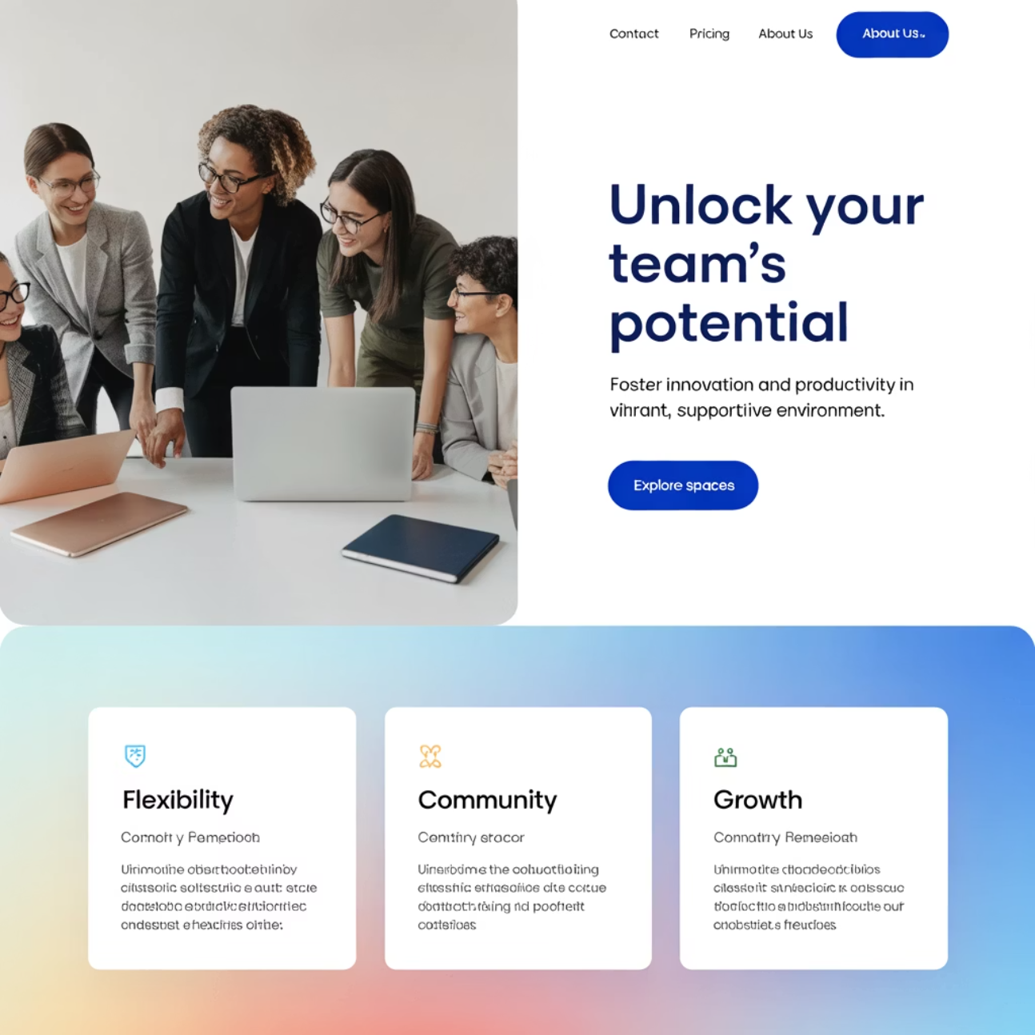
The Trust-Building Engine
How Consistent Ceremonies Build Organizational Trust
Trust isn't built through grand gestures—it emerges from consistent, reliable interactions over time. Well-run ceremonies create predictable touchpoints where team members can depend on each other for transparency, support, and follow-through.
When team members consistently show up prepared, share honestly about their progress and challenges, and follow through on commitments made during ceremonies, they build a foundation of mutual reliability. This trust becomes a competitive advantage, enabling teams to take on more complex challenges and recover more quickly from setbacks.
The Scrum Engineer orchestrates these trust-building moments by modeling vulnerability, celebrating transparency, and ensuring that every team member's contribution is valued and heard.

Slide 7
Creating Organizational Clarity
Stakeholder Engagement
Impediment Surfacing
Metrics and Visibility
Regular backlog refinement sessions with stakeholders ensure requirements are clearly understood and priorities remain aligned with business needs. This prevents costly misunderstandings and rework.
Systematic identification and escalation of blockers ensures problems are addressed quickly before they compound. Transparency about challenges enables proactive support from leadership.
Consistent tracking and communication of key metrics like velocity, burn down, and quality indicators provides data-driven insights into team performance and delivery predictability.
Clear acceptance criteria definition
Daily impediment identification
Sprint velocity trends
Priority alignment with business goals
Clear escalation pathways
Burn down chart analysis
Progress tracking on resolution
Quality metrics tracking
Early identification of dependencies

Slide 8
Connecting Daily Work to Strategic Goals
The most successful teams understand how their daily activities contribute to broader organizational objectives. The Scrum Engineer plays a crucial role in maintaining this connection through purposeful ceremony design and consistent communication.
During sprint planning, they help teams understand not just what they're building, but why it matters. In reviews, they facilitate discussions that connect delivered features to business outcomes. Through retrospectives, they guide teams to consider how process improvements can enhance their contribution to organizational success.
This strategic awareness transforms individual contributors into invested stakeholders who make better decisions, prioritize more effectively, and take greater ownership of outcomes. When team members see the direct line between their work and customer value, engagement and quality naturally improve.

Slide 9


From Motion to Momentum
Going Through the Motions
Building Momentum
Treating ceremonies as checkbox activities that must be completed but don't drive real value. Teams stuck in motion feel busy but rarely feel productive or aligned.
Transforming ceremonies into energizing experiences that generate insights, solve problems, and create forward progress. Teams with momentum feel empowered and confident in their direction.
The difference between motion and momentum is purpose. When ceremonies are conducted with clear intentions and skilled facilitation, they become accelerators rather than interruptions. Teams begin to look forward to these touchpoints as opportunities to make progress, solve challenges, and celebrate achievements.
This momentum is contagious—it spreads beyond individual teams to influence broader organizational culture and performance.

Slide 10
Ceremonies Done Well = Success
When Scrum Engineers transform routine ceremonies into powerful engines of team alignment, the results speak for themselves: improved velocity, higher quality deliveries, stronger stakeholder relationships, and teams that are energized rather than exhausted by their Agile practices.
40%
65%
50%
Faster Delivery
Higher Engagement
Better Outcomes
Teams with strong ceremony cadence deliver features 40% faster than those with inconsistent practices.
Team members report 65% higher satisfaction when ceremonies feel purposeful and productive.
Organizations see 50% improvement in delivery predictability with skilled ceremony facilitation.
The path to Agile success isn't found in perfect processes—it's built through purposeful people who understand that ceremonies, when done well, become the foundation for cadence, clarity, and ultimately, sustainable team success.

