Slide 1

Digital Twins & AI: Transforming Project Management in Supply Chain Optimization
In today's fast-paced, tech-driven world, global supply chains are more complex—and more connected—than ever before. From raw material sourcing to last-mile delivery, every node and link in the chain generates valuable data.
For project managers, staying ahead means harnessing the power of emerging technologies like Digital Twins and Artificial Intelligence to optimize performance, reduce risk, and improve decision-making. These technologies are transforming supply chain management—and redefining the project manager's role.
kW
by Kimberly Wiethoff

Slide 2








The Connected Supply Chain Landscape
Global Complexity
Data Rich
International suppliers, multiple transportation modes, and regional regulations create intricate dependencies that require sophisticated management approaches.
Every touchpoint generates information that can be leveraged for optimization, from IoT sensors to transaction records and geolocation data.
Interconnected
Real-Time Pressure
Changes in one area can create cascading effects throughout the entire network, making system-wide visibility essential.
Customer expectations for speed and visibility have never been higher, creating demand for instant insights and agile responses.

Slide 3





Digital Twins Defined
Virtual Replicas
A digital twin is a real-time, dynamic virtual representation of physical objects, processes, or systems. It mirrors current conditions while enabling simulation of future states.
Two-Way Integration
Changes in the physical world automatically update the digital model, while insights from the model can be applied to the physical environment, creating a continuous feedback loop.
Predictive Capabilities
Digital twins allow for scenario testing and simulation without disrupting actual operations, enabling predictive maintenance and proactive problem-solving.
End-to-End Visibility
From individual assets to entire networks, digital twins provide unprecedented transparency across complex, interconnected supply chain systems.

Slide 4

Digital Twins in Supply Chain Action
Warehouse Operations
Digital twins simulate picking routes, labor allocation, and inventory placement, enabling project managers to optimize warehouse layouts and staffing levels before physical implementation.
Transportation Networks
Route optimization through digital twins factors in real-time traffic, weather conditions, and delivery constraints, allowing project managers to adapt distribution strategies dynamically.
Inventory Management
Virtual modeling of inventory flows enables project managers to identify optimal reorder points, buffer levels, and distribution center locations based on simulated demand patterns.
Crisis Management
When disruptions occur, digital twins enable project managers to quickly simulate alternative scenarios and select the most effective mitigation strategy before implementing it.

Slide 5
AI's Role in Supply Chain Transformation
Predictive Analytics
Autonomous Decision-Making
Pattern Recognition
AI algorithms process historical and real-time data to forecast demand patterns, potential disruptions, and maintenance needs with unprecedented accuracy.
Machine learning excels at identifying subtle patterns in vast datasets that would be invisible to human analysts, revealing optimization opportunities and risk factors.
AI systems can independently optimize routing, adjust inventory levels, and schedule maintenance based on real-time conditions and predefined parameters.
Project managers can rely on these predictions to optimize resource allocation and proactively address potential bottlenecks before they materialize.
This autonomy frees project managers from routine decisions, allowing them to focus on strategic initiatives and exceptional situations requiring human judgment.
These insights enable project managers to make data-driven decisions that consider complex interdependencies across the supply chain ecosystem.

Slide 6
AI Applications for Project Managers
Natural Language Processing
Risk Detection
Automated Scheduling
AI systems continuously monitor for anomalies in operations, financial transactions, and supplier performance. By flagging potential issues before they escalate, AI enables project managers to implement mitigation strategies proactively rather than reactively.
NLP capabilities extract insights from unstructured data sources like emails, supplier communications, and customer feedback. This provides project managers with contextual information that might otherwise be missed in traditional reporting structures.
Demand Forecasting
Machine learning algorithms optimize production and distribution schedules by balancing multiple constraints simultaneously. This gives project managers confidence that timelines are realistic and resources are allocated efficiently across competing priorities.
AI analyzes historical sales data, seasonality, market trends, and even social media sentiment to predict future demand with greater accuracy than traditional methods. Project managers can plan capacity and resources based on these forecasts, reducing both stockouts and excess inventory.

Slide 7





The Evolving Project Manager Role
Task Manager
Traditional focus on monitoring milestones, assignments, and deadlines through static tools and reports.
Data Interpreter
Translating digital twin insights and AI recommendations into actionable strategies for cross-functional teams.
Technology Liaison
Bridging the gap between technical capabilities and business needs, ensuring tools serve strategic objectives.
Strategic Orchestrator
Leveraging predictive capabilities to optimize resources, mitigate risks, and capitalize on opportunities.

Slide 8










New Skills for Tech-Enabled Project Managers
Data Fluency
Understanding analytics fundamentals
Technical Literacy
Comprehending AI and digital twin capabilities
Cross-Functional Collaboration
Working effectively with data scientists and IT
Systems Thinking
Seeing interconnections across the supply chain
Critical Questioning
Challenging algorithms and validating outputs

Slide 9




Practical Implementation Strategy
Assessment
Evaluate current pain points and opportunities in your supply chain operations. Identify specific use cases where digital twins and AI could deliver measurable value. Engage stakeholders to understand their needs and concerns.
Pilot Project
Select a contained, high-impact area for initial implementation. Define clear success metrics and establish baseline measurements. Partner with IT and data science teams to customize solutions for your specific context.
Training & Change Management
Develop comprehensive training programs for affected teams. Focus on both technical skills and new workflows. Address resistance by demonstrating tangible benefits for individual roles.
Scaled Deployment
Gradually expand to additional supply chain areas based on lessons learned. Integrate systems to create a comprehensive digital ecosystem. Establish governance frameworks for data quality and decision protocols.

Slide 10
Best Practices for Tool Selection
1
Prioritize Integration Capabilities
2
Assess Scalability Requirements
Select technologies that seamlessly connect with your existing ERP, WMS, and TMS systems. Avoid creating data silos that limit the effectiveness of both digital twins and AI applications. The most valuable insights often come from connecting previously disparate systems.
Choose platforms designed to grow alongside your organization. Consider both geographic expansion and increasing data volumes. Evaluate the vendor's roadmap to ensure ongoing development aligns with your future needs.
3
Verify Data Governance Features
4
Test User Experience
Ensure tools provide robust capabilities for data quality management, security, and privacy compliance. These foundational elements will determine the reliability of your digital twin models and AI recommendations.
Involve actual end users in the evaluation process. The most sophisticated technology will fail if it's too complex for daily use. Intuitive interfaces and customizable dashboards increase adoption rates and maximize ROI.

Slide 11
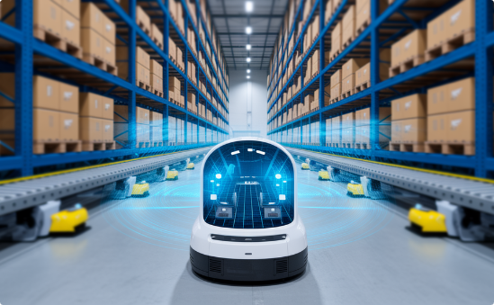


Real-World Success Stories
Warehouse Optimization
Transportation Network Redesign
Disruption Management
A major retailer implemented digital twin technology to simulate warehouse operations, resulting in a 28% improvement in picking efficiency and 15% reduction in labor costs. Project managers used the virtual environment to test multiple layout configurations without disrupting daily operations.
A consumer goods company leveraged AI to optimize their distribution network, reducing fuel consumption by 22% and delivery times by 17%. Project managers continuously refine routes based on real-time conditions and predictive demand patterns.
A pharmaceutical manufacturer created digital twin simulations of their global supply chain, enabling them to respond to the pandemic with 60% faster reconfiguration of production and distribution. Project managers now regularly simulate disruption scenarios to strengthen resilience.

Slide 12
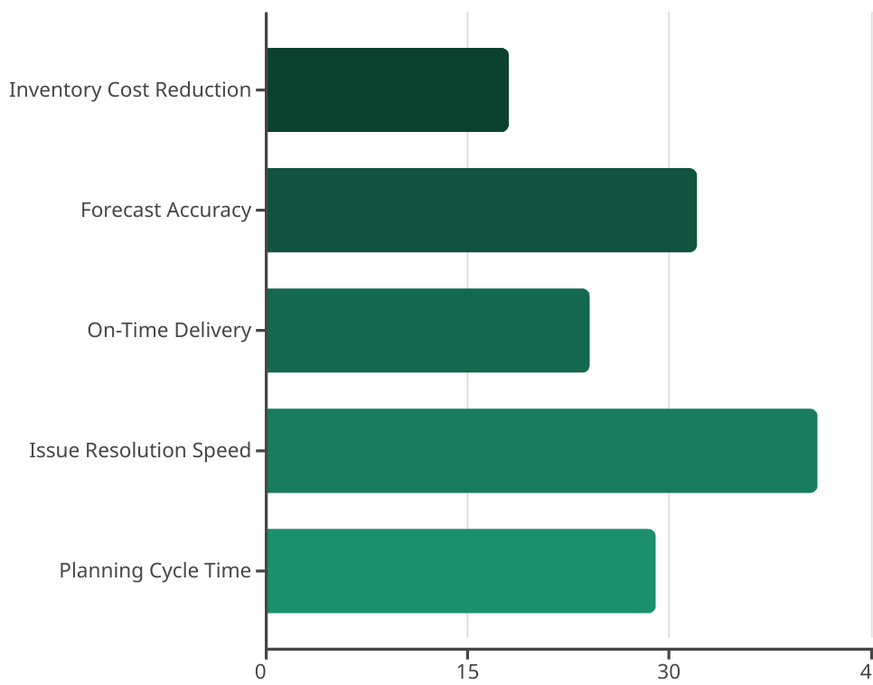
Measuring Success & ROI
Organizations implementing digital twins and AI in supply chain operations report significant improvements across key performance indicators. The most dramatic gains typically occur in areas requiring rapid response to changing conditions, such as issue resolution and forecast accuracy.
Project managers should establish baseline measurements before implementation and track improvements over time. Beyond operational metrics, consider measuring qualitative benefits like improved decision confidence and reduced stress during disruptions.

Slide 13




Common Implementation Challenges
Data Quality Issues
Inconsistent, incomplete, or inaccurate data undermines the effectiveness of both digital twins and AI systems.
Resistance to Change
Teams accustomed to traditional methods may be skeptical of new technologies and reluctant to alter established workflows.
Integration Complexity
Connecting legacy systems with modern platforms often requires more time and resources than initially anticipated.
Skills Gap
Finding talent with both supply chain expertise and technological fluency remains challenging in the current market.
Project managers can overcome these challenges by starting with focused pilot projects, investing in proper data governance, developing comprehensive training programs, and partnering closely with IT and data science teams. Building cross-functional steering committees helps ensure diverse perspectives inform the implementation process.

Slide 14








The Future of Supply Chain Project Management
Immersive Experiences
AI Collaboration
Virtual and augmented reality will enable project managers to "walk through" digital twin environments, making complex data more intuitive and accessible.
Advanced AI assistants will provide proactive recommendations and automate routine decisions, becoming trusted members of project teams.
Human-Centered Design
Autonomous Networks
Technology will increasingly adapt to human work styles rather than the reverse, with interfaces designed around natural language and intuitive interactions.
Self-optimizing supply chains will automatically reconfigure based on changing conditions, with project managers focusing on exception handling and strategic oversight.
The most successful project managers will be those who embrace these emerging technologies while maintaining a focus on the human element. By balancing technological capabilities with strategic vision and interpersonal leadership, they will drive unprecedented levels of supply chain performance and resilience.

