Slide 1


Beyond ChatGPT: How Retrieval-Augmented Generation (RAG) Builds Trust in Enterprise AI
The excitement surrounding generative AI is impossible to ignore. Organizations across nearly every industry are exploring AI-powered assistants, copilots, and automation platforms to improve productivity, accelerate decision-making, reduce operational friction, and drive digital transformation.
#AI #GenerativeAI #RAG #RetrievalAugmentedGeneration #EnterpriseAI #ArtificialIntelligence #DigitalTransformation #AITrust #ResponsibleAI #KnowledgeManagement #BusinessTransformation #ProjectManagement #PMO #OperationalExcellence #TechnologyLeadership #MachineLearning #FutureOfWork #AIOps #HealthcareIT #CloudComputing #Leadership #Innovation #AITransformation #DataStrategy

Slide 2
The Questions Every Executive Is Asking
As organizations move from AI experimentation into real-world implementation, leaders are focused on measurable outcomes. But a critical challenge is emerging that threatens to stall progress.
The Questions Driving AI Investment
The Adoption Barrier No One Expected
How can AI improve operational efficiency?
Can AI reduce manual, repetitive work?
How do we scale knowledge across the enterprise?
Can AI help us make faster, smarter decisions?
Employees do not trust AI systems that provide inconsistent, inaccurate, or unverifiable answers. If employees, regulators, project teams, or business leaders cannot trust the output, adoption will stall — regardless of how impressive the technology appears.
This is where Retrieval-Augmented Generation (RAG) is changing the conversation. RAG may ultimately become the missing link between AI experimentation and true enterprise transformation.

Slide 3
The Enterprise AI Trust Problem
One of the biggest misconceptions about generative AI is that conversational capability automatically creates business value. It does not. In enterprise environments, trust matters more than novelty. Without it, AI adoption struggles to move beyond isolated experimentation.
Accuracy
Currency
Employees need confidence that AI provides correct, reliable information every time.
Responses must reflect current data, policies, and documentation — not outdated training snapshots.
Governance
Explainability
AI systems must follow established standards and respect organizational security boundaries.
Users and auditors need to understand where AI responses originate and how they were generated.

Slide 4

Why Traditional AI Models Create Business Concerns
Large Language Models are powerful, but they were not originally designed to operate inside complex enterprise environments. Most public AI systems are trained on generalized, publicly available information — leaving significant gaps in enterprise applicability.
What LLMs Are Trained On
What LLMs Don't Know
Websites and public articles
Books and academic datasets
General-purpose knowledge repositories
Internal business processes and workflows
Company policies and approved procedures
Regulatory and compliance frameworks
Current project documentation
Enterprise knowledge repositories
This knowledge gap creates measurable business risk — including inaccurate responses, compliance exposure, and erosion of employee confidence in AI systems.

Slide 5

Hallucinations Undermine Confidence
Hallucination — the generation of responses that sound credible but are factually incorrect — is one of the most widely discussed AI risks. In personal use, hallucinations are an inconvenience. In enterprise environments, they can be genuinely dangerous.
Cybersecurity Risk
AI misstates security requirements or references outdated controls, creating compliance gaps and audit exposure.
Compliance Exposure
Invented regulatory guidance leads teams to make decisions based on non-existent rules or superseded policies.
Financial Inaccuracy
Incorrect financial data or misinterpreted operational standards can distort reporting and decision-making.
The result is predictable: employees stop trusting the system. And once trust is lost, enterprise AI adoption becomes extremely difficult to recover.

Slide 6
Employees Still Spend Too Much Time Searching for Information
Many organizations struggle with deeply fragmented knowledge ecosystems. Critical information is scattered across platforms, creating daily friction that slows operations and increases project risk.
Where Knowledge Hides
The Cost of Fragmentation
Operational inefficiency and wasted hours
Delayed decisions and missed deadlines
Duplicate work across teams
Entrenched knowledge silos
Increased project and delivery risk
SharePoint
Confluence
Email & Teams
Wikis
Legacy Systems
Shared Drives
Digital transformation initiatives often fail not because data is unavailable, but because organizational knowledge is too difficult to access reliably.

Slide 7

What Is RAG?
Retrieval-Augmented Generation (RAG) is an AI architecture that combines information retrieval with generative AI — fundamentally changing how AI systems produce responses in enterprise contexts.
Retrieve
Augment
Generate
In simple terms: traditional AI answers from memory. RAG-enabled AI answers after reviewing trusted organizational knowledge — dramatically improving accuracy, relevance, transparency, and user confidence. RAG is not simply a technical enhancement; it fundamentally changes how organizations interact with knowledge and decision-making.

Slide 8

1. RAG Helps Build Trust in AI
Trust is one of the most important factors in successful AI adoption — and it remains one of the hardest to establish with generic AI systems. RAG addresses this directly by grounding every response in verified organizational knowledge.
What RAG Retrieves Before Responding
The Business Impact
Internal policies and approved documentation
Current procedures and operational standards
Trusted knowledge repositories
Project-specific and domain-specific content
Instead of "guessing" from training data, the AI retrieves real, current organizational information before generating a response. Employees receive answers they can verify, trace, and act on with confidence — making AI a reliable part of daily work rather than an uncertain experiment.

Slide 9
2. RAG Makes Enterprise AI More Explainable
Explainability is one of the top concerns executives raise about enterprise AI. Business leaders, compliance officers, and auditors need to understand not just what the AI said — but why it said it and where the information came from.
Source Citations
Retrieval Traceability
Regulatory Auditability
RAG systems surface the specific documents, policies, or repositories that informed each response — providing a clear audit trail.
Every answer can be traced back to the retrieved content, enabling teams to validate AI output against authoritative sources.
In regulated industries, the ability to demonstrate where AI guidance originated is essential for compliance and risk management.

Slide 10



3. RAG Enables Better Decision-Making
Organizations generate enormous amounts of information, but accessing that knowledge efficiently remains one of the most persistent operational challenges. RAG transforms scattered enterprise knowledge into conversational, on-demand intelligence.
"What risks impacted previous ERP implementations?" · "What cybersecurity controls are required for FDA submissions?" · "What lessons learned exist from prior cloud migrations?"
Employees can ask natural-language questions and receive contextual, grounded responses — drawn directly from organizational knowledge — in seconds rather than hours of manual searching.
Faster Decisions
Better Execution
Strategic Alignment
Instant access to relevant context eliminates research delays
Project teams stay aligned with current standards and past learnings
Leadership receives intelligence grounded in real operational data

Slide 11



4. RAG Supports Digital Transformation at Scale
Many digital transformation initiatives struggle because information remains siloed across departments, systems, and geographies. RAG helps unify organizational knowledge by enabling AI systems to retrieve intelligently across multiple repositories simultaneously.
Enterprise AI Assistants
PMO Intelligence Platforms
Regulatory Knowledge Systems
Organization-wide assistants that respond with knowledge drawn from approved internal sources rather than generic training data.
Project offices leverage RAG to surface lessons learned, governance guidance, and risk patterns across the entire portfolio.
Compliance teams access real-time guidance grounded in current regulatory frameworks, policies, and approved procedures.

Slide 12
Real-World Business Use Cases
RAG is already delivering measurable value across industries where trust, accuracy, and knowledge access are mission-critical.
🏥 Healthcare & Regulatory
📋 PMO & Project Delivery
Healthcare organizations leverage RAG to support FDA documentation retrieval, cybersecurity compliance guidance, prior authorization workflows, clinical policy access, and claims intelligence. In highly regulated environments, grounded AI responses are essential for trust, safety, and auditability.
Project Management Offices use RAG for lessons-learned retrieval, portfolio intelligence, governance guidance, and risk pattern analysis. Imagine a project leader asking "What dependencies caused delays in previous transformation programs?" and receiving a contextual summary within seconds — not after days of searching.

Slide 13
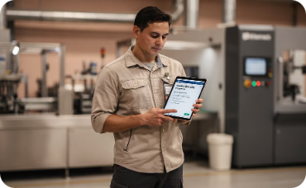

More Use Cases Driving ROI
Manufacturing & Operations
Customer Support & Service Operations
Manufacturers implement RAG to improve SOP retrieval, maintenance guidance, equipment troubleshooting, and operational consistency. This is especially valuable as organizations face growing knowledge-transfer challenges from an aging workforce. Employees receive instant, accurate procedural guidance — reducing errors and downtime.
RAG-powered support systems improve chatbot reliability, reduce escalations, accelerate issue resolution, and enable intelligent self-service. Unlike generic AI chatbots that guess from training data, RAG systems retrieve current organizational knowledge before responding — delivering accurate, consistent answers at scale.

Slide 14

RAG and the Future of Enterprise AI Copilots
One of the most significant trends emerging in enterprise AI is the rise of domain-specific AI copilots. Organizations are building PMO copilots, compliance copilots, healthcare assistants, operational support bots, and engineering knowledge assistants. But these systems only become genuinely valuable when employees trust the information they provide.
PMO Copilots
Compliance Copilots
Project intelligence grounded in portfolio history and governance frameworks
Real-time regulatory guidance sourced from approved policy libraries
Operational Bots
Workflow support grounded in current SOPs and operational procedures
RAG is increasingly becoming the foundational architecture that makes trustworthy AI copilots possible at enterprise scale.

Slide 15
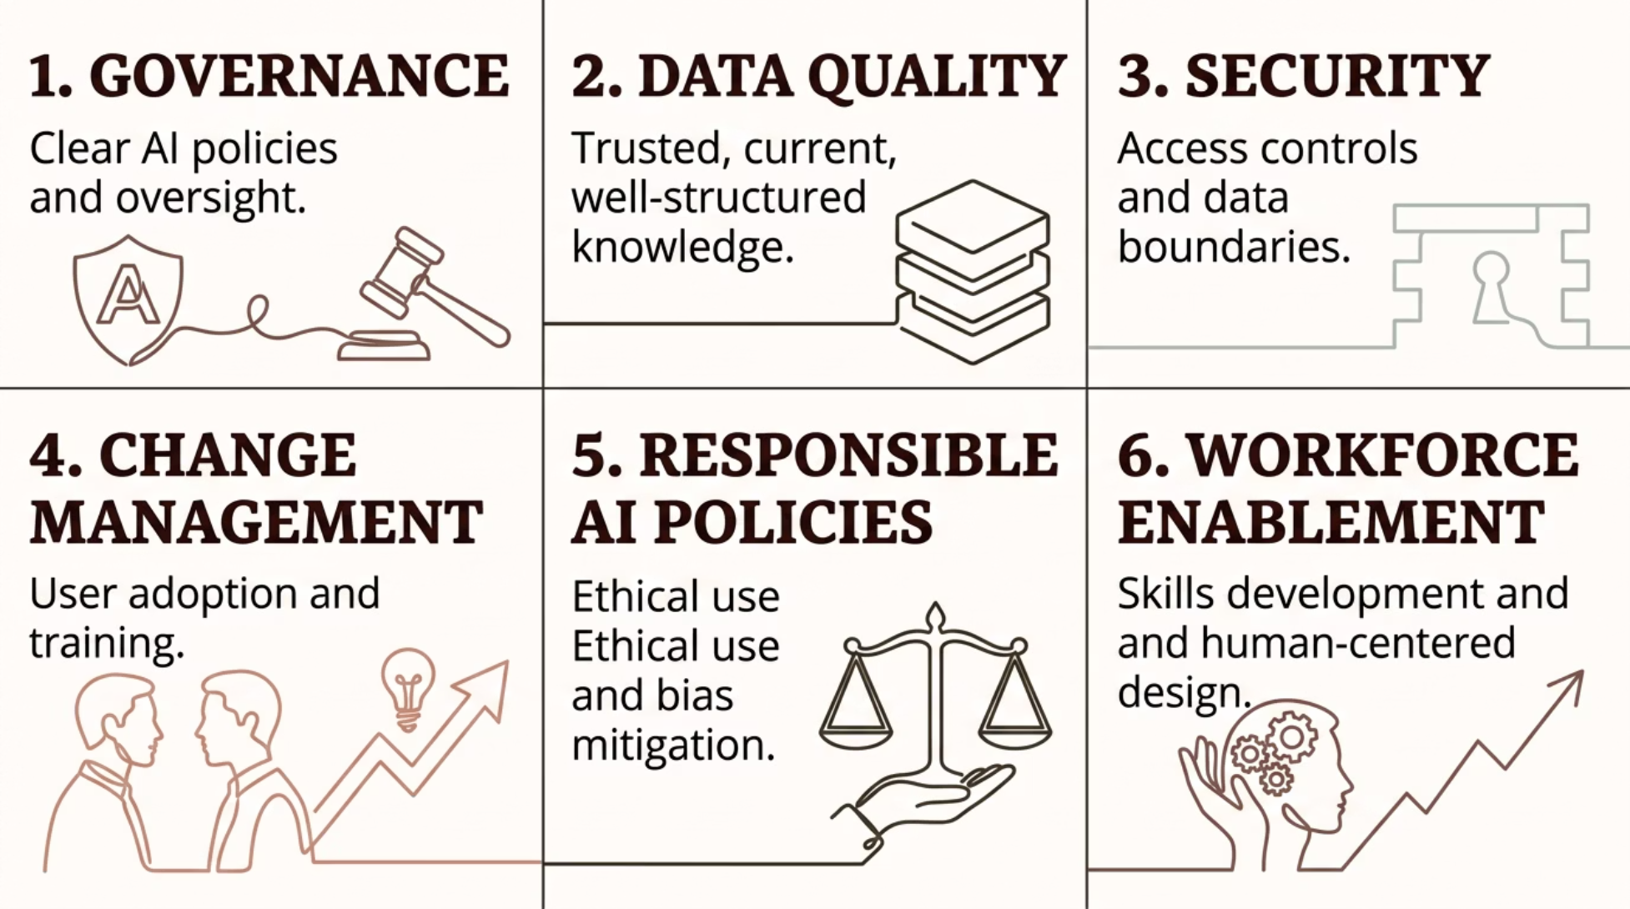

Successful AI Transformation Requires More Than Technology
Technology alone will not guarantee successful AI adoption. The organizations that achieve lasting value from enterprise AI will be those that combine intelligent architectures with the organizational foundations that enable trust.
AI transformation is as much about organizational trust as it is about technical capability. The organizations that succeed will combine strong governance, trusted data, and human-centered adoption strategies with intelligent AI architectures like RAG.

Slide 16




Why RAG May Become Foundational to Enterprise AI
As organizations mature in their AI journeys, a critical insight is emerging: the future of enterprise AI is not simply about generating content — it is about delivering trusted intelligence.
AI Reasoning
Enterprise Knowledge
Advanced language understanding and contextual inference
Grounded in real organizational documentation and policies
Governance & Explainability
Real-Time Retrieval
Auditable, traceable responses that satisfy regulatory and leadership requirements
Current information accessed dynamically at the moment of query
That combination of capability and trust may ultimately become the most important competitive advantage organizations can build in the AI era.

Slide 17

Final Thoughts
Generative AI has created tremendous excitement, but long-term enterprise value depends on more than impressive conversations. The question has shifted.
The Old Question
The Right Question
"Can AI generate answers?"
"Can employees trust those answers enough to use AI as part of daily decision-making?"
Early AI adoption was driven by the novelty of conversational capability — impressive demos that sparked imagination but rarely survived contact with enterprise complexity.
Retrieval-Augmented Generation is helping organizations move closer to that future — by building AI systems that understand business context, retrieve trusted information, reduce hallucinations, support governance, and improve operational decision-making.
For digital transformation leaders, RAG represents one of the most important architectural decisions in building enterprise AI that employees will actually trust and use.

