Slide 1
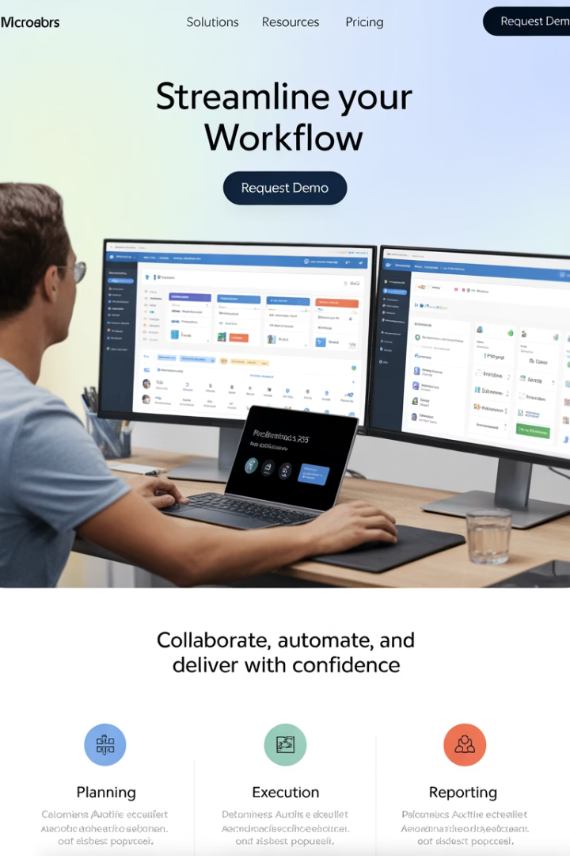
Integrating Microsoft Dynamics 365 with Azure DevOps
Bridge the gap between business operations and software development with this powerful integration that offers a unified view of strategy, execution, and delivery.
kW
by Kimberly Wiethoff

Slide 2
Today's Agenda
Why Integrate?
The business case for connecting these platforms
Key Use Cases
Real-world integration scenarios
Integration Methods
Technical approaches to connect systems
Best Practices
Tips for successful implementation

Slide 3
The Integration Challenge
Disconnected Systems
Visibility Gaps
CRM, project tasks, and development tickets exist in separate tools. This creates information silos.
Business requirements and technical implementation become misaligned. Teams lose sight of priorities.
Process Delays
Manual updates across systems cause delays. Reporting becomes time-consuming and error-prone.

Slide 4
Why Integrate These Platforms?
Full Transparency
Tighter Collaboration
Track progress from customer requirements to deployment in one view.
Connect sales, product, development, and QA teams effectively.
Real-time Syncing
Business-Engineering Alignment
Automatically update project tasks, bugs, and features with CRM data.
Ensure what business wants is what engineering builds.

Slide 5
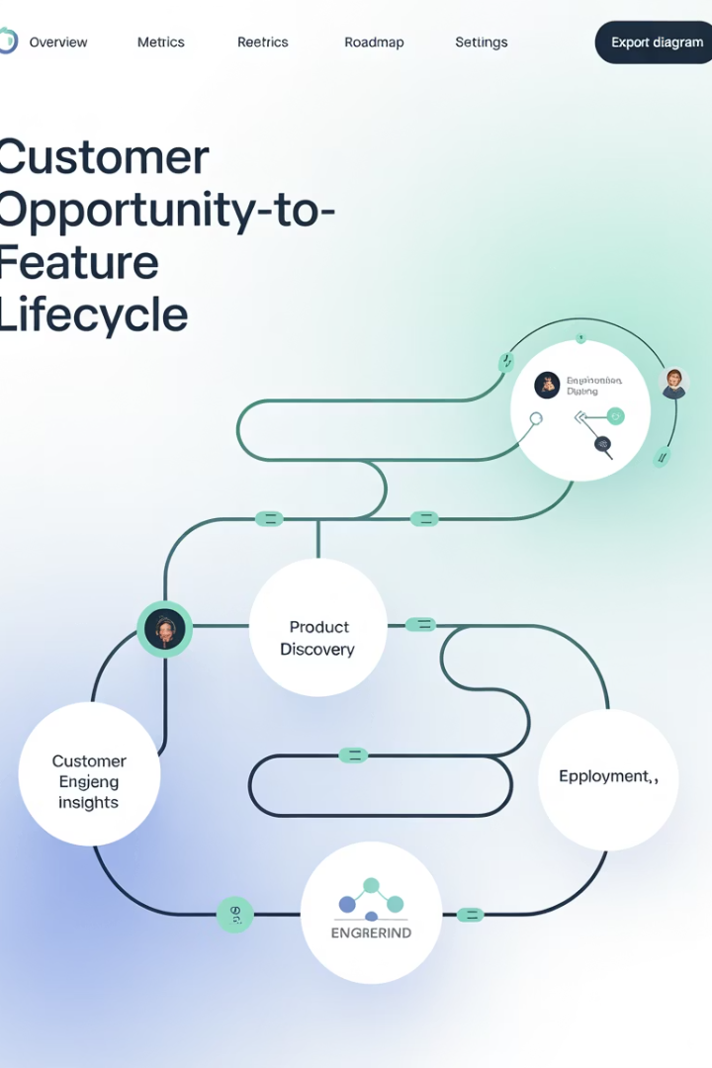
Traceability from Opportunity to Deployment
Deal Closed in Dynamics
Customer opportunity is won in CRM system.
Feature Creation in ADO
User stories auto-generated in development backlog.
Development Progress
Status updates sync back to CRM as work progresses.
Deployment Notification
CRM updated when feature goes live.

Slide 6
Syncing Work Items and Project Tasks
Create Project Task
Auto-Sync
Task created in Dynamics 365 Project Operations
Bidirectional sync moves data between systems
Status Updates
Dev Work Item
Changes in either system reflect in both
Corresponding work item appears in ADO

Slide 7
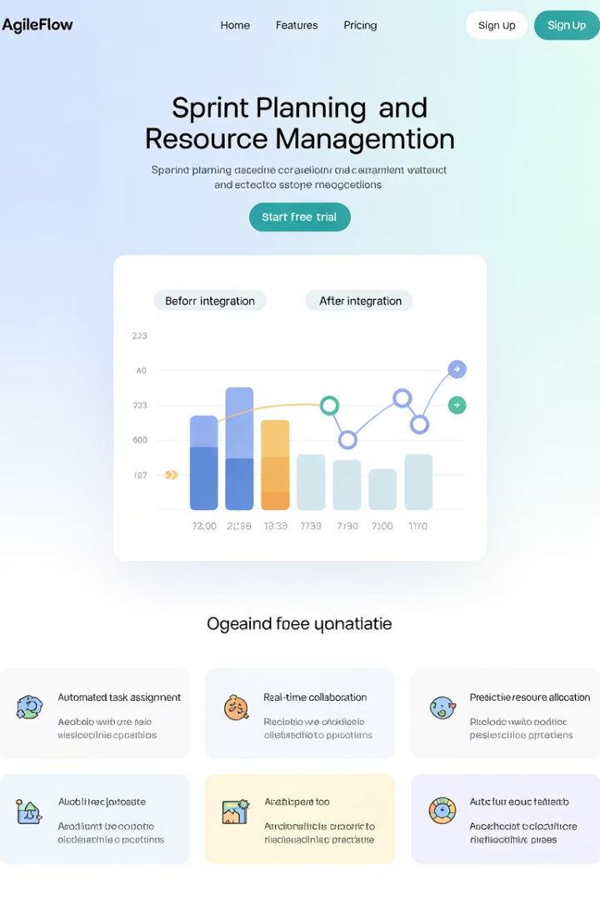
Sprint and Resource Planning Benefits
Before Integration
After Integration
Manual capacity checks
Real-time capacity views
Disconnected planning
Business-aligned planning
Priority conflicts
Clear priority signals
Delayed adjustments
Agile timeline adjustments

Slide 8
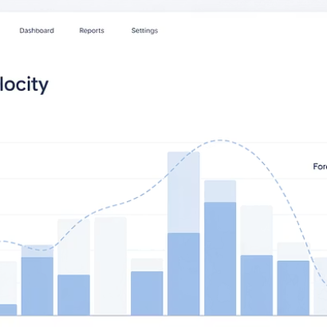
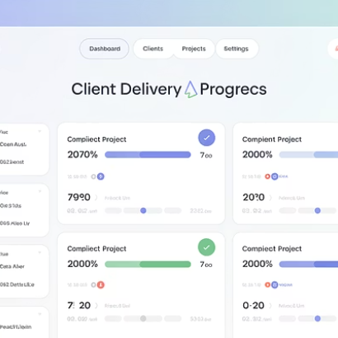
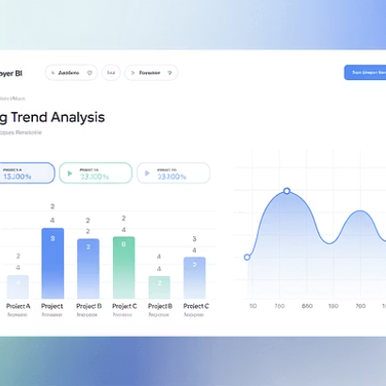
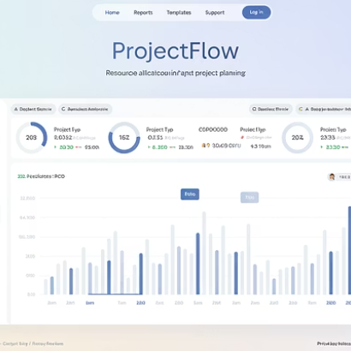
Enhanced Reporting with Power BI
Combine data from both systems to create powerful dashboards. Track sprint velocity, client delivery progress, and bug trends.

Slide 9
Integration Methods
Custom APIs
Tailored integrations for complex requirements
Azure Logic Apps
Enterprise-grade integration for scalability
Power Automate
No-code/low-code workflows for quick setup

Slide 10
Integration Requirements
Real-time Sync
Ensure data updates happen immediately between systems to prevent delays.
Security Compliance
Maintain proper role-based access and data protection across platforms.
Error Handling
Implement robust conflict resolution and notification systems for sync issues.

Slide 11
Project Manager Considerations
Define Key Use Cases
Start with high-impact workflows, not everything
Align Stakeholders
Get buy-in from sales, IT, product and QA teams
Plan Change Management
Prepare training and support for new workflows

Slide 12
Implementation Roadmap
Discovery & Planning
Build & Configure
Map processes and define integration points. Identify key stakeholders.
Implement full integration. Set up monitoring and alerts.
Proof of Concept
Training & Rollout
Test integration with limited scope. Validate sync functionality.
Train teams and deploy to production. Monitor adoption.

Slide 13
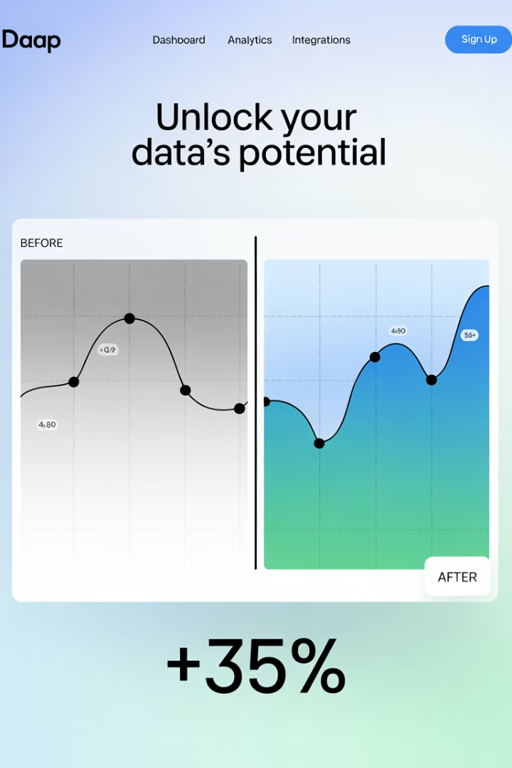
Measuring Success
30%
40%
Time Savings
Visibility Improvement
Reduced manual updates and reporting efforts
Better cross-team awareness of status
25%
90%
Faster Delivery
Alignment
Reduced cycle time from requirement to deployment
Business-development requirement match rate

Slide 14
Key Takeaways
Break Down Silos
Integration connects business operations with technical delivery. This enables true end-to-end visibility.
Start Small, Scale Up
Begin with critical workflows that deliver immediate value. Add complexity as teams adapt to the integration.
Measure the Impact
Track time savings, delivery speed, and alignment metrics. Use data to refine your integration approach.

Slide 15
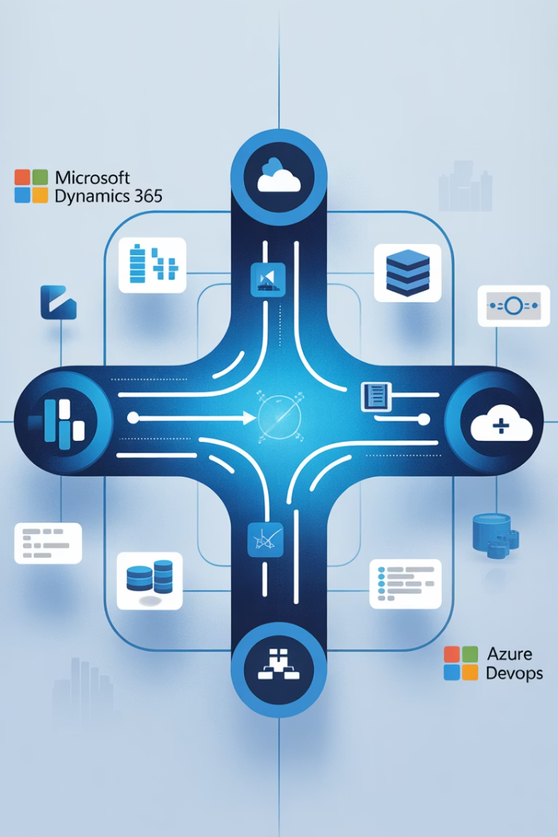
Final Thoughts
The integration of Microsoft Dynamics 365 with Azure DevOps is a strategic move for IT project managers aiming to break down silos and increase alignment between business and development. By streamlining collaboration, improving traceability, and enhancing reporting, this integration transforms how projects are planned, executed, and delivered.
In a world where agile transformation is no longer optional, this kind of cross-platform connectivity is essential to staying competitive and responsive.

