Slide 1

The 5 Stakeholder Management Mistakes That Can Sink Your Project
Stakeholder management isn't just a "soft skill." It's the lifeline that keeps projects aligned, funded, and supported from start to finish. Even the most experienced project managers can make small missteps that snowball into big problems.
#ManagingProjectsTheAgileWay #StakeholderManagement #ProjectManagement #ProcessImprovement #AgileDelivery
by Kimberly Wiethoff
Managing Projects The Agile Way

Slide 2
Agenda
01
02
03
Understanding Stakeholder Management
The 5 Critical Mistakes
Practical Solutions
Common pitfalls that derail projects and damage relationships
Actionable strategies to overcome each mistake
The foundation of project success and why it matters
04
05
Implementation Framework
Key Takeaways & Next Steps
How to integrate these practices into your project methodology
Your action plan for stakeholder management excellence

Slide 3
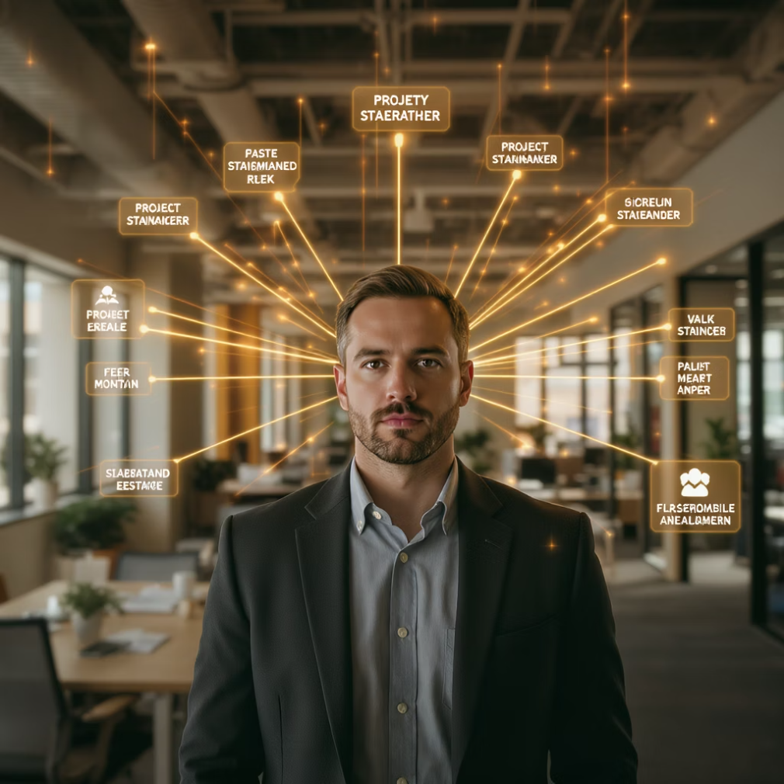
Why Stakeholder Management Makes or Breaks Projects
Stakeholder management directly impacts:
Resource allocation - Supportive stakeholders advocate for your project's needs
Decision velocity - Aligned stakeholders remove roadblocks faster
Project scope - Engaged stakeholders provide clearer requirements
Team morale - Well-managed expectations reduce friction and stress
Implementation success - Stakeholder buy-in drives adoption
According to PMI, projects with effective stakeholder engagement are 35% more likely to meet objectives and 27% more likely to stay within budget.

Slide 4
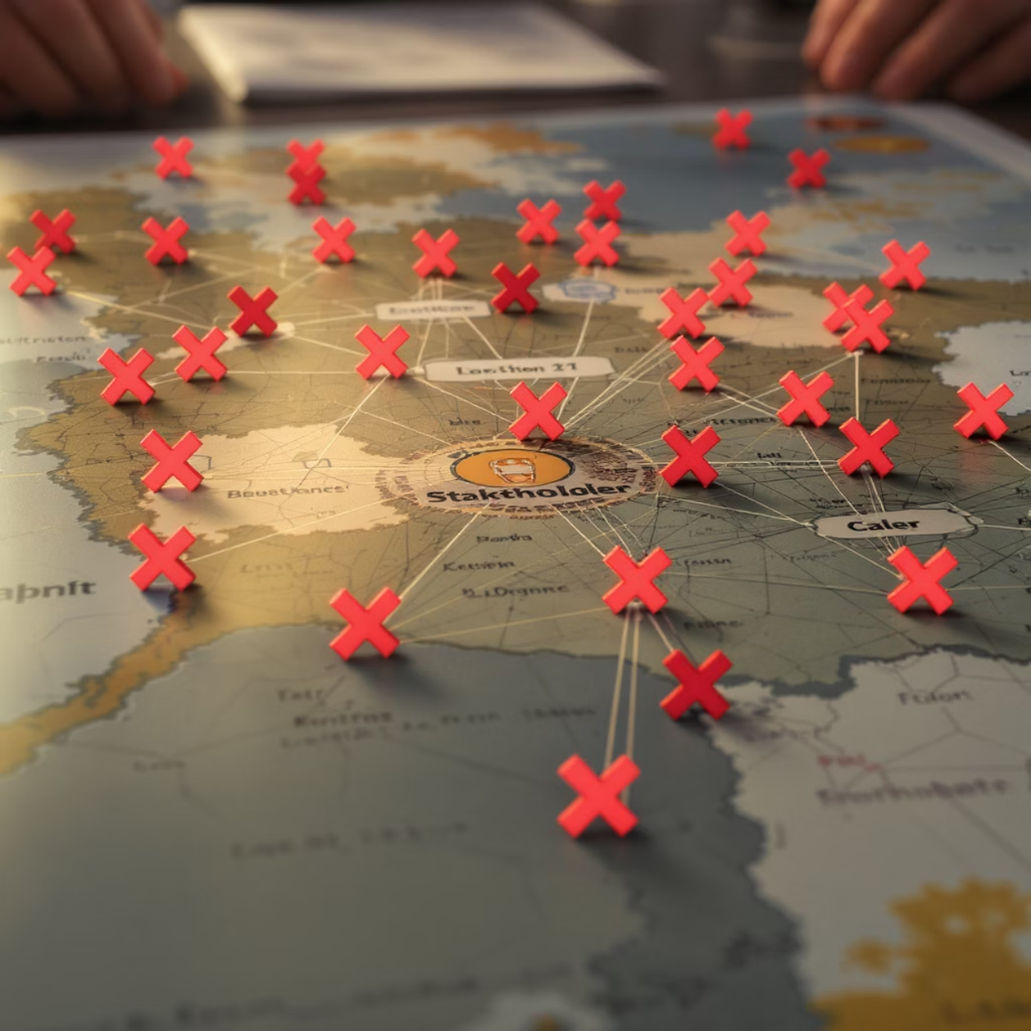
Mistake #1: Ignoring Stakeholder Mapping
The Problem:
When you don't systematically identify who your stakeholders are, you create dangerous blind spots that often surface at the worst possible moments.
The Impact:
Key decision-makers left out of critical conversations
Unexpected resistance late in the project lifecycle
Missing requirements from overlooked user groups
Contradictory priorities from competing interests
"The stakeholders you forget are often the ones who remember you—and not in a good way."

Slide 5

Solution: Comprehensive Stakeholder Analysis Framework
1
Identify ALL Potential Stakeholders
Cast a wide net: include direct and indirect stakeholders, both internal and external. Consider those impacted by or who can impact your project.
2
Map Using Power/Interest Grid
Categorize each stakeholder based on their level of influence and interest in the project. This determines your engagement strategy.
3
Analyze Motivations & Concerns
Document what each stakeholder values, their success metrics, potential resistance points, and political considerations.
4
Create Engagement Plans
Develop specific approaches for each stakeholder group based on their position in your matrix and their unique needs.

Slide 6

Mistake #2: One-Size-Fits-All Communication
The Overloaded Executive
The Starved Subject Matter Expert
Drowning in detailed technical updates they don't need or want, leading to disengagement and missed opportunities for executive sponsorship.
Receiving only high-level summaries without the technical details they need to contribute effectively, resulting in frustration and incomplete guidance.
The Confused End User
Given jargon-filled updates that don't address their practical concerns, creating anxiety about the upcoming changes and potential resistance.
Research shows that 67% of project failures can be attributed to poor communication. Each stakeholder group requires information delivered in a format, frequency, and level of detail that meets their specific needs.

Slide 7
Solution: Tailored Communication Strategy
Stakeholder Type
Format
Frequency
Content Focus
Executives/Sponsors
Dashboards, one-pagers
Bi-weekly
ROI, strategic alignment, major risks
Functional Leaders
Status reports, impact assessments
Weekly
Resource needs, cross-functional dependencies
Subject Matter Experts
Technical briefings, working sessions
As needed
Detailed specifications, implementation challenges
End Users
Visual demos, FAQs, training materials
Monthly + milestones
Benefits, changes to workflow, support resources
Governance Bodies
Formal status reports, decision documents
Per governance calendar
Compliance, approvals, exception handling
Create communication templates for each stakeholder group and establish a regular cadence that stakeholders can anticipate. Track engagement metrics to refine your approach over time.

Slide 8


Mistake #3: Underestimating Soft Resistance
What is Soft Resistance?
The subtle, often non-verbal opposition that occurs when stakeholders appear supportive in meetings but create obstacles behind the scenes.
Warning Signs:
Delays in providing feedback or approvals
Consistently missing meetings or sending delegates
Asking the same questions repeatedly
Introducing new requirements late in the process
Body language that contradicts verbal agreement
"Yes, but..." responses that highlight problems without solutions
Soft resistance is particularly dangerous because it's difficult to address directly and often manifests as project delays rather than outright opposition.

Slide 9




Solution: Building Authentic Stakeholder Relationships
One-on-One Connections
Active Listening
Schedule regular informal check-ins outside of project meetings. These create safe spaces for stakeholders to voice concerns they might not share publicly.
Pay attention to tone, hesitations, and qualifiers in stakeholder responses. Ask clarifying questions to uncover hidden concerns.
Interest-Based Problem Solving
Psychological Safety
Focus on underlying needs rather than stated positions. Find solutions that address stakeholders' core concerns while advancing project goals.
Create an environment where stakeholders feel comfortable expressing disagreement without fear of being labeled "difficult" or "not a team player."
Research shows that project managers who invest in relationship-building are 40% more likely to detect resistance early enough to address it constructively.

Slide 10

Mistake #4: Focusing Only on Problems
"When stakeholders only hear from you during crises, they develop 'project manager PTSD' – they start to associate your name in their inbox with bad news."
The negative consequences of problem-focused stakeholder communication include:
Erosion of Confidence
Stakeholders begin to question the project's viability and your leadership capabilities.
Defensive Positioning
Stakeholders start preparing explanations for failure rather than contributing to success.
Increased Scrutiny
Additional oversight mechanisms are implemented, adding bureaucracy and slowing progress.
Resource Withdrawal
Key resources get reallocated to "safer" projects that seem more likely to succeed.

Slide 11


Solution: Balanced Progress Communication
The 3:1 Positive Ratio
For every challenge you communicate, share at least three positive developments. This doesn't mean hiding problems—it means putting them in context.
Progress Visualization
Use visual indicators of progress that make achievements tangible:
Burndown/burnup charts
Milestone completion trackers
Before/after comparisons
User feedback quotes
Success Spotlights
Regularly highlight team members who have contributed to project successes, reinforcing a culture of recognition.
A Harvard Business Review study found that teams with positive-to-negative communication ratios of 3:1 or higher significantly outperformed teams with lower ratios.

Slide 12








Mistake #5: Treating Stakeholder Engagement as a "One-and-Done" Task
Initial Engagement
Context Changes
Stakeholders identified and initially engaged during project kickoff. Their input shapes initial plans.
Business priorities shift, organizational structures change, and new stakeholders enter the picture.
Late Discovery
Misalignment Occurs
Misalignment discovered late in the project when changes are costly and disruptive.
Without reassessment, stakeholder expectations and project direction gradually diverge.
The business environment is dynamic. Stakeholder analysis must be revisited regularly to maintain alignment as priorities evolve and new stakeholders emerge throughout the project lifecycle.

Slide 13
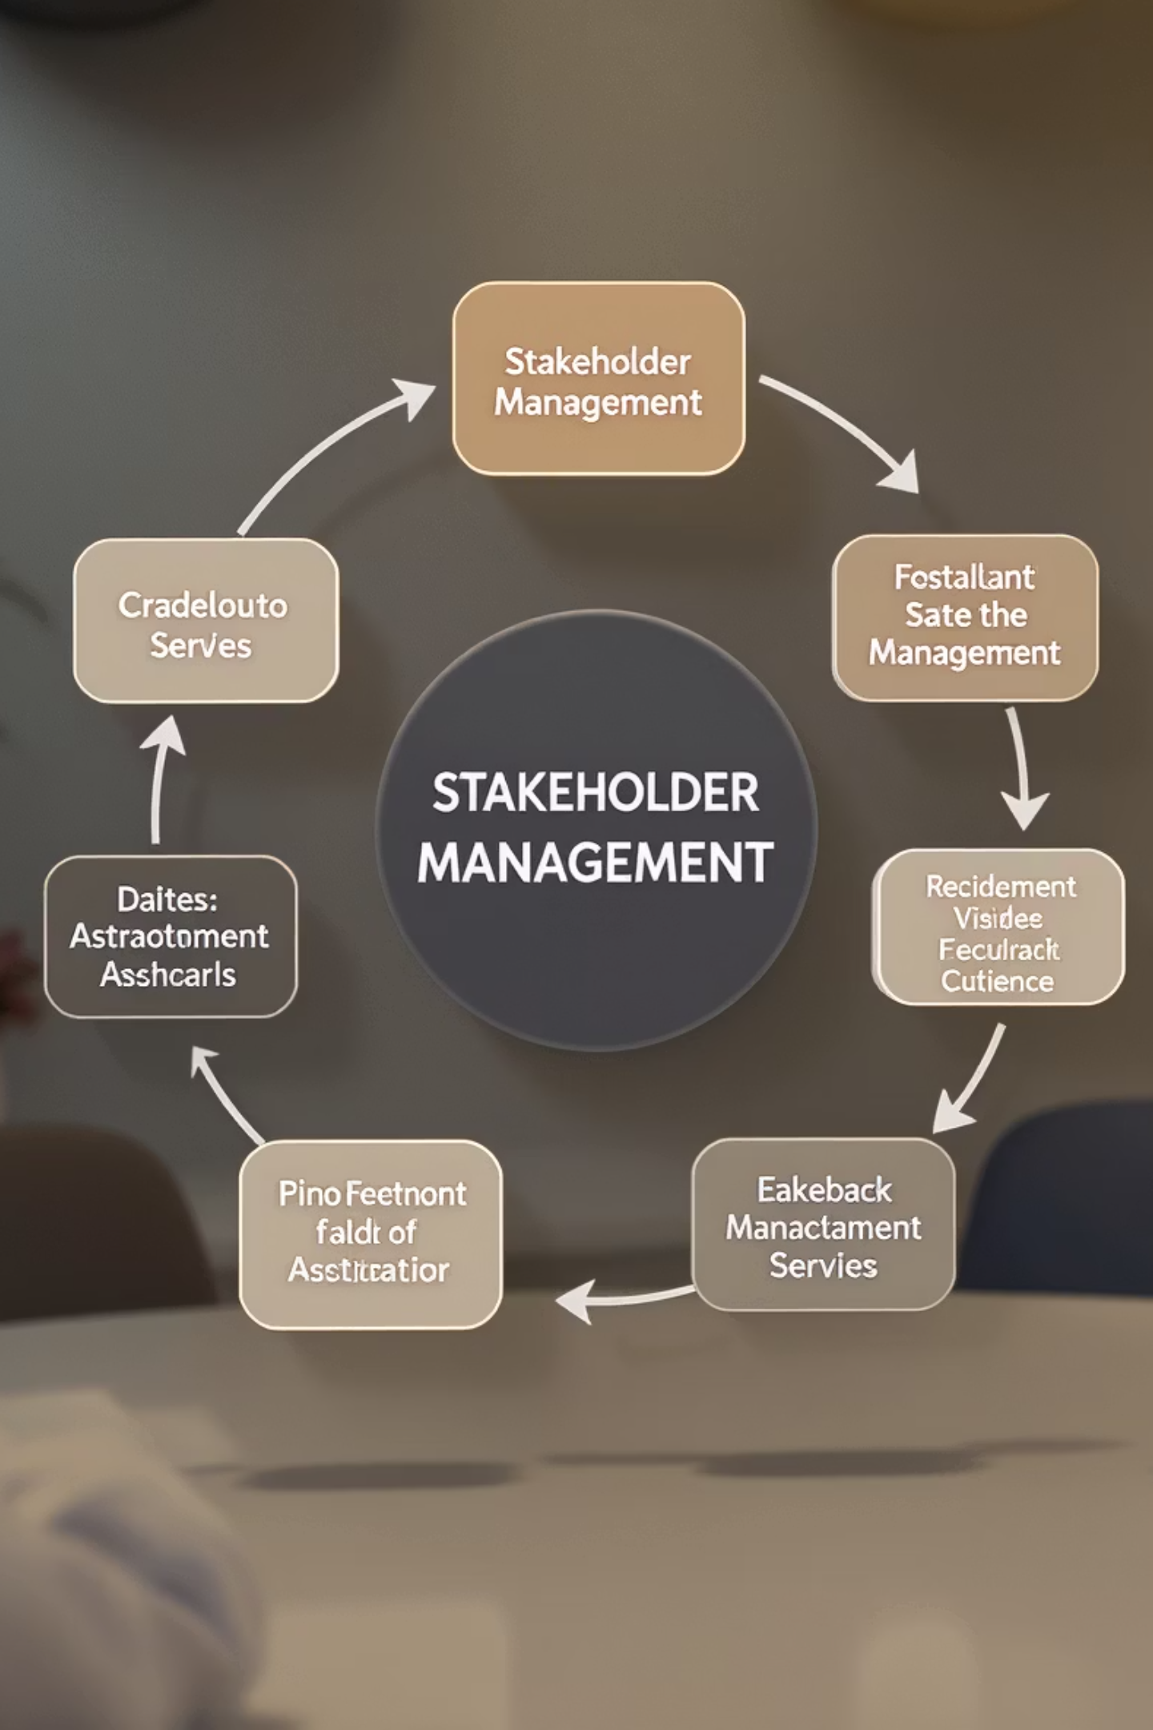
Solution: Continuous Stakeholder Management Framework
Quarterly Stakeholder Reassessment
Trigger-Based Reviews
Automatically reassess when major organizational changes occur, key stakeholders leave, or business strategy shifts.
Formally review and update your stakeholder analysis each quarter, adjusting engagement plans as needed.
Stakeholder Feedback Loops
Engagement Effectiveness Metrics
Create mechanisms for stakeholders to provide feedback on how well their needs are being met throughout the project.
Track metrics like response rates, meeting attendance, and decision turnaround times to gauge engagement quality.
Implement a stakeholder management tool that integrates with your project management system, making continuous engagement part of your standard workflow rather than a separate activity.

Slide 14
Key Takeaways: Elevating Your Stakeholder Management Practice
72%
5
3x
Project Success Rate
Critical Mistakes
ROI Impact
Projects with effective stakeholder management achieve objectives at this rate compared to 45% for those without it.
Avoiding these common pitfalls can dramatically improve your stakeholder relationships and project outcomes.
The return on time invested in stakeholder management typically exceeds three times the effort in reduced rework and faster decisions.
Your Next Steps:
Conduct a comprehensive stakeholder analysis for your current project
Develop tailored communication plans for each stakeholder group
Schedule one-on-one check-ins with high-influence stakeholders
Create a system for tracking and celebrating project progress
Implement quarterly stakeholder reassessment practices
Remember: Stakeholder management isn't about avoiding conflict—it's about building trust, alignment, and partnership that powers project success.

