Slide 1

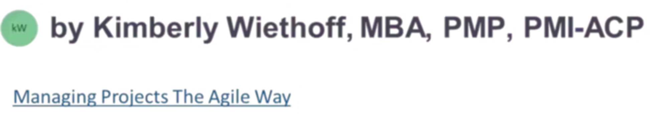
From Gantt Charts to Generative AI: The Evolution of Project Management
Project management is transforming through AI adoption, shifting from traditional tools to intelligent systems that adapt, automate, and enhance decision-making.
#ProjectManagement #ArtificialIntelligence #GenerativeAI #PMOTools #DigitalTransformation #FutureOfWork #AgileLeadership #AIInProjectManagement #SmartPM #ProductivityBoost #ManagingProjectsTheAgileWay

Slide 2
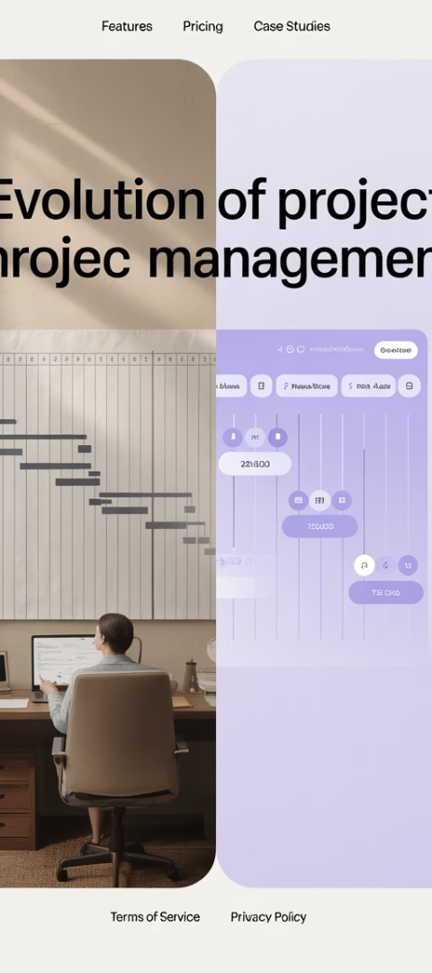



The Journey of Project Management
Traditional Era
Gantt charts, WBS diagrams, and critical path analysis formed the backbone of project delivery.
Digital Transformation
Project management software digitized workflows but maintained linear approaches.
AI Revolution
Intelligent systems now reshape how projects are conceived, managed, and delivered.

Slide 3




From Static to Adaptive Planning
Static Plans
Dynamic Adjustments
Predictive Intelligence
Traditional plans required constant manual updates to reflect project changes.
AI suggests real-time schedule adjustments based on resource availability and team patterns.
Systems forecast outcomes and simulate alternative timelines for proactive decisions.

Slide 4

Automating the Repetitive
Meeting Summaries
Status Reporting
NLP models automatically extract key points and action items from project discussions.
AI drafts comprehensive weekly reports by analyzing project data and team communications.
Documentation
Task Management
Systems generate and update project artifacts as changes occur throughout the lifecycle.
Intelligent assistants prioritize work and suggest optimal resource allocation.

Slide 5








Enhanced Risk Prediction
Mitigation Suggestions
Early Warnings
Systems flag potential bottlenecks, overallocated resources, and scope creep before they impact.
AI recommends specific actions to address risks based on past successful interventions.
Confidence Scoring
Pattern Recognition
Algorithms calculate probability of meeting targets and highlight areas needing attention.
AI scans historical project data to identify common failure points and success patterns.

Slide 6






Decision Support Through AI
Strategic Decisions
Portfolio optimization and resource allocation across enterprise
Tactical Planning
Schedule optimization and scenario modeling
Operational Insights
Team performance analytics and workflow improvements

Slide 7
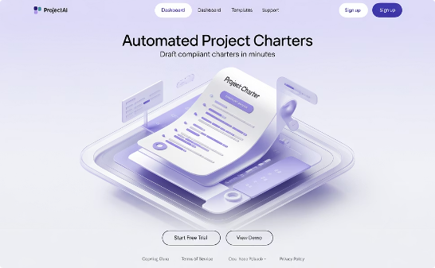
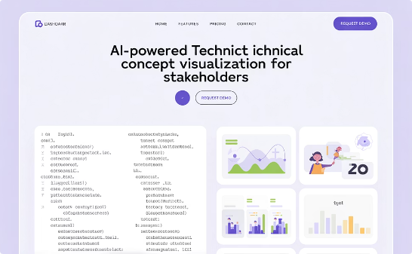
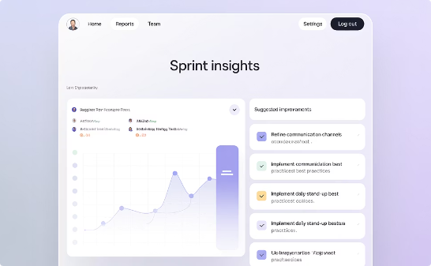
Generative AI Applications
Document Creation
Stakeholder Communications
Process Improvement
Generate project charters, SOWs, and requirements in seconds instead of hours.
Generate insights from retrospectives and suggest concrete process improvements.
Translate technical updates for non-technical audiences with appropriate context.

Slide 8
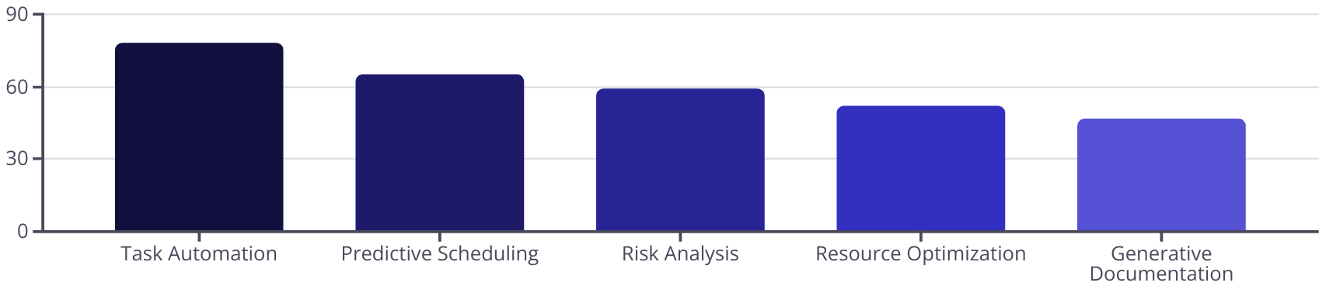
Real-World Tool Integration
Project management tools are rapidly incorporating AI capabilities, with varying adoption rates across different features. The following chart highlights the percentage of organizations currently leveraging key AI functionalities in their project management systems:
Task automation leads adoption with over three-quarters of organizations implementing these solutions, while predictive capabilities are gaining significant traction. Despite their transformative potential, generative documentation features currently show the lowest adoption rate, suggesting an opportunity for growth as organizations become more comfortable with AI-driven content creation in project environments.

Slide 9




The Evolving PM Skillset
Strategic Thinking
Interpreting AI insights in context of business goals
Change Leadership
Guiding teams through AI-powered transformations
Digital Fluency
Using AI tools responsibly and effectively
Ethical Oversight
Ensuring AI applications align with organizational values

Slide 10
Human + AI: The Perfect Partnership
AI Strengths
Human Strengths
Processing vast data quickly
Emotional intelligence
Identifying patterns humans miss
Ethical decision making
Automating repetitive tasks
Creative problem solving
Generating consistent documentation
Stakeholder relationship building
Working 24/7 without fatigue
Contextual understanding

Slide 11





Challenges in AI Adoption
Data Privacy Concerns
Projects often contain sensitive information requiring careful AI implementation with proper safeguards.
Resistance to Change
Team members may fear replacement rather than seeing AI as an augmentation tool.
Overreliance Risks
Becoming too dependent on AI recommendations without critical evaluation can lead to mistakes.
Implementation Costs
Advanced AI tools require investment in both technology and training for effective use.

Slide 12

Getting Started with AI in PM
Identify Repetitive Tasks
Begin by listing the routine activities that consume your time without adding strategic value.
Examples: status reporting, meeting notes, schedule updates, and basic communications.
Experiment with Available Tools
Start with AI features already embedded in your existing tools before investing in new platforms.
Try free versions of AI assistants to draft documents and summarize information.
Measure Impact and Scale
Track time saved and quality improvements from initial AI implementations.
Gradually expand to more complex applications as confidence and capabilities grow.

Slide 13

The Future of Project Management
80%
65%
40%
Time Savings
Improved Accuracy
Strategic Focus
Reduction in administrative tasks through AI automation
Increase in forecasting precision with AI-powered analytics
More time dedicated to high-value activities and innovation

Slide 14

Final Thoughts
Project management is no longer just about managing tasks—it's about orchestrating outcomes in an increasingly complex, data-rich world. AI is the next frontier, and those who embrace it early will gain a decisive edge.
Whether you're an experienced PM or just starting out, now is the time to upskill, explore AI tools, and rethink how you deliver value.

