Slide 1

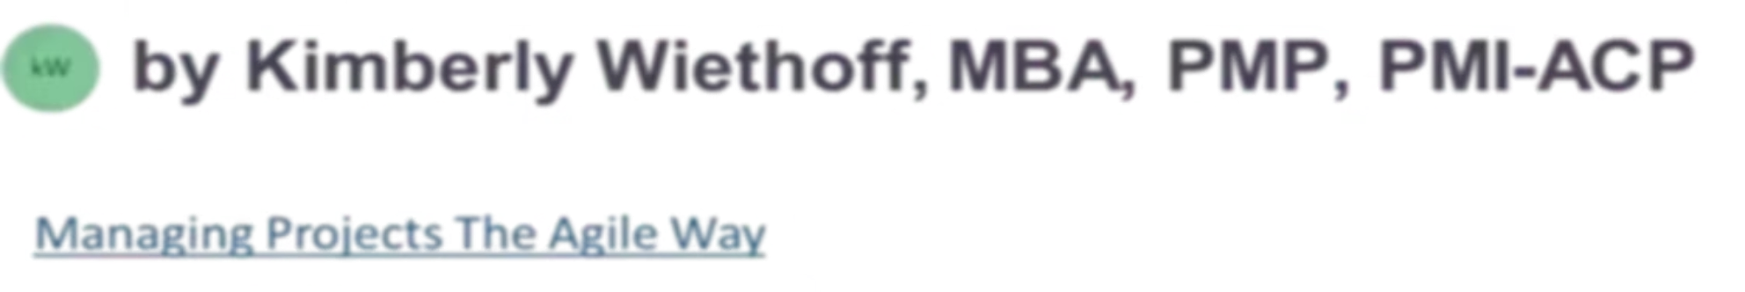
Why Agile Transformations Fail—and How Agile Coaches Can Prevent It
Organizations worldwide have invested billions in Agile transformations—yet many still struggle to realize the promised benefits. The reason is rarely the framework. Sustainable transformation requires changing behaviors, not just processes. Agile Coaches are the catalysts who bridge strategy, culture, and execution.
#AgileTransformation #AgileCoaching #AgileLeadership #Leadership #ContinuousImprovement #EnterpriseAgility #Scrum #ScrumMaster #ChangeManagement #BusinessTransformation #DigitalTransformation #ServantLeadership #OrganizationalChange #ProjectManagement #ProductManagement #LeanAgile #ArtificialIntelligence #Innovation #HighPerformingTeams #FutureOfWork

Slide 2
The Core Problem
Process Change Is Not Enough
What Organizations Focus On
What Actually Drives Transformation
Introducing new ceremonies and tools
Adopting Scrum, Kanban, or SAFe® terminology
Training teams on Agile frameworks
Deploying sprint boards and tracking tools
Over the past two decades, organizations that achieved remarkable improvements in speed, quality, and customer satisfaction did so by addressing how people collaborate, make decisions, solve problems, and deliver value—not just which tools they used.
Agile is not a project with a finish line. It is an ongoing transformation in mindset, culture, and leadership behavior.

Slide 3


Mistake #1
Treating Agile as a Process Instead of a Mindset
Teams adopt stand-ups, sprint boards, and user stories—yet months later, very little has truly changed. Simply following Agile practices does not create Agile thinking. Without the right mindset, Agile becomes little more than a new vocabulary layered on top of old behaviors.
Customer Value
Transparency
Decisions are anchored to what delivers real value to the customer.
Teams share progress, risks, and learnings openly and honestly.
Continuous Learning
Shared Ownership
Experimentation, reflection, and adaptation are daily practices.
Teams take collective responsibility for outcomes, not just tasks.
Agile Coaches continually reinforce the "why" behind practices—helping teams and leaders understand that ceremonies are tools, not the destination.

Slide 4
Mistake #2
Lack of Executive Sponsorship
Active leadership engagement is one of the strongest predictors of transformation success. When executives delegate Agile to the technology department while continuing to operate through command-and-control structures, teams quickly recognize the disconnect—and momentum disappears.
The Danger Signal
How Coaches Help
The Core Principle
Teams are told to be empowered, yet every decision still requires executive approval. Trust erodes. Innovation slows. The transformation stalls before it gains traction.
Agile Coaches work with executives to align leadership behaviors with Agile values, establish realistic goals, remove impediments, and model servant leadership alongside their teams.
Transformation succeeds when leaders change alongside their teams—not when they simply mandate change from a distance.

Slide 5
Mistake #3
Measuring Activity Instead of Outcomes
Metrics That Feel Productive
Metrics That Actually Matter
Story points completed per sprint
Sprint velocity trends
Number of ceremonies conducted
Are customers measurably happier?
Are releases becoming more predictable?
Is quality and defect rate improving?
Is time-to-market decreasing?
Are teams collaborating more effectively?
These metrics are easy to track—but they say very little about whether the business is actually succeeding.
Experienced Agile Coaches help organizations build outcome-focused dashboards that connect delivery metrics with real business results—enabling leadership to make more informed strategic decisions.

Slide 6

Mistake #4
Ignoring Organizational Impediments
Many transformations focus heavily on coaching individual teams while leaving systemic organizational barriers completely untouched. No amount of Scrum training can overcome organizational systems that actively prevent teams from working effectively.
Slow Governance
Functional Silos
Multi-layer approval processes that stall delivery and kill momentum.
Departments that operate independently, preventing cross-functional flow.
Conflicting Priorities
Legacy Structures
Teams pulled in multiple directions without clear, aligned objectives.
Organizational designs inherited from a pre-Agile, hierarchical era.
Sometimes the greatest improvement comes not from changing the team—but from changing the environment around the team.

Slide 7
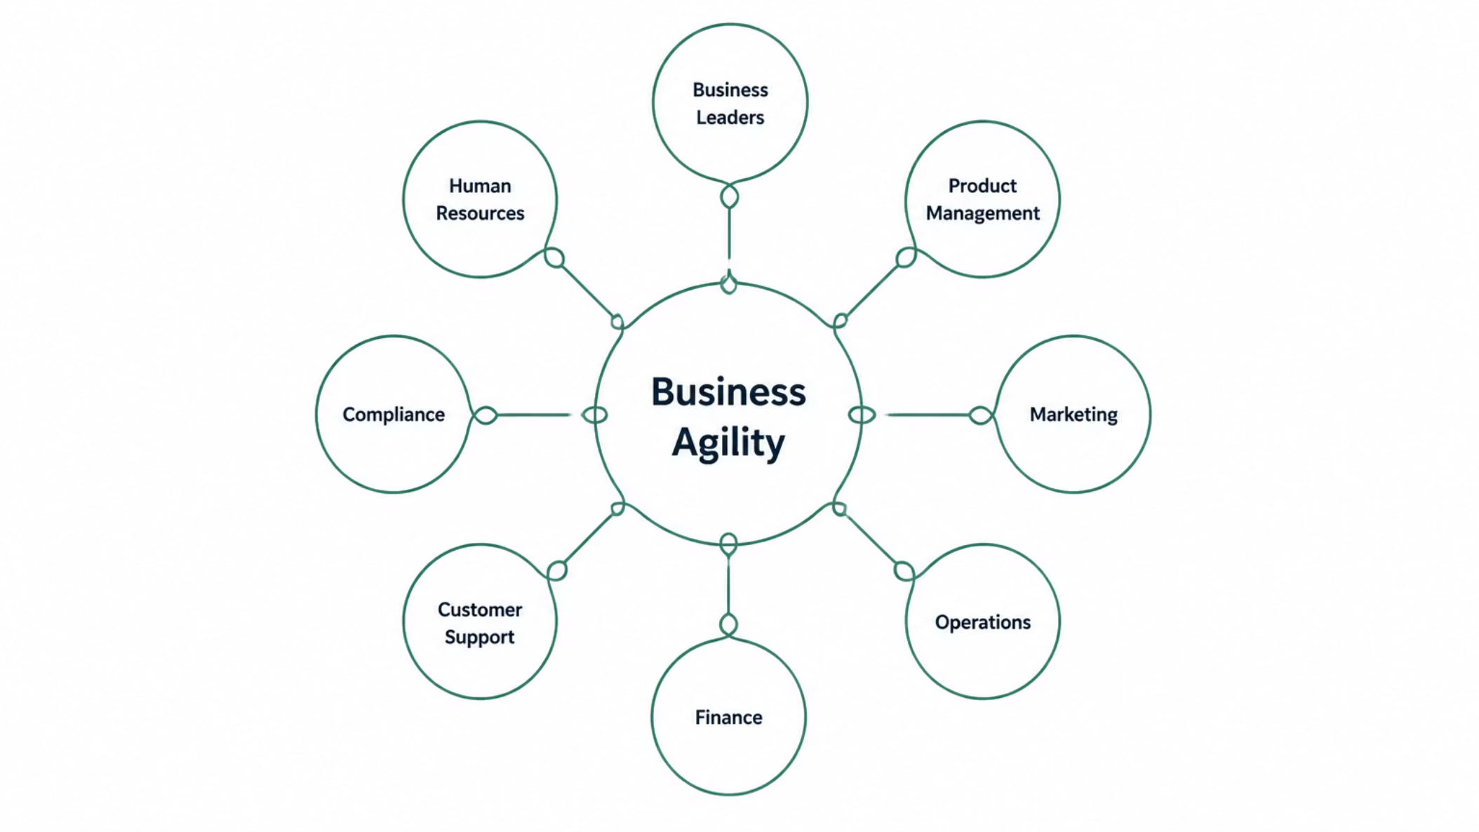
Mistake #5
Treating Agile as an IT Initiative
Agile originated in software development—but today's organizations recognize that business agility extends far beyond technology. When Agile remains isolated within IT, cross-functional collaboration suffers and enterprise-wide value is left unrealized.
Agile Coaches encourage enterprise-wide collaboration by helping business and technology teams align around shared goals, customer outcomes, and value delivery—transforming Agile from a department initiative into an organizational capability.

Slide 8
Mistake #6
Neglecting Continuous Improvement
Some organizations assume that once Agile has been implemented, the transformation is complete. In reality, Agile is built on the foundation of continuous improvement. Organizations that stop improving eventually stop evolving—and their competitive advantage erodes.
High-Performing Organizations Regularly:
Evaluate delivery performance and quality trends
Analyze customer feedback and incorporate it quickly
Experiment with new practices and measure results
Learn openly from failures without blame
Adapt their processes to meet changing conditions
Agile Coaches foster this culture through retrospectives, Communities of Practice, leadership coaching, and structured organizational improvement initiatives.

Slide 9

Mistake #7
Underestimating the Human Side of Change
Technology and frameworks are relatively easy to implement. Changing deeply ingrained behaviors is much harder. Agile transformations create genuine uncertainty for employees adapting to new roles, greater accountability, increased transparency, and fundamentally different leadership expectations.
Resistance Is Natural
Without adequate support and psychological safety, resistance to change is a predictable human response—not a personal failing.
Coaches as Change Leaders
Agile Coaches help individuals navigate uncertainty, build trust, resolve conflict, and develop the confidence to embrace new ways of working.
Choice, Not Compliance
Transformation succeeds because people choose to change—not because processes require them to. That distinction makes all the difference.

Slide 10

The 7 Critical Mistakes at a Glance
IT‑Only Initiative
No Executive Sponsor
Mindset vs Process
Activity Metrics
Ignoring Impediments
Each of these seven mistakes is addressable—but only when organizations commit to honest self-assessment and partner with experienced Agile Coaches who can identify patterns, challenge assumptions, and drive meaningful behavioral change at every level of the organization.

Slide 11


Emerging Capability
How AI Is Strengthening Agile Transformations
Artificial intelligence is becoming an increasingly valuable partner in Agile transformations—not as a replacement for human coaching, but as a powerful amplifier of it.
Delivery Intelligence
Team Health Monitoring
AI detects bottlenecks, predicts delivery risks, and analyzes sprint trends across teams in real time.
Continuous signals surface early warning indicators before problems become organizational crises.
Pattern Recognition
Coaching Focus
AI identifies recurring impediments and organizational patterns across multiple teams simultaneously.
Coaches shift from data collection to interpretation—spending more time mentoring leaders and driving meaningful improvements.
AI enhances coaching—it does not replace it. The most effective coaches combine human-centered leadership with data-driven intelligence.

Slide 12
The Modern Role
The Agile Coach as a Transformation Leader
Today's Agile Coach is far more than a Scrum expert or meeting facilitator. Their success is measured not by how many ceremonies they run, but by how effectively they help organizations deliver customer value and build resilient, high-performing teams.
Leadership Advisor
Change Agent
Partners with executives to align leadership behaviors with Agile values and build sponsorship at the top.
Guides individuals and teams through the uncertainty and behavioral shifts that real transformation demands.
Systems Thinker
Improvement Champion
Identifies and addresses systemic organizational barriers that prevent teams from reaching their potential.
Builds a culture of continuous reflection, experimentation, and learning across the entire enterprise.

Slide 13
Principles for Success
What Successful Transformations Have in Common
Processes That Enable
Lean governance and clear structure that removes friction rather than creating it.
Outcomes Over Activities
Success measured by customer value delivered, not ceremonies completed or velocity achieved.
People Before Processes
Investing in mindset, trust, and human capability as the primary driver of lasting change.
Continuous Learning Over Rigid Compliance
A culture that embraces experimentation, learns from failure, and adapts without fear.

Slide 14

Agility as a Lasting Competitive Advantage
Agile transformations rarely fail because organizations choose the wrong framework. They fail when organizations overlook the cultural, organizational, and leadership changes required to support Agile ways of working.
The Coach's Essential Role
By mentoring leaders, empowering teams, removing barriers, and fostering a culture of collaboration and continuous improvement, Agile Coaches turn Agile from a methodology into a lasting competitive advantage.
The Organizations That Will Win
In today's rapidly changing business environment, the organizations that succeed won't simply adopt Agile—they will embrace agility as part of their culture. That transformation begins with strong leadership, committed teams, and exceptional Agile Coaches.

