Slide 1

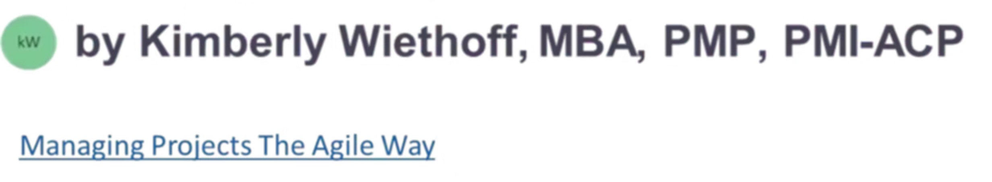
Personality Tests for Job Seekers: Comparing DiSC and the Top 5 Alternatives
When searching for the right career path or preparing for interviews, personality assessments can be a powerful tool. While the DiSC Assessment is widely recognized, it's not your only option for career development and interview preparation.
#CareerDevelopment #JobSearchTips #StrengthsFinder #CliftonStrengths #TeamDynamics #MBTI #BigFive #Enneagram #DiSC #CareerClarity #InterviewPreparation #WorkplaceSuccess #SelfAwareness #CareerAlignment #ProfessionalGrowth #JobSeekers #CareerCoaching #Teamwork #LeadershipDevelopment #HiringInsights

Slide 2

Why Personality Assessments Matter in Your Job Search
Self-Discovery
Interview Advantage
Cultural Fit
Understanding your natural preferences, strengths, and work style helps you identify roles where you'll truly thrive. These insights become the foundation for confident interviews and strategic career decisions.
Assessments give you concrete language to articulate your value proposition. Instead of generic answers, you can speak specifically about how your personality traits translate into workplace success.
Many employers use personality insights to evaluate team fit and organizational alignment. Being assessment-aware shows you're serious about finding the right mutual match.

Slide 3
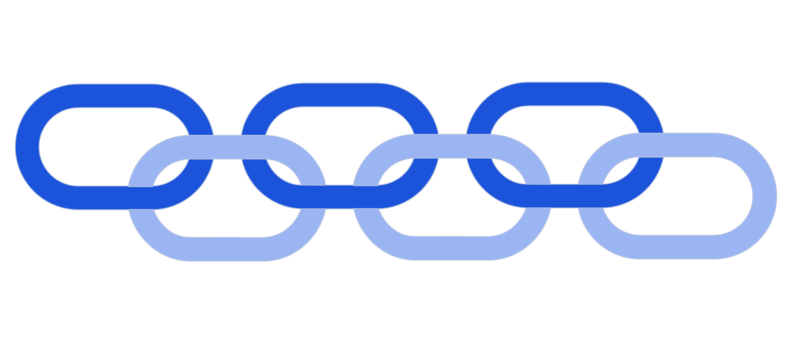
Personality Tests
When exploring career paths or preparing for interviews, personality assessments can provide valuable insights. They help you understand your communication style, strengths, and motivators—ultimately making it easier to showcase your fit for a role.
The DiSC Assessment is one of the most widely used workplace tools, but it’s not the only option. Depending on your goals, you might find other personality frameworks—like StrengthsFinder, TeamDynamics, MBTI, the Big Five, or the Enneagram—better suited to your job search strategy.
DiSC
Team Dynamics
Big Five (OCEAN)
StrengthsFinder
MBTI
Enneagram

Slide 4
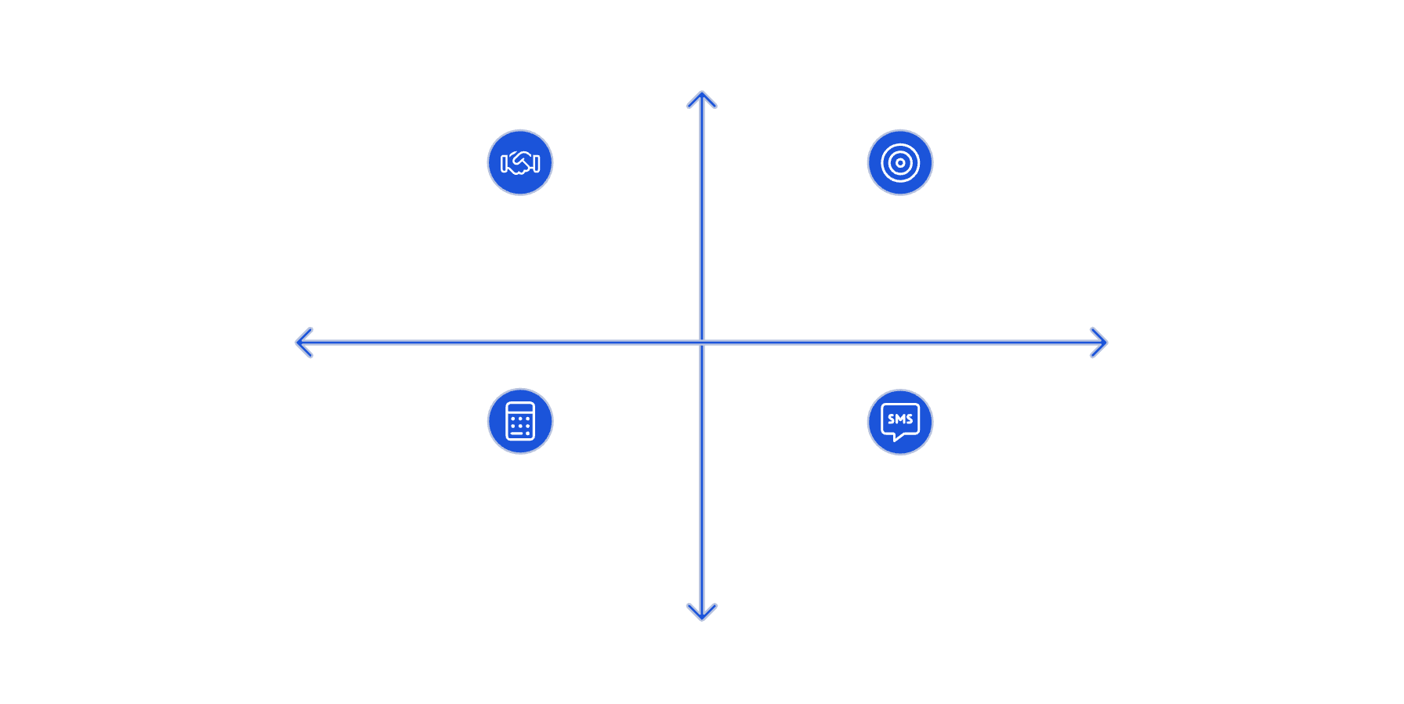




The DiSC Assessment
What it measures: Four core behavioral styles—Dominance (D), Influence (I), Steadiness (S), and Conscientiousness (C).
Why it’s useful: DiSC reveals how you communicate, solve problems, and collaborate with others. It’s particularly valuable in team-based or client-facing roles where communication style can make or break success.
Best for job seekers who want to: Highlight adaptability, explain how they interact with teams, and position themselves as effective collaborators.
High Collaboration
Steadiness (S) - Patient, Reliable Team Player
Dominance (D) - Decisive, Results-Focused Leader
Supportiveness
Assertiveness
Conscientiousness (C) - Detail-Oriented, Analytical
Influence (I) - Energetic, Persuasive Communicator
Low Collaboration
Example job search application: In an interview, someone with a “High S” profile might emphasize patience, loyalty, and dependability, while a “High D” might focus on decisiveness and results.

Slide 5
Alternative #1: StrengthsFinder (Gallup CliftonStrengths)
The CliftonStrengths (StrengthsFinder) assessment identifies 34 talent themes, which Gallup groups into four domains: Executing, Influencing, Relationship Building, and Strategic Thinking.
What It Measures
Job Search Benefits
Best For
Identifies your top 5 strengths across 34 talent themes like Strategic, Achiever, Relator, and Communication. Unlike deficit-focused assessments, it emphasizes what you naturally do best.
Provides positive, strength-based language for resumes and interviews. Helps you articulate unique value and align your natural talents with specific job requirements confidently.
Job seekers wanting to highlight unique value, boost interview confidence, and demonstrate clear understanding of what they bring to potential employers.
Pro Tip: Use your top 5 strengths to craft compelling "Tell me about yourself" responses that immediately differentiate you from other candidates.

Slide 6
StrengthsFinder
4 Domains 34 Talent Themes
Executing Domain
Influencing Domain
Relationship Domain
Strategic Thinking Domain
(How you make things happen)
1. Achiever
2. Arranger
3, Belief
4. Consistency
5. Deliberative
6. Discipline
7. Focus
8. Responsibility
9. Restorative
(How you influence others)
10. Activator
11. Command
12. Communication
13. Competition
14. Maximizer
15. Self-Assurance
16. Significance
17. Woo (Winning Others Over)
(How you build strong relationships)
18. Adaptability
19. Connectedness
20. Developer
21. Empathy
22. Harmony
23. Includer
24. Individualization
25. Positivity
26. Relator
(How you absorb and analyze information)
27. Analytical
28. Context
29. Futuristic
30. Ideation
31. Input
32. Intellection
33. Learner
34. Strategic

Slide 7

Alternative #2: TeamDynamics
TeamDynamics focuses on how individuals contribute to a team, handle collaboration, and resolve conflict. Instead of labeling personality types in isolation, it looks at how different working styles interact in a group environment.
Assessment Focus
Career Application
Ideal Candidates
Evaluates how you work in teams—your collaboration style, communication approach, conflict resolution methods, and potential blind spots in group settings.
Many hiring managers prioritize team integration. This tool provides specific language to describe your teamwork style and demonstrates emotional intelligence to potential employers.
Perfect for job seekers wanting to demonstrate adaptability, show collaborative skills, and explain how they add measurable value in group settings and cross-functional projects.
The framework typically evaluates:
Domains or Style Categories - TeamDynamics assessments usually sort people into team role archetypes.
Collaboration style (how you prefer to work with others)
Drivers – push projects forward, action-oriented
Communication style (direct, supportive, detailed, big-picture, etc.)
Organizers – detail-focused, process-oriented
Decision-making approach (analytical vs. intuitive, fast vs. careful)
Collaborators – relationship builders, supportive
Conflict style (avoidant, collaborative, competitive, etc.)
Visionaries – big-picture thinkers, innovators
Preferred team role (driver, supporter, innovator, coordinator, etc.)
Analyzers – data-driven, cautious decision makers
(Some providers use slightly different naming conventions, but the essence is consistent: balancing results, relationships, creativity, and structure.)
Job Search Application Example - If your TeamDynamics report shows you’re a Visionary, you might say in an interview: “I naturally bring creative ideas and big-picture thinking to teams. I complement detail-oriented teammates by helping them see new opportunities, while relying on them to operationalize plans.”

Slide 8








Alternative #3: Myers-Briggs Type Indicator (MBTI)
The MBTI identifies personality preferences across four dichotomies, resulting in 16 possible personality types.
Thinking vs. Feeling
Extraversion vs. Introversion
How you make decisions—through logical analysis or values-based considerations
Where you direct energy—toward the outer world or internal reflection
Judging vs. Perceiving
Sensing vs. Intuition
How you approach structure—preferring planned organization or flexible adaptation
How you take in information—through concrete details or big picture patterns
While MBTI isn't predictive of performance, it helps you reflect on decision-making processes, communication preferences, and work environments where you'll be most productive and satisfied.

Slide 9

MBTI - Domains or Style Categories
MBTI sorts people into 16 types, which are often grouped into 4 bigger categories:
Analysts (e.g., INTJ, ENTJ, INTP, ENTP) – Strategic, logical, innovative thinkers.
Diplomats (e.g., INFJ, ENFJ, INFP, ENFP) – Empathetic, values-driven, people-focused.
Sentinels (e.g., ISTJ, ESTJ, ISFJ, ESFJ) – Organized, dependable, tradition-oriented.
Explorers (e.g., ISTP, ESTP, ISFP, ESFP) – Flexible, spontaneous, practical problem solvers.
Best for job seekers who want to
Improve self-awareness to describe strengths and work preferences.
Identify potential growth areas (e.g., introverts practicing networking, perceivers working on deadlines).
Explore careers that align with personality type (e.g., INFJs may gravitate toward coaching/mentorship roles, ESTJs toward management).
Job Search Application Example - If you’re an ENTP, you might say in an interview: “I thrive in dynamic environments where I can brainstorm new solutions, adapt quickly, and influence others to try innovative approaches.”

Slide 10
Alternative #4: The Big Five Personality Traits
The Big Five is one of the most scientifically validated frameworks in psychology. It measures personality across five broad dimensions (often remembered by the acronym OCEAN):
Openness
Conscientiousness
Creativity, intellectual curiosity, and willingness to try new experiences. High scorers thrive in innovative, change-oriented environments.
Organization, reliability, and goal-directed behavior. Strongly predicts job performance across virtually all industries and roles.
Extraversion
Agreeableness
Sociability, assertiveness, and energy levels. Particularly valuable for sales, leadership, and customer-facing positions.
Cooperation, trust, and empathy. Essential for team-based roles, healthcare, education, and service-oriented positions.
Neuroticism
Emotional stability and stress resilience. Lower scores indicate better performance under pressure and in high-stress environments.
Each trait is measured on a spectrum rather than a type, making it more nuanced than MBTI or DiSC.

Slide 11
The Big Five - Personality Traits
Why it’s useful for job seekers
Many employers use Big Five-based assessments in hiring because it has strong predictive validity for job performance.
Provides insight into workplace strengths (e.g., high conscientiousness → strong reliability, low neuroticism → calm under pressure).
Helps identify fit for certain roles:
  High Openness → creative or innovative industries.
  High Conscientiousness → structured, detail-driven roles like project management.
  High Extraversion → sales, leadership, or public-facing roles.
  High Agreeableness → customer service, HR, or team-oriented careers.
  Low Neuroticism (high stability) → high-pressure jobs like emergency response or executive leadership.
Job Search Application Example - If your results show high Conscientiousness and low Neuroticism, you might say:“I’m known for being dependable and level-headed under pressure, which makes me well-suited to manage complex projects and deliver results consistently.”

Slide 12
Alternative #5: Enneagram
The Enneagram describes nine core personality types, each with unique strengths, fears, and motivations. Unlike some assessments that focus on behavior (DiSC) or cognitive preferences (MBTI), the Enneagram digs into underlying drivers that influence decision-making and interpersonal dynamics.
Type 1: The Perfectionist (Reformer)
Type 2: The Helper
Type 3: The Achiever
Principled, Quality-focused, ethical, responsible, improvement-oriented
People-focused, generous, relationship-building
Success-driven, adaptable, goal-oriented
Type 4: The Individualist
Type 5: The Investigator
Type 6: The Loyalist
Creative, authentic, emotionally deep, values authenticity
Knowledge-seeking, independent, analytical
Security-focused, responsible, team-committed
Type 7: The Enthusiast
Type 8: The Challenger
Type 9: The Peacemaker
Fun-loving, adventurous, motivated by variety and excitement
Assertive, decisive, seeks control and autonomy
Easygoing, diplomatic, motivated by harmony and stability
The Enneagram goes deeper into core motivations, fears, and growth paths. It's particularly valuable for exploring long-term career alignment and understanding what truly drives your professional satisfaction.

Slide 13
Enneagram - Domains
Why it’s useful for job seekers
Domains or Style Categories
Provides insight into core motivators and fears, which helps align job choices with long-term fulfillment.
The nine types are often grouped into three centers of intelligence:
Head Types (5, 6, 7) – Thinkers, focused on logic, security, and planning.
Useful for identifying company cultures or leadership styles that will help you thrive.
Heart Types (2, 3, 4) – Feelers, focused on relationships, identity, and recognition.
Enhances storytelling in interviews, since you can connect your motivators with career achievements.
Gut Types (8, 9, 1) – Instinctive, focused on control, fairness, and action.

Slide 14
Side-by-Side Comparison
Assessment
Focus Area
Key Job Search Benefit
Best Fit For
StrengthsFinder
Strengths & talents
Highlighting unique value in resumes/interviews
Career clarity and confidence
TeamDynamics
Team collaboration
Explaining how you work with others
Team-oriented roles
MBTI
Personality preferences
Self-awareness and communication insights
Job seekers exploring fit
Big Five
Evidence-based traits
Pre-employment testing preparation
Data-driven candidates
Enneagram
Motivations & values
Career alignment and personal growth
Long-term job fit seekers
DiSC
Workplace behavior
Team and communication alignment
General workplace adaptability

Slide 15





Which Assessment Should You Choose?
For Interview Confidence
Choose StrengthsFinder if you want concrete, positive language to describe your unique value proposition and natural talents during interviews.
For Team Roles
Select TeamDynamics if you're pursuing collaborative positions and want to articulate your teamwork style and emotional intelligence effectively.
For Data-Driven Preparation
Go with Big Five if you want research-backed insights and preparation for companies that use scientific personality testing in hiring.
For Career Direction
Pick Enneagram if you're exploring long-term career alignment and want to understand your core motivations and growth opportunities.

Slide 16
Frequently Asked Questions
Are personality tests required for job seekers?
Which test is the most accurate?
No—but they provide valuable language to describe your strengths, preferences, and values. This is especially useful during interviews, networking conversations, and when crafting your personal brand narrative.
The Big Five has the strongest scientific backing and validity. However, the "best" test depends on your specific needs—whether you want confidence, self-awareness, team fit, or career direction guidance.
Can I use test results on my resume or LinkedIn?
Do employers actually use these tests?
Yes, but strategically. Instead of saying "I'm an ENFJ," translate insights into workplace value: "I thrive in people-centered environments where collaboration drives measurable results."
Many companies use Big Five or DiSC during recruitment. Even if not required, understanding your results helps align your personal brand with company culture and demonstrate self-awareness.

Slide 17

Making Assessments Work in Your Job Search
Resume Enhancement
Interview Preparation
Use assessment insights to craft compelling summary statements
Prepare stories that showcase your natural strengths and work style
Align your strengths with specific job requirements
Practice articulating how your personality adds value to teams
Provide concrete examples that demonstrate your personality traits in action
Use assessment language to explain cultural fit and collaboration approach
Remember: Assessments are tools for self-discovery and communication, not boxes that define your capabilities or limit your career options.

Slide 18
Your Next Steps
01
02
Choose Your Assessment
Take Action
Based on your current job search needs—confidence, team fit, career direction, or scientific preparation—select the assessment that aligns with your goals.
Complete your chosen assessment and thoroughly review your results. Take notes on key insights that resonate with your experience and career aspirations.
03
04
Apply Insights
Track Results
Integrate your assessment results into your resume, LinkedIn profile, and interview preparation. Practice translating personality insights into professional value statements.
Monitor how assessment-informed approaches improve your interview confidence, networking conversations, and overall job search effectiveness.
Finding the right job isn't only about skills—it's also about fit. Personality assessments give you powerful tools to understand yourself and communicate more effectively with employers. While no test should define your career path, they can illuminate how you work best and help you thrive in your next role.

