Slide 1

Data-Driven Retrospectives: Powering Agile Change
Retrospectives are the heartbeat of Agile. They’re where teams pause, reflect, and commit to doing better. But too often, retros become routine—rote check-ins with little actionable output. When retros lose their edge, so does continuous improvement.
The solution? Make retrospectives data-driven—and turn reflection into measurable momentum.
Transform your Agile retrospectives from routine check-ins to powerful engines of innovation. This guide shows how data can amplify team insights, creating meaningful, measurable improvements.
kW
by Kimberly Wiethoff

Slide 2

Why Traditional Retros Fall Short
Symptom: Routine Repetition
Symptom: Limited Actionability
Symptom: Subjective Perspectives
Teams go through the motions. The same format creates predictable responses. Innovation stalls.
Discussions remain abstract. Action items lack specificity. Follow-through suffers.
Opinions dominate facts. Strong voices overwhelm quieter insights. Bias clouds reality.

Slide 3
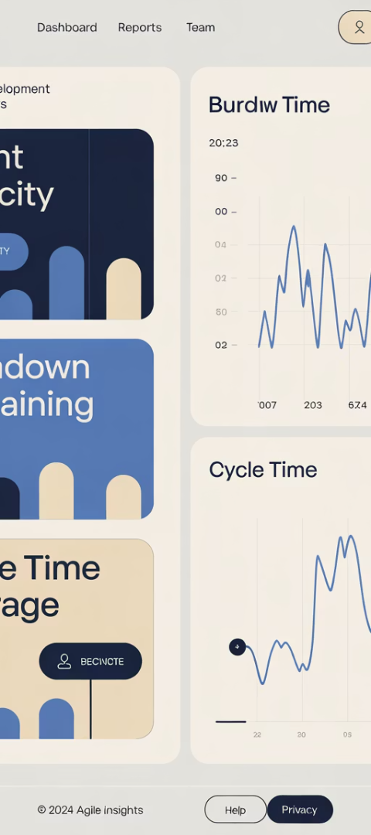




Start With Numbers, Not Noise
Sprint Burndown Trends
Analyze completion patterns across multiple sprints. Identify recurring bottlenecks.
Cycle Time Averages
Track how long work takes from start to finish. Spot where tasks consistently slow down.
Bug Count Patterns
Monitor when and where defects appear. Connect to process or technical debt issues.
Velocity Deviations
Measure consistency in team output. Investigate unusual spikes or drops.

Slide 4

Creating A Neutral Baseline
Facts Before Feelings
Pattern Recognition
Start with objective metrics. Ground discussions in reality. Move beyond perceptions.
Look across multiple sprints. Identify recurring challenges. Spot positive trends too.
System Focus
Examine processes, not people. Address root causes. Avoid blame and defensiveness.

Slide 5
Pair Metrics With Mindsets
Data Collection
Insight Integration
Gather sprint metrics. Prepare visual representations. Highlight key patterns.
Synthesize numbers and narratives. Create a complete picture. Identify actionable improvements.
1
2
3
Team Reflection
Share personal experiences. Connect feelings to facts. Build collective understanding.

Slide 6








Powerful Data-Insight Combinations
Cycle Time + Developer Input
QA Throughput + Tester Feedback
Ask: "What's slowing our work down?" Connect bottlenecks to team experience.
Explore: "Where are we getting stuck?" Link testing metrics to process pain points.
Velocity + Complexity Assessment
Sentiment Trends + Morale Discussion
Consider: "Why did our pace change?" Relate output fluctuations to work challenges.
Investigate: "How did team energy shift?" Connect mood patterns to project events.

Slide 7






Visualize Actionable Takeaways
Specific Metrics Target
"Reduce code review time by 25%"
Clear Ownership
Assign accountable team members
Timeboxed Deadline
Set concrete completion dates

Slide 8
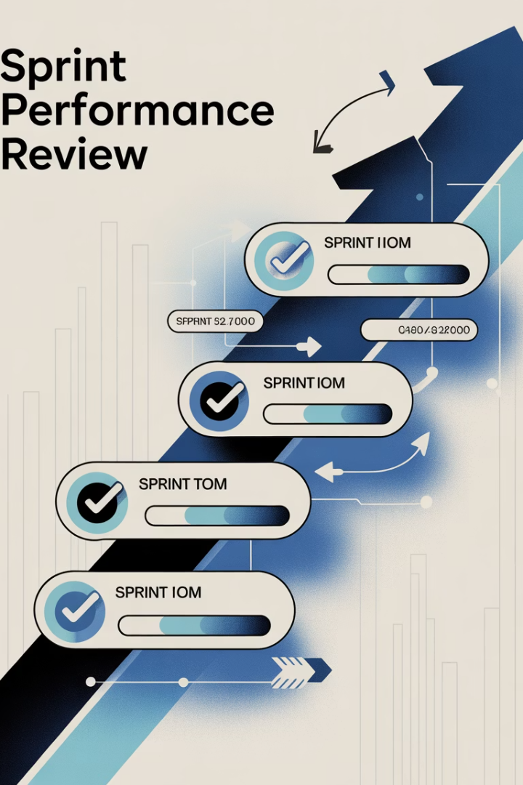




Creating A Living Roadmap
Review Past Actions
Start each retro by checking previous commitments. Celebrate progress. Address blockers.
Analyze Current Data
Examine the newest metrics. Compare to historical patterns. Identify emerging trends.
Generate New Insights
Combine data analysis with team discussion. Create fresh improvement ideas.
Plan Next Actions
Document specific commitments. Set measurable targets. Assign clear ownership.

Slide 9



Accelerate Feedback Loops
Sprint Retrospective
Comprehensive review every 1-2 weeks
Mid-Sprint Micro-Retros
15-minute check-ins at sprint midpoint
Daily Slackbot Pulse
Quick anonymous feedback collection

Slide 10

Lead With Curiosity, Not Blame
5
3
0
Powerful Questions
Minutes Wait Time
Blame Statements
Open-ended inquiries that invite exploration
Patience after asking questions
Focus on systems, not individuals

Slide 11


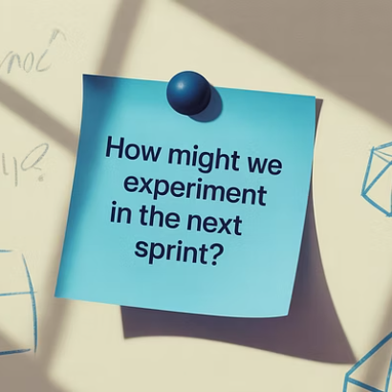
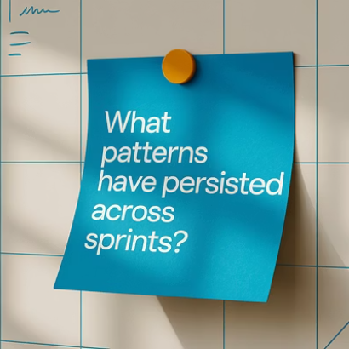
Curiosity-Driven Question Framework

Slide 12
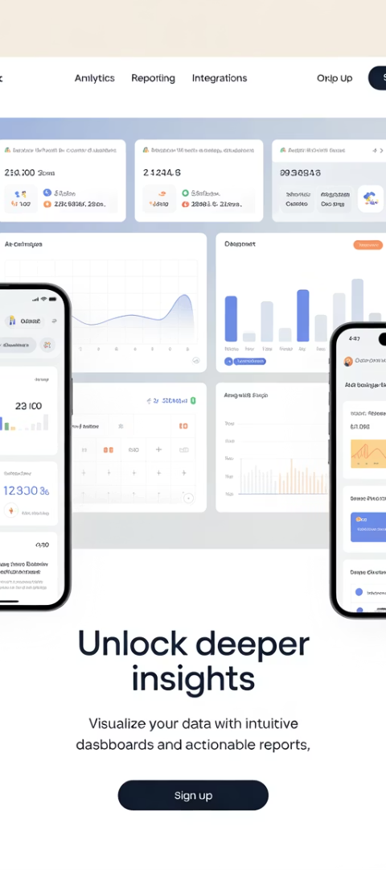
Tools That Support Data-Driven Retros
Tool Category
Examples
Key Benefits
Retrospective Platforms
Parabol, RetroTool, Reetro
Structure, templates, action tracking
Visual Collaboration
Miro, Mural, Lucidspark
Custom boards, voting, engagement
Metrics Dashboards
Jira, Azure DevOps, ClickUp
Sprint analytics, historical trends
Feedback Collection
Geekbot, Polly, SurveyMonkey
Anonymous input, sentiment tracking

Slide 13

From Reflection to Resilience
Data-Grounded Insights
Start with objective metrics. Create a shared reality. Build trust in the process.
Collaborative Learning
Blend numbers with narratives. Value diverse perspectives. Create collective wisdom.
Continuous Evolution
Implement targeted improvements. Measure their impact. Repeat with growing skill.

