Slide 1

Project Manager vs. Program Manager in IT
If you've worked in IT or the tech world long enough, you've probably heard the terms "Project Manager" and "Program Manager" used interchangeably. Some people even think they’re the same thing with a fancier title. But anyone who has worked in either role knows — they’re very different, both in scope and responsibility.
Understanding these crucial IT leadership roles can transform how you approach projects and your career path.
kW
by Kimberly Wiethoff

Slide 2
The Two Roles at a Glance
Project Manager
Program Manager
Focuses on tactical execution of a single project
Focuses on strategic alignment of multiple projects
Success = On time, on budget, within scope
Success = Business value and outcomes
Works with project teams directly
Works with executives and project managers

Slide 3





Project Manager: The Tactical Driver
Defines project scope and goals
Creates detailed plans with specific deliverables and milestones.
Manages timelines and resources
Ensures project stays on schedule and within budget constraints.
Leads daily execution
Coordinates team activities and resolves tactical issues quickly.
Monitors project performance
Tracks metrics and communicates status to stakeholders regularly.

Slide 4








Program Manager: The Strategic Conductor
Strategic Alignment
Ensures all projects support business objectives
Cross-Project Coordination
Manages dependencies between projects
Stakeholder Management
Builds executive relationships
Benefits Realization
Drives long-term business value

Slide 5

The Ship Analogy
Project Manager = Ship Captain
Program Manager = Fleet Admiral
Steers one vessel safely to its destination on schedule. Manages crew, resources, and everyday obstacles.
Coordinates multiple ships toward a strategic objective. Ensures the fleet works together toward larger mission goals.
The Difference
Captains focus on their ship's journey. Admirals focus on why the fleet exists and where it should go next.

Slide 6
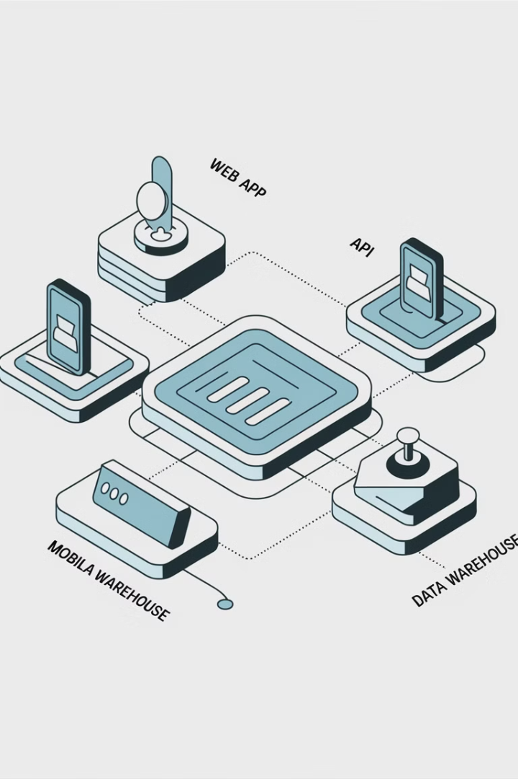




Real-World IT Platform Example
Mobile App Project
Project Manager ensures app development meets requirements and deadlines.
Web Application Project
Another Project Manager focuses on web interface delivery.
Backend Infrastructure Project
Third Project Manager handles API and data warehouse integration.
Program Management
Program Manager ensures all components work together for business value.

Slide 7
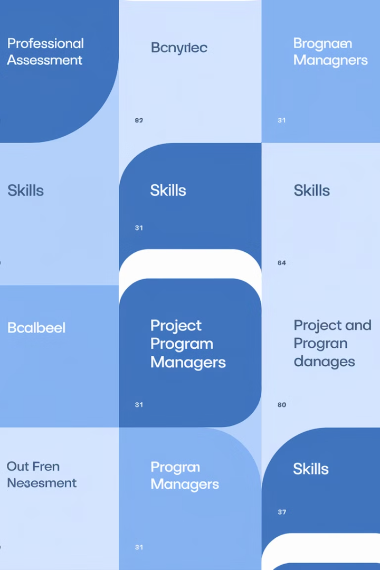
Skill Set Comparison
Skill Area
Project Manager
Program Manager
Planning Focus
Detailed task planning
Strategic roadmapping
Leadership Style
Team-focused
Organization-focused
Technical Depth
Deep in specific areas
Broad across domains
Communication
Team and stakeholders
Executives and sponsors
Problem Solving
Tactical issues
Strategic challenges

Slide 8
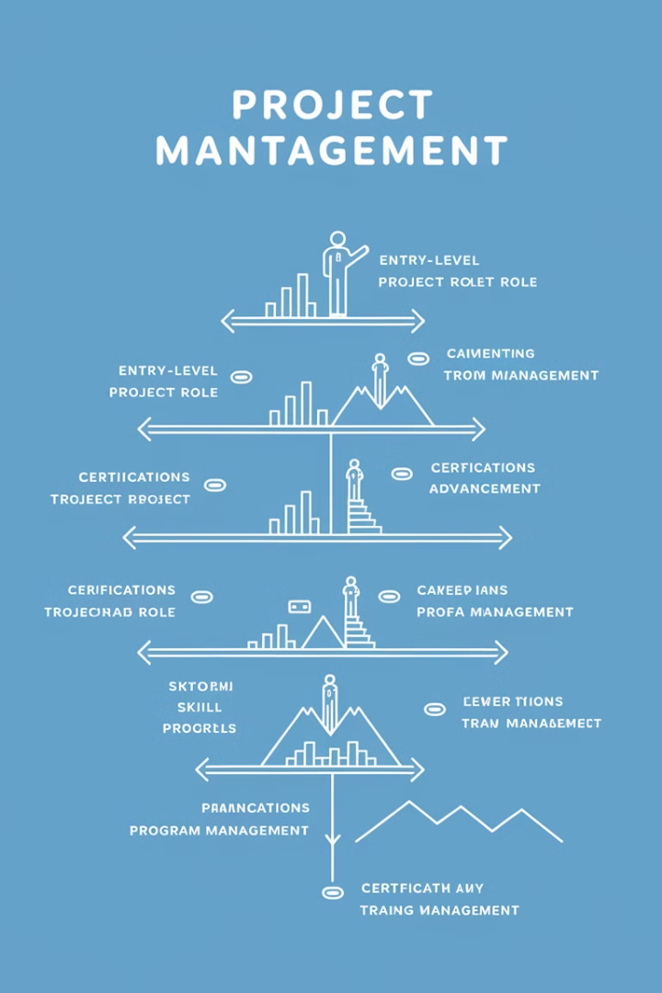



Career Path Considerations
Team Member/Subject Matter Expert
Build technical expertise and project participation experience.
Project Manager
Develop tactical delivery skills and team leadership abilities.
Senior Project Manager
Handle complex projects and begin strategic thinking development.
4
Program Manager
Transition to strategic oversight and business alignment focus.

Slide 9








Common Misconceptions
Just a Title Difference
Natural Promotion Path
They differ fundamentally in scope and responsibilities.
They require different mindsets, not just more experience.
Same Stakeholders
Technical Roles Only
They engage with different levels in the organization.
Both require business acumen beyond technical skills.

Slide 10

Which Role Is Right For You?
Assess Your Strengths
Detail-oriented executors excel as Project Managers. Strategic thinkers thrive as Program Managers.
Consider Your Interests
Do you enjoy hands-on delivery? Or aligning work to business outcomes?
Evaluate Your Experience
Program management typically requires broader organizational knowledge.
Plan Your Development
Identify skill gaps and seek opportunities to grow in your target direction.

