Slide 1

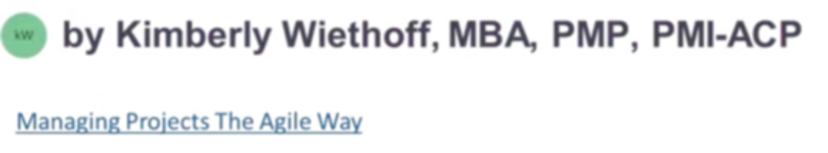
The Agile Coach's Playbook for Continuous Improvement
A practical guide for Agile Coaches and team leads who want to move beyond occasional retrospectives and build a genuine culture of learning, adaptation, and growth — one iteration at a time.
AGILE COACHING
CONTINUOUS IMPROVEMENT
#ContinuousImprovement #AgileCoaching #AgileTransformation #LeanAgile #Scrum #ScrumMaster #Leadership #OrganizationalChange #BusinessTransformation #TeamPerformance #ContinuousLearning #AgileLeadership #EnterpriseAgility #DigitalTransformation #ProjectManagement #ProductManagement #Innovation #TeamCollaboration #FutureOfWork #OperationalExcellence

Slide 2


The Challenge
Why Most Teams Get Stuck
Continuous improvement is one of the foundational principles of Agile — yet many organizations struggle to move beyond the occasional retrospective or one-off process adjustment. Teams settle into the status quo, recurring issues go unresolved, and growth opportunities slip by unnoticed.
The most effective Agile Coaches understand that continuous improvement is not a meeting, a metric, or a single initiative. It is a mindset and organizational capability that enables teams to consistently learn, adapt, and raise their performance over time.
High-performing organizations succeed not by avoiding challenges — but by continuously identifying opportunities and taking action.

Slide 3
Why Continuous Improvement Matters
Markets evolve, customer expectations shift, and technology advances at an unprecedented pace. Organizations that fail to adapt quickly risk falling behind. Small improvements made consistently over time generate far greater results than large, infrequent transformation efforts. The goal is not perfection — it is becoming slightly better with every iteration.
Delivery
Quality
Efficiency
Increase predictability and release frequency
Reduce defects and rework across products
Eliminate waste and streamline workflows
Engagement
Agility
Boost team morale and stakeholder satisfaction
Strengthen the organization's ability to adapt

Slide 4


Chapter 1
Moving Beyond the Retrospective
Retrospectives are a vital Agile practice — but continuous improvement cannot be confined to a single discussion at the end of a sprint. Many teams fall into patterns that prevent real progress.
Common Traps
Effective Retrospectives
Revisiting the same issues sprint after sprint
Action items that never get completed
Focusing only on team-level concerns
Failing to measure improvement efforts
Identify root causes, not just symptoms
Assign clear ownership of action items
Establish measurable outcomes
Review progress at the next session
Improvement only occurs when insights consistently lead to action.

Slide 5
Chapter 2
Building a Culture of Experimentation
Continuous improvement thrives in environments where teams feel empowered to try new things without fear of failure. Agile Coaches shift teams from defensiveness to curiosity — replacing "How do we fix this permanently?" with a more agile set of questions.
What can we try next?
How can we test quickly?
Generate multiple hypotheses before committing to a single solution. Quantity of ideas precedes quality of execution.
Small, low-risk experiments produce valuable insights while minimizing disruption to ongoing delivery.
What does success look like?
What did we learn?
Define clear, measurable outcomes before the experiment begins so results can be evaluated objectively.
Whether an experiment succeeds or fails, the learning itself is the value. Capture and share it broadly.

Slide 6
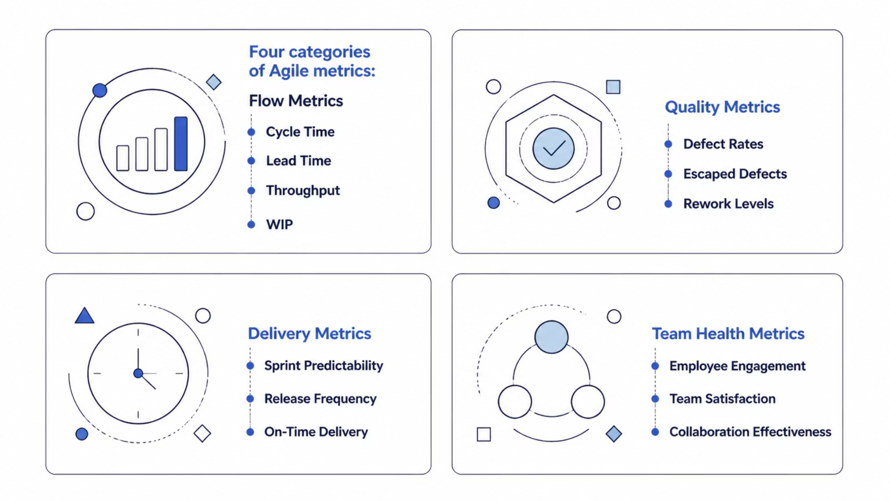
Chapter 3
Using Metrics to Drive Improvement
Data provides visibility into team performance — but metrics should never be used as a tool for judgment. The purpose of measurement is learning. The most important question is never "What does the metric say?" — it is "What should we do differently because of it?"

Slide 7
Chapter 4
Removing Organizational Impediments
Many of the most impactful improvement opportunities lie outside the team's direct control. Systemic barriers at the organizational level can quietly undermine even the most motivated teams — no matter how strong their practices are.
Common Organizational Barriers
Slow approval processes
Unclear decision-making authority
Resource constraints
Excessive governance overhead
Cross-functional dependencies
Competing organizational priorities
Identify the real blockers
Slow approvals, unclear decision authority, resource constraints, and excessive governance all reduce team effectiveness.
Partner with leadership
Agile Coaches act as organizational change agents, surfacing systemic issues and co-creating solutions with leaders who have the authority to act.
Unblock delivery flow
When impediments are removed, teams can redirect their energy from navigating bureaucracy to delivering customer value.

Slide 8

Chapter 5
Coaching Leaders for Continuous Improvement
Continuous improvement is not solely a team responsibility. Leaders create the environment in which improvement efforts either flourish or stagnate. When leaders model the behaviors they want to see, teams are far more likely to embrace the mindset. Transformation starts at the top.
Encourage Transparency
Create safety to surface problems without blame
Support Experimentation
Reward learning, not just outcomes
Remove Barriers
Actively clear the path for team progress
Focus on Outcomes
Measure results, not activity or hours worked

Slide 9


Chapter 6
Leveraging AI to Accelerate Improvement
Artificial intelligence is creating powerful new opportunities for Agile Coaches to identify improvement areas faster and more accurately than ever before. Instead of spending hours collecting and analyzing data manually, coaches can focus on interpreting insights and guiding meaningful action.
What AI Can Surface
Delivery bottlenecks and flow disruptions
Recurring defect patterns
Team sentiment trends
Sprint performance analysis
Predicted delivery risks
Systemic organizational impediments
AI does not replace coaching. It enhances the coach's ability to make data-driven decisions and direct attention where it matters most.

Slide 10




Chapter 7
Creating Sustainable Improvement Habits
One of the most common mistakes organizations make is treating continuous improvement as a temporary initiative — a workshop, a sprint, a quarter-long push. Sustainable improvement requires habits that become embedded in everyday work, not activities bolted on top of it.
Reflect Regularly
Celebrate Progress
Share Lessons Learned
Embrace Experimentation
Build structured reflection into the rhythm of work — not just at retrospectives, but in daily standups and weekly check-ins.
Recognize and share wins — however small. Celebrating progress reinforces the behaviors that drive continuous improvement.
Create channels for learnings to flow across teams. What one team discovers today can save another team weeks tomorrow.
Challenge assumptions continuously. The teams that improve fastest are those most willing to question how they currently work.

Slide 11





The Continuous Improvement Flywheel
High-performing Agile teams create a self-reinforcing cycle where each iteration generates new insights, stronger capabilities, and consistently improved outcomes. This flywheel effect allows organizations to continuously adapt while maintaining alignment with business objectives — and it accelerates over time.
Identify
Measure
Surface opportunities for improvement
Track performance with meaningful metrics
Experiment
Test hypotheses with small, safe-to-fail trials
Implement
Adopt successful changes at scale
Evaluate
Assess results against defined success criteria

Slide 12
Putting It All Together
The Agile Coach's Continuous Improvement Toolkit
Diagnose the Current State
Engage the Team
Use flow metrics, retrospective data, and team health indicators to build an honest picture of where the team stands today.
Co-create improvement goals with the team. Ownership drives commitment — improvements assigned from outside rarely stick.
Clear Organizational Blockers
Build the Habit Loop
Partner with leadership to address the systemic impediments that teams cannot resolve on their own.
Embed reflection, experimentation, and measurement into the regular rhythm of work — not as extra effort, but as second nature.

Slide 13

The Teams That Learn Fastest Win
Continuous improvement is the heartbeat of Agile. While frameworks, ceremonies, and tools provide structure, lasting success comes from creating a culture where learning, experimentation, and adaptation are embedded into daily work — not scheduled into a calendar.
What Organizations Gain
"The most successful Agile teams are not those that get everything right the first time. They are the teams that learn faster than everyone else."
Resilience — the ability to absorb and recover from disruption
Adaptability — the capacity to pivot when the market demands it
Competitive advantage — a pace of learning that compounds over time
Agile Coaches who invest in building continuous improvement as an organizational capability — not just a practice — create teams that are ready for whatever comes next.

