Slide 1
NetSuite: Beyond ERP - A Complete Business Platform
Discover how NetSuite's integrated cloud platform transforms business operations. Join us to explore the full capabilities that make it more than just an ERP system.
kW
by Kimberly Wiethoff

Slide 2
The Power of Integration
Cloud-Based Platform
Access your data from anywhere, anytime with Oracle's secure infrastructure.
Real-Time Updates
Get instant visibility across departments with synchronized data.
Modular Design
Add capabilities as your business grows without disruption.
Scalable Architecture
Support business from startup to enterprise with the same platform.

Slide 3
Financial Management Excellence
Real-Time Visibility
Monitor key financial metrics instantly. Make decisions based on current data.
Multi-Currency Support
Manage global operations seamlessly. Consolidate financials across regions.
Tax Management
Automate compliance requirements. Reduce audit risks with built-in controls.
Project Costing
Link expenses directly to projects. Track budgets against actuals in real time.

Slide 4
Project Management Reimagined
Project Creation
Resource Assignment
Define scope, timelines, and deliverables in one system.
Match the right people to tasks based on skills and availability.
Progress Tracking
Budget Management
Monitor milestones and completion rates with visual dashboards.
Compare planned vs. actual costs throughout the project lifecycle.

Slide 5
Optimize Your Resources
Availability Tracking
Skills Management
View real-time resource calendars to prevent overbooking and conflicts.
Match project requirements with team capabilities for optimal assignments.
Workload Balancing
Utilization Reporting
Distribute work evenly across teams to prevent burnout and delays.
Analyze resource usage patterns to improve operational efficiency.

Slide 6
Customer Relationship Excellence
Lead to Proposal
Track potential clients from first contact through proposal development.
Project Scoping
Document client requirements and expectations in a centralized system.
Delivery Management
Keep clients informed with automated status updates and milestones.
Post-Project Support
Manage ongoing maintenance and enhancement requests seamlessly.

Slide 7
Streamlined Supply Chain
Delivery
Inventory
Purchasing
Planning
Track shipments in real-time
Maintain optimal stock levels
Automate procurement workflows
Align supply with project timelines
Keep your projects on schedule with materials and assets delivered just when you need them. NetSuite synchronizes procurement with project demands.

Slide 8
Data-Driven Decision Making
Real-Time Dashboards
Custom Reports
Predictive Analytics
Monitor KPIs with customizable visual displays. Get instant insights into project health and financial performance.
Build tailored reports for different stakeholders. Deliver the right information to the right people.
Anticipate issues before they impact projects. Use historical data to improve future performance.
Executive summaries
Risk identification
Project profitability
Client status reports
Trend analysis
Resource utilization
Team performance metrics
Resource forecasting
Milestone completion

Slide 9
Tailored to Your Business
Role-Based Access
Forms & Fields
Control who sees what based on job function. Maintain security while enabling collaboration.
SuiteScript
Design custom data entry screens for your teams. Capture industry-specific information with minimal clicks.
SuiteFlow
Develop JavaScript customizations for unique requirements. Extend standard functionality to match your exact needs.
Create custom approval workflows without coding. Automate routine processes for consistent execution.

Slide 10
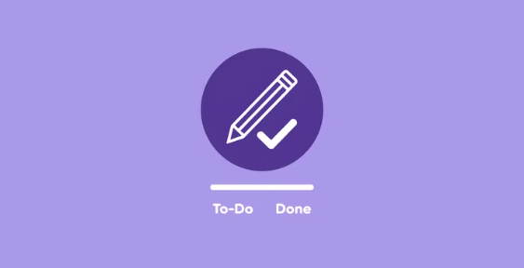
Extend Your Capabilities
Tap into NetSuite's robust SuiteApp Marketplace featuring over 600 certified, third-party solutions. Seamlessly integrate your essential business tools while maintaining data integrity across a unified platform, eliminating silos and accelerating your operational efficiency.

Slide 11
The Strategic Advantage
1
Complete Visibility
Full view across all business functions
2
Time Savings
Average reduction in manual reporting
3
Profit Increase
Typical improvement in project margins
4
Uptime
System reliability for continuous operations

Slide 12
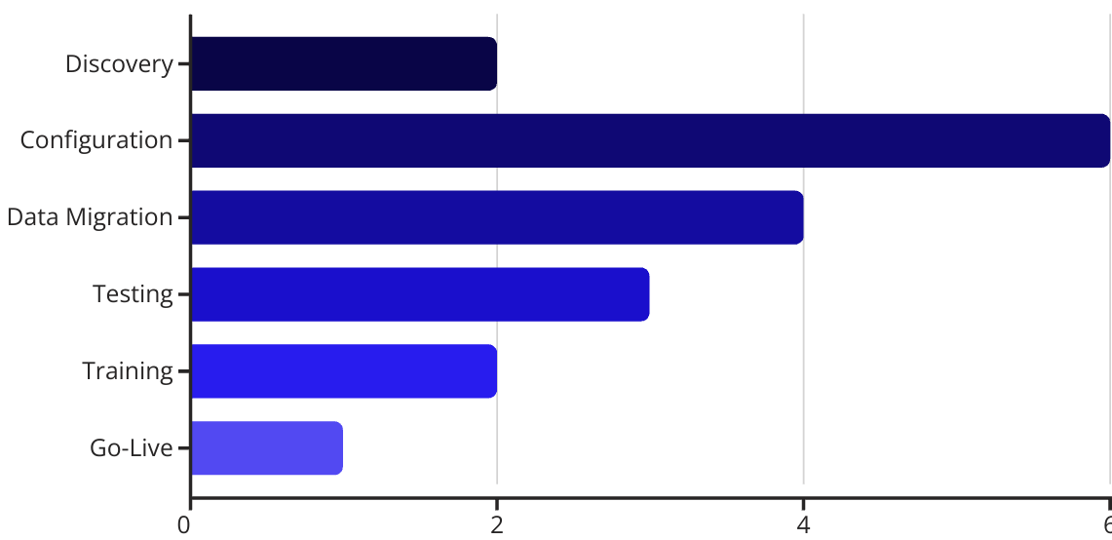
Start Your NetSuite Journey
Ready to transform your project management capabilities? Contact us to discuss your implementation plan and timeline.

