Slide 1

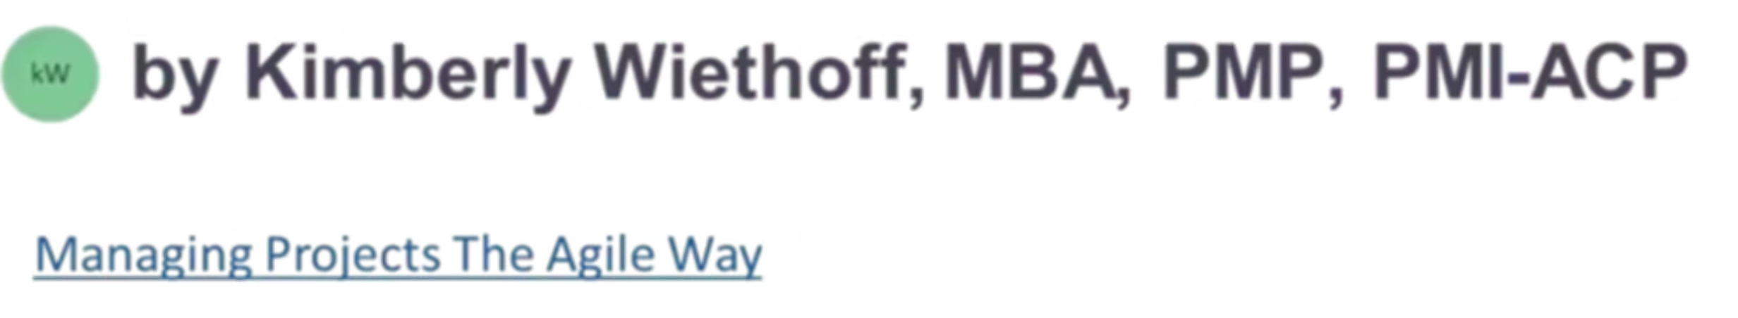
Agile Within Waterfall: How to Infuse Flexibility Without Losing Structure
Traditional Waterfall project management remains the standard in many organizations—especially in highly regulated industries like healthcare, finance, and manufacturing. But as projects grow more complex and customer expectations evolve faster than ever, rigid sequential structures often struggle to keep pace. The solution isn't abandoning Waterfall entirely. It's about strategically infusing Agile principles to create responsive, collaborative, value-driven projects while maintaining the governance and compliance frameworks your organization depends on.
#ManagingProjectsTheAgileWay #HybridProjectManagement #AgileMindset #WaterfallToAgile #ProjectLeadership #PMO #BusinessAgility #ChangeManagement #ContinuousImprovement #AgileWithinWaterfall

Slide 2
The Challenge: Structure vs. Flexibility
Why Waterfall Persists
Why Teams Struggle
Regulatory compliance requirements
Delayed feedback until late stages
Fixed-budget contracts
Limited adaptability to change
Established governance frameworks
Siloed team communication
Predictable timelines and deliverables
Long wait times for value delivery
Clear accountability structures
Reduced stakeholder engagement
The tension between structure and flexibility is real. But it's not an either-or proposition. The most successful project teams today are finding ways to honor both—creating what we call "structured agility" that respects organizational constraints while building in responsiveness.

Slide 3
Start with an Agile Mindset—Not a Framework
You don't need to "run Scrum" to be Agile. What matters most is adopting core Agile principles: frequent feedback, incremental improvement, collaboration, and transparency. These principles can coexist beautifully within Waterfall structures.
Frequent Feedback
Incremental Improvement
Don't wait until phase gates. Create informal checkpoints to gather stakeholder input continuously.
View deliverables as evolving rather than final. Refinement is strength, not weakness.
Active Collaboration
Radical Transparency
Break down silos early. Bring diverse perspectives together throughout the lifecycle.
Make progress, risks, and blockers visible to all stakeholders in real time.
The mindset shift alone—encouraging teams to embrace change rather than resist it—can transform how your organization approaches project delivery. Start here, before changing any processes.

Slide 4
Introduce Iterations Within Phases
Waterfall projects have distinct stages—requirements, design, build, test, deploy. But that doesn't mean you can't iterate within each phase. Small cycles within larger phases create natural opportunities for course correction without disrupting the overall project structure.
01
02
03
Requirements Phase
Design Phase
Build Phase
Hold short working sessions to validate user stories with stakeholders. Create requirement prototypes for early feedback before documentation is finalized.
Use wireframes, mockups, and prototypes to gain stakeholder input before finalizing specifications. Design reviews become collaborative sessions, not approval ceremonies.
Break development into smaller modules. Demonstrate completed modules to stakeholders incrementally rather than waiting for full completion.
04
05
Test Phase
Deploy Phase
Create mini release cycles to validate key functionality earlier. Don't wait until the end—test continuously as components become available.
Consider phased rollouts instead of big-bang releases. Gather user feedback from early adopters to refine before full deployment.

Slide 5

Small iterations lead to big agility

Slide 6
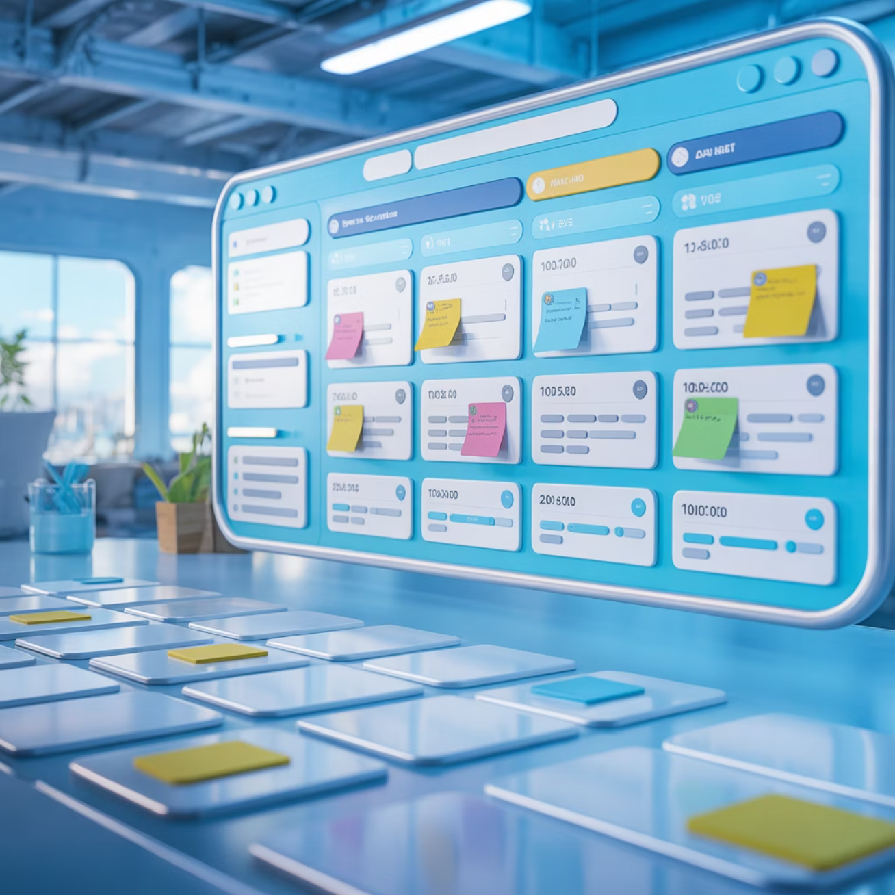

Enhance Visibility with Agile-Inspired Tools
Even in a Waterfall project, Agile tools can dramatically boost alignment and transparency. These aren't just for Scrum teams—they're powerful visibility enhancers for any project structure.
Tools That Transform Visibility
Kanban boards visualize work in progress and bottlenecks
Burndown charts track progress against planned timelines
Daily standups surface blockers before they become critical
Digital dashboards provide real-time status for all stakeholders
Tools like Jira, Azure DevOps, and ServiceNow make it easy to track dependencies, communicate risks, and maintain transparency—essential ingredients for adaptive project management.
Transparency creates accountability and helps prevent surprises during critical milestones. When everyone can see the same information, collaboration improves naturally.

Slide 7
Build Feedback Loops into Governance
Traditional governance focuses on control points and approval gates. But these mandatory checkpoints can double as powerful opportunities for continuous improvement. The key is reframing how you approach governance meetings.
Traditional Governance
Agile-Enhanced Governance
Status reporting focused on completion percentages
Collaborative discussions on what's working and what isn't
Red/yellow/green indicators without context
Risk identification with proposed mitigations
One-way communication from PM to stakeholders
Two-way dialogue about priorities and trade-offs
Focus on finding who's accountable for problems
Focus on learning and continuous improvement
Turn your status meetings into sprint-style reviews: focus on delivered value, emerging risks, and what adjustments can deliver more value sooner. Encourage stakeholders to view governance as a learning mechanism that enables success, not a bottleneck that delays progress.

Slide 8





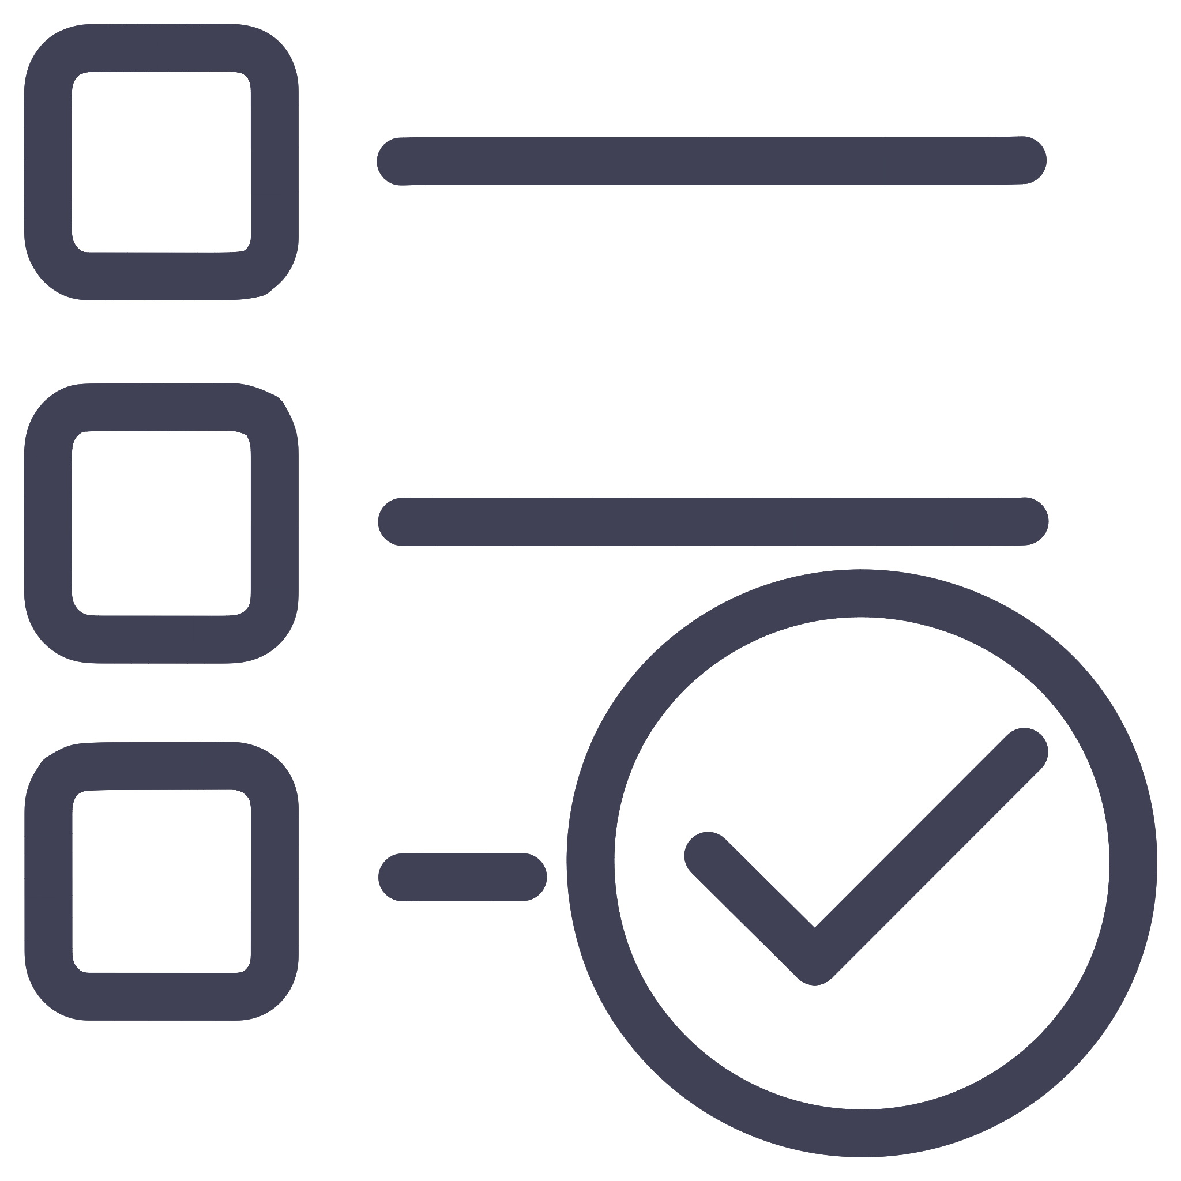

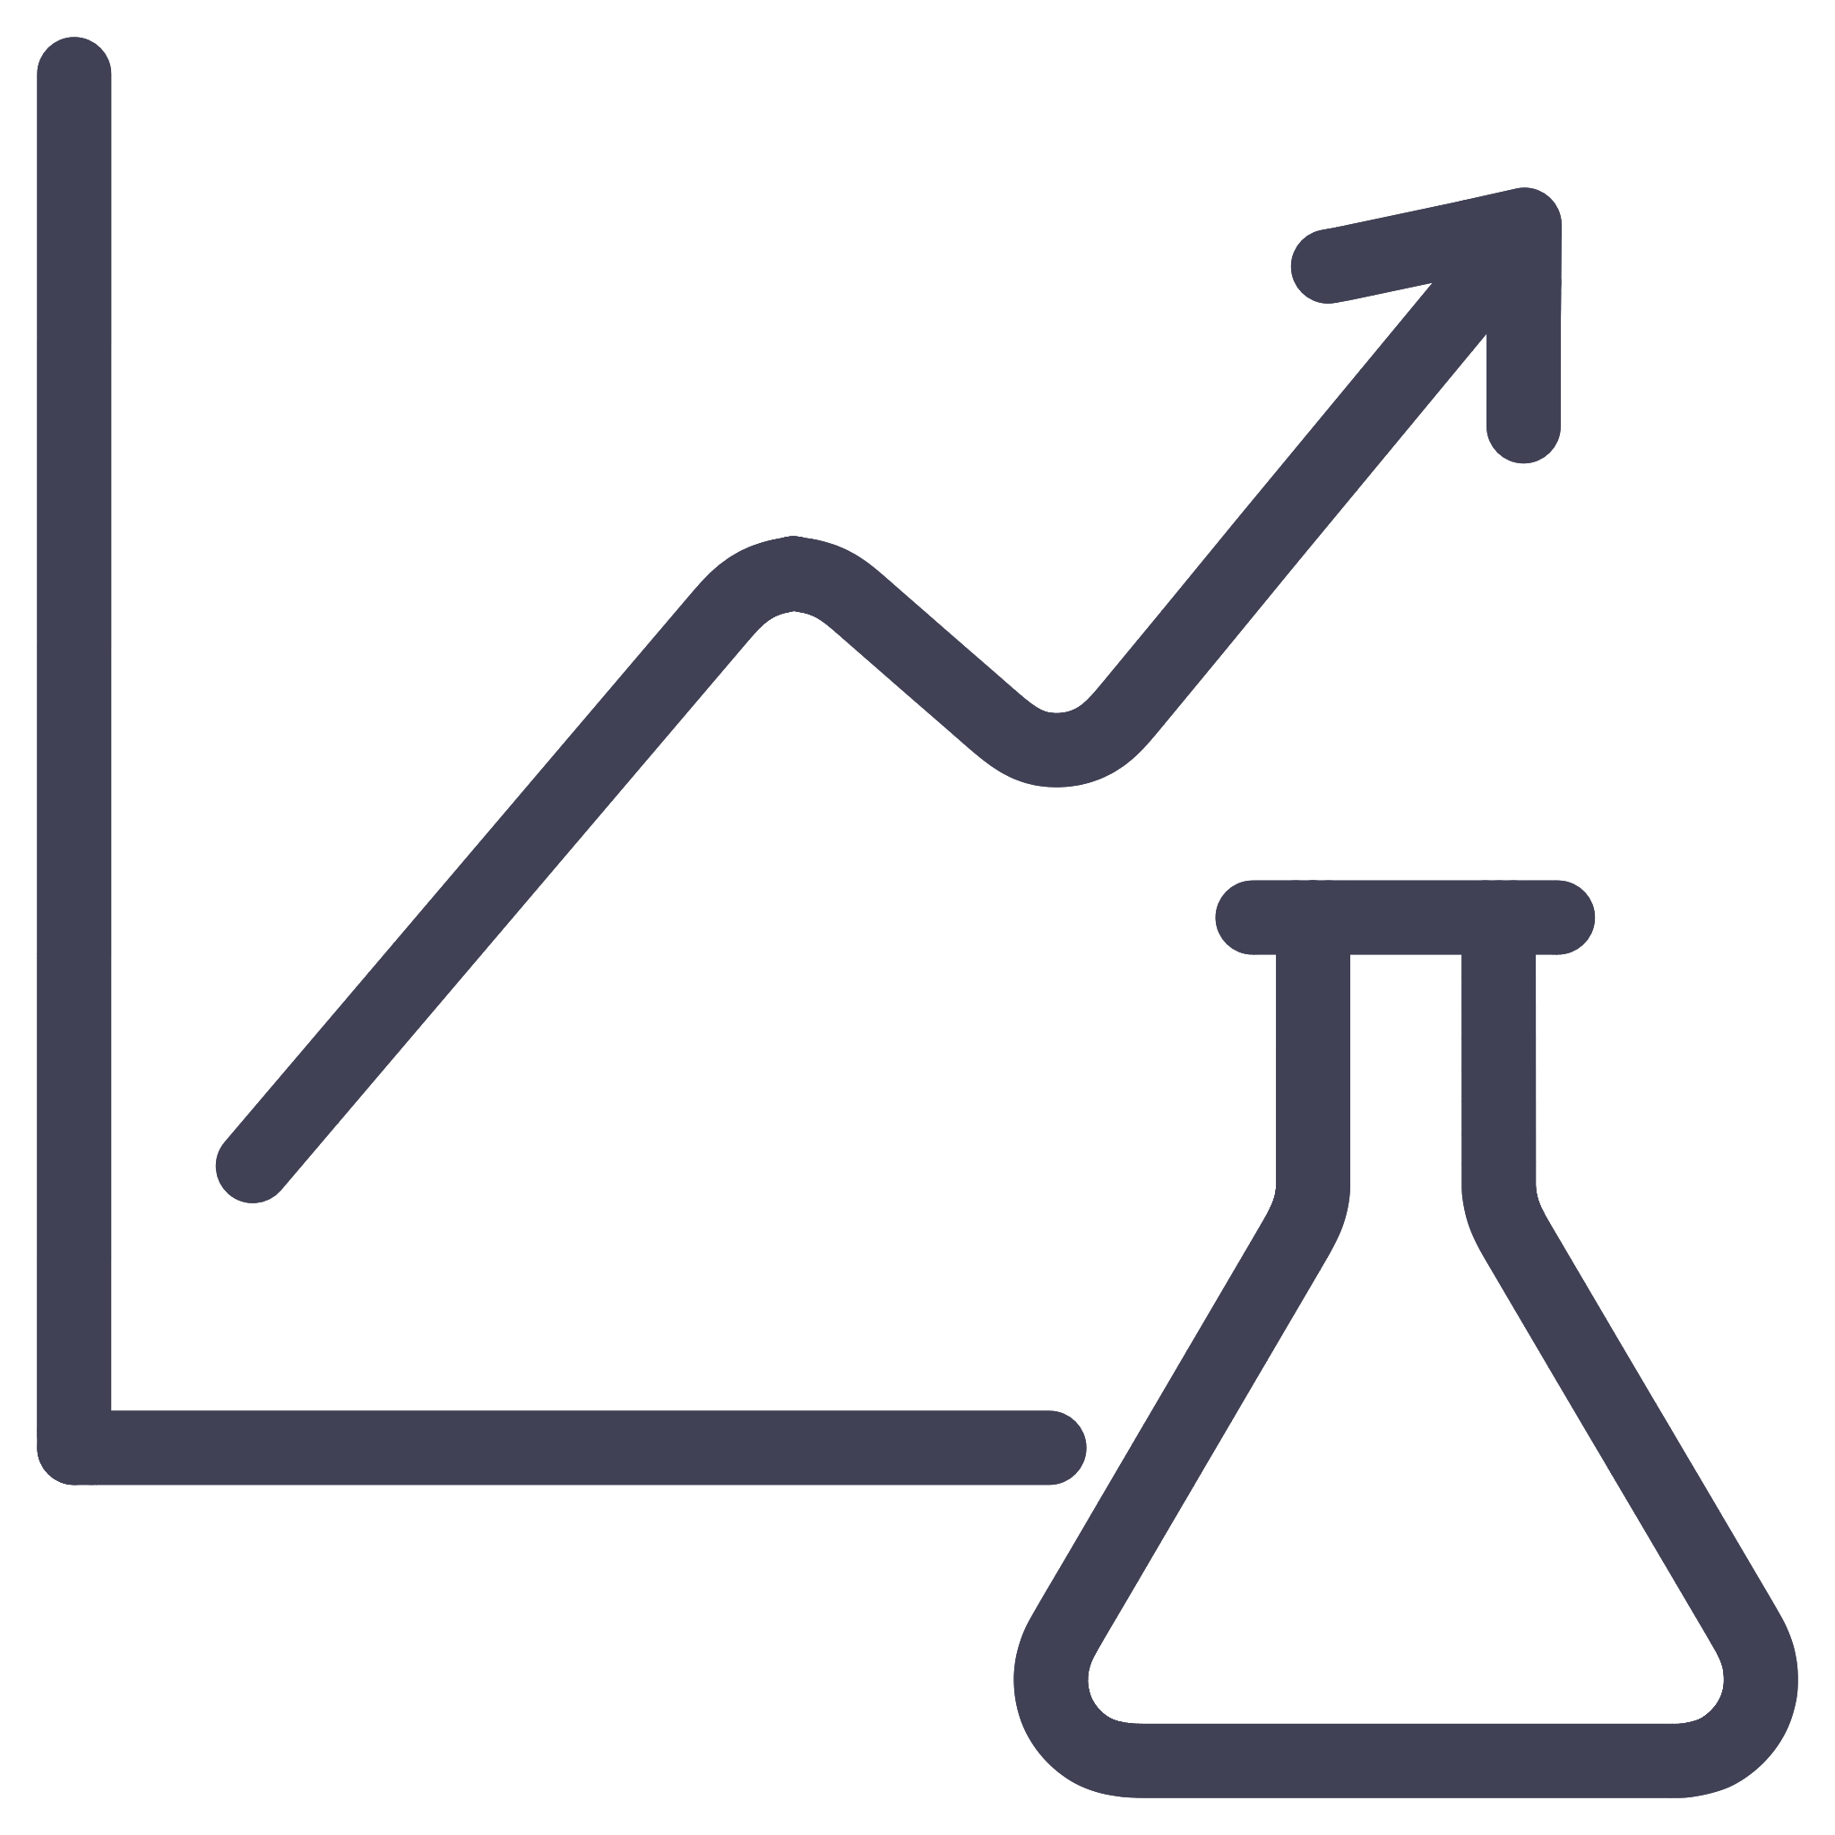
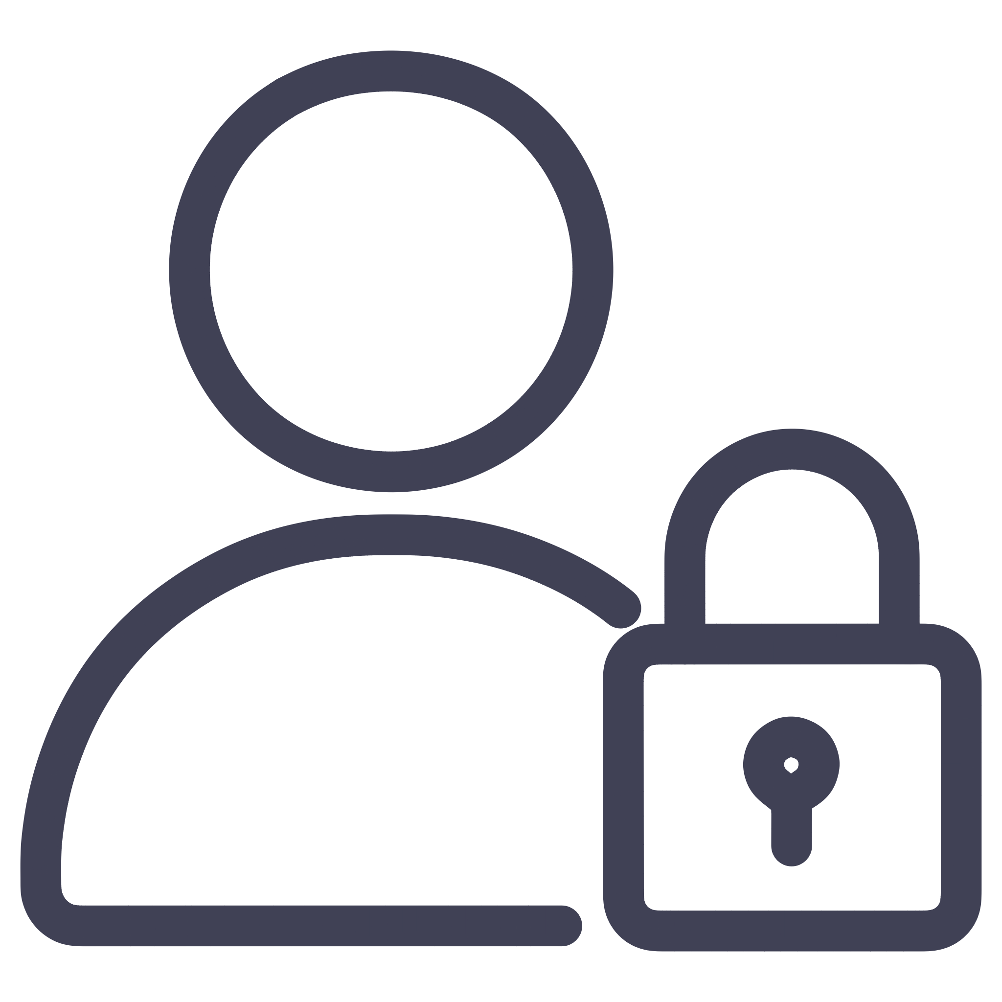
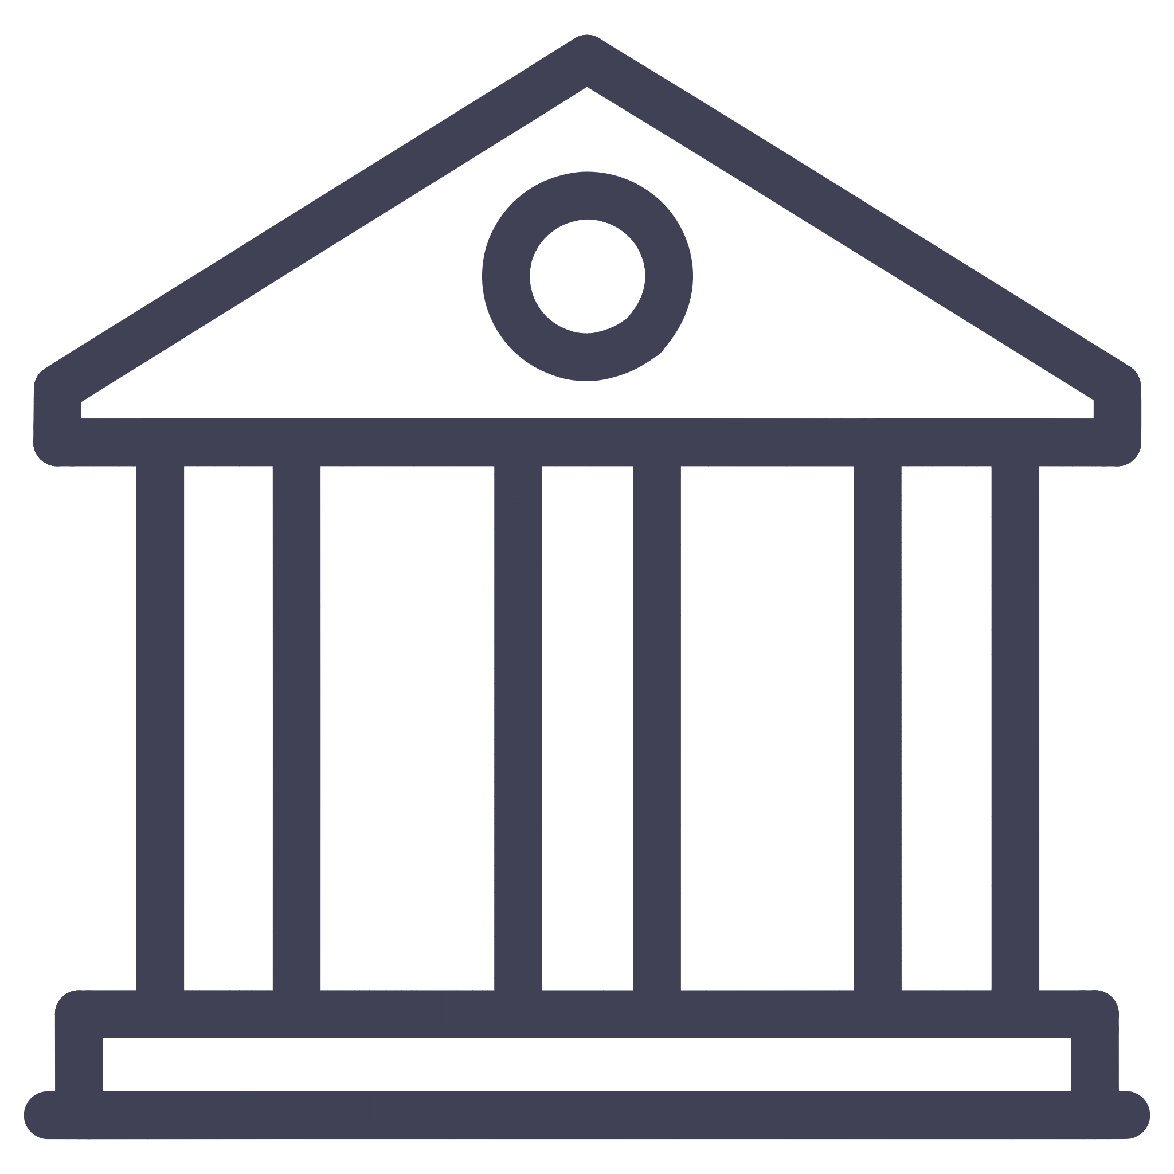
Empower Cross-Functional Collaboration
Testers
Developers
Quality assurance and validation
Technical expertise and implementation
Analysts
Requirements and data insights
End Users
Real-world needs and feedback
Business Partners
Strategic direction and priorities
Agility thrives where silos end. Even if roles and responsibilities are clearly defined in your Waterfall methodology, bring your diverse team members together earlier and more frequently. Regular cross-functional check-ins break down barriers, improve mutual understanding of dependencies, and enable adaptive planning. When developers understand business priorities and business partners appreciate technical constraints, better decisions emerge naturally.

Slide 9

Celebrate Incremental Wins
Waterfall projects often delay recognition until final delivery, but that approach can dampen morale and obscure progress for months at a time. Teams lose momentum when achievements go unacknowledged.
Instead, celebrate phase completions and incremental successes just like Agile teams celebrate sprint outcomes. Recognize when requirements are validated, when designs are approved, when key modules are completed, when testing milestones are achieved.
These celebration moments serve multiple purposes: they reinforce momentum, boost team motivation, and create shared accountability—the heart of every high-performing team. Recognition doesn't need to be elaborate. Sometimes a simple team acknowledgment or stakeholder thank-you is enough.

Slide 10

Real-World Success Metrics
Organizations that successfully blend Agile principles into Waterfall structures see measurable improvements across multiple dimensions. These aren't theoretical benefits—they're outcomes experienced by project teams in regulated industries.
35%
50%
40%
25%
Faster Issue Resolution
Reduced Rework
Higher Satisfaction
Better Predictability
Problems identified and addressed earlier through continuous feedback
Fewer late-stage changes due to incremental validation
Stakeholders report increased confidence and engagement
Improved accuracy in estimates and delivery timelines
These metrics come from organizations that maintained Waterfall governance while adopting Agile practices like regular demonstrations, cross-functional collaboration, and iterative refinement within phases.

Slide 11
Getting Started: Your 90-Day Roadmap
Days 1-30: Foundation
1
Introduce Agile mindset concepts to your team
Pilot daily standups with one project team
Set up a simple Kanban board for visibility
2
Days 31-60: Experimentation
Identify one governance meeting to restructure
Introduce iteration cycles within one project phase
Schedule cross-functional collaboration sessions
Days 61-90: Expansion
3
Create feedback checkpoints with stakeholders
Document what's working and share lessons learned
Celebrate first incremental wins publicly
Apply successful practices to additional projects
Train additional team members on hybrid approach
Refine governance processes based on feedback
Start small, measure results, and expand what works. Don't try to transform everything at once. Incremental change is more sustainable and builds organizational confidence in new approaches.

Slide 12
The Hybrid Future of Project Management
Blending Agile into Waterfall isn't about changing your methodology—it's about changing your mindset and selectively adopting practices that make your projects more responsive. By applying iterative thinking, feedback loops, and collaboration principles, you unlock agility where it matters most: in the people and processes driving your projects forward.
In today's business environment, the best project managers are bilingual—fluent in both structure and adaptability. They know when to follow the plan and when to adjust course. They balance governance requirements with responsiveness to change. They create space for both predictability and innovation.
You don't need permission to start experimenting with these approaches. Begin with small changes on your next project. Introduce a feedback checkpoint. Run a cross-functional workshop. Celebrate an incremental milestone. Each small step builds the muscle memory your organization needs to thrive in an increasingly dynamic world.

Slide 13

Key Takeaways
1
2
Mindset Over Methodology
Iterate Within Phases
Adopt Agile principles—feedback, collaboration, transparency—without abandoning Waterfall structure
Build short cycles into each Waterfall stage for continuous validation and refinement
3
4
Enhance Visibility
Transform Governance
Use Agile tools like Kanban boards and standups to improve transparency and accountability
Convert control points into learning opportunities focused on value delivery
5
6
Break Down Silos
Celebrate Progress
Foster cross-functional collaboration early and often throughout the project lifecycle
Recognize incremental achievements to maintain momentum and team engagement

