Slide 1
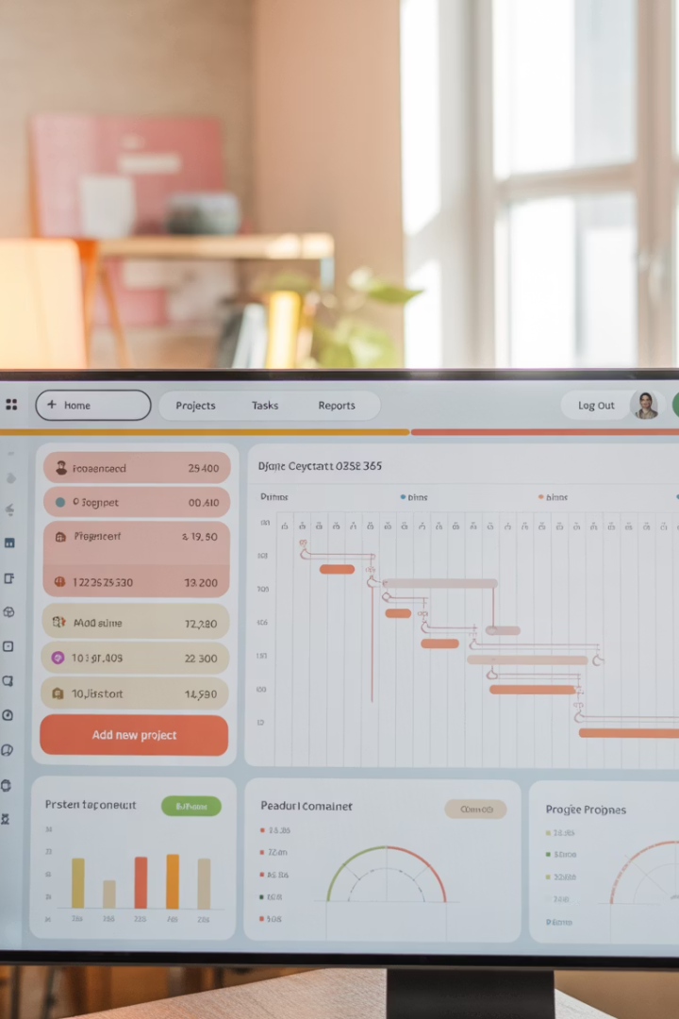
Microsoft Dynamics 365 Finance and Operations: The Project Manager's Guide
Welcome to this comprehensive exploration of Microsoft Dynamics 365 Finance and Operations (D365 F&O) for project managers. This powerful enterprise resource planning solution unifies financials, supply chain, operations, and project management within a single integrated platform. Throughout this presentation, we'll examine how each module works together to enhance project visibility, streamline processes, and support data-driven decision-making across the entire project lifecycle.
We'll dive deep into the functionalities that matter most to project managers, providing practical insights on how to leverage D365 F&O to drive project success in your organization.
kW
by Kimberly Wiethoff

Slide 2
Module Overview: The D365 F&O Ecosystem
Reporting & Analytics
Cross-module visibility and insights
Project & Resource Management
Planning, execution and performance tracking
Financial Management
Budgeting, accounting, payables and receivables
Operations Management
Supply chain, inventory and procurement
The D365 F&O platform consists of tightly integrated modules that share data seamlessly. This interconnected ecosystem eliminates traditional information silos, allowing project managers to access real-time data across organizational boundaries. The platform's architecture ensures that changes in one area—such as procurement or human resources—are immediately reflected in project dashboards and financial reports.

Slide 3
Project Management and Accounting Module
Contract Management
Work Breakdown Structures
Create and manage project contracts with flexible terms and conditions, supporting both time-and-materials and fixed-price engagements with customizable billing schedules.
Develop comprehensive WBS hierarchies with tasks, subtasks, and milestones. Link deliverables, resources, and budgets directly to specific WBS elements for granular tracking.
Time and Expense Tracking
Project Monitoring
Capture labor hours and project expenses through web and mobile interfaces. Automated approval workflows ensure proper validation before costs hit project financials.
Track actual vs. planned performance across schedule, budget, and resource dimensions with automated alerts for variances that exceed predefined thresholds.
The Project Management and Accounting module serves as the central hub for project delivery activities. By consolidating planning, execution, and monitoring functions, it provides project managers with a single source of truth for project performance data, eliminating the need to reconcile information from disparate systems.

Slide 4
General Ledger and Budgeting
Core Financial Functions
Budget Management
The General Ledger module serves as the financial backbone of D365 F&O, consolidating all financial transactions across the organization. For project managers, this means having unprecedented visibility into how project expenditures impact the overall financial health of the business.
D365 F&O's budgeting capabilities allow for sophisticated budget modeling and forecasting. Project managers can create detailed project budgets that roll up into departmental and organizational budgets, providing context for resource allocation decisions.
The system supports multi-currency transactions, intercompany accounting, and financial period closings, ensuring that project financials remain accurate regardless of complexity or geographic distribution.
The system supports budget versioning, allowing teams to maintain multiple budget scenarios (optimistic, realistic, conservative) and perform what-if analysis to assess potential outcomes before committing to specific approaches.
With real-time financial insight, project managers can identify cost trends early and implement corrective actions before budget variances become significant issues. The integration between project-specific and organization-wide financials also facilitates more accurate forecasting and resource planning across the portfolio.

Slide 5
Procurement and Sourcing
Vendor Management
Requisition Processing
Purchase Order Creation
Receipt and Verification
Qualify, onboard and evaluate suppliers using standardized processes
Create and route purchase requests through customizable approval workflows
Confirm deliveries and validate invoices with three-way matching
Generate POs with automated validation against contracts and catalogs
The Procurement and Sourcing module streamlines the acquisition of goods and services required for project execution. By automating the procurement lifecycle, it reduces administrative overhead and accelerates fulfillment times. The integration with project timelines ensures that materials and services are ordered with sufficient lead time to prevent delays in critical path activities.
Project managers gain visibility into procurement status, enabling proactive management of potential supply chain disruptions before they impact project schedules or budgets.

Slide 6
Human Resources and Resource Management
Resource Capacity Planning
Skills and Competency Management
Time Management and Utilization
D365 F&O provides comprehensive visibility into resource availability across departments and projects. The system accounts for vacation time, training days, and existing project commitments to present an accurate picture of capacity.
The platform maintains detailed profiles of employee skills, certifications, and experience levels. This enables project managers to identify the best resource matches for specific project roles based on required competencies.
Time entry capabilities integrate directly with project tasks, allowing for accurate tracking of effort against planned work. Utilization dashboards provide insights into productivity patterns and resource efficiency.
Visual capacity heatmaps identify potential bottlenecks
Skill gap analysis for project requirements
Automated timesheet approvals and validation
What-if scenarios for resource allocation decisions
Certification tracking with expiration alerts
Utilization reporting by resource, team, or department
Long-term capacity forecasting for strategic planning
Development planning aligned with project needs
Trend analysis for capacity optimization
By integrating human resource management with project planning, D365 F&O enables project managers to build realistic staffing plans based on actual resource availability and capabilities. This integration reduces the risk of resource conflicts and helps maintain consistent utilization levels across the organization.

Slide 7
Accounts Payable and Receivable
Financial Visibility and Reporting
Customer Billing and Collections
Both modules provide comprehensive reporting on payment status, aging, and projections. Project managers can access detailed transaction histories to resolve disputes quickly and track payment trends. Credit management functionality helps manage customer risk, while vendor performance metrics inform future procurement decisions for similar projects.
Invoice Processing and Vendor Payments
The Accounts Receivable module handles customer invoicing based on project billing rules. It supports diverse billing methods including milestone-based, time-and-materials, and fixed-price with percentage completion calculations. Automated billing schedules ensure invoices are generated according to contract terms, improving cash flow predictability for project-driven organizations.
The Accounts Payable module automates the processing of vendor invoices related to project purchases. The system performs matching against purchase orders and receipts, routes invoices through approval workflows, and schedules payments based on terms and cash flow requirements. For project managers, this ensures timely payment to critical vendors while maintaining appropriate financial controls.
The integration of accounts payable and receivable with project management creates a closed-loop system for financial tracking throughout the project lifecycle. This ensures that all financial transactions are properly attributed to the correct projects, enabling accurate profitability analysis and supporting data-driven decisions about future project investments.

Slide 8
Inventory and Warehouse Management
Inventory Tracking
Demand Forecasting
Logistics Management
Replenishment
Real-time visibility into inventory levels, locations, and statuses across multiple warehouses. Barcode and RFID scanning capabilities ensure accurate item identification and movement tracking.
Predictive analytics tools that analyze historical usage patterns and project plans to anticipate material requirements and optimize stock levels.
Coordination of inbound and outbound shipments, with integration to transportation management systems for complete supply chain visibility.
Automated reordering based on minimum/maximum levels, lead times, and projected consumption rates from active and planned projects.
For project managers overseeing initiatives with significant material components, the Inventory and Warehouse Management module provides critical visibility into supply availability. By connecting project material requirements directly to inventory systems, D365 F&O helps prevent stockouts that could delay project completion while also minimizing excess inventory that ties up working capital.

Slide 9
Cost Accounting and Control
Cost Dimension
Tracking Capability
Project Management Benefit
Direct Project Costs
Time, materials, equipment usage and purchases linked directly to projects
Accurate project-specific cost tracking for budget management
Indirect/Overhead
Allocation rules for distributing shared costs across multiple projects
Complete cost picture including appropriately assigned organizational overhead
Cost Centers
Departmental and functional breakdowns of expenses
Understanding department contribution to project delivery costs
Cost Categories
Classification by expense type (labor, travel, materials, etc.)
Detailed cost composition analysis for targeted optimization efforts
The Cost Accounting module in D365 F&O provides multidimensional views of cost data, allowing project managers to analyze expenses from multiple perspectives. This granular visibility enables the identification of cost drivers and inefficiencies that might otherwise remain hidden. By understanding the true cost structures of projects, managers can develop more accurate estimates for similar future work.
Cost control capabilities include variance tracking, threshold alerts, and trend analysis to spot potential overruns early in the project lifecycle. These proactive controls help maintain project profitability and support continuous improvement in estimation accuracy.

Slide 10
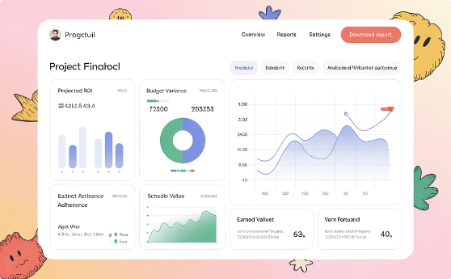
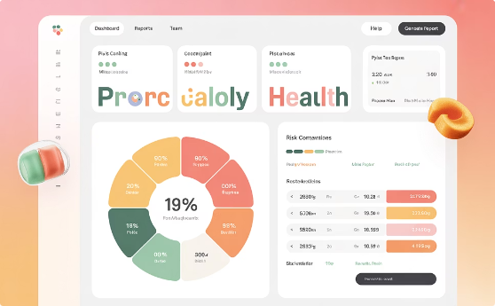
Reporting and Analytics (Power BI Integration)
Financial Performance
Resource Utilization
Project Health
Track budget compliance, cost variances, earned value metrics, and forecasted completion costs. Drill-down capabilities allow managers to investigate unusual patterns and identify the root causes of financial deviations at any level of the WBS.
Monitor allocation percentages, billable vs. non-billable time, and capacity forecasts. Resource managers can identify both overallocation risks and underutilization opportunities to optimize workforce deployment across the project portfolio.
Comprehensive scorecards that combine schedule adherence, budget performance, quality metrics, and stakeholder satisfaction into holistic health indicators. Early warning systems flag potential issues before they become critical problems.
The integration between D365 F&O and Power BI transforms raw transactional data into actionable business intelligence. Project managers can leverage pre-built report templates or create custom visualizations tailored to their specific information needs. Role-based dashboards ensure that team members, executives, and stakeholders all receive appropriate levels of detail for effective decision-making.

Slide 11
System Integration Capabilities
Microsoft 365 Integration
Third-Party Connections
Mobile Accessibility
Process Automation
Seamless connection with Outlook, Teams, Excel, and SharePoint enables project teams to access D365 F&O data directly within their productivity tools. Schedule meetings from project milestones, collaborate on documents linked to project tasks, and analyze project data in Excel without switching applications.
Robust API framework and pre-built connectors facilitate integration with specialized industry tools, external partner systems, and legacy applications. This enables project managers to maintain a connected ecosystem even when working with tools outside the Microsoft stack.
Native mobile applications provide on-the-go access to key project data, approvals, and updates. Field teams can capture time, expenses, and progress updates in real-time, ensuring that project information remains current regardless of location.
Integration with Power Automate enables the creation of cross-system workflows without coding. Automate routine tasks such as status reporting, notification delivery, and document generation to increase efficiency and consistency.
D365 F&O's extensive integration capabilities eliminate the data silos that traditionally hamper project visibility and execution. By connecting all relevant systems in a unified information ecosystem, project managers gain a truly comprehensive view of project activities, resources, and performance, regardless of where the original data resides.

Slide 12
Implementation Best Practices
Strategic Planning
Define clear objectives, success criteria, and ROI expectations
Process Configuration
Align system workflows with organizational procedures
Training & Change Management
Develop role-specific learning paths and adoption strategies
Phased Deployment
Roll out functionality incrementally to manage change impact
Successful implementation of D365 F&O requires careful planning and execution. Organizations should begin by identifying their most critical project management pain points and mapping them to specific D365 F&O capabilities. This focused approach ensures that high-value functionality is prioritized for early delivery, generating quick wins that build momentum and stakeholder support.
Cross-functional implementation teams that include both IT and business representatives help ensure that technical configuration decisions align with operational needs. Structured user acceptance testing with real project scenarios validates that the system will support actual work processes effectively.

Slide 13
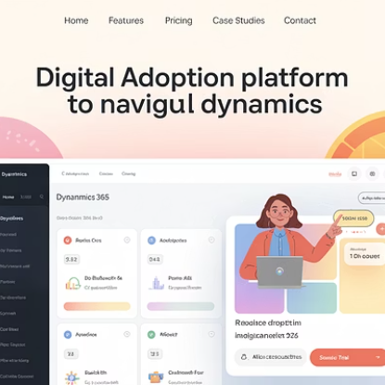
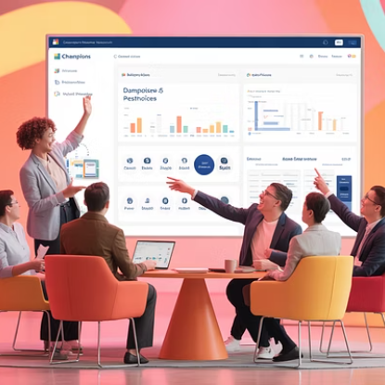
Change Management and User Adoption
Even the most powerful technology delivers little value without effective user adoption. Successful D365 F&O implementations incorporate comprehensive change management strategies that address both the technical and human aspects of the transition. Executive sponsorship establishes the importance of the initiative, while clearly articulated benefits answer the "what's in it for me" question for project managers and team members.
Role-based training programs ensure that users learn the specific functionality relevant to their responsibilities. Self-service learning resources, tip sheets, and process guides provide ongoing support beyond initial training. Establishing a network of power users or "champions" creates internal expertise that can be leveraged for continuous improvement and peer coaching.

Slide 14
Key Takeaways and Next Steps
8+
360°
40%
Integrated Modules
Visibility
Efficiency Gain
Powerful modules working together to provide end-to-end project management capabilities from planning to closeout
Comprehensive view of project health across financial, operational, and resource dimensions
Average productivity improvement reported by organizations after full implementation
Microsoft Dynamics 365 Finance and Operations represents a transformative opportunity for project-driven organizations. By unifying project management with finance, operations, and resource planning, it enables unprecedented integration and visibility across the project lifecycle. Project managers gain the real-time insights needed to make data-driven decisions, proactively address issues, and deliver consistent results.
Your next steps should include conducting a detailed assessment of your current project management challenges, prioritizing your most critical needs, and developing a phased implementation roadmap. Begin with a focused pilot to demonstrate value quickly, then expand systematically based on organizational readiness and business priorities. With the right approach, D365 F&O can become a powerful enabler of project management excellence in your organization.

Slide 15
Final Thoughts
For project managers, Microsoft Dynamics 365 Finance and Operations is far more than a financial tool—it's an enterprise-wide project enabler. By leveraging its integrated modules, PMs can eliminate silos, streamline project execution, and improve visibility across every phase of the project lifecycle. Whether you're managing internal initiatives or large client-facing programs, D365 F&O can empower you to lead with agility, accountability, and strategic impact.

