Slide 1


From Enrollment to Retention: How AI Is Transforming the Customer Journey
Customer expectations have fundamentally changed. Today's consumers benchmark every interaction against the best digital experiences they encounter anywhere — not just within your industry. AI is becoming the most powerful tool for building seamless, personalized journeys from first contact to lasting loyalty.
#ArtificialIntelligence #AI #CustomerExperience #DigitalTransformation #CustomerJourney #CustomerRetention #CustomerAcquisition #AgenticAI #GenerativeAI #BusinessTransformation #ProgramManagement #AgileLeadership #DigitalStrategy #Innovation #DataAnalytics #CustomerSuccess #EnterpriseTransformation #ProjectManagement #ManagingProjectsTheAgileWay #Leadership
#AI
#CUSTOMEREXPERIENCE
#DIGITALTRANSFORMATION

Slide 2
Setting the Stage
The New Standard for Customer Experience
The Old Benchmark
The New Reality
Organizations once compared their customer experience only to direct competitors in their industry. Being "good enough" for your sector was sufficient to retain customers and grow market share.
Today, customers compare every interaction to the best digital experience they've ever had — whether that's a streaming service, a one-click purchase, or an instant account opening. The bar has never been higher, and it keeps rising.
Organizations that fail to meet these expectations face abandonment, churn, and reputational damage — regardless of how strong their core product may be.

Slide 3

The Customer Journey as Competitive Advantage
Leading organizations no longer treat acquisition, onboarding, service, and retention as separate functions. Customers experience these as one continuous journey — and every touchpoint shapes their perception of your brand.
Friction at Enrollment
Poor Onboarding
Kills conversions before a relationship begins
Drives early dissatisfaction and disengagement
Slow Support
AI Optimization
Accelerates churn among otherwise loyal customers
Connects and elevates every stage of the journey

Slide 4

The Full Picture
Five Stages of AI-Powered Customer Experience
Acquisition
Personalization
Retention
Attract prospects with targeted outreach
Drive loyalty through continuous value
Tailor experiences using AI insights
Customer Service
Enrollment
Simplify sign-up and initial setup
Resolve issues with smart support
AI creates value across the entire customer lifecycle — not just in isolated functions. Here is how each stage connects to the next.
Each stage builds on the last. AI amplifies performance at every step and creates the connective tissue that turns a series of transactions into a lasting relationship.

Slide 5

STAGE 1
AI-Powered Customer Acquisition
The customer journey begins long before a purchase is made. AI analyzes behavior, demographics, purchasing patterns, and digital interactions to identify and engage the right prospects at precisely the right moment.
Key Questions AI Answers
Which prospects are most likely to convert?
Which products are most relevant to each customer?
Predictive analytics models can identify high-value prospects and recommend personalized offers — improving marketing ROI while significantly reducing acquisition costs.
What messaging resonates with each segment?
When is the optimal moment to engage?

Slide 6

STAGE 2
Simplifying Enrollment and Onboarding
Friction during enrollment is one of the most common — and most preventable — reasons organizations lose customers. Long forms, redundant data entry, and confusing requirements drive abandonment before the relationship even starts.
Guided Experiences
Smart Pre-Fill
AI walks customers step-by-step through enrollment, reducing confusion and errors in real time.
Automatically populates known information, shortening forms and minimizing repetitive data entry.
Fraud Detection
Real-Time Assistance
Identifies suspicious patterns in real time without adding friction to legitimate customers.
Delivers contextual help during registration — answering questions before they become blockers.

Slide 7
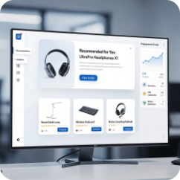


STAGE 3
Personalizing the Customer Experience at Scale
Personalization has moved from a "nice to have" to a fundamental expectation. AI enables organizations to analyze customer behaviors in real time and deliver experiences that feel individually tailored — across millions of simultaneous interactions.
Product Recommendations
Dynamic Content & Portals
Tailored Offers & Next-Best-Action
AI surfaces the right products at the right moment, increasing average order value and customer satisfaction.
Customer portals and communications adapt in real time based on each individual's history and preferences.
AI determines the most relevant offer or action to present, maximizing conversion and long-term loyalty.

Slide 8
STAGE 4
Transforming Customer Service with AI
Customer service is where many organizations have the greatest opportunity to close the gap between expectation and reality. Traditional support models — heavily reliant on human agents — create delays, inconsistency, and escalating operational costs.
Modern AI solutions transform support by empowering both customers and service representatives with intelligent tools that resolve issues faster and more consistently.
The Next Evolution: Agentic AI
Unlike traditional chatbots that answer questions, agentic AI systems take action on behalf of customers.
Update account information
Process service requests
Schedule appointments
Initiate transactions
Resolve common issues end-to-end
Intelligent Self-Service
Smart Routing
History Summarization
Directs complex cases to the right team immediately
Resolves routine inquiries instantly, 24/7
Gives agents full context before the first word is spoken
This shift from conversation to action has the potential to fundamentally transform customer support operations.

Slide 9

Agentic AI:
From Conversation to Action
The next frontier isn't smarter chatbots. It's AI that gets things done.
Agentic AI systems move beyond question-and-answer interactions to independently complete multi-step tasks. For customer experience leaders, this represents a fundamental shift in what's operationally possible — enabling true end-to-end resolution without human intervention for a growing class of customer needs.

Slide 10

STAGE 5
Predicting and Preventing Customer Churn
Retention is consistently more valuable — and less expensive — than acquisition. Yet most organizations don't act on churn risk until it's too late. AI changes that equation entirely by identifying at-risk customers before they decide to leave.
Churn Signals AI Monitors
Declining engagement and login frequency
Reduced purchase volume or frequency
Organizations that deploy AI-driven retention models can proactively intervene with personalized offers, targeted communications, or service improvements — turning potential defectors into loyal advocates.
Increase in support complaints
Changes in website or app activity patterns
Sentiment shifts in service interactions

Slide 11
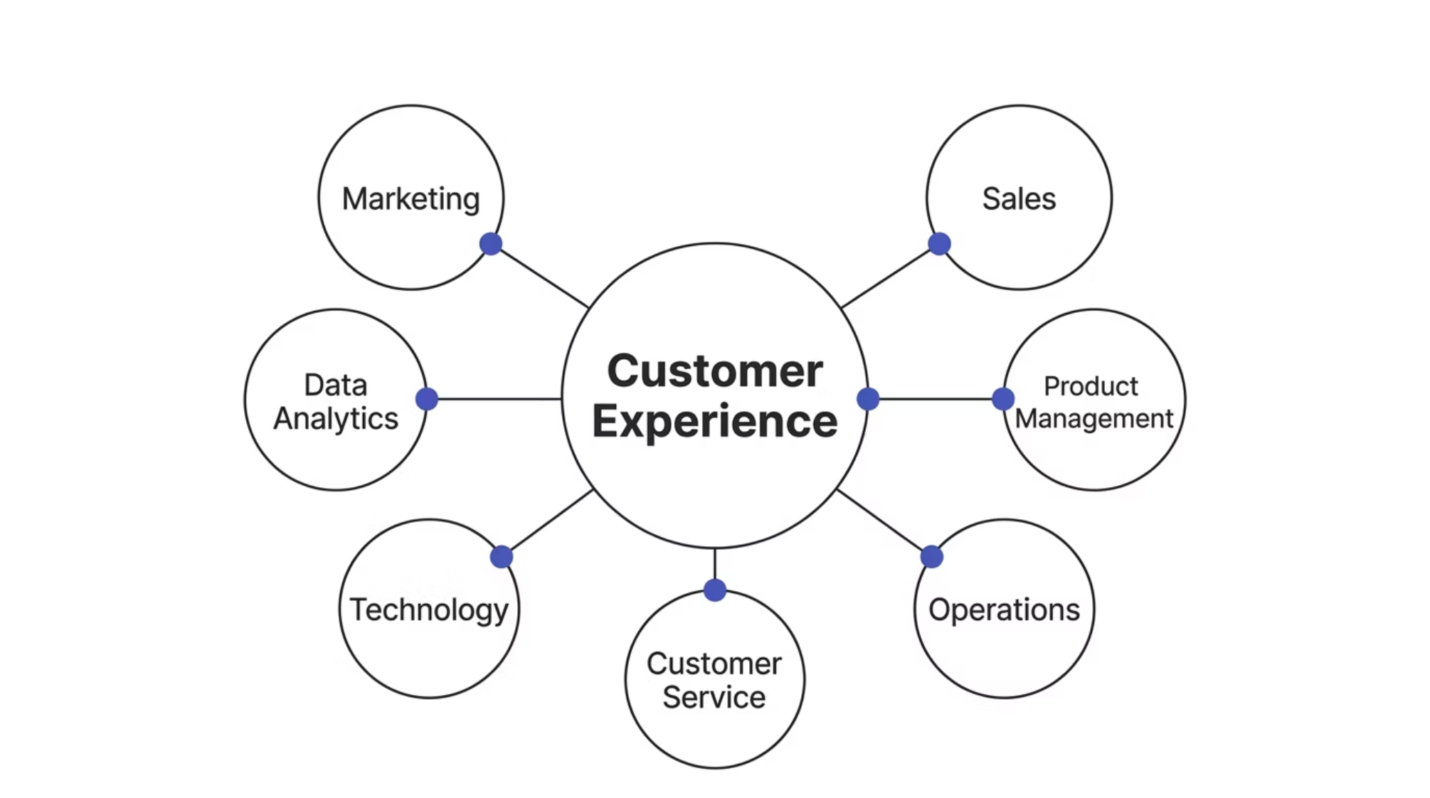

The Rise of Journey-Centric Organizations
The most significant organizational shift driven by AI is the move from departmental optimization to end-to-end customer journey thinking. Successful AI initiatives require alignment — and shared accountability — across the entire enterprise.
Organizations that treat AI as a customer experience strategy — rather than a technology project — consistently outperform those that don't. Cross-functional alignment is not optional; it is the foundation of success.

Slide 12

The Role of Program Leadership
As AI initiatives grow in scale and complexity, strong program leadership becomes a critical differentiator. These are not simple technology deployments — they are business transformation programs.
Cross-Unit Coordination
Data Governance
Aligning multiple business units with competing priorities and timelines
Ensuring data quality, privacy compliance, and ethical AI use
Change Management
Executive Alignment
Driving adoption across teams and managing organizational resistance
Keeping stakeholders engaged and initiatives tied to strategic business goals

Slide 13

Defining Success: Outcomes Over Outputs
What Success Is NOT
What Success Looks Like
Deploying an AI platform
Launching a chatbot
Completing a technology implementation on time
Achieving high model accuracy scores
Improved customer satisfaction and NPS scores
Measurable reduction in enrollment abandonment
Lower cost to serve with maintained quality
Reduced churn and increased customer lifetime value
Demonstrable ROI tied to strategic business goals
Program leaders must define and track the right success metrics from day one — business outcomes, not technology milestones.

Slide 14
Key Takeaways
01
02
03
The entire journey is the product
AI value spans the full lifecycle
Agentic AI is the next frontier
Customers don't experience departments — they experience a single, continuous journey. AI connects and optimizes every stage.
From acquisition and enrollment to personalization, service, and retention — AI creates measurable impact at every touchpoint.
The shift from answering questions to taking action represents a step-change in what customer support can deliver.
04
05
Strategy before technology
Leadership is the differentiator
The organizations that win are those that treat AI as a customer experience strategy, not just a technology investment.
Strong program leadership — aligned around business outcomes — is what separates successful AI transformations from stalled pilots.

Slide 15

The Future Belongs to Customer-Centric Organizations
AI won't replace the human relationship. It will make every human interaction worth having.
Artificial Intelligence is no longer a future capability — it is becoming a foundational component of modern customer experience strategy. The organizations that succeed will not be those with the most sophisticated algorithms. They will be the ones that use AI to remove friction, strengthen relationships, and deliver meaningful value at every stage of the customer journey.
#AI
#AGENTICAI
#CUSTOMERJOURNEY
#DIGITALTRANSFORMATION
#CUSTOMERRETENTION

