Slide 1

Embracing Scrumban: A Hybrid Approach to Agile Project Management
A flexible framework that combines the structure of Scrum with the flow of Kanban for teams navigating dynamic workloads and evolving priorities.
kW
by Kimberly Wiethoff

Slide 2
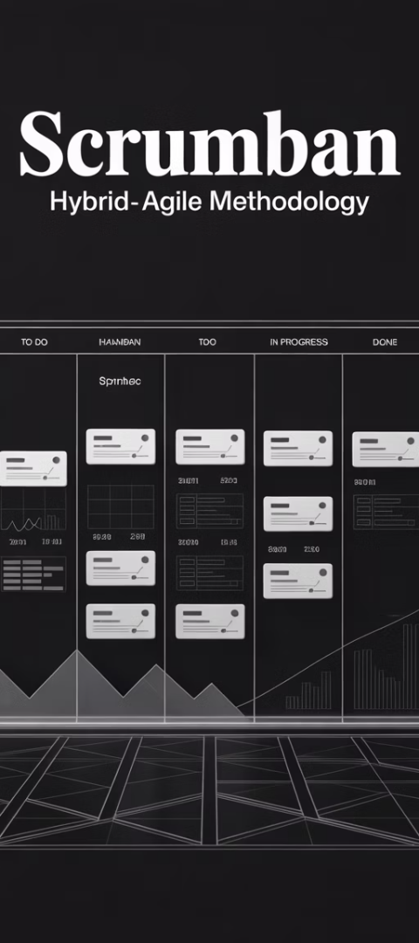
What Is Scrumban?
Definition
Core Elements
Scrumban is a hybrid Agile framework blending structured elements from Scrum with visual workflow and flexibility from Kanban.
Continuous workflow without fixed sprints
Pull-based task management with WIP limits
It was originally created to help Scrum teams transition to more flow-based processes.
Optional Scrum ceremonies
Visual Kanban board tracking
On-demand planning

Slide 3





Why Choose Scrumban?
Structure Without Rigidity
Perfect for teams needing framework guidance without Scrum's strict ceremonies.
Handles Changing Priorities
Adapts to frequent scope changes and shifting requirements with ease.
Balances Maintenance & New Features
Accommodates both ongoing support and new development work.
Improves Workflow
Identifies and eliminates bottlenecks through visual management.

Slide 4
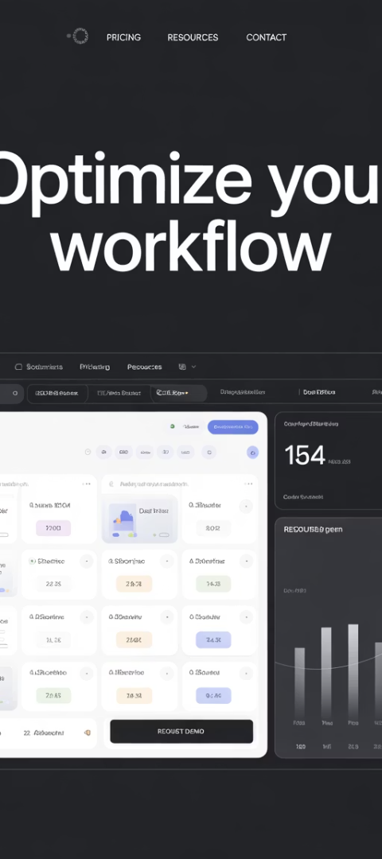
Ideal Use Cases
Hybrid Teams
Cross-functional teams with varied workflows and delivery patterns.
Teams working across multiple departments or specializations.
Product Support
Teams balancing bug fixes with feature development.
Support environments with unpredictable work intake.
DevOps Teams
Operations teams managing both planned and unplanned work.
Environments requiring rapid response alongside scheduled tasks.
Agile Transitions
Organizations moving from traditional methods to Agile approaches.
Teams evolving their process maturity gradually.

Slide 5





Scrum Elements in Scrumban
Flexible Planning
Maintains planning routines but schedules them based on need rather than fixed sprints.
Selective Ceremonies
Uses daily stand-ups and retrospectives when beneficial, not by rigid schedule.
Goal-Focused
Sets clear work objectives without strict sprint deadlines.
Backlog Management
Maintains prioritized work items ready to pull into the workflow.

Slide 6








Kanban Contributions to Scrumban
WIP Limits
Visual Workflow
Restricts tasks in progress to improve focus and prevent bottlenecks.
Enhances transparency through clear visualization of work stages.
Flow Metrics
Continuous Delivery
Focuses on cycle time and throughput instead of velocity.
Enables smooth, ongoing release of completed work items.

Slide 7






Visualizing Your Scrumban Board
Backlog
Prioritized items ready for work.
Ready
Top items selected for next pull.
In Progress (WIP Limited)
Currently active work items.
Testing/Review
Verification before completion.
Done
Completed work ready for delivery.

Slide 8

Setting Effective WIP Limits
Analyze Current Capacity
Observe how many tasks team members can handle effectively.
Start with your team's natural work pattern as a baseline.
Implement Conservative Limits
Begin with slightly lower limits than current work patterns.
A common formula: Team size × 1.5 = Initial WIP limit.
Monitor and Adjust
Track bottlenecks and idle time to fine-tune your WIP limits.
Reduce limits if quality suffers; increase if workflow stalls.

Slide 9








On-Demand Planning in Action
Planning Trigger
Planning Session
Backlog drops below threshold or team capacity opens up.
Brief meeting to prioritize and estimate upcoming work.
Review & Adapt
Work Pull
Regular check-ins to adjust workflow and priorities.
Team pulls new items from ready queue as capacity allows.

Slide 10
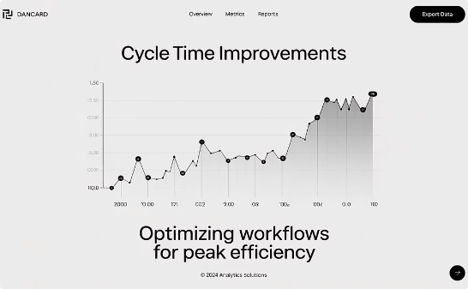
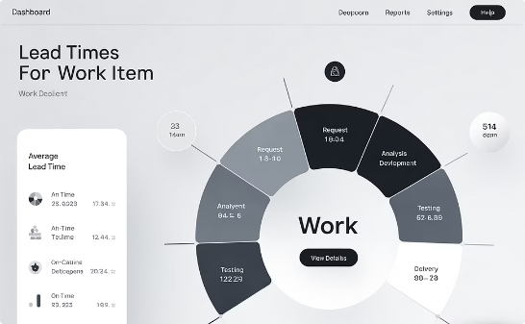
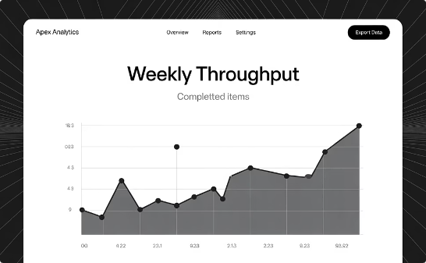
Key Metrics to Track
Cycle Time
Lead Time
Throughput
Measures how long items take to complete once started.
Tracks total time from request to delivery.
Counts items completed in a time period.
Target: Consistent or decreasing over time.
Reveals overall process efficiency.
Shows team capacity and productivity trends.

Slide 11





Implementation Roadmap
Map Current Process
Document existing workflow steps and bottlenecks
Create Visual Board
Set up columns reflecting your workflow
Establish WIP Limits
Start conservative and adjust as needed
Implement Key Metrics
Begin tracking cycle time and throughput
Evolve Ceremonies
Adapt meetings to support the workflow

Slide 12

Common Challenges and Solutions
Challenge
Solution
Teams ignore WIP limits
Add visual alerts and discuss impacts in retrospectives
Communication gaps
Maintain regular stand-ups and team check-ins
Poor backlog hygiene
Schedule regular grooming sessions based on backlog size
Unclear completion criteria
Establish and display a clear "Definition of Done"
Inconsistent metrics
Use automated tools to track cycle time and throughput

Slide 13
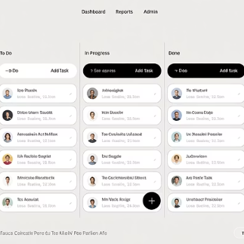
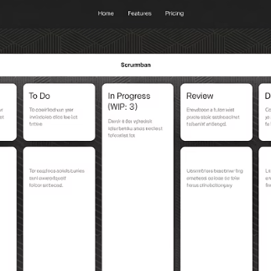
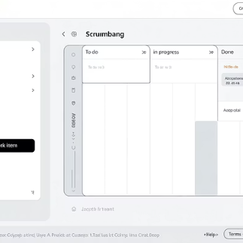
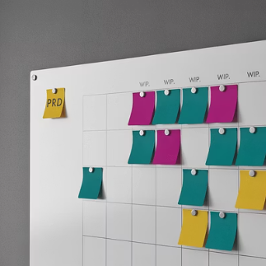
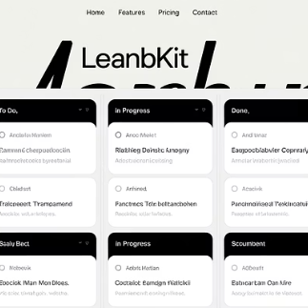
Tools to Support Scrumban
Popular tools include Jira, Trello, Azure DevOps, physical boards, and LeanKit. Each offers unique features to support Scrumban implementation.

Slide 14

Getting Started with Scrumban
1
2
Start Simple
Add WIP Limits
Begin with your current process visualized on a board.
Introduce constraints to manage flow.
3
4
Track Metrics
Evolve Gradually
Measure cycle time to improve predictability.
Adapt ceremonies and practices based on results.

Slide 15
Final Thoughts
Scrumban offers a powerful, flexible approach for Agile teams navigating dynamic workloads and evolving priorities. By combining the structure of Scrum with the flow of Kanban, it empowers teams to stay focused, responsive, and continuously improving—without being bogged down by process.
Whether you're supporting multiple initiatives, scaling Agile in non-software teams, or seeking a better balance between planning and flexibility, Scrumban could be the Agile middle ground you've been looking for.

